Slide 1
Java Programming
152-130 Module 4

Slide 2
File Input and Output
Section 1

Slide 3
Saving Data
As your programs run, data lives in RAM
When program exits, data is lost
To persist data, save to file on the hard drive

Slide 4
Steps to Using a File
Open the file
Creates a connection between file and program
Write/read data
When finished, close the file

Slide 5
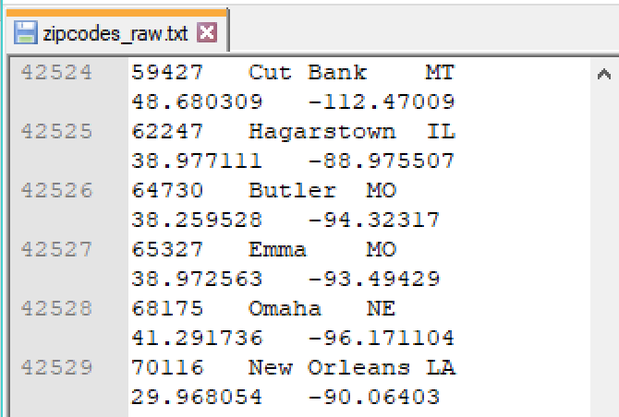
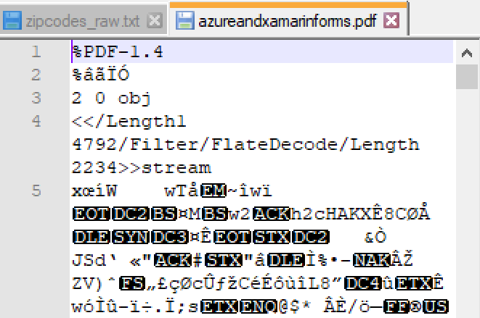
Two Types of Files
Text file
Contains text-encoded data
Human readable
Can open in text editor like Notepad
Binary file
Contains ones and zeroes
Not human readable
Need a specialized program to use

Slide 6
The PrintWriter Class
Create an instance of the PrintWriter class
PrintWriter outputFile = new PrintWriter("data.txt");
Lets you open a file for writing
Need to import java.io.PrintWriter

Slide 7
Warning!
When you create a PrintWriter:
If the file does not exist, it will be created
If the file does exist, it will be erased and rewritten

Slide 8
Adding a throws Clause
When an unexpected event happens, Java throws an exception
The program cannot continue until it's dealt with
When dealing with files, lots of possible exceptions
Disk is full
Don't have access rights
File doesn't exist

Slide 9
Two Ways of Handling Exceptions
1. Deal with it
Use a try-catch block to specify how to recover from the exception
2. Pass the buck
Let the method re-throw the exception
Whatever method called that method has to deal with it

Slide 10
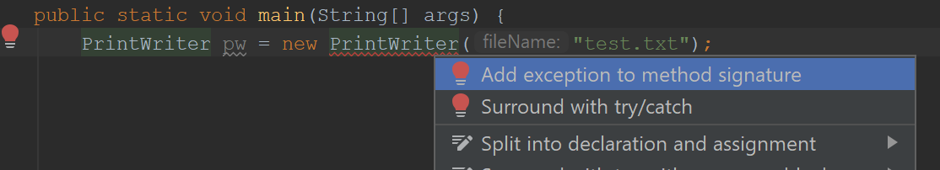
Throwing Exceptions
In IntelliJ, place cursor at exception
Alt + Enter
Select fix that says "throw exception" or "add exception"

Slide 11
Throwing Exceptions
The throws clause will be added to the method header
public static void main(String[] args) throws IOException {
Whatever method calls this method will have to be prepared to handle a IOException
Because it's the main method, program will crash

Slide 12
Write to the File
Use print(), println(), and printf() methods the same as the console
outputFile.print("Hello");
outputFile.println("Hello again");
outputFile.printf("%.2f", tax * total);

Slide 13
Close the File
When you're done writing, close the file
Sever the connection between the file and the program
Good idea to flush the buffer
(Faster to write characters to a buffer, and write buffer to file when full)
outputFile.flush();
outputFile.close();

Slide 14
Appending Data
Creating a PrintWriter by passing a String filename to constructor will overwrite the file
To open for appending, create a FileWriter first
FileWriter fwriter = new FileWriter("data.txt", true);
As before, will create if does not exist
The true means append

Slide 15
Appending Data
Creating a PrintWriter by passing the FileWriter
Any data written to outputFile adds to what was already in data.txt
FileWriter fwriter = new FileWriter("data.txt", true);
PrintWriter outputFile = new PrintWriter(fwriter);

Slide 16
File Location
Using just the file name, file is created in the current directory (varies by IDE)
You can specify the full file path, with drive letter
Remember to escape backslashes
String filename = "E:\\homework\\names.txt";
PrintWriter pw = new PrintWriter(filename);

Slide 17
Reading from a File
Use a Scanner to read a text file
Instead of passing System.in to constructor, pass a File object
File file = new File("customers.txt");
Scanner inputFile = new Scanner(file);

Slide 18
Reading from a File
You can use the same Scanner methods to read the file as you do with console input
File file = new File("customers.txt");
Scanner inputFile = new Scanner(file);
String line = inputFile.nextLine();

Slide 19
End of File
To read multiple lines, use a loop
How do you know how many lines are in a file?
How do you know when the loop should stop?
If using a Scanner, call the hasNext() method
Returns true if there is another line to read

Slide 20
Detecting End of File
File file = new File("customers.txt");
Scanner inputFile = new Scanner(file);
while (inputFile.hasNext()) {
String line = inputFile.nextLine();
System.out.println(line);
}

Slide 21
Warning!
Don't pass the String file name directly to the Scanner
Scanner inputFile = new Scanner("customers.txt");
File file = new File("customers.txt");
Scanner inputFile = new Scanner(file);

Slide 22
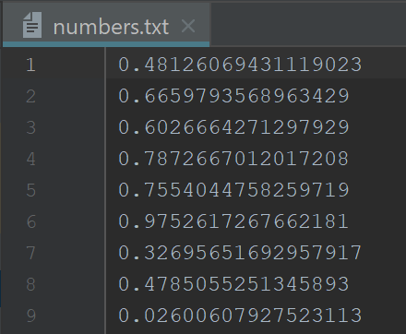
Reading Primitive Values
File file = new File("numbers.txt");
Scanner inputFile = new Scanner(file);
double sum = 0;
while (inputFile.hasNext()) {
String number = inputFile.nextLine();
sum = sum + Double.parseDouble(number);
}
System.out.printf("%.3f", sum);

Slide 23
Check if File Exists
What happens if you try to open a file for reading that doesn't exist?
// should be "numbers.txt"!
File file = new File("number.txt");

Slide 24
Check if File Exists
The program crashes with FileNotFoundException!
Exception in thread "main" java.io.FileNotFoundException: number.txt (The system cannot find the file specified)

Slide 25
Check if File Exists
Before creating the Scanner, use exists() method of File object
File file = new File("number.txt");
if (!file.exists()) {
System.out.print("Error!");
}
// Now what? Can the next line run?
Scanner inputFile = new Scanner(file);

Slide 26
Reading and Writing
You may need to read console input with a Scanner AND read a file with a Scanner
For example, you may ask the user the name of the file to open
You must make two Scanners: one for console input, one for file input

Slide 27
Reading and Writing
Scanner keyboard = new Scanner(System.in);
System.out.print("File name: ");
String filename = keyboard.nextLine();
File file = new File(filename);
Scanner inputFile = new Scanner(file);

Slide 28
Read All Lines into a List
You can easily read all lines in a text file into a List!
Must import Files and Paths from java.nio.file
List<String> lines =
Files.readAllLines(Paths.get("info.txt"));

Slide 29
Try-Catch
Section 2

Slide 30
Dealing With It
Letting our program crash whenever something goes wrong is not a long-term solution
Java allows us to try a dangerous operation, then recover if an exception occurs

Slide 31
Try Block
Code that can generate an exception goes inside a try block
int response;
try {
response =
Integer.parseInt(keyboard.nextLine());
}

Slide 32
What Could Go Wrong?
If the user types something that can't be parsed to an int, a NumberFormatException is thrown
We can catch the exception (instead of throwing) it, and recover
catch (NumberFormatException e) { ... }

Slide 33
Catching Exceptions
An exception is an object
It will be placed in the variable you provide
Usually named e or ex, but any name is okay
catch (NumberFormatException e) { ... }

Slide 34
Recovery Time
Inside the body of the catch block, specify what to do if the exception occurs
Show a message to the user, set a default value, etc.
catch (NumberFormatException e) {
response = 5;
}

Slide 35
Catch Block Execution
The code inside the catch block only executes if the exception occurs
Otherwise, it is ignored
catch (NumberFormatException e) {
response = 5;
}

Slide 36
Complete Try-Catch
int response;
try {
response =
Integer.parseInt(keyboard.nextLine());
} catch (NumberFormatException e) {
response = 5;
}

Slide 37
More Than One Catch
Every try must have at least catch*
You can have more than one
try { ... }
catch (IllegalArgumentException e) { ... }
catch (NullPointerException e) { ... }
* Or exactly one finally

Slide 38
Combining Exceptions
If the recovery code is the same for multiple exceptions, you can catch multiple exception types
Use a single pipe between them
try { ... }
catch (IllegalArgumentException |
NullPointerException e) { ... }

Slide 39
Optional Final Steps
You can add an optional finally block after the last catch
Code in the finally block always executes, even if no exception occurs
Good for cleanup step, closing files, etc.

Slide 40
Complete Try-Catch-Finally
int response;
try {
response = Integer.parseInt(keyboard.nextLine());
} catch (NumberFormatException e) {
response = 5;
} finally {
System.out.print("You chose " + response);
}

Slide 41
try/finally?
You can have a finally block without any catch blocks
You must have at least one catch block or exactly one finally block with every try block

Slide 42
Printing the Stack Trace
Many IDEs will include this line of code in a catch block automatically
The stack trace contains the sequence of method calls that led up to the exception
Useful info for developers, not for users
e.printStackTrace();

Slide 43
Binary Files
Section 3

Slide 44
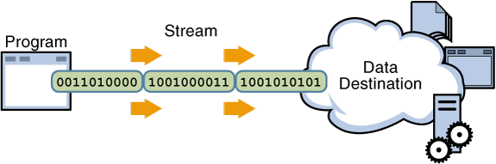
Serializing
Converting data objects to a byte stream (a series of 1's and 0's) for storage or transfer
Writing objects to a network connection, database, or file
Going the other direction (bytes to objects) is deserializing

Slide 45
Object Serialization
The simplest way of saving objects to a file is to serialize the whole object
Converted to a series of bytes that contain the object's data
The class must implement the Serializable interface:
import java.io.Serializable;
public class Room implements Serializable {...}

Slide 46
Serializable
The Serializable interface is empty: no methods or fields
It tells the Java compiler that objects of a class can be serialized (written to a stream)
If a Serializable class contains other objects, those objects' classes should also be Serializable

Slide 47
Serializing
The process of writing objects to a stream (usually a file or a network connection)
Use a FileOutputStream wrapped in an ObjectOutputStream
FileOutputStream fos = new FileOutputStream("data.obj");
ObjectOutputStream oos = new ObjectOutputStream(fos);

Slide 48
Why Wrapping?
Design pattern preview: Decorator!
Think about all the different file options:
Binary vs text
Encrypted vs unencrypted
Compressed vs uncompressed

Slide 49
How Many Possible Combinations?
Rather than have separate classes for a EncryptedUncompressedBinaryFileReader, UnencryptedCompressedTextFileWriter, etc...
Java starts with a basic input (or output) class
The programmer wraps that basic class in additional functionality as needed

Slide 50
Binary File Extension
The file extension you use doesn't matter
I like .obj, but .dat is another good option
FileOutputStream fos = new FileOutputStream("data.obj");
ObjectOutputStream oos = new ObjectOutputStream(fos);

Slide 51
Serializing
Write objects directly to the file with the writeObject method
GradeBook gradebook = new GradeBook();
// Open file for reading
oos.writeObject(gradeBook);

Slide 52
So Many Red Squiggles!
Whenever you work with files, there's a large possibility of something going wrong
We must handle the possible exceptions
FileOutputStream os = new FileOutputStream("data.obj");
ObjectOutputStream oos = new ObjectOutputStream(os);
oos.writeObject(paintCalculator);

Slide 53
Dealing With It
Let's not crash our program over bad files
We will try to write to the file
If an exception happens, we will catch it
(As opposed to throwing it)
This allows the program to recover gracefully

Slide 54
How to Deal with It?
Print a message to the user that the operation failed
If the file was open, close it
As of Java 7, there is a special try-catch syntax for working with system resources
Files, database connections, network connections, etc.

Slide 55
Try With Resources
Begin a try block that includes the resource declaration(s) in its head
try (FileOutputStream os = new FileOutputStream("data.obj");
ObjectOutputStream oos = new ObjectOutputStream(os))

Slide 56
Try With Resources Body
Within the body of the block, perform file reading or writing
try (FileOutputStream os = ...;
ObjectOutputStream oos = ...)
{
oos.writeObject(gradeBook);
}

Slide 57
Catch Block
Working with files usually causes several exceptions so you may need multiple blocks
Or use the single pipe |
catch (IOException e) { ... }

Slide 58
Catch Block Execution
Code in the catch block only executes if the associated exception occurs
Specify your recovery procedure here
catch (IOException e) {
System.out.println("File could not be opened.");
}

Slide 59
No Need to Close the File
Try-with-resources syntax can only be used on autocloseable resources
Whether an exception occurs or not, the resource will be closed at the end of the block
This saves a ton of boilerplate code!

Slide 60
Deserializing
The process of reading objects back into memory
Use a FileInputStream wrapped in an ObjectInputStream
try (FileInputStream fis = new FileInputStream("data.obj");
ObjectInputStream ois = new ObjectInputStream(fis)) {

Slide 61
Cast Incoming Objects
The readObject method returns a data type Object
Must cast back to original data type
try (FileInputStream fis = ...;
ObjectInputStream ois = ...) {
gradebook = (GradeBook)ois.readObject();
}

Slide 62
How Many Objects?
When we read a text file, we can test if there are more lines
Test for hasNext() when using a Scanner, for example
ObjectInputStream can't do that easily
Testing for end of file is messy

Slide 63
A Better Solution
Write only a single object to the file
That object may contain a collection -- or be a collection -- of other objects
List<Student> myList = null;
// Read in the object, casting to List
myList = (List<Student>) ois.readObject();

Slide 64
Transient
Fields declared as transient are not serialized
private transient int roomNumber;
Useful for temporary data created during program execution

Slide 65
Static Fields
Static fields are not serialized
They are implicitly transient
Serialization is for saving objects, not classes
Static fields belong to the class
Any changes to their values will be lost in serialization
They will be reinitialized during deserialization

Slide 66
InvalidClassException
If you change a class after serializing it, you might get an error when you deserialize
The two classes have different serialVersionUID values
Java thinks they are incompatible
java.io.InvalidClassException: edu.wctc.paintcalc.Wall; local class incompatible: stream classdesc serialVersionUID = -3491412124372031509, local class serialVersionUID = 3199987019459001905

Slide 67
Add a Version ID Field
Where did serialVersionUID come from?
The JVM generates one automatically if a Serializable class doesn't contain one
It's good practice to manually include one

Slide 68
Add a Version ID Field
Add this field to every Serializable class, exactly as shown
It doesn't matter what the number is, so we use 1 for simplicity
If a class undergoes changes that do make it incompatible with previously serialized versions, update the ID
private static final long serialVersionUID = 1L;

Slide 69
Control Break Logic
Section 4

Slide 70
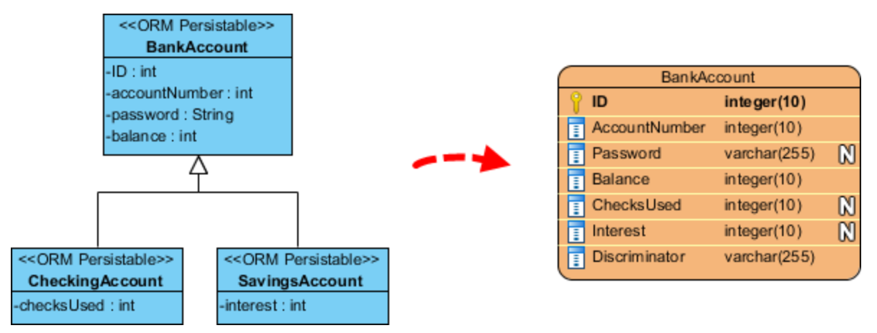
Entity Classes
An entity class is one whose fields match the attributes of a table in a database

Slide 71
Entity Classes
Very simple classes, usually only to transport data
The lab program includes a class called Meal that matches lines in a comma-separated value (CSV) file
Breakfast,Belgian waffle,647

Slide 72
Entity Object
File contains lines like:
Breakfast,Belgian waffle,647
Class contains fields like:
public class Meal {
private MealType mealType;
private String item;
private int calories;
}

Slide 73
The .split() method
Java can break this line apart into in an array of Strings
Breakfast,Belgian waffle,647
We must supply the delimiter (in this case, a comma) as an argument
String line = scanner.readLine();
String[] lineArray = line.split(",");

Slide 74
Problem Statement
We have a comma-separated value (CSV) file that contains meals for a cookbook
Meals have a type, a name, and a calorie count
Breakfast,Belgian waffle,647
We want to find the total, average, min, max, and median calories for each meal type (Breakfast, Dinner, etc.)
The file is already sorted by meal type

Slide 75
Control Break Algorithm
Get a Meal object from the List of all meals
If this Meal has a different meal type than the previous Meal:
Calculate and output the total, average, etc. for the previous type
Clear any previous running totals
Repeat from 1 until no more Meals
Repeat step 2a one last time for the final meal type

Slide 76
Control Break
Step 2 of the algorithm is the control break
A key value has changed, requiring us to do extra processing
To detect the change, we need to keep track of the current meal type!
Compare the meal type you are currently totaling to the new one you just read

Slide 77
Control Break
How do we prevent totals from printing during the first iteration?
Initialize current meal type with a dummy value
(null is often used for this purpose)
If current type is the dummy, don't print anything

