Slide 1
Java Programming
152-130 Module 5

Slide 2
Generating Random Numbers
Section 1

Slide 3
Math Utility for Random Numbers
Java's Math class contains many utility methods for math operations
To generate a random double between 0 (inclusive) and 1 (exclusive):
double randomNum = Math.random();

Slide 4
The Random Class
Behind the scenes, Math.random() creates a pseudo-random number generator object
An instance of java.util.Random class
The Random class offers more options and can be used directly
Random randomGen = new Random();

Slide 5
Generate Random Integers
Get a random integer between around -2.1 billion and +2.1 billion
int randInt = randomGen.nextInt();
Get a random integer between 0 (inclusive) and 100 (exclusive)
int randInt = randomGen.nextInt(100);

Slide 6
Other Random Numbers
Get a random double between 0 (inclusive) and 1 (exclusive)
double randDb = randomGen.nextDouble();
Get a random float between 0 (inclusive) and 1 (exclusive)
float randFt = randomGen.nextFloat();
Get a random long between min long and max long
long randLg = randomGen.nextLong();

Slide 7
Random Integer Between X and Y
There is no built-in method that generates an integer in range X - Y
Use the same technique as in C# and JavaScript
Math.floor(Math.random() * numPossibleVals) + minValue;

Slide 8
Dates
"Unfortunately, the Java API isn't always perfect."
Urma, Fusco, and Mycroft Modern Java in Action
Section 2

Slide 9
Dates Prior to Java 8
Java 1.0 contained one class: java.util.Date
Not really a date, a point in time measured in milliseconds
1/1000th of a second

Slide 10
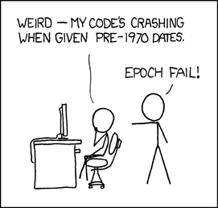
Milliseconds Since the Epoch
A date was specified by the number of milliseconds since "the Unix epoch": January 1st, 1970
Represented as a long (64 bit integer data type)
https://xkcd.com/376/

Slide 11
Creating a java.util.Date
What date is represented by this object?
Date date = new Date(117, 8, 21);
September 21st, 2017
Offset for year (1900) and month (zero-based) are non-intuitive

Slide 12
Dates Prior to Java 8
Java 1.1 deprecated much of java.util.Date and added java.util.Calendar
Confusing, which to use?
Months still started at 0
Formatters like DateFormat still required the Date class

Slide 13
Dates Prior to Java 8
Date and Calendar are both mutable
Maintenance problems when values change
Many developers relied on third-party date and time libraries (Joda-Time)

Slide 14
Changes in Java 8
In Java 8, Oracle integrated much of Joda-Time into the java.time package
New classes introduced to simplify usage
Human-friendly versus machine-friendly
Dates (years, months, and days) versus times (hours, minutes, seconds)
Points in time versus elapsed time

Slide 15
LocalDate and LocalTime
Both are human-friendly classes
LocalDate: a plain date without a time
LocalTime: a plain time without a date
Neither class contains time zone information!

Slide 16
LocalDate
Year, month, and day are all ints, no offsets
LocalDate date = LocalDate.of(2017, 9, 21);
Shorthand to create today's date:
LocalDate today = LocalDate.now();

Slide 17
LocalTime
Hours uses 24-hour clock (0-23 are valid)
0-59 are valid for minute and seconds
LocalTime time = LocalTime.of(13, 45, 20);
Shorthand to create the current time:
LocalTime current = LocalTime.now();

Slide 18
LocalTime
LocalTime has three overloaded of() methods:
LocalTime hm = LocalTime.of(13, 45);
LocalTime hms = LocalTime.of(13, 45, 20);
LocalTime hmsn = LocalTime.of(13, 45, 20, 345);
The fourth int is nanoseconds (one-billionth of a second)

Slide 19
Large Literal Numbers
Can be difficult for humans to read
int nanos = 100000000;
Java ignores the underscores
int nanos = 100_000_000;
LocalTime hmsn = LocalTime.of(13, 45, 20, nanos);

Slide 20
LocalDateTime
Combines a LocalDate and LocalTime
LocalDateTime dt1 = LocalDateTime.of (2017, 9, 21, 13, 45, 20);
Shorthand to create the current date/time:
LocalDateTime current = LocalDateTime.now();

Slide 21
Creating a LocalDateTime
If you have a LocalDate and/or LocalTime, you can use them to create a LocalDateTime
LocalDateTime dt2 = LocalDateTime.of(date, time);
LocalDateTime dt3 = date.atTime(13, 45, 20);

Slide 22
Static Factory Methods
Methods like of() and now() are static
Called with respect to the class
These methods are creating new objects for us
We're not calling any constructors
We never say new LocalDate(...)
This is a pattern known as Factory

Slide 23
Extracting LocalDate or LocalTime
If you have a LocalDateTime, you can extract the date portion as a LocalDate
LocalDate date = dateTime.toLocalDate();
If you have a LocalDateTime, you can extract the time portion as a LocalTime
LocalTime time = dateTime.toLocalTime();

Slide 24
Instant
Machine-friendly representation of a moment in time
A single large number (long integer)
Seconds since the Unix epoch (January 1, 1970)
NOT MILLISECONDS LIKE java.util.Date
Also has nanosecond precision (1 billionth of a second)

Slide 25
Instant
Instant i1 = Instant.ofEpochSecond(3);
System.out.print(i1);
>> 1970-01-01T00:00:03Z
Instant i2 = Instant.now();
System.out.print(i2.getEpochSecond());
>> 1550634413

Slide 26
Duration
Represents a time distance between two Temporal objects
Can accept two LocalTimes, two LocalDateTimes, or two Instants
Duration d1 = Duration.between(lt1, lt2);
Duration d2 = Duration.between(dt1, dt2);
Duration d3 = Duration.between(i1, i2);

Slide 27
Duration
Why not LocalDate?
Duration models time in hours, minutes, and seconds
LocalDate has no time component
If you need to measure a temporal difference in years, months, and days, use Period

Slide 28
Period
Can only accept two LocalDates
Period p1 = Period.between(date1, date2);
You can also create a Period manually
Period tenDays = Period.ofDays(10);
Period threeWeeks = Period.ofWeeks(3);
Period twoYearsSixMonthsOneDay = Period.of(2, 6, 1);

Slide 29
Manipulating Dates
All Temporal objects in java.time are immutable
Changing one of an object's values (e.g. updating the month) creates a brand new object

Slide 30
Manipulating Dates
// Get the current date
LocalDate d1 = LocalDate.now();
// Keep month and day, change year to 2011
LocalDate d2 = d1.withYear(2011);
// Keep month and year, change day to 25
LocalDate d3 = d1.withDayOfMonth(25);

Slide 31
Manipulating Dates
// Add 1 week
LocalDate d3 = d1.plusWeeks(1);
// Subtract 6 years
LocalDate d4 = d1.minusYears(6);
// Add 1 week AND subtract 6 years
LocalDate d5 = d1.plusWeeks(1).minusYears(6);

Slide 32
Common Temporal Methods
Classes that represent a point in time (LocalDate, LocalTime, LocalDateTime, and Instant) all share common methods:
from()
now()
of()
parse() // create from a String
format() // convert to a String
get()
minus()
plus()
with()

Slide 33
The get() Method
You can use unit-specific methods
int hour = time.getHour();
int year = date.getYear();

Slide 34
The get() Method
Or you can use the plain get() method and specify a unit
int month = nowDate.get(ChronoField.MONTH_OF_YEAR);
int second = nowTime.get(ChronoField.SECOND_OF_MINUTE);

Slide 35
Parsing Date-Time Objects
A LocalDate can be parsed from a String in the pattern "yyyy-MM-dd"
LocalDate date = LocalDate.parse("2017-09-21");
A LocalTime can be parsed from a String in the pattern "hh:mm:ss"
LocalTime time = LocalTime.parse("13:45:20");

Slide 36
Parsing Date-Time Objects
More complex patterns require a DateTimeFormatter object
DateTimeFormatter formatter = DateTimeFormatter.ofPattern("dd/MM/yyyy");

Slide 37
Parsing Date-Time Objects
Pass the String and the formatter to LocalDate's parse method
String dateStr = "18/03/2014";
LocalDate date1 = LocalDate.parse(dateStr, formatter);

Slide 38
Printing Date-Time Objects
The same DateTimeFormatter object can also be used to format a LocalDate into a String
DateTimeFormatter formatter = DateTimeFormatter.ofPattern("dd/MM/yyyy");

Slide 39
Printing Date-Time Objects
Pass the formatter to the LocalDate's format method
LocalDate date1 = LocalDate.of(2014, 3, 18);
String formattedDate = date1.format(formatter);
See the Java API for pattern abbreviations

Slide 40
BigDecimal and BigInteger
Section 3

Slide 41
Floating Point Math
Doubles and floats use 64 and 32 bits to store decimal numbers
When accuracy is required, do not use them
double num1 = 34.56789876;
double num2 = 34.2234;
double sum1 = num1 + num2;
System.out.println(sum1);

Slide 42
BigDecimal
A class to enable accurate math
BigDecimal bd1 = new BigDecimal("34.56789876");
BigDecimal bd2 = new BigDecimal("34.2234");
BigDecimal sum = bd1 + bd2; // Nope! Error

Slide 43
BigDecimal
Can't use arithmetic operators
Must use the class's methods
BigDecimal sum2 = bd1.add(bd2);
Also divide(), multiply(), and subtract() methods

Slide 44
BigDecimals are Immutable
Like Strings, can't change their value
You can only create new ones
The add() method returns a new BigDecimal object containing the sum
The values of bd1 and bd2 can't be changed
BigDecimal sum = bd1.add(bd2);

Slide 45
Creating BigDecimals
The BigDecimal class has many overloaded constructors
Earlier, we used one that accepts a String
Why not use the one that takes a primitive double?
(Spoiler: Don't!)
BigDecimal bd3 = new BigDecimal(34.56789876);

Slide 46
Comparing BigDecimals
Like Strings, we can't use relational operators to compare BigDecimals
if (bd3 < bd4) { // Nope! Error
Need to use .equals() and .compareTo() methods
if (bd3.compareTo(bd4) < 0) ...
if (bd3.equals(bd4)) ...

Slide 47
BigInteger
Represents whole numbers of more than 64 bits (the size of a long)
BigInteger bi1 = new BigInteger("123456789000");
BigInteger bi2 = new BigInteger("-8000");

Slide 48
BigInteger
Can't use the underscore separator when using the String constructor
// Nope! Error
BigInteger bi1 = new BigInteger("123_456_789_000");

Slide 49
BigInteger
Works similar to BigDecimal
Also immutable
Can't use relational operators, use .compareTo() and .equals()
BigInteger prod = bi1.multiply(bi2);
BigInteger div = bi1.divide(bi2);

Slide 50
Exceptions
Section 4

Slide 51
Exceptions
An object generated as the result of an error or unexpected event
We say that an exception was "thrown"

Slide 52
Exception Classes
An exception is an object
Created from classes in the Java API
Derived from the Throwable class
Two main ones: Error and Exception

Slide 53
Exception Classes
Object
Throwable
Error
Exception
…
…
IOException
RuntimeException
…
EOFException
FileNotFoundException
…

Slide 54
Errors
An Error mean something very bad happened!
An internal error in the Java Virtual Machine
Running out of memory
Applications usually can't recover from errors
Don't try to handle them

Slide 55
Polymorphism and Exceptions
FileNotFoundException extends IOException
IOException extends Exception
Would a catch block for IOException trigger for a FileNotFoundException?
For an Exception?
Exception
IOException
FileNotFound Exception

Slide 56
Polymorphism and Exceptions
try {
number = Integer.parseInt("abc");
} catch (Exception e) {
System.out.println( "The following error occurred: " + e.getMessage());
}
What exception is actually thrown when you can't parse an int?

Slide 57
Why Not Always Catch Exception?
Catching the Exception superclass is bad practice
It catches the exceptions you expected, but also the unexpected, making them hard to identify and debug
For example, the IOException you expected when reading lines from a file, but also the ArrayIndexOutOfBoundsException you really should fix!

Slide 58
Checked and Unchecked Exceptions
Section 5

Slide 59
Checked and Unchecked
Two main categories of exceptions: checked and unchecked
You must handle checked exceptions or your code won't compile
Unchecked exceptions happen at runtime
Java expects programmers to prevent them

Slide 60
Unchecked Exceptions
Either an Error (bad!) or a RuntimeException
Look up ArrayIndexOutOfBoundsException in the Java API documentation
From what does it inherit?
What causes it to be thrown?

Slide 61
Checked Exceptions
All exceptions that are not derived from Error or RuntimeException are checked exceptions
IOException, for example
Must handle those at compile time using try/catch or throws

Slide 62
Creating Exceptions
Find Exception in the Java API documentation
What constructors does it have?

Slide 63
Throwing Exceptions Manually
Exception has a one-argument constructor that accepts a String message
Retrieved with getMessage method
if (fuel < 0)
throw new Exception("Out of fuel");

Slide 64
Creating Exception Classes
What can go wrong with a BankAccount class?
Negative starting balance passed to the constructor
Negative interest rate passed to constructor
Negative number passed to deposit method
Negative number passed to withdraw method
Amount passed to withdraw method exceeds accounts balance
We can create exceptions that represent each of these conditions

Slide 65
Creating Exception Classes
public class NegativeDepositException extends Exception {
public NegativeDepositException (double amount) {
super("Deposit cannot be negative: " + amount);
}
}

Slide 66
Superclass Constructor
Our custom exception class calls the one-argument constructor from its parent class, Exception
super("Deposit cannot be negative: " + amount);

Slide 67
Throwing Custom Exceptions
The BankAccount class contains a deposit method
If a negative amount is deposited, the method creates and throws a NegativeDepositException
public void deposit(double amount) throws NegativeDepositException

Slide 68
Throwing Custom Exceptions
public void deposit(double amount) throws NegativeDepositException {
if (amount < 0) {
throw new NegativeDepositException(amount);
}
balance += amount;
}

Slide 69
Catch, Create, Throw
It is very common to catch native Java exceptions and throw custom ones
For example, you're writing a game that is supposed to autosave once per turn
If the autosave fails, Java's IOException is caught and a custom AutosaveException is thrown

Slide 70
Third-Party Libraries
Section 6

Slide 71
What Do Libraries Do?
iText allows you to write Java code that creates PDFs
Jackson makes it easy to read/write JSON and XML with Java
Mockito enables you to write unit tests to automatically ensure your code does what it's supposed to
Neat! How do we use them in our program?

Slide 72
Jar Files
A Java application is packaged into a jar file for distribution
jar == Java archive
You can download a jar and include it in your application
Your application can reference the classes in the jar

Slide 73
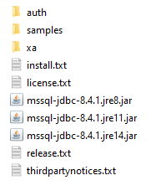
Example: Database Drivers
Every database manufacturer publishes driver libraries
Contains classes that enable Java programs to connect to their database
SQL Server drivers can be downloaded here
See the jar files for different Java versions?

Slide 74
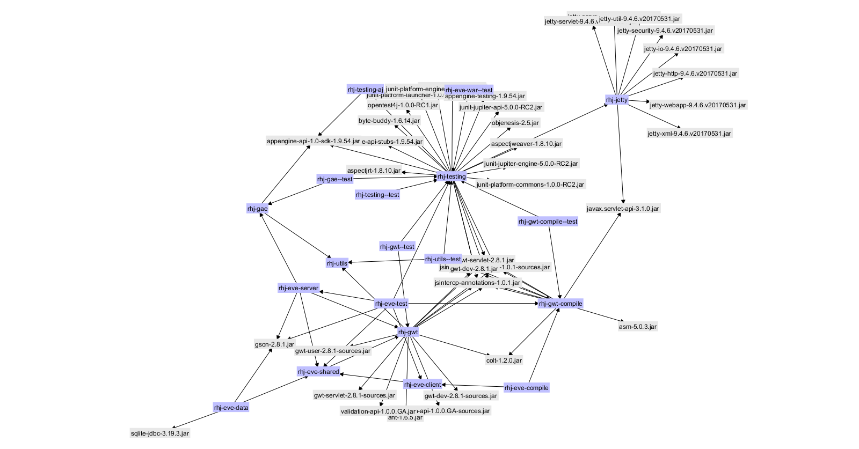
Dependency Hell
The frustration that arises when libraries require other libraries to work (transitive dependencies)
Gets worse when library versions are in conflict!

Slide 75
Maven for Dependencies
Maven is a popular Java tool to manage dependencies (libraries)
You create a Project Object Model file that includes all the libraries your project needs
Maven downloads them and manages transitive dependencies

Slide 76
SQL Server Driver in Maven
Using Maven, you don't download a jar from Microsoft
You include this entry in your pom.xml file
<dependency>
<groupId>com.microsoft.sqlserver</groupId>
<artifactId>mssql-jdbc</artifactId>
<version>8.4.1.jre14</version>
</dependency>

Slide 77
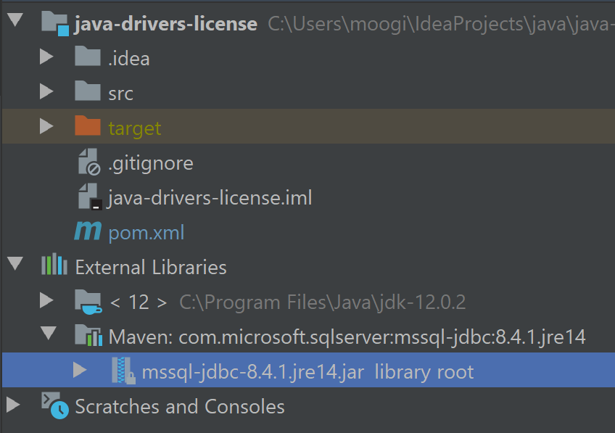
SQL Server Driver in Maven
Maven will download the correct jar, and any other required libraries
Your Java code can use the classes in these libraries

Slide 78
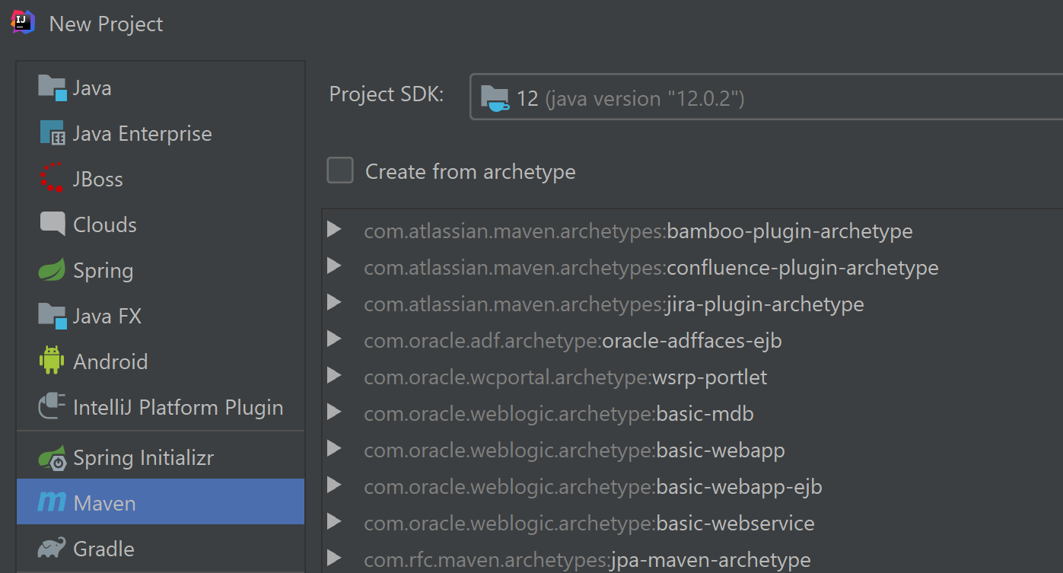
Maven in IntelliJ
Create a new project, but select Maven from the left menu

Slide 79
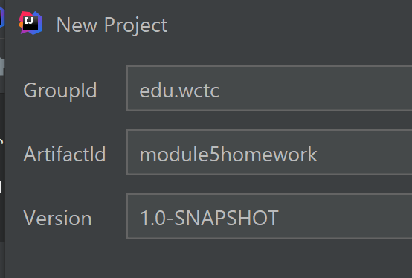
Group, Artifact, Version
The group, artifact, and version (GAV) uniquely identifies a Maven project
Usually the group is your domain name backwards (edu.wctc)
The artifact ID is your project name (module5homework)
Version can remain 1.0-SNAPSHOT

Slide 80
IntelliJ Stuff
The next screen relates solely to your IntelliJ project settings
Feel free to change directories or project name here
It won't affect Maven

Slide 81
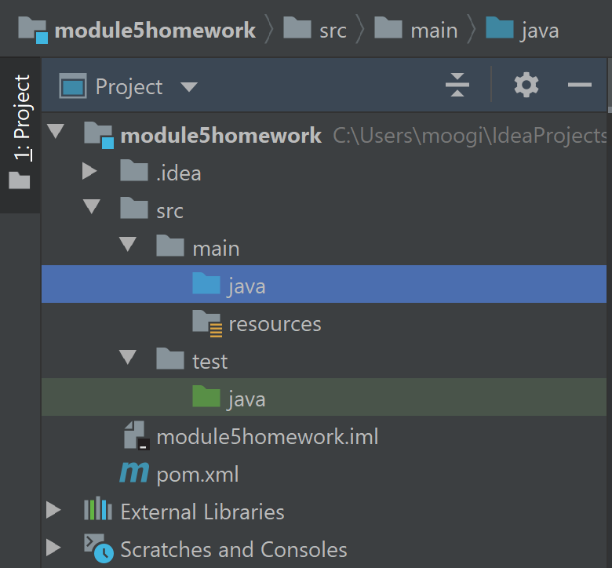
Project Layout
A Maven project is organized a little differently
Our Java classes should go in the src > main > java folder

Slide 82
Edit the POM
Your Maven project comes with a starter pom.xml file
The first thing we'll change is the default Java version (which is 5)
This means we can't use any language features introduced in Java 6+
(Not good... Java 6 released in 2006!)

Slide 83
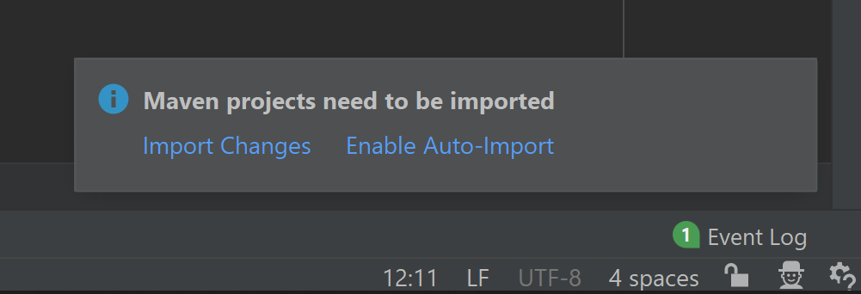
Super Important Popup!
When you make any change to the POM, this popup will appear
Do not dismiss it!
You must import changes (or enable auto-import) or your changes will not be applied

Slide 84
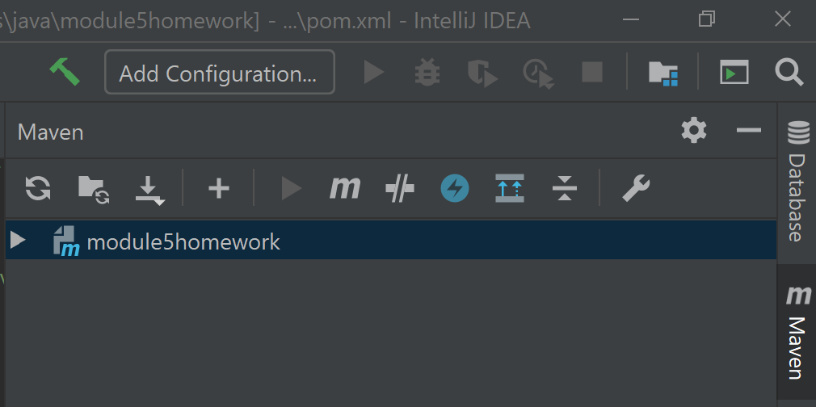
Oh No! I Dismissed It!
If you accidentally dismiss the popup, or your changes don't seem to be having an effect
Open the Maven drawer from the right screen edge
Click the refresh wheel button (first on the left)
Reimport
Open drawer

Slide 85
Change Java Version
Add these lines inside the <project> ... </project> tags
Change the X to your Java version:
<properties>
<maven.compiler.target>X</maven.compiler.target>
<maven.compiler.source>X</maven.compiler.source>
</properties>
Java Version | Use
8 or lower | 1.8, 1.7, etc.
9 or higher | 9, 11, 14, etc.

Slide 86
Add a Dependency
We're going to use a library published by the Apache Foundation
They maintain a huge collection of open source libraries
We're going to use one called Commons Codec
Contains lots of encoding/decoding algorithms (Base64, Hex, Phonetic, etc.)

Slide 87
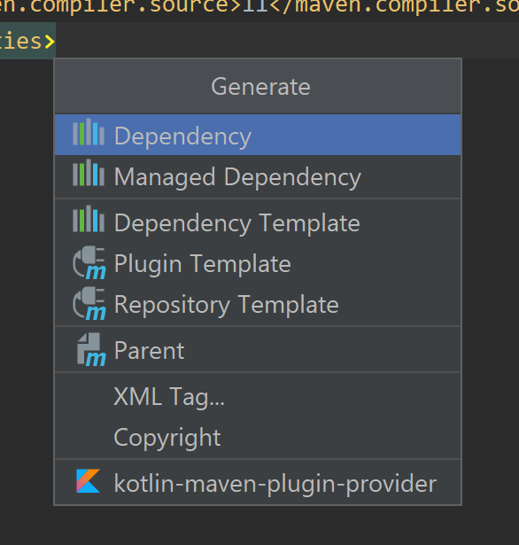
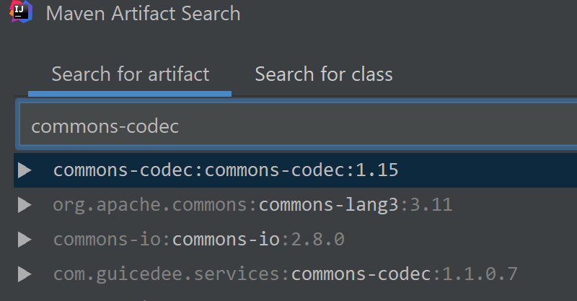
Generate Dependency
Right click inside pom.xml and select Generate > Dependency
Type commons-codec, then highlight and add the top entry

Slide 88
Super Important Popup!
Did you remember to import changes?

Slide 89
Use the Library
Commons-codec contains a class named Soundex
A phonetic algorithm that encodes sounds
You can now use Soundex in your code
Soundex soundex = new Soundex();
String enc = soundex.encode("Stacy");

Slide 90
Notice the Import
To use Soundex, you must import it
Above your class header, you should see:
import org.apache.commons.codec.language.Soundex;
Notice the reverse domain name? https://commons.apache.org

