Slide 1
Java Programming
152-130 Module 7

Slide 2
Multi-Threading
Section 1

Slide 3

Central Processing Unit
The CPU is where program instructions are executed
Instructions are executed serially
One after another
The operating system manages the CPU's "attention" when multiple programs are running

Slide 4

Humans Multitask
Your very competent assistant seems to do many things at once
In reality, she can only do one thing at a time
She switches between multiple tasks very quickly

Slide 5

Multi-Processor and Multi-Core
Single processor systems are like your one assistant
Multi-processor (or multi-core) systems are like hiring additional assistants
With more assistants, multiple tasks can be performed simultaneously

Slide 6
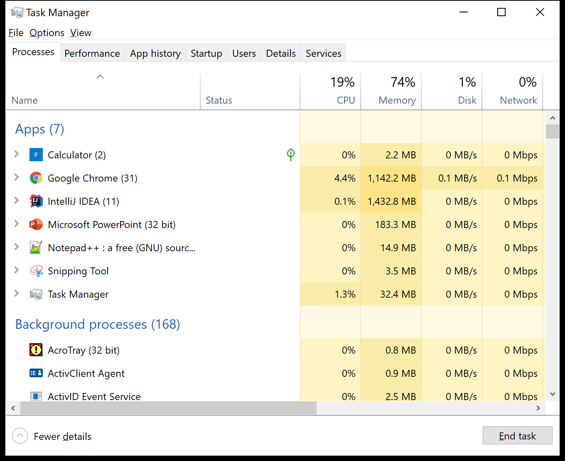
Threads vs Processes
A process is an instance of a program running on a computer
Starting/stopping processes is resource intensive

Slide 7

Threads vs Processes
Threads are a path of execution within a process
Processes can contain multiple threads
Threads are not as expensive to start/stop

Slide 8
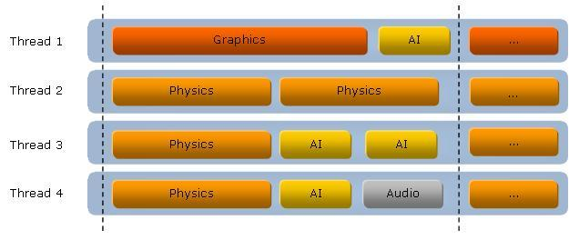
Multiple Threads Enhance Responsiveness
Multi-threading is often used in GUI applications
Operations running in the background don't impede user interaction
A video game may have rendering on a separate thread from audio

Slide 9
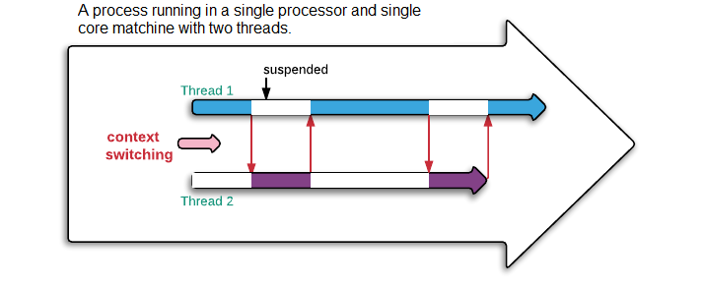
Single Processor, Multiple Threads
Can you use multiple threads if you only have one processor?
Yes, the CPU just switches between the threads

Slide 10
Runnable Tasks
Section 2

Slide 11
Task Class
A task contains the code you want to run on a new thread
Usually something that's going to take a long time
Download a file, API call, crunching a bunch of numbers...

Slide 12
Runnable Interface
Your task class should implement the Runnable interface
Runnable contains one method named run()
Your long-running code (that downloads a file, calls an API, etc.) goes inside run()

Slide 13
Sample Task Class
public class MyTask implements Runnable {
@Override
public void run() {
// Code to run in its own thread
}
}

Slide 14
Create a Thread
Create a task object
Create a new Thread and pass it the task
Runnable task = new MyTask();
Thread thread = new Thread(task);

Slide 15
Start the Thread
The thread will run the task when you tell it to start
Runnable task = new MyTask();
Thread thread = new Thread(task);
thread.start();

Slide 16
Demo: Text Spammer
This nested loop prints some text ~16 billion times
public class Spammer {
public void spam(String text) {
for (int i = Integer.MIN_VALUE; i < Integer.MAX_VALUE; i++) {
for (int j = Integer.MIN_VALUE; j < Integer.MAX_VALUE; j++) {
System.out.println(text);
}
}
}
}

Slide 17
Demo: Text Spammer
This loops runs until the user enters "q" or "Q"
The thread blocks while waiting for the spammer to finish
public static void main(String[] args) {
String text;
do {
text = JOptionPane.showInputDialog("Enter spam text");
new Spammer().spam(text);
} while (!spam.equalsIgnoreCase("q"));
}

Slide 18
Demo: Text Spammer
Create a spammer task that implements Runnable
Its run method (not shown) contains the nested loops
public class SpammerTask implements Runnable {
private String text;
public SpammerTask(String text) {
this.text = text;
}
}

Slide 19
Demo: Text Spammer
Update main to create new tasks and threads
With the loops on their own threads, they do not block
// new Spammer().spam(spam);
Runnable task = new SpammerTask(spam);
Thread thread = new Thread(task);
thread.start();

Slide 20
Don't Call run()
The thread calls the run method in the task
Don't call it explicitly
Call start on the thread

Slide 21
Don't Reuse Threads
When a thread is finished, it's finished
Don't try to restart a completed thread
Just make a new one
(Or use a thread pool)

Slide 22
Sleeping and Interrupting Threads
Section 3

Slide 23
Pausing a Thread
A thread can be paused by calling its sleep method
Accepts the number of milliseconds (1/1000th second) to sleep for
Within the task's run method, call Thread.sleep(millis)
Will need to handle InterruptedException

Slide 24
Demo: Countdown Task
Print the numbers from X to 1, one per second
public class CountdownTask implements Runnable {
private int secondsRemaining;
public CountdownTask(int secondsRemaining) {
this.secondsRemaining = secondsRemaining;
}

Slide 25
Demo: Countdown Task
@Override
public void run() {
while (secondsRemaining > 0) {
System.out.println(secondsRemaining--);
Thread.sleep(1000); // catch? throw?
}
}
}

Slide 26
Demo: Countdown Task
Start the countdown thread in main
String secondsText = JOptionPane.showInputDialog("Enter seconds");
int seconds = Integer.parseInt(secondsText);
Runnable task = new CountdownTask(seconds);
Thread thread = new Thread(task);
thread.start();

Slide 27
InterruptedException
Should we throw or catch the exception?
It depends... can your program recover?
Was the interruption expected (user clicks a cancel button) or abnormal (network connection terminates)?

Slide 28
Catching InterruptedException
If you decide to catch the exception, call the interrupt method of the thread
Sets a flag that can be checked elsewhere in the program
try {
Thread.sleep(1000);
} catch (InterruptedException e) {
Thread.currentThread().interrupt();
}

Slide 29
Interrupting on Purpose
Within the task's run method, check if its thread has been interrupted (check that flag)
If it has, stop whatever the task was doing
public void run() {
while (!Thread.currentThread().isInterrupted())
// do stuff
}

Slide 30
Demo: Infinite Task
public class InfiniteTask implements Runnable {
public void run() {
try {
while (!Thread.currentThread().isInterrupted()) {
Thread.sleep(1500);
System.out.println("Loading, please wait...");
}
} catch (InterruptedException e) {
Thread.currentThread().interrupt();
}
}
}

Slide 31
Demo: Infinite Task
The main thread blocks until the dialog is dismissed
After dialog closed, the thread's interrupt method is called
Runnable task = new InfiniteTask();
Thread thread = new Thread(task);
thread.start();
JOptionPane.showMessageDialog (null, "Close dialog to stop loading");
thread.interrupt();

Slide 32
Joining Threads
Section 4

Slide 33
One Thread Waits for Another
Your program needs to make three network requests for data
But it can't continue until all three requests complete
For efficiency, you start three new threads, one per request
The main thread must wait until all three network threads finish fetching data

Slide 34
Start Two Countdown Threads
One for 10 seconds, one for 15 seconds
Thread thread1 = new Thread(new CountdownTask(10));
Thread thread2 = new Thread(new CountdownTask(15));
thread1.start();
thread2.start();

Slide 35
Wait For Both
The main thread (the one that created the countdown threads) must wait for both to be done before continuing
thread1.start();
thread2.start();
// wait for both countdowns to finish
System.out.println("Countdowns done!");

Slide 36
Join the Threads
After the main thread starts the countdowns, it joins them
(Join throws InterruptedException also)
try {
thread1.join();
thread2.join();
} catch (InterruptedException e) {...}
System.out.println("Countdowns done!");

Slide 37
Thread Priority
Section 5

Slide 38
Prioritizing Threads
Every thread has a priority
By default, it inherits the priority of the thread that created it
JVM will execute the highest priority thread first
If all threads are equal, they are placed in a circular queue and share CPU time equally
Round-robin scheduling

Slide 39
Priority Constants
Priority is a numeric value between 1 and 10
The Thread class contains three constants you can use
Thread.MIN_PRIORITY; // 1
Thread.NORM_PRIORITY; // 5
Thread.MAX_PRIORITY; // 10

Slide 40
Change Countdown Priority
In the joining threads example, maximize the priority of the 15-second thread
Thread thread1 = new Thread(new CountdownTask(10));
Thread thread2 = new Thread(new CountdownTask(15));
thread2.setPriority(Thread.MAX_PRIORITY);

Slide 41
Wait... They Both Ran?
When the high-priority thread was sleeping, the CPU could run the low-priority thread
Comment out the block that sleeps the thread in CountdownTask
Now the 15-second countdown finishes before the 10-second countdown starts

Slide 42
No It Didn't!
Run the program a few more times
Do you always get the same results?
Rule of thumb: At any given time, the highest priority thread is running. However, this is not guaranteed. The thread scheduler may choose to run a lower priority thread to avoid starvation. For this reason, use priority only to affect scheduling policy for efficiency purposes. Do not rely on thread priority for algorithm correctness.
https://www.eg.bucknell.edu/~mead/Java-tutorial/essential/threads/priority.html

Slide 43
Thread Starvation
If a low-priority thread never gets a chance to run it is called contention or starvation
High-priority threads should sleep (or yield) periodically to give lower-priority threads a chance to run

Slide 44
Thread Pools
Section 6

Slide 45
Many Threads
Creating a thread by calling the Thread constructor is good for a single task
Can perform poorly when creating many threads
Instead, use a thread pool
A group of pre-made, available Threads that can run tasks
When done, they go back into the pool for reuse

Slide 46
Two Types of Thread Pools
A fixed thread pool creates X threads
If more than X tasks are executed, the excess must wait for a free thread
A cached thread pool creates threads as needed, discarding any that haven't been used in 60 seconds
Good when there are many short tasks

Slide 47
Create a Fixed Thread Pool
The pool will have three threads available
Start three countdown tasks using threads from the pool
ExecutorService threadPool = Executors.newFixedThreadPool(3);
threadPool.execute(new CountdownTask(5));
threadPool.execute(new CountdownTask(10));
threadPool.execute(new CountdownTask(15));

Slide 48
Umm... My Program Is Still Running
When you're done with the thread pool, shut it down
threadPool.execute(new CountdownTask(5));
threadPool.execute(new CountdownTask(10));
threadPool.execute(new CountdownTask(15));
threadPool.shutdown();

Slide 49
Change Size of Pool
Update the fixed thread pool to only contain one thread
ExecutorService threadPool = Executors.newFixedThreadPool(1);
Now the countdowns run sequentially
Each must wait for the sole thread to be free

Slide 50
Cached Thread Pool
Don't specify a size when creating a cached thread pool
ExecutorService threadPool = Executors.newCachedThreadPool();
threadPool.execute(new CountdownTask(5));
threadPool.execute(new CountdownTask(5));
threadPool.execute(new CountdownTask(5));
threadPool.shutdown();

Slide 51
Interrupting Thread Pool Tasks
Calling the shutdown method of the thread pool will stop it from accepting new tasks
If you want to also interrupting any existing tasks, use:
threadPool.shutdownNow();

Slide 52
Synchronization
Section 7

Slide 53
Accessing Shared Resources
When multiple threads try to access the same resource, it can cause corruption
A common problem in multi-threaded program
A race condition occurs
A thread-safe object is safe to use with multiple threads

Slide 54
Demo: Bank Account
A simple class to represent a bank account
public class BankAccount {
private int balance = 0;
public int getBalance() {
return balance;
}

Slide 55
Demo: Bank Account
Deposit method contains an artificial delay to reliably demonstrate the race condition
public void deposit(int amount) {
int newBalance = balance + amount;
try {
Thread.sleep(5); // Artificial delay
} catch (InterruptedException e) {...}
balance = newBalance;
}

Slide 56
Demo: Bank Account
public class DepositPennyTask implements Runnable {
private BankAccount bankAccount;
public DepositPennyTask(BankAccount bankAccount){
this.bankAccount = bankAccount;
}
public void run() {
bankAccount.deposit(1);
}
}

Slide 57
Demo: Bank Account
Create 100 threads that each deposit one penny
BankAccount account = new BankAccount();
ExecutorService threadPool = Executors.newCachedThreadPool();
for (int i = 0; i < 100; i++)
threadPool.execute(new DepositPennyTask(account));

Slide 58
Demo: Bank Account
Loop until all threads are finished, then print the balance
while (!threadPool.isTerminated()) {
// do nothing, just wait
}
threadPool.shutdown();
System.out.println(account.getBalance());

Slide 59
Race Conditions
Your bank customer would be very upset to discover they only had 2 or 3 cents in their account!
Why not 100 cents?
Multiple threads were accessing the balance variable at the same time

Slide 60
Multiple Threads Read the Same Balance
Value of balance | Thread 1 | Thread 2 | Thread 3
0 | newBalance = balance + 1;
0 |  | newBalance = balance + 1;
1 | balance = newBalance;
1 |  | balance = newBalance;
1 |  |  | newBalance = balance + 1;
2 |  |  | balance = newBalance;

Slide 61
Race Conditions Are Tricky
We added an artificial delay to guarantee the threads would interfere with each other
In practice, a race condition may only happen once every thousandth or millionth execution
They can be very tricky bugs to spot!

Slide 62
Remove the Delay
Try removing the artificial delay in BankAccount's deposit method
Running the program many times may result in many different outcomes, some correct
for (int i = 0; i < 20; i++)
raceCondition();

Slide 63
Preventing Corruption
One way to make BankAccount thread-safe is to only allow one thread at a time to call the deposit method
When a method is synchronized it can only be called by one thread at a time
public synchronized void deposit(int amount) {

Slide 64
Synchronized
Before a thread can call a synchronized method, it must acquire a lock
After the method is done, the lock is released
Other threads must wait until the lock is released before they can acquire it
They are blocked while they wait

Slide 65
What Is a Lock?
For a non-static method, the lock is the object itself (this)
For a static method, the lock is the class

Slide 66
Overusing Synchronization
Synchronizing too many methods degrades performance
Threads are blocking unnecessarily
Like having many checkout lanes but only one cashier!
You can be more fine-grained by creating a synchronized block within a method
Only that portion of a method requires a lock

Slide 67
Rewriting the deposit Method
The synchronized keyword starts the block
this is the lock for the block
public void deposit(int amount) {
synchronized (this) {
int newBalance = balance + amount;
balance = newBalance;
}
// other code that doesn't require synchronization
}

Slide 68
Synchronized Collections
Section 8

Slide 69
List, Set, and Map
The Java Collections Framework classes are not thread-safe
Adding or deleting items in a collection from multiple threads can result in a runtime exception
See the documentation for ArrayList here

Slide 70
Wrap the Collection
It would be wasteful to use synchronization in a single-threaded program
Why acquire and release locks unnecessarily?
Java allows us to take a regular collection and wrap it with a thread-safe class

Slide 71
Wrap the Collection
Use the wrapped collection like you normally would
List<String> list = Collections.synchronizedList(new ArrayList<>());
Set<String> set = Collections.synchronizedSet(new HashSet<>());
Map<Integer, String> map = Collections.synchronizedMap(new HashMap<>());

