Slide 1
Sentiment Analysis
-Movie Reviews
IST 557: Data Mining Project
Team 10
12/09/2014

Slide 2
Dataset- Amazon movie reviews
How many Data?
Number of reviews: 7,911,684
Number of users: 889,176
Number of products: 253,059
Users with > 50 reviews: 16,341
Median no. of words per review: 101
Timespan: Aug 1997 - Oct 2012
How many we use?
11,040 pieces of reviews

Slide 3
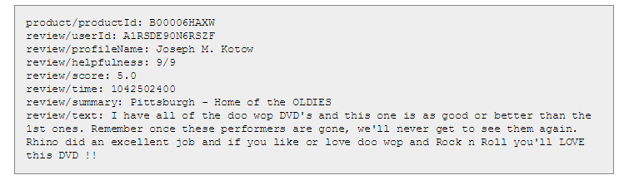
Data Format
Score: 1-5

Slide 4
Preprocessing
Clean the pieces of reviews with imcomplete data (such as no score or no movie name);
Sampling from the whole dataset with random choices. We get out 11,040 pieces of reviews, which include
Transform the .txt file to .csv file in order to separate the data by the score(1.0-5.0);
Separate the reviews into [1-5].txt files that each of them contains the reviews of a typical score;
Merge [1-3].txt into n.txt; Merge [4-5].txt into p.txt;

Slide 5
Tasks
Ranking (Pos/Neg) Prediction
Aspect Extraction
Sentiment for each Aspect

Slide 6
Task 1: Ranking (Pos/Neg) Prediction
Model : Naive Bayes
Feature : Bag of Words
Training set and Testing set: 3:1
10-fold Cross Validation
Ranking (5 classes) accuracy: 0.316555249705
Pos/Neg (2 classes) accuracy: 0.699879590608
Notes:
| P(label) * P(f1|label) * ... * P(fn|label) | P(label|features) = -------------------------------------------- | P(features)

Slide 7
Most Informative Features
5 Classes
Save = True one : five = 63.8 : 1.0
Josh = True thre : five = 58.2 : 1.0
Bush = True thre : five = 56.7 : 1.0
stupid = True two : five = 42.0 : 1.0
Damon = True thre : five = 40.6 : 1.0
toilet = True one : five = 38.3 : 1.0
wooden = True two : five = 35.5 : 1.0
awful = True two : five = 35.5 : 1.0
angels = True thre : five = 33.5 : 1.0
jumps = True thre : five = 33.5 : 1.0
2 Classes
horrible. = True n : p = 35.9 : 1.0
stupid = True n : p = 31.6 : 1.0
Save = True n : p = 25.5 : 1.0
crap. = True n : p = 20.7 : 1.0
shoddy = True n : p = 18.5 : 1.0
McLintock = True n : p = 18.5 : 1.0
zero = True n : p = 17.6 : 1.0
Sorry = True n : p = 16.3 : 1.0
garbage. = True n : p = 16.3 : 1.0
zombies = True n : p = 14.1 : 1.0
Notes:
each column

Slide 8
Task 1: Ranking (Pos/Neg) Prediction
Model : Naive Bayes
Feature : Bi-Gram
Training set and Testing set: 3:1
10-fold Cross Validation
Ranking (5 classes) accuracy: 0.309633269483
Pos/Neg (2 classes) accuracy: 0.715507246377

Slide 9
Most Informative Features
5 Classes
2 stars = True two : five = 93.8 : 1.0
Save your = True one : five = 53.6 : 1.0
3 stars = True thre : five = 51.2 : 1.0
films were = True two : five = 48.5 : 1.0
comes off = True two : five = 48.5 : 1.0
it two = True two : five = 48.5 : 1.0
the machines = True two : five =48.5 : 1.0
as bad = True two : five = 48.5 : 1.0
money on = True one : five = 43.4 : 1.0
waste of = True one : five = 43.4 : 1.0
2 Classes
Save your = True n : p = 33.7 : 1.0
Don't waste = True n : p = 29.4 : 1.0
3 stars = True n : p = 24.2 : 1.0
excuse for = True n : p = 22.9 : 1.0
horror movie = True n : p = 22.9 : 1.0
very disappointed=True n : p = 22.9 : 1.0
terrible movie = True n : p = 20.7 : 1.0
worst movie = True n : p = 20.7 : 1.0
had high = True n : p = 20.7 : 1.0
absolutely no = True n : p = 20.7 : 1.0

Slide 10
Task 1: Ranking (Pos/Neg) Prediction
Model : Naive Bayes
Feature : Bi-Gram & Bag of Words
Training set and Testing set: 3:1
10-fold Cross Validation
Ranking (5 classes) accuracy: 0.305635440701
Pos/Neg (2 classes) accuracy: 0.67219537219251

Slide 11
Most Informative Features
5 Classes
2 stars = True two : five = 93.8 : 1.0
Save = True one : five = 63.8 : 1.0
Josh = True thre : five = 58.3 : 1.0
Bush = True thre : five = 56.8 : 1.0
Save your = True one : five = 53.6 : 1.0
3 stars = True thre : five = 51.2 : 1.0
films were = True two : five = 48.5 : 1.0
comes off = True two : five = 48.5 : 1.0
it two = True two : five = 48.5 : 1.0
the machines = True two : five = 48.5 : 1.0
2 Classes
horrible. = True n : p = 35.9 : 1.0
Save your = True n : p = 33.7 : 1.0
stupid. = True n : p = 31.6 : 1.0
Save = True n : p = 25.5 : 1.0
Don't waste = True n : p = 25.0 : 1.0
3 stars = True n : p = 24.2 : 1.0
excuse for = True n : p = 22.9 : 1.0
horror movie = True n : p = 22.9 : 1.0
very disappointed = Truen : p = 22.9 : 1.0
worst movie = True n : p = 20.7 : 1.0

Slide 12
Task 1: Ranking (Pos/Neg) Prediction
Basic Model : Naive Bayes
Feature : Bag of Words (Stop Words out)
Data set Balanced
Training set and Testing set: 3:1
10-fold Cross Validation
Ranking (5 classes) accuracy: 0.448459383754
Pos/Neg (2 classes) accuracy: 0.755326965467

Slide 13
Task 1: Ranking (Pos/Neg) Prediction
Model : Naive Bayes
Feature : JJ, JJR, JJS, VB (Stop Words out)
Example: I love this fantastic movie!
Data set Balanced
Training set and Testing set: 3:1
10-fold Cross Validation
Much Faster
Ranking (5 classes) accuracy: 0.395891341256
Pos/Neg (2 classes) accuracy: 0.735488611315

Slide 14
Look into the errors
"Not" cases
I know that it is not fair to say that the movie is not as good as the book. (1'->4')
No significant evidence
I recvd this video (DVD version) as a Christmas gift. I put it on about 11 pm just to see what it was like, and finally got dragged to bed about 4 (5'->3')

Slide 15
Look into the errors
Feeling changes
At first I was so excited to order this because I have heard so much about Tina Landon was eager to give this a try. I found it so difficult to keep up with Tina you basically need to have some sort of training in choreography to understand how to do some of the moves. (1'->4')

Slide 16
Look into the errors
Different Things
I had just finished reading the fantastic book and decided I'd like see how it was adapted to the big screen. As I watched the film I wondered if the makers of the movie even bothered to read the book. My girlfriend kept asking me during the film if "that happened in the book?" At the end of the movie I told her that basically everything in the movie was not how it occurred in the book. She enjoyed the movie until the end when it was like a "cheesy 80's montage". The book is wonderful...(1'->5')

Slide 17
Task 2: Aspect Extraction (Review)
I bought an iPhone a few days ago. It is such a nice phone. The touch screen is really cool.
Aspect 1: touch screen
Aspect 2: voice
Aspect 3: keyboard
Aspect 4: price
The voice quality is clear too. It is much better than my old Blackberry, which was a terrible phone and so difficult to type with its tiny keys.
However, my mother was mad with me as I did not tell her before I bought the phone. She thought the phone was too expensive...

Slide 18
Aspect Extraction: Frequent
Frequency (Hu and Liu, 2004) (NN, NNS)
e.g. GREAT Camera., Jun 3, 2004
Reviewer: jprice174 from Atlanta, Ga.
The pictures coming out of this camera are amazing. The 'auto' feature takes great pictures most of the time. And the selfy function is also very great. …
How about the infrequent nouns?
Notes:
Different reviewers tell different stories (irrelevant)
When product features are discussed, the words that they use converge.
They are main features.

Slide 19

Aspect Extraction: Infrequent
Using part-of relationship and the Web
Better Precision (a small Drop in Recall).
Pointwise mutual information (PMI) score(Noun, Part Discriminators) using the Web
PMI (higher means more frequently be seen together)
Tend to co-occur : positive.
Presence – absence : negative.
e.g., a scanner class. (color; voice)
The part discriminators: “of scanner”, “scanner has”, “scanner comes with”, etc.
Notes:
hint for infrequent

Slide 20
Task 2: Aspect Extraction
Method 1: Frequency-based
Method 2: Improved by PMI
While this movie defers from the book it is an amazing modern rendition of a classic novel. Good actors, costumes, and a good director bring this movie together into what I believe is one of the best versions of "The Count of Monte Cristo to date.

Slide 21
Task 2: Aspect Extraction
Method 3:
Method 1 and 2 on a Sampling, manually generate the aspect seeds
seed=["plot", "cast", "actor", "music", "story", "stereotype", "character", "acting", "director", "producer", "scene", "book", "adaptation"]
Define synonyms using Leacock-Chodorow Similarity
Extract NN, NNS similar to any aspect in the seed

Slide 22
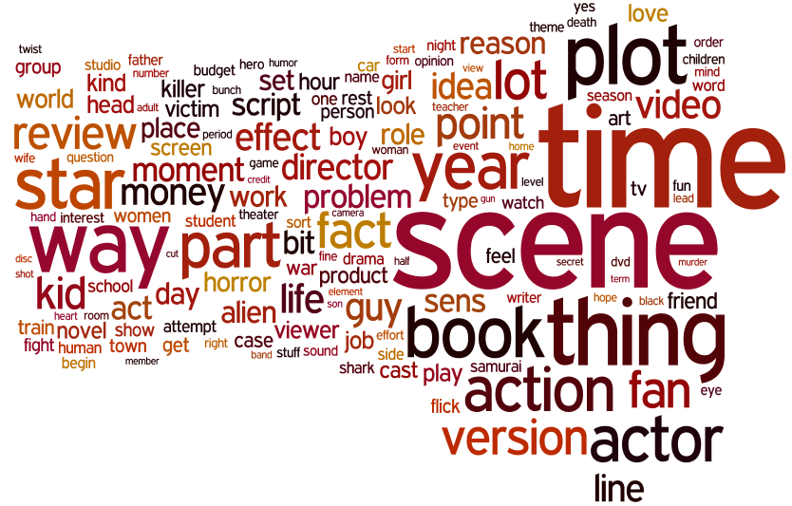
Aspects
Time
Scene
plot
Way
Star
book
version
year
actor
action

Slide 23
Questions?

Slide 25
Task 1: Ranking (Pos/Neg) Prediction
Basic Model : Naive Bayes
Feature : Bag of Words (Stop Words out)
Stop Words: such as the, is, at, which, and on. (NLTK)
Training set and Testing set: 3:1
10-fold Cross Validation
Ranking (5 classes) accuracy: 0.373484162896
Pos/Neg (2 classes) accuracy: 0.730072463768

Slide 26
Discussions
Make the dataset balanced will make a great contribution to the accuracy.
Bi-gram improves the accuracy as it solves the 'No' case problem to some extent and involves many more valuable features.
Uni-gram + Bi-gram might make the model overfit.
Use part of the sentence after POS tagging is no worse than the Uni-gram or Bi-gram but faster when the text is pre-processed.

Slide 27
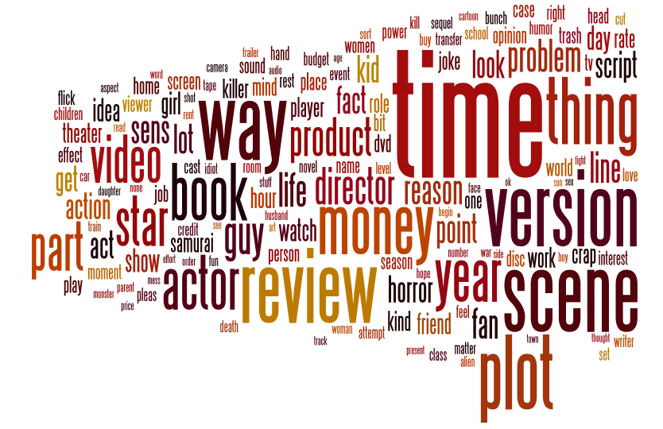
Rank 1 Aspect
Time
Version
Scene
review
money
plot
book
actor
product
video

Slide 28
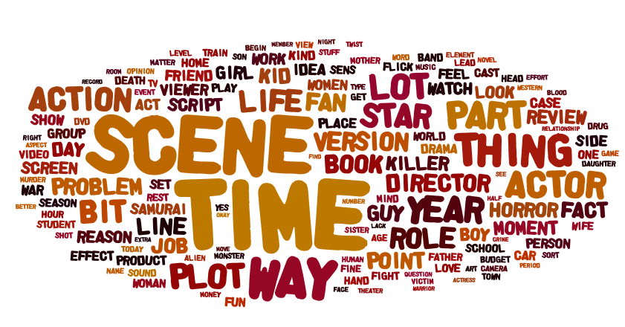
Rank 3 Aspect
Scene
Time
Thing
Way
Action
Actor
Way
Plot
Part
Role

Slide 29
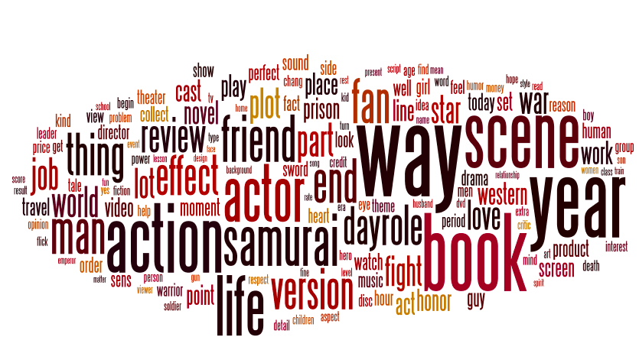
Aspect

Slide 30
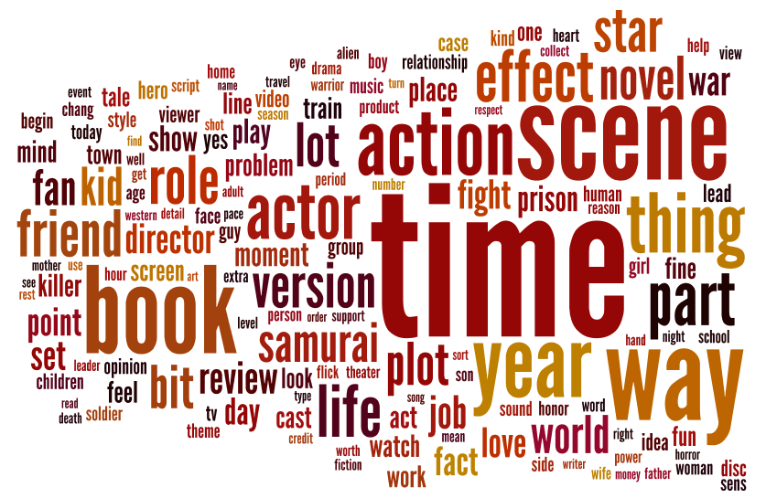
Rank 4 Aspect
Time
Scene
Way
Book
Action
Effect
Novel
Role
Thing
Part

Slide 31
Comparison
Rank1
Time
Version
Scene
review
money
plot
book
actor
product
video
Rank2
Time
Scene
plot
Way
Star
book
version
year
actor
action
Rank3
Scene
Time
Thing
Way
Action
Actor
Way
Plot
Part
Role
Rank4
Time
Scene
Way
Book
Action
Effect
Novel
Role
Thing
Part
Rank5
Time
Way
Action
Book
Year
Scene
life
friend
version
effect

