Slide 1
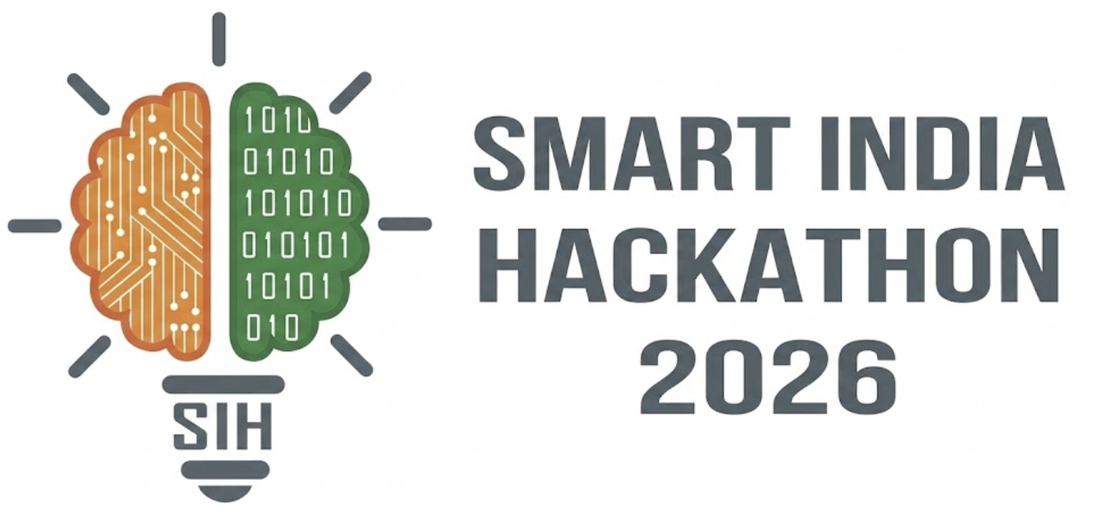

SMART INDIA HACKATHON 2026
TITLE PAGE
Problem Statement ID: 26261
Problem Statement Title: AI-Powered Application Validation, Document Authentication and Regulatory Compliance Verification
Theme: [Theme as listed on the SIH portal]
PS Category: Software
Team ID: BMS/SIH2026/54
Team Name (Registered on portal): CITADEL

Slide 2











IDEA TITLE
Citadel
Proposed Solution: DossierGraph is an on-premise AI pre-scrutiny engine that validates an institution's whole AICTE approval dossier: every document against its issuing authority, against 20 APH 2024-27 rules, and against every other document. Officers get evidence-linked findings and an inspection list; they make every decision.
Addressing the Problem
Core idea: the dossier cross-consistency graph
Solution Overview
Self-disclosure is trusted at entry
Land deed
(survey no.)
Land-use
certificate
Building plan
(area, address)
Verify first
EoA letters list deficiencies "based on Self Disclosure", fixed up to 6 months later.
survey no. ✓
Digital signatures (DSC), QR codes and DigiLocker records checked at the issuing source before any forensics.
→ Every document cross-checked at submission
12,000 ≠ 9,800 m²
Faculty roster
(IDs, count)
Application
form
Affidavit 2
(declared area)
Dossier graph + APH rules
1:20 ✓
Facts linked across documents; 20 versioned rules citing APH clauses (land, building, fire, faculty).
Fraud is caught late, if at all
APH Cl. 2.3.5(b): a fraudulent document means a criminal case, yet detection rests on random EVC visits.
Structural
stability cert
Occupancy /
completion cert
Fire safety
certificate
Forensics only where needed
→ Forgery indicators + issuer checks before scrutiny
CC date ✓
address ≠
Unsigned scans get PDF-revision, metadata, ELA and photo-reuse checks, shown as advisory indicators.
Officers re-check the same papers
consistent
contradiction → flag
mismatch → review
Deeds, NOCs, OCs and faculty rosters are re-verified by hand every cycle.
Innovation & uniqueness
Officer workstation + trust layer
Whole-dossier checks
not single-document KYC
Measured accuracy
on an open, labelled benchmark
Rules as code
AI advises, officer decides
Evidence viewer, 6 verification statuses, 2-officer rule for adverse outcomes, tamper-evident log.
→ Severity-ranked queue, clause + evidence per flag

Slide 3

























TECHNICAL APPROACH
Citadel
One dossier,
end to end
Intake
1
Extract
2
Verify
3
Cross-check
4
Forensics
5
Decide
6
What the officer sees
Drag-drop dossier; checklist ticks as each document is recognised
Extracted fields highlighted on the page; unsure OCR fields editable
Status chip per document: verified, mismatch, expired, pending…
Graph view: red edges mark contradictions between documents
Heat-map on suspicious regions, labelled "indicator"
Severity-ranked queue: accept, override with reason, escalate
What the system does, and its call
Virus scan, PDF disarm & rebuild, per-document encryption
Classify 8 doc types; OCR; extract facts with page coordinates
Validate DSC / QR; fetch the issuer's record and compare
Link facts across documents; evaluate the APH rule pack
PDF revisions + metadata, ELA, perceptual-hash photo reuse
Write finding + evidence crop; append to hash-chained log
intake.scan() → ClamAV
extract() → PaddleOCR
verify() → pyHanko
rules.eval() → aph.yaml
forensics() → OpenCV
audit.append() → PG
Model or store
MinIO + Vault
PaddleOCR
pyHanko + adapters
Rule engine + PG
OpenCV + pikepdf
Next.js workstation
encrypted object store, per-doc keys
English + Hindi, runs on-prem
DSC, QR, DigiLocker; mocks where no API
versioned YAML rules, 20 APH clauses
ELA, PDF structure, imagehash
Keycloak MFA + OPA access rules
Output, and what's guaranteed
dossier (encrypted)
facts.json
status per document
findings + APH clause
advisory indicators
signed report + EVC list
never leaves AICTE servers
every value linked to its page
issuer data beats forensics
rule version frozen at submission
never auto-rejects
2nd officer for adverse outcomes
Rules as code: a real APH 2024-27 clause
Technology stack (all on-prem)
Verification decision logic
rule_id: BLDG_FIRE
aph_ref: "Cl. 6.17(i), Annexure-14"
applies_to: [EoA, NEW_INSTITUTION]
check: fire_cert.valid_until >= ay_start
and fire_cert.address ~ plan.address
severity: high
on_fail: "Upload valid Fire Safety Cert"
Signed / QR /
DigiLocker?
yes
Verify at issuer
Verified
Mismatch
Next.js
Tailwind
FastAPI
Python
Celery
Redis
PostgreSQL
MinIO
no
Forensics
Expired
Manual review
Source down
Pending
PaddleOCR
OpenCV
Keycloak
Vault
Docker
Kubernetes
pyHanko
ClamAV
Unavailable
Trust layer: AES-256 encryption per document · Keycloak MFA + OPA role/region rules · hash-chained, tamper-evident audit log · HMAC-hashed faculty IDs · on-prem models, no third-party AI APIs
0
0
0
0
0
0
@SIH Idea submission
3
Notes:
Technologies to be used (e.g. programming languages, frameworks, hardware)
Methodology and process for implementation (Flow Charts/Images/ working prototype)

Slide 4











FEASIBILITY AND VIABILITY
Citadel
Technical
Mature open-source parts: PaddleOCR, pyHanko, OpenCV; no custom model training needed
Verify-first: signed / DigiLocker documents skip forensics, cutting false flags
Operational
Plugs in before the Scrutiny Committee: Scrutiny → EVC → SHC → Executive Committee chain unchanged
One engine, two sides: institutions run the same checks as a pre-check before submitting
Feasibility &
Viability
Economic
On-prem, no per-document API fees: scale by adding worker nodes on government servers
Targeted inspections: EVC visits focus on unresolved items, not full re-checks
Legal & Privacy
DPDP Act 2023 + Rules 2025: encryption, access logs, HMAC-hashed IDs, retention limits
MeitY AI Governance Guidelines (2025): human oversight; officer makes every decision
Proof of accuracy
Open synthetic benchmark: 200 institutions · ~2,000 documents · 8 labelled tamper types
We report: precision / recall per tamper type and false flags per genuine application
POTENTIAL CHALLENGES & STRATEGIES TO OVERCOME THEM
POTENTIAL CHALLENGES & RISKS
MITIGATION STRATEGIES
Poor or regional-language scans: faded stamps, Hindi and state-language NOCs
Indic OCR + per-field confidence: low confidence goes to manual review, never auto-fails
Sophisticated forgeries: edits that pass image forensics
Issuer check first: multi-signal forensics (PDF structure + ELA + reuse), always advisory
False flags overload officers: noise erodes trust in the tool
Benchmark-tuned thresholds: false flags per genuine application tracked; severity-ranked queue
No public APIs: fire NOCs, land records, AICTE faculty registry
Pluggable adapters: spec-faithful mocks now, 'Source unavailable' + retry; MoUs on the roadmap
Rules change: APH revisions; the VBSA Bill may replace AICTE norms
Versioned rule packs: clause IDs per rule; dry-run on past applications before publishing

Slide 5












IMPACT AND BENEFITS
Citadel
Where DossierGraph plugs into AICTE's approval chain (APH 2024-27)
Institution applies
NSWS / AICTE portal
DossierGraph
AI pre-scrutiny
Scrutiny Committee
zero-deficiency check
Expert Visit Committee
offline or online
Standing Hearing Cttee
show-cause replies
Executive Committee
LoA / LoR
Standing Appellate Cttee
appeal within 7 days
▲ flags + evidence to Scrutiny · 'verify on site' list to the EVC
Potential Impact on Target Audience
Benefits of the Solution
Today vs. with DossierGraph
AICTE scrutiny officers
Social
Students protected from institutions with unverified infrastructure or faculty claims
Today | With DossierGraph
Documents trusted on self-disclosure | Cross-checked against issuers and each other
Deficiencies fixed up to 6 months after EoA | Fixed before submission via pre-check
Fraud found by random EVC visits | Every dossier screened; indicators with evidence
Findings vary by reviewer | Same APH rule version for every application
Inspectors re-check everything | EVC targets only unresolved items
Severity-ranked queue; every flag shows the APH clause and the evidence crop
Economic
Officer and inspection hours spent on real issues, not routine re-checks
Institutions
Pre-check before submission: fix deficiencies first, fewer re-scrutiny rounds
Operational
Deficiencies caught before scrutiny; fewer back-and-forth cycles
Expert Visit Committees
A 'verify on site' list of only what could not be confirmed remotely
Governance
Same versioned rules for every application; tamper-evident trail for appeals and RTI
KPIs we will measure and report
Students and parents
Precision / recall per tamper type
False flags per genuine application
Approved institutions' land, building, safety and faculty claims checked
Environmental
Digital-first verification; fewer physical re-inspection trips
Minutes per application vs. manual
% documents verified at source

Slide 6


RESEARCH AND REFERENCES
Citadel
Regulatory: AICTE
• AICTE Approval Process Handbook 2024-25 to 2026-27 (Cl. 2.3.5, 2.4, 6.14, 6.17, 6.18, 7.4; Annexures 3, 5, 14) https://cdnbbsr.s3waas.gov.in/s35938b4d054136e5d59ada6ec9c295d7a/uploads/2025…
• AICTE Grant of Approval guidelines 2024-27 (EVC, SHC, SAC process; fraudulent documents) https://indiankanoon.org/doc/163708613/
• Sample AICTE EoA 2026-27 letter listing deficiencies based on self-disclosure (VESIT) https://vesit.ves.ac.in/storage/aicte/1775193851EOA%20Report%202026-27%20(2).…
Data protection and AI governance
• Digital Personal Data Protection Act 2023 & DPDP Rules 2025 (notified Nov 2025) https://ssrana.in/articles/meity-notifies-final-digital-personal-data-protect…
• MeitY India AI Governance Guidelines (Nov 2025): human oversight, accountability https://en.vikaspedia.in/viewcontent/e-governance/digital-india/india-ai-gove…
Verification infrastructure
• DigiLocker Requester Entity Locker API Specification, NeGD (28-11-2024) https://entity.digilocker.gov.in/assets/img/Requester%20-%20Entity%20Locker%2…
• AICTE circular on NAD / DigiLocker adoption (06/2021) https://cdn.digilocker.gov.in/nad/assets/circulars/4%20Circular_AICTE_NAD_Dig…
• pyHanko: PDF digital-signature validation https://pyhanko.readthedocs.io/
Research and prior work
• Grobler et al., A Technique for the Detection of PDF Tampering or Forgery, arXiv:2507.00827 (2025) https://arxiv.org/abs/2507.00827
• PaddleOCR: multilingual OCR toolkit (PaddlePaddle) https://github.com/PaddlePaddle/PaddleOCR
• SIH 2024 AICTE problem statements SIH1729 (AI approval portal) and SIH1730 (AI inspection) https://www.driems.ac.in/wp-content/uploads/2024/08/SIH_2024_PS.pdf
How we compare
Capability | KYC tools | Typical SIH entry | DossierGraph
Verify at issuer | ✓ | Partial | ✓
Whole-dossier cross-checks | ✗ | Partial | ✓
APH rules with clauses | ✗ | Partial | ✓
Measured accuracy, open data | Partial | ✗ | ✓
On-prem, DPDP-aligned | Partial | Partial | ✓
KYC tools: e.g. IDfy, HyperVerge (tamper checks for KYC and lending). Typical SIH entry: public SIH26261 repositories, Oct 2026.
Regulatory facts we build on
Cl. 2.3.5(b)
6 months
Fraudulent document → criminal case against Principal and Trust
Window to fix self-disclosure deficiencies in EoA letters
Nov 2025
30 yrs / 5 yrs
DPDP Rules notified; MeitY AI guidelines issued
Min. land lease (Cl. 6.17a); stability cert validity (6.17h)

