Slide 1
BAMBU- WEEK 12 PROGRESS REPORT
Global Manufacturing Strategy

Slide 2
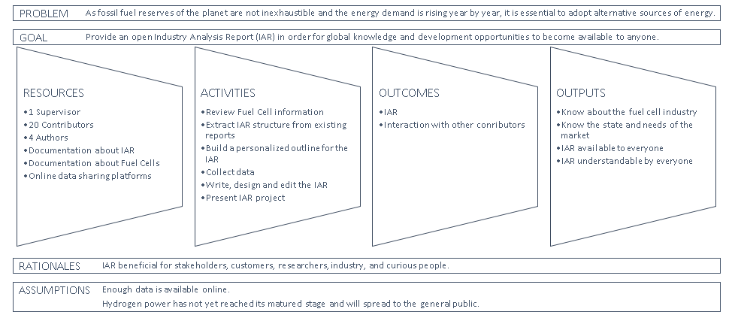
Logic Model

Slide 3
List of Variables
In accordance with 3T- MODEL

Slide 4
List of Variables
Technology | Tolerance | Talent
Fuel Types | Implementation | Governmental Incentives
Power Output | Region | Access to Institutions
Efficiency | Safety | Military Interests
Applications | Distance per Fuel Load | R&D Focus
Production Capacity | Price of Fuel | Salary
System Stability | Device Portability | Global Awareness
Operation and Maintenance | Supply Limit | Expertise
Distribution Energy Resources | Market Size | Environmental Exposure
Fuel Delivery Module | Social Policy
 | Law and Regulations

Slide 5
PROCESS DATA
Activity traces on github.com

Slide 6
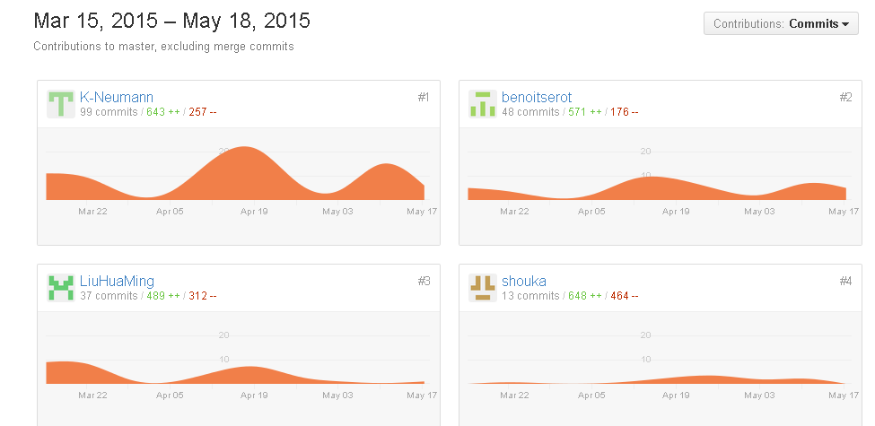
Process Data

Slide 7
IAR PROGRESS
‘Completed Tasks’ And ‘Work-in-progress’

Slide 8
IAR Progress : Completed Tasks
Task | Progress
Review Fuel Cell Information | COMPLETED
Extract IAR Structure from existing literature | COMPLETED
Build a personalized outline for the IAR | COMPLETED
Develop a personalized template for the IAR | COMPLETED
Collect data | COMPLETED
IAR: Introduction | COMPLETED

Slide 9
IAR Progress : Work-in-Progress
90%
80%
85%
IAR: Product Perspectives
IAR : Market Perspectives
IAR: Law and Governmental Regulations
50%
10%
40%
IAR : Comparison to other Technologies
IAR : Future Perspectives
IAR : Final Revision

Slide 10
IAR Progress

Slide 11
LOGIC MODEL
Resources
4 Team members
Activities
Read IAR, extract structure
Outcomes
IAR
Lab & Supervisor
Documentation about IAR
Documentation about fuel cells
Office supplies
Outputs
Have knowledge about global fuel cell industry (e.g. technology, application, manufacturers, risks, opportunities
Build a structure for our IAR
Read about fuel cell and surrounding industry
Collect data
Collaboration with chemistry lab
Being able to identify needs of the market
Ability to write an IAR
IAR available for other people
Interact with the chemistry lab

