Slide 1
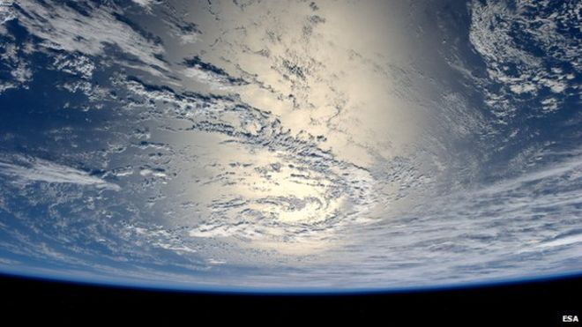
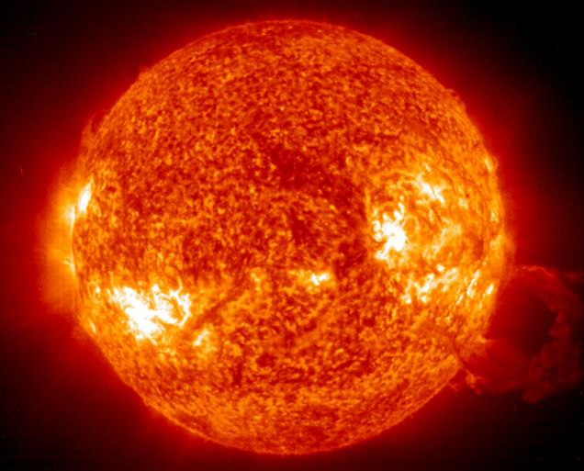

Photo from space to earth with question “what do you so” →hydrogen as XX% is hydrogen
Several non related pictures of hydrogen, question before the statement „what do they have in common“ →hydrogen

Slide 2

FUEL CELL INDUSTRY ANALYSIS REPORT
Global Manufacturing Strategy

Slide 3



BAMBU, THE TEAM
Benoit Serot |  | Pongsathorn Tiranun |  | Konstantin Neumann

Slide 4
BACKGROUND
In terms of number of molecules, Hydrogen is the most abundant gas on the Solar system.
Its combination with Oxygen can lead to
Arnett, David (1996). Supernovae and Nucleosynthesis (First ed.). Princeton, New Jersey: Princeton University Press.

Slide 5
LOGIC MODEL
PROBLEM | Fuel cells are an alternative to fossil fuels, yet there is a lack of knowledge about fuel cells and the state of the industry.
GOAL | Provide an open Industry Analysis Report (IAR) in order for global knowledge and development opportunities to become available to anyone especially global policy makers..
RESOURCES
ACTIVITIES
OUTPUTS
IAR
Fuel cell authorities
Create the IAR
OUTCOMES
Condensed Information about the fuel cell industry available
Scientific publications
Company websites
Newspapers and magazines
Governmental authorities
Statistic databases
Online Tools
Software
Introduction
GitHub page
IAR understandable by everyone
Interaction with other contributors
Product description
Market description
Policy framework
Future perspective
Conclusion
IAR available to everyone
Identify leading technologies and potential applications
Determine shipment data, investigate about companies
Review governmental regulations and subsidies
Analyze potential development and threads
Describe historical evolution
Publish IAR online and link it to printed version
RATIONALES | IAR beneficial for consumer, global policy institutions

Slide 6
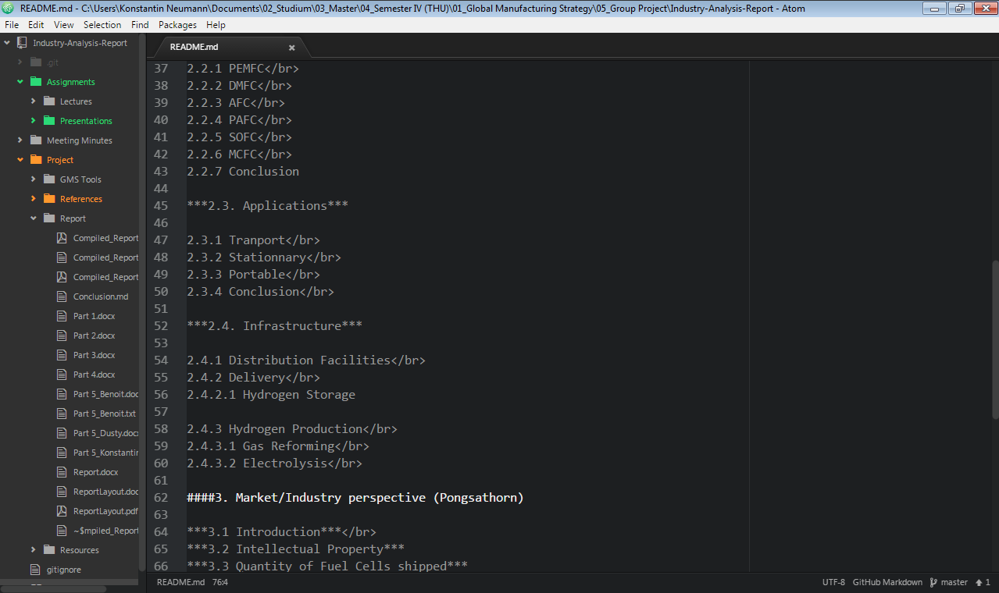
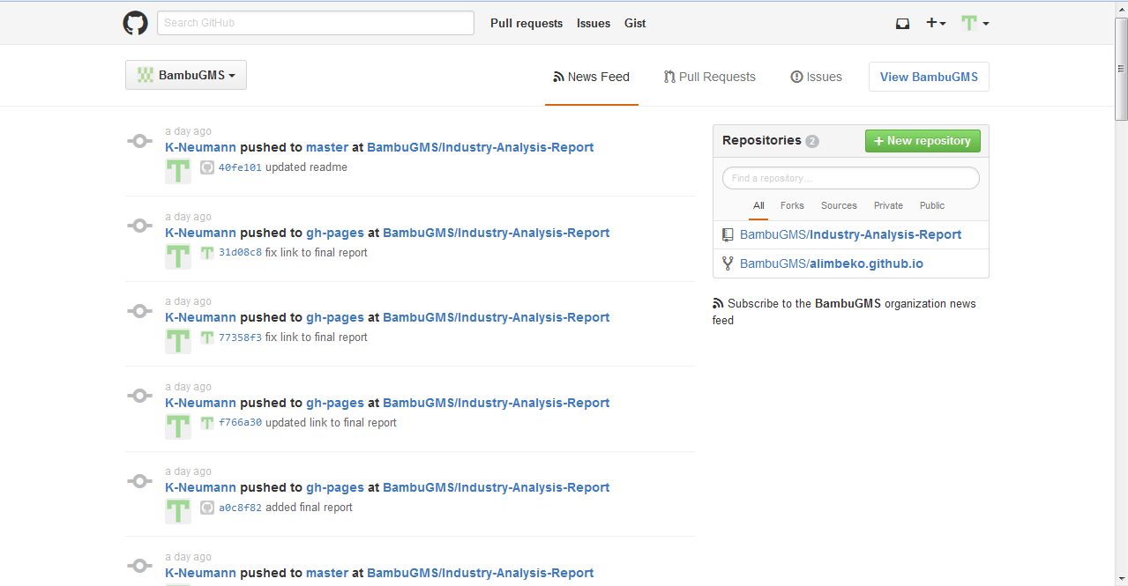
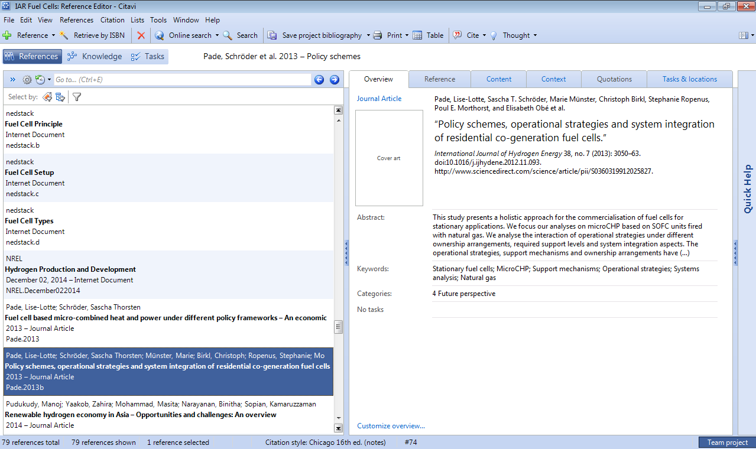
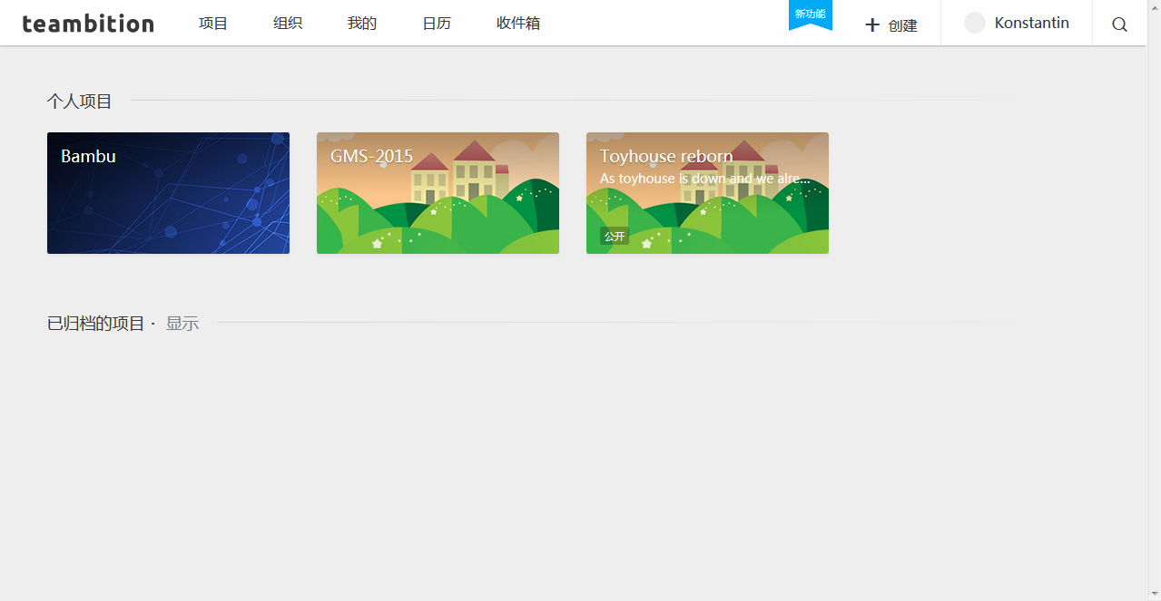
RESOURCES
ONLINE TOols
GitHub
Teambition
SOFTWARES
MS Office
Atom
Citavi

Slide 7
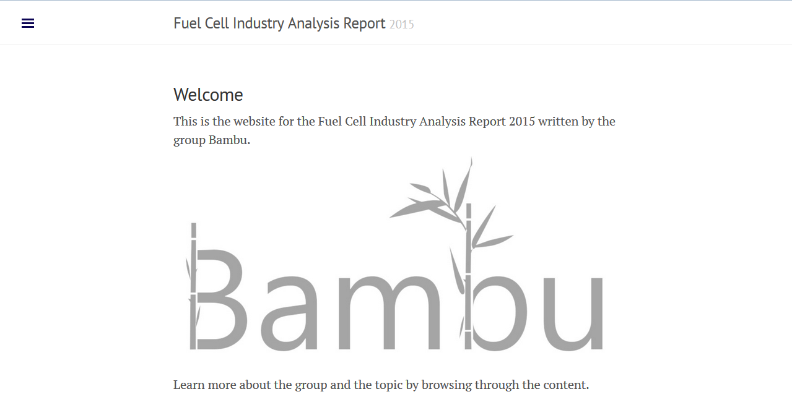
Website
http://bambugms.github.io/Industry-Analysis-Report/

Slide 8
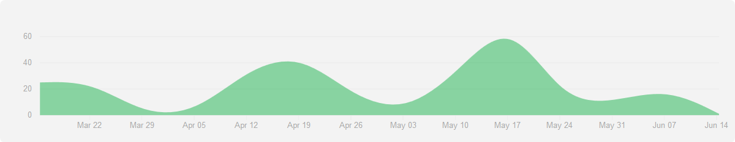
WORK PROCESS
First class, group building, Kick off,
Finding a topic
Assigned a new teammember
Midterms and May holiday
Assigned teammember drops class
Contributions to GitHub Repository BambuGMS/Industry-Analysis-Report from 15.03.2015-14.06.2015
First internal deadline „data research
Final internal deadline for finishing the report

Slide 9
THANK YOU FOR YOUR ATTENTION!
Feel free to ask questionS

