Slide 1

Notes:
What do you see? Actually you see dihydrogen, as dihydrogen with 84% is the most abundant gas in the solar system in terms of molar numbers. It is present on earth only in small quantities and hard to preserve. However, combined with water under certain conditions, it is involved in a electricity generating reaction that emits water. Fuel cells are relying on this principle to generate clean energy. This raises several questions:</br> * How does a fuel cell work? * What can it be used for? * Where does hydrogen come from? * Is there a market related? What stage has it reached? * How can governments support hydrogen power? * What are the potential evolutions for the product and the market? You can find answers to those questions in the Fuel Cell Industry Analysis Report 2015

Slide 2

FUEL CELL INDUSTRY ANALYSIS REPORT
Global Manufacturing Strategy

Slide 3



BAMBU, THE TEAM
Benoit Serot |  | Pongsathorn « Dusty » Tiranun |  | Konstantin Neumann

Slide 4
LOGIC MODEL
PROBLEM
Fuel cells are an alternative to fossil fuels, yet there is a lack of knowledge about fuel cells and the state of the industry.
GOAL
Provide an open Industry Analysis Report (IAR) in order for global knowledge and development opportunities to become available to anyone especially global policy makers.
RESOURCES
Fuel cell authorities
Scientific publications
Company websites
Newspapers and magazines
Governmental authorities
Statistic databases
Online Tools
Software
ACTIVITIES
Create the IAR
Describe historical evolution
Identify leading technologies and potential applications
Determine shipment data, investigate about companies
Review governmental regulations and subsidies
Analyze potential development and threads
Publish IAR online and link it to printed version
OUTPUTS
IAR
Introduction
Product description
Market description
Policy framework
Future perspective
Conclusion
GitHub page
OUTCOMES
Condensed Information about the fuel cell industry available
IAR available to everyone
IAR understandable by everyone
Interaction with other contributors
RATIONALES
IAR beneficial for consumer, global policy institutions
Notes:
Tell more about background
Interested in writig about fc as an alernative source, at the same time lack of knowldege, esp automotive industry, apears in media,
Share the knowledge, realized the relevance in first presentation,

Slide 5
LOGIC MODEL
RESOURCES
Fuel cell authorities
Scientific publications
Company websites
Newspapers and magazines
Governmental authorities
Statistic databases
Online Tools
Software
ACTIVITIES
Create the IAR
Describe historical evolution
Identify leading technologies and potential applications
Determine shipment data, investigate about companies
Review governmental regulations and subsidies
Analyze potential development and threads
Publish IAR online and link it to printed version
OUTPUTS
IAR
Introduction
Product description
Market description
Policy framework
Future perspective
Conclusion
GitHub page
OUTCOMES
Condensed Information about the fuel cell industry available
IAR available to everyone
IAR understandable by everyone
Interaction with other contributors
PROBLEM
Fuel cells are an alternative to fossil fuels, yet there is a lack of knowledge about fuel cells and the state of the industry.
PROBLEM
Fuel cells are an alternative to fossil fuels, yet there is a lack of knowledge about fuel cells and the state of the industry.
GOAL
Provide an open Industry Analysis Report (IAR) in order for global knowledge and development opportunities to become available to anyone especially global policy makers.
GOAL
Provide an open Industry Analysis Report (IAR) in order for global knowledge and development opportunities to become available to anyone especially global policy makers.
RESOURCES
Fuel cell authorities
Scientific publications
Company websites
Newspapers and magazines
Governmental authorities
Statistic databases
Online Tools
Software
ACTIVITIES
Create the IAR
Describe historical evolution
Identify leading technologies and potential applications
Determine shipment data, investigate about companies
Review governmental regulations and subsidies
Analyze potential development and threads
Publish IAR online and link it to printed version
OUTPUTS
IAR
Introduction
Product description
Market description
Policy framework
Future perspective
Conclusion
GitHub page
OUTCOMES
Condensed Information about the fuel cell industry available
IAR available to everyone
IAR understandable by everyone
Interaction with other contributors
RATIONALES
IAR beneficial for consumer, global policy institutions
RATIONALES
IAR beneficial for consumer, global policy institutions
Notes:
Tell more about background
Interested in writig about fc as an alernative source, at the same time lack of knowldege, esp automotive industry, apears in media,
Share the knowledge, realized the relevance in first presentation,

Slide 6
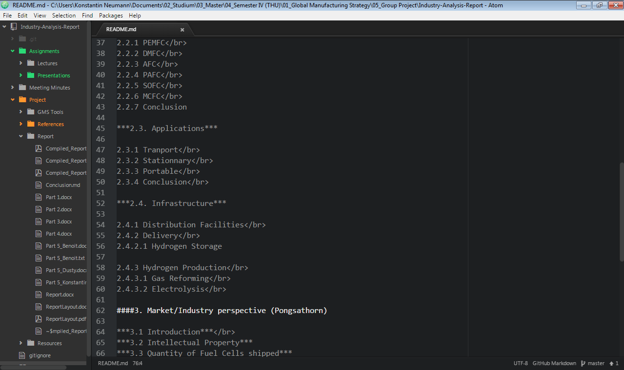
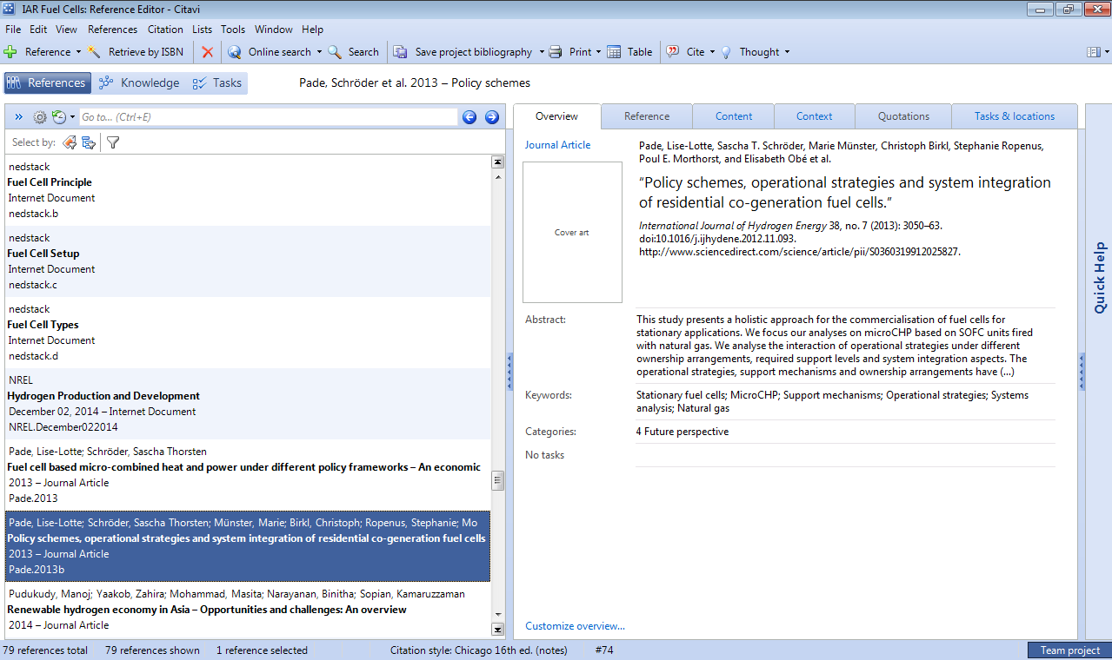
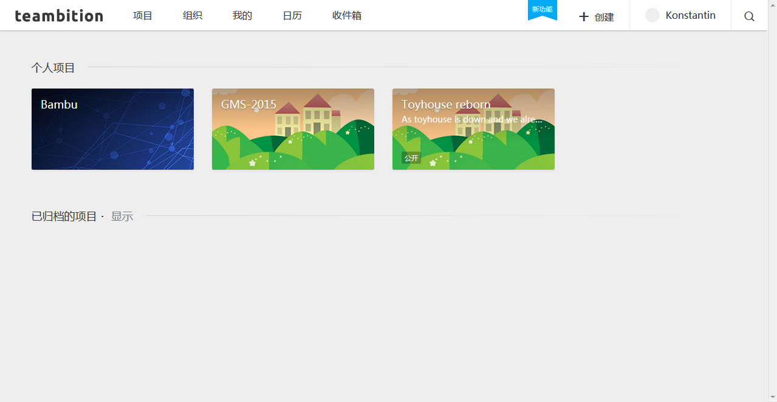
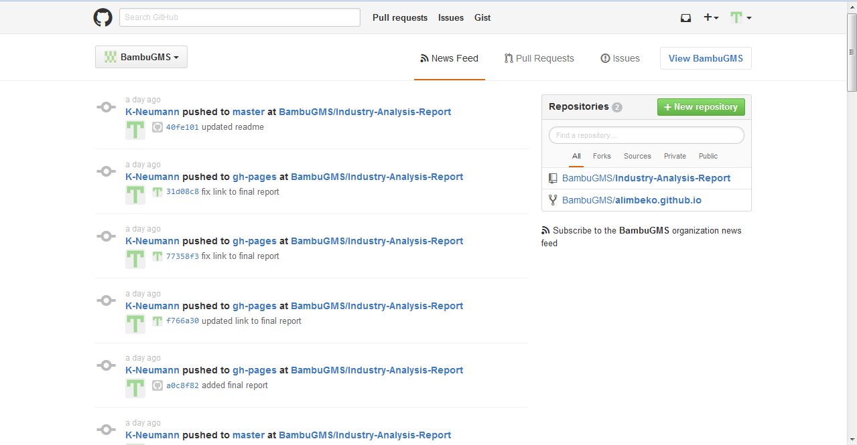
RESOURCES
ONLINE TOOLS
GitHub
Collaboration and version control tool
Website building
Teambition
Project management, collaborate, share
SOFTWARE
MS Office
Writing, presenting
Atom
Editor for Markdown files, enable preview, standardization
Citavi
Reference manager
Notes:
GitHub: collaborate with whole class, website free, language easy
Teambition: set deadlines for ourselves, shared resources
Office: chose Word everybody can use it have it, Indesign and Latex weren‘t options cause not everybody could work with it
Atom: keep track with meetingminutes, used because of markdown preview
Citavi: add papers and websites easily, with word plugin add references in document, consistency in all references

Slide 7
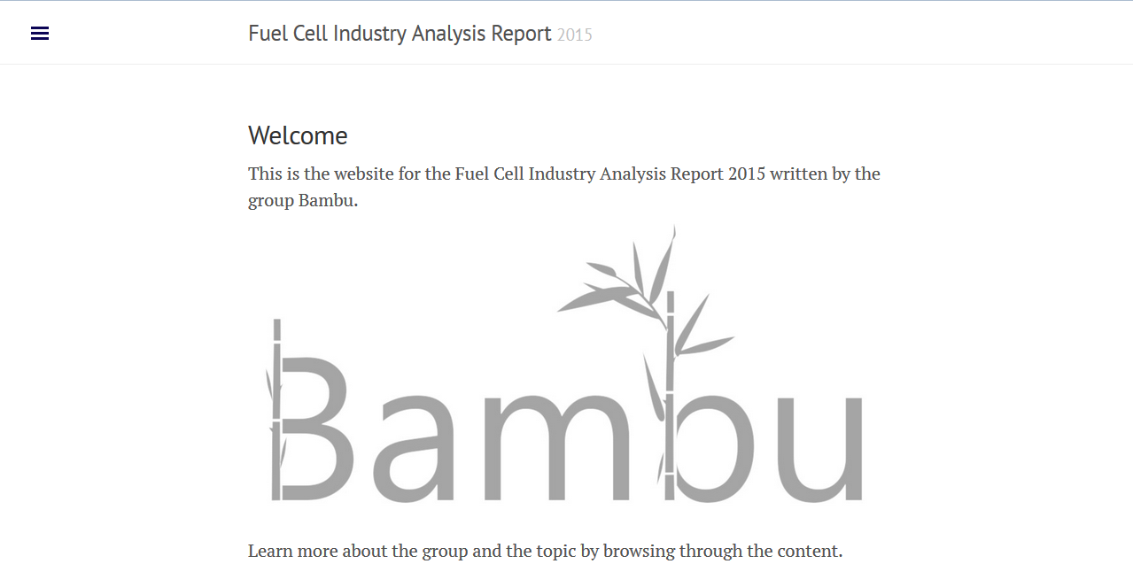
Website
Notes:
Website: make report available online, simple intro about each topic, download report, link to giutHub for further collaboration

Slide 8
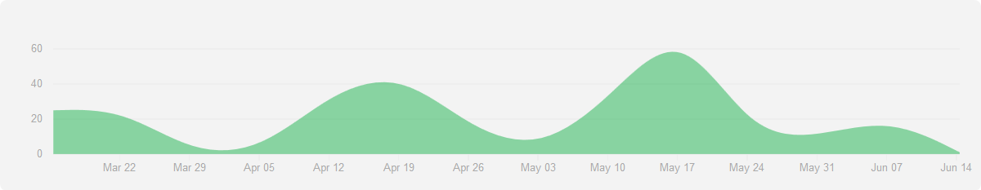
WORK PROCESS
Continuously weekly meetings
Started review of first drafts
First class, group building, Kick off,
Find a topic
Assigned a new teammember
Start to layout the document,
Data collection
Midterms and May holiday
Assigned teammember drops class
Start to create webpage
Finished report
Contributions to GitHub Repository BambuGMS/Industry-Analysis-Report from 15.03.2015-14.06.2015
Notes:
Go through points
Changed outline because member dropped class

Slide 9
THANK YOU FOR YOUR ATTENTION!
Feel free to ask questionS

