Slide 1
BAMBU- WEEK 12 PROGRESS REPORT
Global Manufacturing Strategy

Slide 2
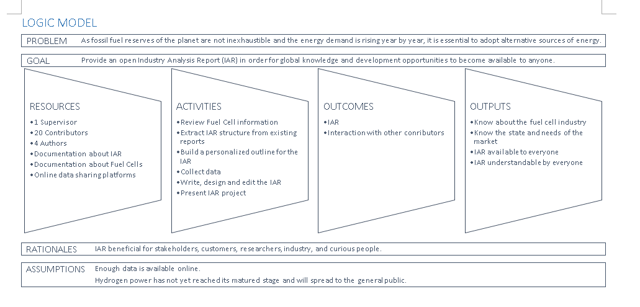
Logic Model

Slide 3
List of Variables
In accordance with 3T- MODEL

Slide 4
List of Variables : 1) Technology
Fuel Types
Power Output
Efficiency
Applications
Production Capacity
System Stability
Operation and Maintenance
Distribution Energy Resources (DER)
Fuel delivery module (fuel processor or a hydrogen storage tank)

Slide 5
List of Variables : 2) Tolerance
Implementation
Region
Safety
Distance per fuel load (only in transport application)
Price of Fuel
Device Portability
Supply Limit
Market size
Regulations
Social Policy
Ergonomics

Slide 6
List of Variables : 3) Talent
Governmental incentives
Access to Universities
Military interest
R&D Focus of Companies
Salary
Global Awareness
Expertise
Environmental Exposure

Slide 7
PROCESS DATA
Activity traces on github.com

Slide 8
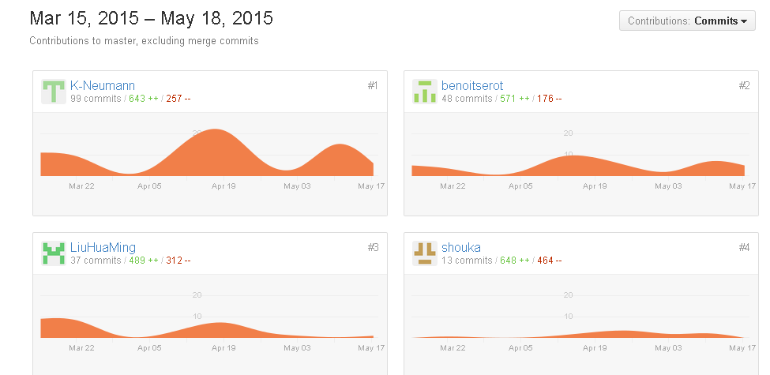
Process Data

