Slide 1

FUEL CELLS

Slide 2
LOGIC MODEL
Resources
4 Team members
Activities
Read IAR, extract structure
Outcomes
IAR
Lab & Supervisor
Documentation about IAR
Documentation about fuel cells
Office supplies
Outputs
Have knowledge about global fuel cell industry (e.g. technology, application, manufacturers, risks, opportunities
Build a structure for our IAR
Read about fuel cell and surrounding industry
Collect data
Collaboration with chemistry lab
Being able to identify needs of the market
Ability to write an IAR
IAR available for other people
Interact with the chemistry lab

Slide 3
INTRODUCTION
Intention of this report:
Provide public information about fuel cells
Discuss fuel cell as an alternative
Give a short industry overview
Developement of large stationary fuel cells
Commercial use as portable energy source
Honda is leasing first fuel cell vehicle
Discovery of the principle
First use in in submarines
„Gas battery“ as first fuel cell
First use in space missions
Commerzialisation of micro fuel cells
1801
1839
1960s
1980s
1990s
2007
2008
2009

Slide 4
PRODUCT PERSPECTIVES
Questions | Indicators | Data collection
 |  | sources | methods | timing
How do fuel cells work? | Concepts; Principles; | Web resources; Student’s lab | Document Review; Interview | 10.04.2015
What are the different types of fuel cells? | Number of products; | Web resources; | Document Review; | 15.04.2015
What are their characteristics? | Technical indicators; | Web resources; | Document Review; | 15.04.2015
What are the main applications for fuell cells? | Type of services; | Web resources; | Document review; | 20.04.2015

Slide 5
PRODUCT PERSPECTIVES
MAIN PRINCIPLE
Combine Hydrogen and Oxygen to produce electricity
PROBLEM
Where to find Hydrogen?
Hydrogen
Water
Oxygen

Slide 6
PRODUCT PERSPECTIVES
TYPE | TEMPERATURE (°C) | Fuel | Electrolyte
PEMFC | 40-90 | H₂ (/CO₂) | Polymer
AFC | 40-200 | H₂ | KOH
DMFC | 60-130 | Methanol | Polymer
PAFC | 200 | H₂ (/CO₂) | Phosphoric Acid
MCFC | 650 | CH₄, H₂, CO₂ | Molten Carbonate
SOFC | 600-950 | CH₄, H₂, CO₂ | Solid Oxide
Noble metals
Non-metals/ Non-noble metals
Non-noble metals

Slide 7
PRODUCT PERSPECTIVES

Slide 8
PRODUCT PERSPECTIVES
TRANSPORTATION | PORTABLE | STATIONNARY
Forklift trucks and other goods handling vehicles | Military applications | Off-line short run-time systems for telecommunication base stations
Two- and three-wheeler vehicles | Auxiliary Power Units (APU) | Off-line extended run-time systems for critical communication base stations
Light duty vehicles (LDVs), such as cars and vans | Portable products | Off-line extended run-time rack mountable systems for data centres
Buses and trucks |  | On-line rack mountable systems for data centres
Trains and trams |  | Off-line systems for residential use
Ferries and smaller boats
Manned light aircraft
Unmanned vehicles

Slide 9
MARKET PERSPECTIVES
Questions | Indicators | Data collection
 |  | sources | methods | timing
What was the state of the industry in 2014? (before 2015) | MW sold; Units shipped; Leading countries; Market leaders; Incentives; | Older Industry analysis reports; | Document review; | 30.04.2015
Which factor(s) caused Japan to became the world’s leading market in FC? | Country Energy Plan ;Related Governmental Policies; Corporate Fundings | Online Resources | Document review; | 30.04.2015

Slide 10

MARKET PERSPECTIVES - ASIA
Asia
Asia is currently the leading market for fuel cells.
-Japan
Biggest Market in terms of units.
- South Korea
Biggest Market in terms of Megawatts.

Slide 11

MARKET PERSPECTIVES - EUROPE
Europe :
Large and diverse fuel cell industry.
- Research Institutes are researching fuel cells
- Big markets for fuel cell buses and cars
- Germany is currently the biggest market for stationary fuel cells

Slide 12

MARKET PERSPECTIVES – N.A.
North America :
Fuel cell bus delivery demo program taking place in British Columbia.
Fuel cell electric vehicles are running on the streets of southern California, the government also installed a few FC stations.
FC used as backup power source for the telecom segment.

Slide 13
MARKET PERSPECTIVES - ROW
Caribbean region- off grid power FC
Brazil – FC Public Buses
Australia – minor market with various FC imports
South African region- telecom backup & portable FC

Slide 14
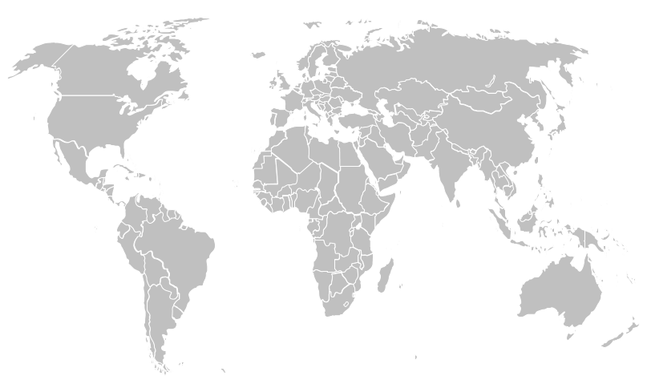
MARKET PERSPECTIVES- CONCLUSION
Megawatts by Regions
Megawatts | 2009 | 2010 | 2011 | 2012 | 2013 | 2014
Europe | 2.9 | 5.8 | 9.4 | 17.3 | 17.3 | 10.4
North America | 37.6 | 42.5 | 59.6 | 61.5 | 74.7 | 52.3
Asia | 45.3 | 42.5 | 39.6 | 86.1 | 122.9 | 112.4
Rest of World | 0.7 | 0.4 | 0.8 | 1.8 | 0.4 | 1.0
Total | 86.5 | 91.2 | 109.4 | 166.7 | 215.3 | 176.0

Slide 15
LAW AND GOVERNMENTAL INFLUENCE
Questions | Indicators | Data collection
 |  | sources | methods | timing
What are the governmental influences? | Law; subsidies; active support; | Laws; newspapers; web resources; | Document Review; | 29.04.2015
In which degree the influence is different between the countries? | Law; subsidies; active support; | Laws; newspapers; web resources; | Document Review; | 29.04.2015

Slide 16
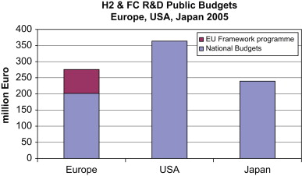
LAW AND GOVERNMENTAL INFLUENCE
Compare institutional environment
Starting point for research: USA, Japan, Germany (EU)
Including subsidies and other governmental support or discouragement

Slide 17
COMPARISON WITH OTHER TECHNOLOGIES
Questions | Indicators | Data collection
 |  | sources | methods | timing
What are the alternative technologies? | Products; Concepts; | Web resources; | Document Review; | 29.04.2015
What is the trend for each of those technologies in the last years? | Sales Volume; | Web resources; | Document Review; | 29.04.2015
Compared to fuel cells, what are advantages/disadvantages of those technologies? | Product characteristics; | Web resources; | Document Review; | 29.04.2015

Slide 18
COMPARISON WITH OTHER TECHNOLOGIES
batteries
Super capacitors
fuel cells
thermo electrics,
superconductors
lighting
hydrogen technologies.
They compete with each other mostly on: usage , cost, safety aspects, standards and regulations.
Also policies of different nations and regions are important.

Slide 19
COMPARISON WITH OTHER TECHNOLOGIES
Advantages of hydrogen energy in fuel cell:
Readily Available
No Harmful Emissions
Environment Friendly
Used as Fuel in Rockets
Fuel Efficient
Renewable
Disadvantages of hydrogen energy in fuel cell :
Expensive
Storage
Not Easy to Replace Existing Infrastructure
Highly Flammable
Dependency on Fossil Fuels
Challenges of hydrogen fuel cell:
fuel cell cost and durability
Hydrogen storage and the range of that
Hydrogen cost and delivery

Slide 20
FUTURE PERSPECTIVE
Questions | Indicators | Data collection
 |  | sources | methods | timing
What are the innovation fields? | Company names; Projects; | Web resources; | Document Review; | 20.05.2015
What is the sales forecast? | Forecasted sales volume; | Web resources; | Document Review; | 20.05.2015
What is the next awaited milestone? | Opinion of experts; date; | Web resources; | Document Review; | 20.05.2015

