Slide 1
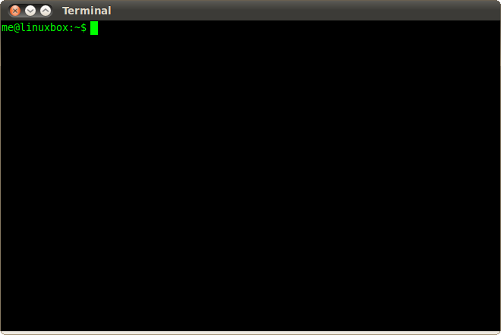
Bash Scripting

Slide 2
Bash
Bourne Again Shell.
It is a scripting language.
allowing users to write sequences of commands in a file, known as a script.
File Extension: .sh
For example:
myscript.sh

Slide 3
Hello World in Bash
To print something to the terminal in Bash, you can use the echo command.

Slide 4

Variables
variable is a container used to store data or values

Slide 5
Variable Declaration
my_number=42
echo "The value of my_number is $my_number"

Slide 6
data types
Supports mainly three data types.
string
integer
array

Slide 7
String
String: Strings are sequences of characters.
Example: name="John"

Slide 8
Integer
Bash can handle integer arithmetic.
Example: age=25

Slide 9
Array
Arrays are used to store multiple values under a single variable.
Example: numbers=(10 20 30)

Slide 10
If Statements
if statements are used to conditionally execute a block of code based on the success or failure of a test command
Example:
number=10
# Simple if statement
if [ $number -eq 10 ]; then
echo "The number is 10."
fi

Slide 11
if-else Statements
if-else statement allows you to execute different blocks of code based on whether a condition is true or false.
Example:
number=5
# If-else statement
if [ $number -eq 10 ]; then
echo "The number is 10."
else
echo "The number is not 10."
fi

Slide 12
Loops
Loops in programming are control structures that allow you to repeatedly execute a block of code.
Why Loops?
Loops help you execute a block of code repeatedly, saving you from writing the same code over and over.

Slide 13
Two common types of loops
for Loop
while Loop

Slide 14
For loop
The for loop is used to iterate over a sequence, such as a range of numbers or elements in an array.
Syntax:
for variable in list
do
# Code to be executed for each iteration
done

Slide 15
while loop
The while loop in Bash is used to repeatedly execute a block of code as long as a specified condition is true
Syntax:
while [ condition ]
do
# Code to be executed while the condition is true
done

Slide 16
Function
In Bash, a function is a block of code that can be defined and executed within a script. Functions provide a way to organize and reuse code, making scripts more modular and maintainable
Syntax:
function function_name {
# Code to be executed
}
# Call the function
function_name

Slide 17
Input and output
The read command allows you to interactively take input from the user.
The echo command is used to print text to the terminal.
# Example script (input_script.sh)
echo "Enter your name:"
read username
echo "Hello, $username!"

Slide 18
working with files
Creating a File
Writing to a File
Appending to a File
Reading a File
Copying a File
Moving/Renaming a File
Deleting a File

Slide 19
working with directory
Creating a Directory
Listing Contents of a Directory
Changing Directory
Copying a Directory
Moving/Renaming a Directory
Deleting a Directory
Checking File Types

Slide 20
awk
In Bash, awk is used as a command-line tool for processing and analyzing text data.
Syntax:
awk 'pattern { action }' filename
pattern: Specifies a condition or regular expression to match lines.
action: Specifies the code to be executed for lines that match the pattern.

Slide 21
sed
sed stands for "stream editor," and it is a powerful and versatile text-processing tool in Unix-like operating systems. sed is designed for parsing and transforming text streams on the command line or in scripts. It allows you to perform basic text manipulations, such as search and replace, insertion, deletion, and more.
Syntax:
sed 'command' filename

Slide 22
Command-Line Arguments
command-line arguments are values that you pass to a script or a command when you run it from the terminal.
Example:
#!/bin/bash
echo "Script Name: $0"
echo "First Argument: $1"
echo "Second Argument: $2"
echo "Total number of arguments: $#"
echo "All arguments: $@"

Slide 23
Array
In Bash, arrays are used to store lists of values.
Elements are accessed using their index, starting from 0.
Syntax:
array_name=(value1 value2 value3 ... valueN)

Slide 24
Example
#!/bin/bash
# Declaring an array
fruits=("Apple" "Banana" "Orange" "Grapes")
# Accessing array elements
echo "First fruit: ${fruits[0]}"
echo "Second fruit: ${fruits[1]}"
# Length of the array
echo "Number of fruits: ${#fruits[@]}"

Slide 25
Thanks
Presentation by
Twinkle

