Slide 1
Machine Learning Practice
8. Optimization algorithm

Slide 2
References
Andrew Ng’s ML class
https://class.coursera.org/ml-003/lecture
http://www.holehouse.org/mlclass/ (note)
Convolutional Neural Networks for Visual Recognition.
http://cs231n.github.io/
Tensorflow
https://www.tensorflow.org
https://github.com/aymericdamien/TensorFlow-Examples
모두의 머신러닝
Wikipedia
Neural Network and Deep Learning, Michael Nielsen,
http://neuralnetworksanddepplearning.com

Slide 3
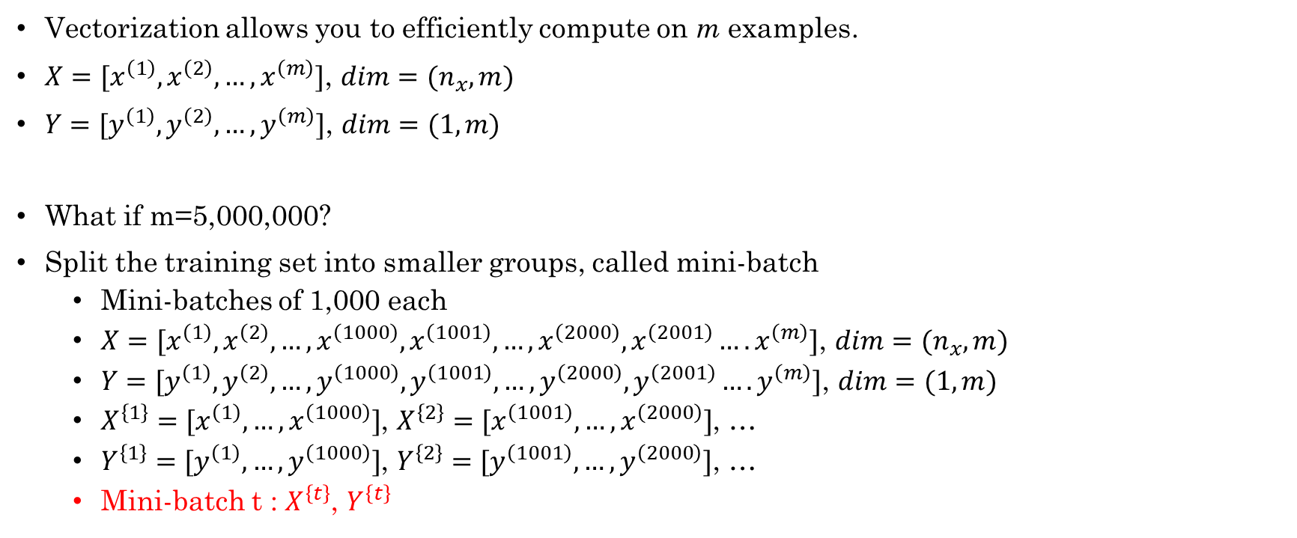
Mini-batch gradient descent vs. batch GD
Vectorization allows you to efficiently compute on m examples.
$X=[x^{\left(1\right)},x^{\left(2\right)},…, x^{\left(m\right)}]$, $dim=(n_{x},m)$
$Y=[y^{\left(1\right)},y^{\left(2\right)},…,y^{\left(m\right)}]$, $dim=(1,m)$
What if m=5,000,000?
Split the training set into smaller groups, called mini-batch
Mini-batches of 1,000 each
$X=[x^{\left(1\right)},x^{\left(2\right)},…,x^{\left(1000\right)},x^{\left(1001\right)},…,x^{\left(2000\right)},x^{\left(2001\right)}….x^{\left(m\right)}]$, $dim=(n_{x},m)$
$Y=[y^{\left(1\right)},y^{\left(2\right)},…,y^{\left(1000\right)},y^{\left(1001\right)},…,y^{\left(2000\right)},y^{\left(2001\right)}….y^{\left(m\right)}]$, $dim=(1,m)$
$X^{\left\{1\right\}}=[x^{\left(1\right)}, …,x^{\left(1000\right)}]$, $X^{\left\{2\right\}}=[x^{\left(1001\right)}, …,x^{\left(2000\right)}]$, …
$Y^{\left\{1\right\}}=[y^{\left(1\right)}, …,y^{\left(1000\right)}]$, $Y^{\left\{2\right\}}=[y^{\left(1001\right)}, …,y^{\left(2000\right)}]$, …
Mini-batch t : $X^{\left\{t\right\}}$, $Y^{\left\{t\right\}}$

Slide 4

Mini-batch gradient descent
repeat{
for t=1,…,5000{
Forwardprop on $X^{\left\{t\right\}}$
$Z^{\left[1\right]}=W^{\left[1\right]}X^{\left\{t\right\}}+b^{\left[1\right]}$
$A^{\left[1\right]}={g^{\left[1\right]}(Z}^{\left[1\right]})$
…
$A^{\left[L\right]}={g^{\left[L\right]}(Z}^{\left[L\right]})$
Compute cost $J^{\left\{t\right\}}=\frac{1}{1000}\sum_{i=1}^{1000}{L\left({\hat{y}}^{\left(i\right)}−y^{\left(i\right)}\right)+\frac{λ}{2⋅1000}{{\sum_{l}{\left\|w^{\left[l\right]}\right\|}}^{2}}_{F} }$
Backprop to compute gradient w.r.t. $J^{\left\{t\right\}}$ using ($X^{\left\{t\right\}},Y^{\left\{t\right\}}$)
$W^{\left[l\right]}=W^{\left[l\right]}−αdW^{\left[l\right]}$, $b^{\left[l\right]}=b^{\left[l\right]}−αdb^{\left[l\right]}$
} # 1epoch : pass through a training set
}

Slide 5
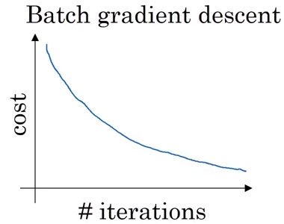
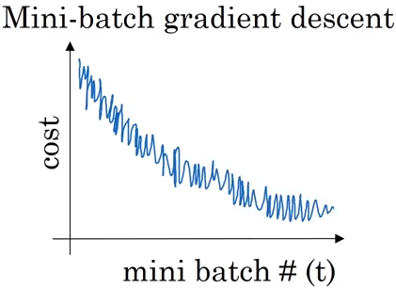
Understanding Mini-batch GD
Oscillations in mini-batch plot is caused by
For example, maybe X^{{1}}, Y^{{1}} is just an easy mini batch so your cost might be a bit lower, but then maybe just by chance, X^{{2}}, Y^{{2}} is just a harder mini batch.

Slide 6
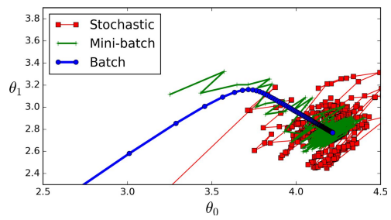
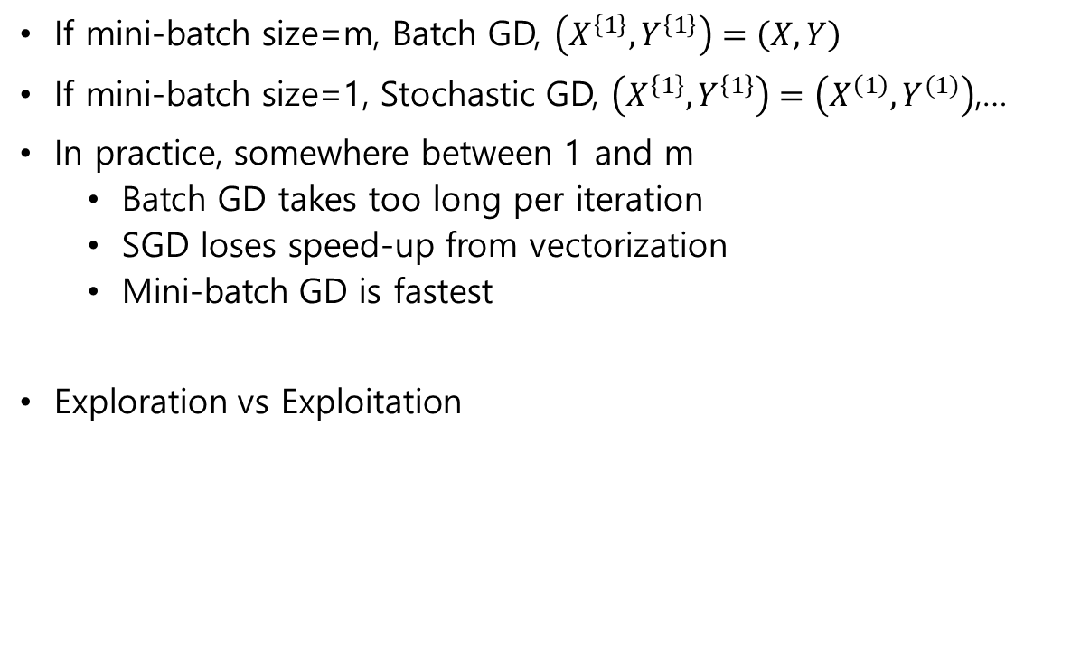
Choosing mini-batch size
If mini-batch size=m, Batch GD, $\left(X^{\left\{1\right\}},Y^{\left\{1\right\}}\right)=\left(X,Y\right)$
If mini-batch size=1, Stochastic GD, $\left(X^{\left\{1\right\}},Y^{\left\{1\right\}}\right)=\left(X^{\left(1\right)},Y^{(1)}\right)$,…
In practice, somewhere between 1 and m
Batch GD takes too long per iteration
SGD loses speed-up from vectorization
Mini-batch GD is fastest
Exploration vs Exploitation

Slide 7

Choosing mini-batch size
If you have a small training set ($m<2000)$, use batch GD
Typical mini-batch sizes: 64, 128, 256, 512
Make sure mini-batch $(X^{\left\{t\right\}},Y^{\left\{t\right\}})$ fit in CPU/GPU memory (OOM : out of memory)

Slide 8
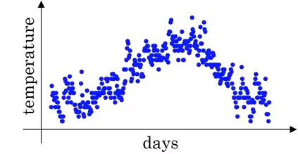
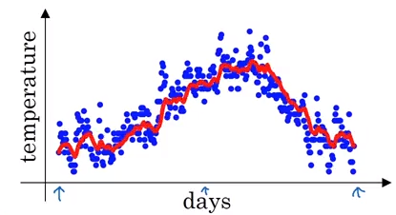
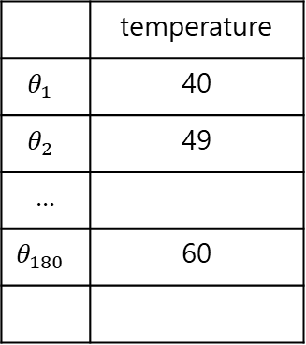
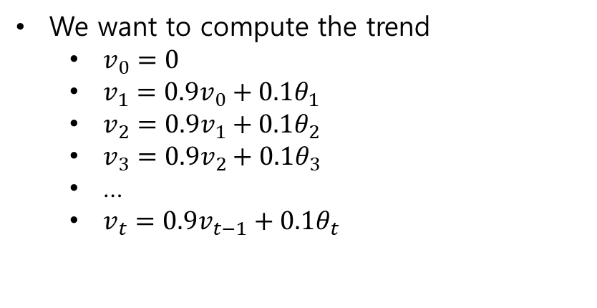
Optimization algorithm : exponentially weighted average
 | temperature
$$θ_{1}$$ | 40
$$θ_{2}$$ | 49
…
$$θ_{180}$$ | 60
We want to compute the trend
$v_{0}=0$
$v_{1}=0.9v_{0}+0.1θ_{1}$
$v_{2}=0.9v_{1}+0.1θ_{2}$
$v_{3}=0.9v_{2}+0.1θ_{3}$
…
$v_{t}=0.9v_{t−1}+0.1θ_{t}$

Slide 9
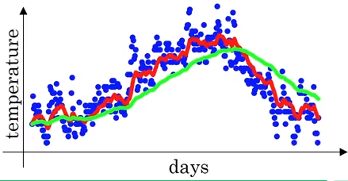
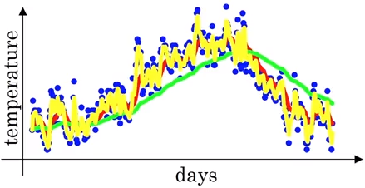

Optimization algorithm : exponentially weighted average
$v_{t}=βv_{t−1}+(1−β)θ_{t}$
$v_{t}$ is an approximate average over $≈\frac{1}{1−β }$ days’ temperature
E.g, $β=0.9$ : $≈10$ days’ temperature (red)
E.g, $β=0.98$ : $≈50$ days’ temperature (green)
E.g, $β=0.5$ : $≈2$ days’ temperature (yellow)

Slide 10


Understanding exponentially weighted average
$$θ_{t}$$
$v_{t}=βv_{t−1}+(1−β)θ_{t}$
$v_{100}=βv_{99}+(1−β)θ_{100}$
$v_{99}=βv_{98}+\left(1−β\right)θ_{99}$
$v_{98}=βv_{97}+\left(1−β\right)θ_{98}$
…
→
$v_{100}=βv_{99}+\left(1−β\right)θ_{100}=β\left(βv_{98}+\left(1−β\right)θ_{99}\right)+\left(1−β\right)θ_{100}=β^{2}v_{98}+β\left(1−β\right)θ_{99}+\left(1−β\right)θ_{100}$
$=β^{2}\left(βv_{97}+\left(1−β\right)θ_{98}\right)+β\left(1−β\right)θ_{99}+\left(1−β\right)θ_{100}=β^{3}v_{97}+β^{2}\left(1−β\right)θ_{98}+β\left(1−β\right)θ_{99}+\left(1−β\right)θ_{100}$
=$β^{100}v_{0}+β^{99}\left(1−β\right)θ_{1}+…+\left(1−β\right)θ_{100}$
When $β=0.9$, then ${0.9}^{10}≈0.35≈\frac{1}{e}$
Here, ${\left(1−ε\right)}^{1/ε}=\frac{1}{e}$
v
v
v
v
v
weights

Slide 11

Implementing exponentially weighted averages
$v_{θ}=0$
$v_{θ}=βv_{θ}+\left(1−β\right)θ_{1}$
$v_{θ}=βv_{θ}+\left(1−β\right)θ_{2}$
…
$v_{θ}=0$
repeat{
Get next $θ_{t}$
$v_{θ}=βv_{θ}+\left(1−β\right)θ_{t}$
}
One advantage is that it needs a very little memory

Slide 12
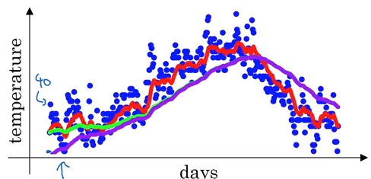
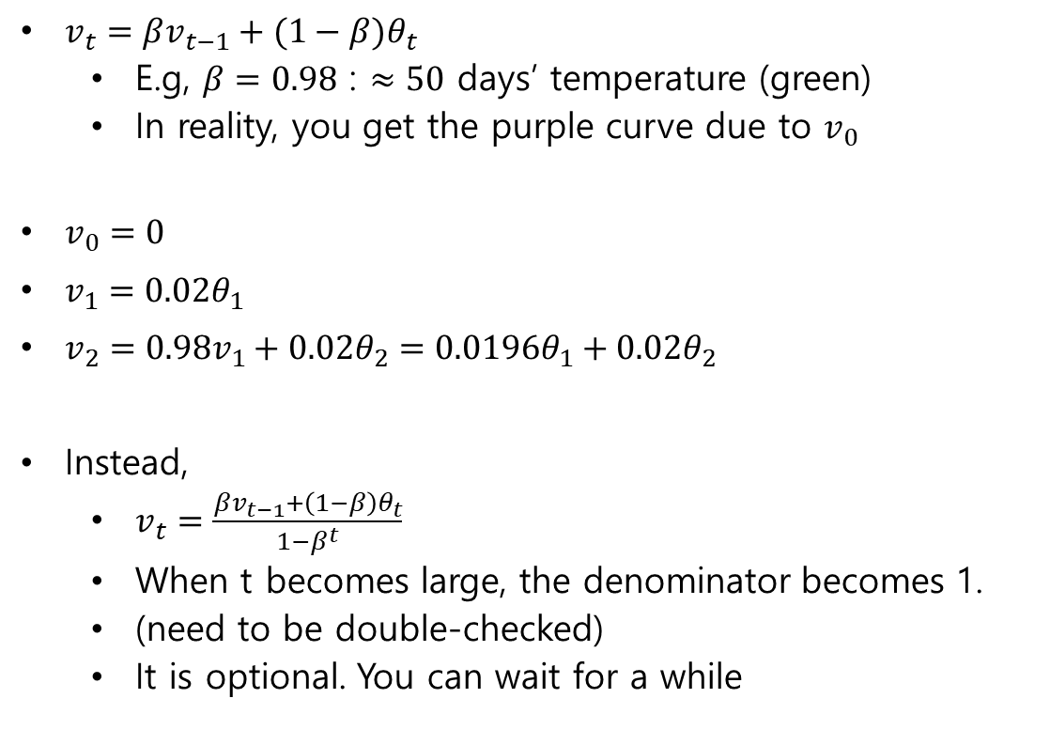
Implementing exponentially weighted averages
$v_{t}=βv_{t−1}+(1−β)θ_{t}$
E.g, $β=0.98$ : $≈50$ days’ temperature (green)
In reality, you get the purple curve due to $v_{0}$
$v_{0}=0$
$v_{1}=0.02θ_{1}$
$v_{2}=0.98v_{1}+0.02θ_{2}=0.0196θ_{1}+0.02θ_{2}$
Instead,
$v_{t}=\frac{βv_{t−1}+\left(1−β\right)θ_{t}}{1−β^{t}}$
When t becomes large, the denominator becomes 1.
(need to be double-checked)
It is optional. You can wait for a while

Slide 13
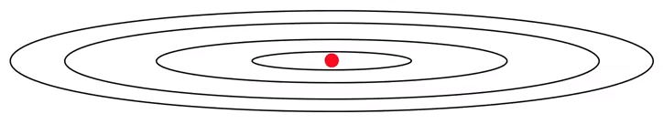
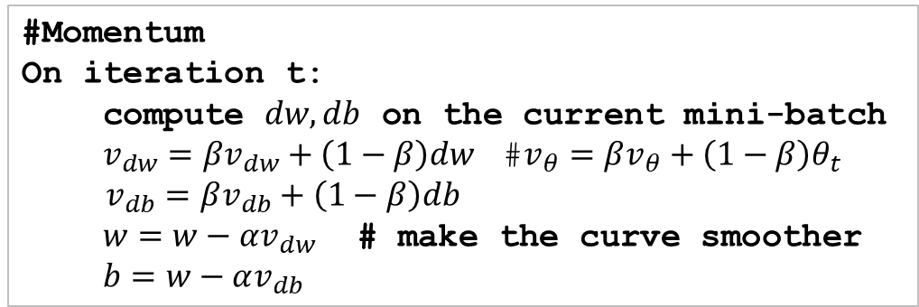
Gradient descent with momentum
Contour of a cost function with an optimal point(red)
The oscillation of GD slows down learning and prevents you from using a larger learning rate
On the vertical axis, you want slow learning. On the other hand, on the horizontal axis, you want fast learning.
#Momentum
On iteration t:
compute $dw,db$ on the current mini-batch
$v_{dw}=βv_{dw}+\left(1−β\right)dw$ #$v_{θ}=βv_{θ}+\left(1−β\right)θ_{t}$
$v_{db}=βv_{db}+\left(1−β\right)db$
$w=w−αv_{dw}$ # make the curve smoother
$b=w−αv_{db}$

Slide 14
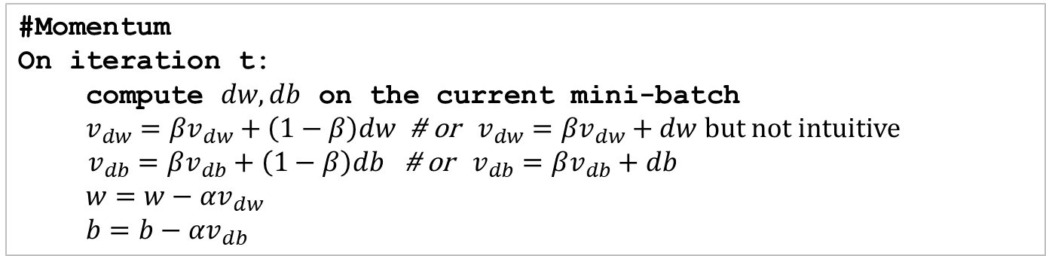
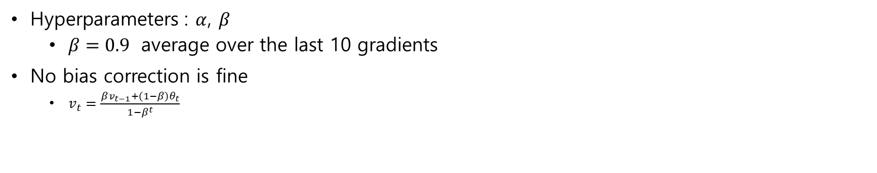
Implementation
#Momentum
On iteration t:
compute $dw,db$ on the current mini-batch
$v_{dw}=βv_{dw}+\left(1−β\right)dw$ # or $v_{dw}=βv_{dw}+dw$ but not intuitive
$v_{db}=βv_{db}+\left(1−β\right)db$ # or $v_{db}=βv_{db}+db$
$w=w−αv_{dw}$
$b=b−αv_{db}$
Hyperparameters : $α$, $β$
$β=0.9$ average over the last 10 gradients
No bias correction is fine
$v_{t}=\frac{βv_{t−1}+\left(1−β\right)θ_{t}}{1−β^{t}}$

Slide 15
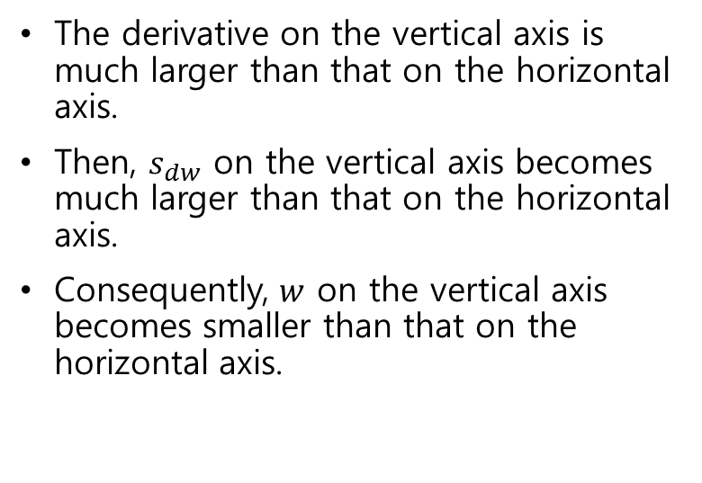
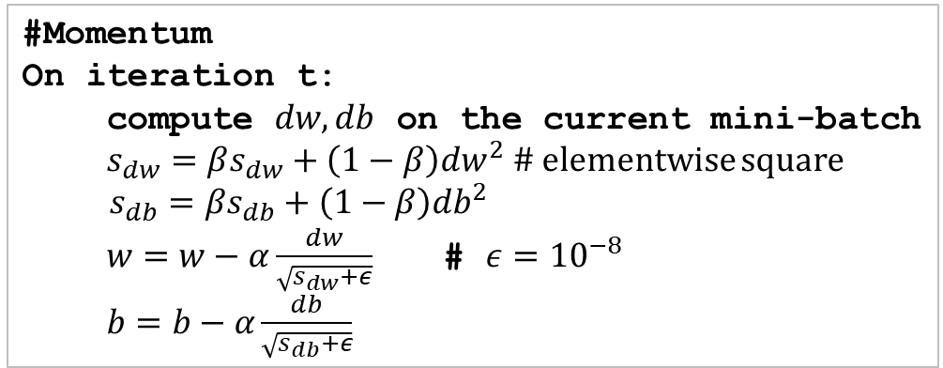
RMSprop (root mean square)
#Momentum
On iteration t:
compute $dw,db$ on the current mini-batch
$s_{dw}=βs_{dw}+\left(1−β\right)dw^{2}$ # elementwise square
$s_{db}=βs_{db}+\left(1−β\right)db^{2}$
$w=w−α\frac{dw}{\sqrt{s_{dw}+ε}}$ # $ε={10}^{−8}$
$b=b−α\frac{db}{\sqrt{s_{db}+ε}}$
The derivative on the vertical axis is much larger than that on the horizontal axis.
Then, $s_{dw}$ on the vertical axis becomes much larger than that on the horizontal axis.
Consequently, $w$ on the vertical axis becomes smaller than that on the horizontal axis.
This algorithm was created by Tijmen Tieleman and Geoffrey Hinton in 2012, and presented by Geoffrey Hinton in his Coursera class on neural networks (slides: http:// goo.gl/ RsQeis; video: https:// goo.gl/ XUbIyJ).

Slide 16
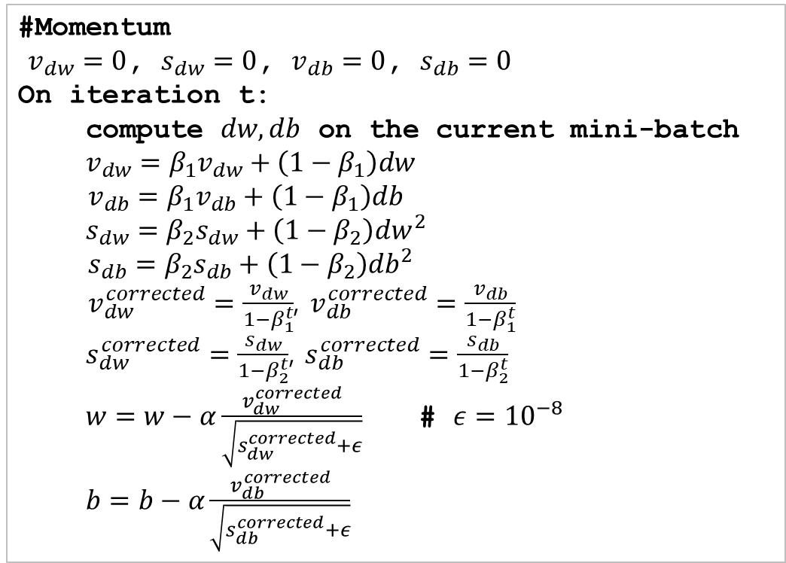

Adam optimization (adaptive moment estimation)
#Momentum
$v_{dw}=0$, $s_{dw}=0$, $v_{db}=0$, $s_{db}=0$
On iteration t:
compute $dw,db$ on the current mini-batch
$v_{dw}=β_{1}v_{dw}+\left(1−β_{1}\right)dw$
$v_{db}=β_{1}v_{db}+\left(1−β_{1}\right)db$
$s_{dw}=β_{2}s_{dw}+\left(1−β_{2}\right)dw^{2}$
$s_{db}=β_{2}s_{db}+\left(1−β_{2}\right)db^{2}$
$v_{dw}^{corrected}=\frac{v_{dw}}{1−β_{1}^{t}}$, $v_{db}^{corrected}=\frac{v_{db}}{1−β_{1}^{t}}$
$s_{dw}^{corrected}=\frac{s_{dw}}{1−β_{2}^{t}}$, $s_{db}^{corrected}=\frac{s_{db}}{1−β_{2}^{t}}$
$w=w−α\frac{v_{dw}^{corrected}}{\sqrt{s_{dw}^{corrected}+ε}}$ # $ε={10}^{−8}$
$b=b−α\frac{v_{db}^{corrected}}{\sqrt{s_{db}^{corrected}+ε}}$
Hyperparameters
$α$ : need to be tuned
$β_{1}$: 0.9 (default choice)
$β_{2}$: 0.999 (in its paper)
$ε$ : ${10}^{−8}$ (almost fixed)

Slide 17
tf.train.AdamOptimizer
__init__(
learning_rate=0.001,
beta1=0.9,
beta2=0.999,
epsilon=1e-08,
use_locking=False,
name='Adam'
)
minimize(
loss,
global_step=None,
var_list=None,
gate_gradients=GATE_OP,
aggregation_method=None,
colocate_gradients_with_ops=False,
name=None,
grad_loss=None
)

Slide 18
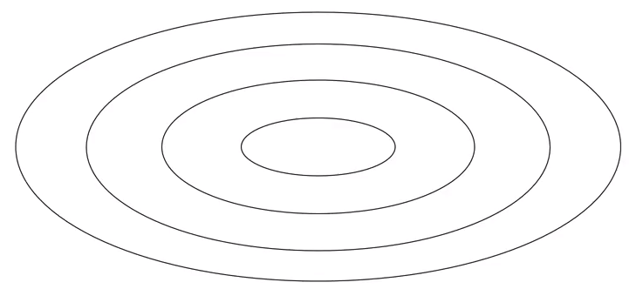
Learning rate decay
The algorithm cannot converge the minimum if its learning rate is constant.
To avoid it, the learning rate can be gradually reduced as it approaches to the minimum

Slide 19
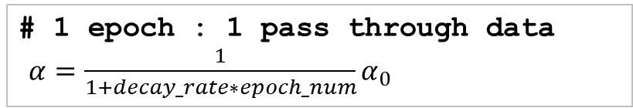
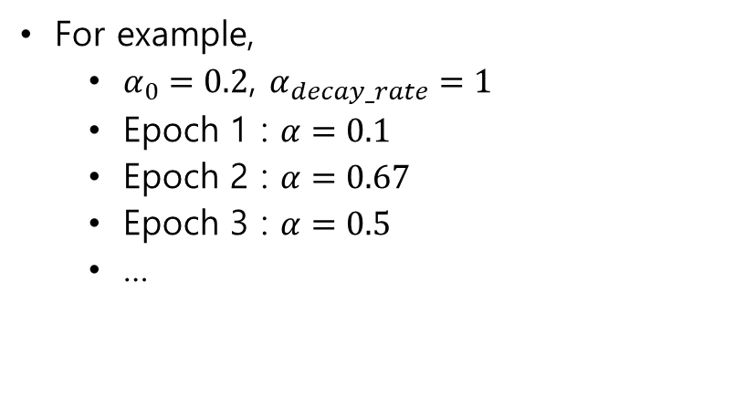
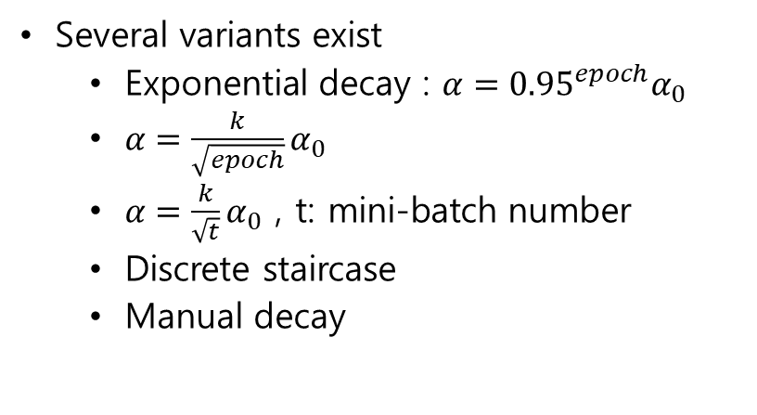
Learning rate decay implementation
# 1 epoch : 1 pass through data
$α=\frac{1}{1+decay_rate∗epoch_num}α_{0}$
Several variants exist
Exponential decay : ${α={0.95}^{epoch}α}_{0}$
$α=\frac{k}{\sqrt{epoch}}α_{0}$
$α=\frac{k}{\sqrt{t}}α_{0}$ , t: mini-batch number
Discrete staircase
Manual decay
For example,
$α_{0}=0.2$, $α_{decay_rate}=1$
Epoch 1 : $α=0.1$
Epoch 2 : $α=0.67$
Epoch 3 : $α=0.5$
…

Slide 20
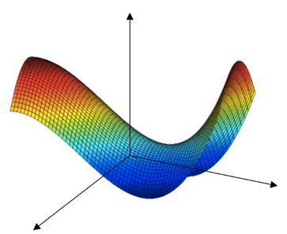
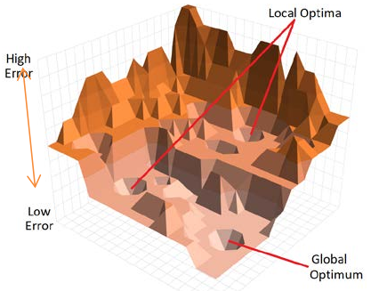
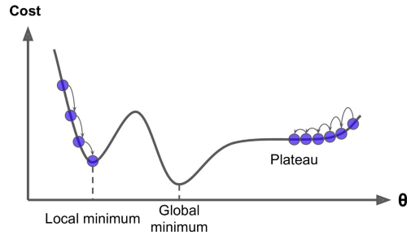
The problem of local optima
Source : How AI works by Philip Boucher (2019)
Most of points having 0 derivative are not local optima, but saddle points.
For example, 20,000 dimensions considered, the function in all directions should be convex or concave to be local optima.

Slide 21
The problem of plateaus
It is unlikely to get stuck in a bad local optima
it will take a very long time to cross the plateau, and if you stop too early you will never reach the global minimum.

Slide 22
Something to think about
By François Chollet at Google on Twitter
“A common misconception about deep learning is that gradient descent is meant to reach the "global minimum" of the loss, while avoiding "local minima". In practice, a deep neural network that's anywhere close to the global minimum would be utterly useless (extremely overfit)”
“The only setup where a global minimum has any chance to generalize is for underparameterized models, such as logistic regression, or a 1-layer network with few units. Otherwise, the points in parameter space that you are looking for during training are pretty far from the minima”
“An important research direction would be to use the information bottleneck principle to come up with models that have exactly the right amount of memorization capacity for a given task, as well as optimization methods to get to the global optimum”

