Slide 1
Machine Learning Practice
Introducing TensorFlow (1.4)

Slide 2
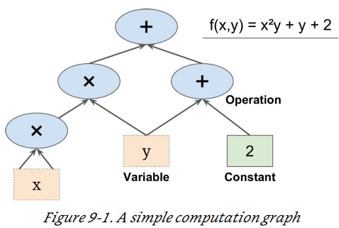
TensorFlow (Since Nov. 2015)
Open source software library, designed by Google, for numerical computation, particularly well suited and fine-tuned for large-scale Machine Learning.
(1) define in Python a graph of computations to perform
(2) then TensorFlow takes that graph and runs it efficiently using optimized C++ code.
Most importantly, it is possible to break up the graph into several chunks and run them in parallel across multiple CPUs or GPUs
Visit www.tensorflow.org

Slide 3
TensorFlow
Run on Windows, Linux, macOS, iOS, Android
Provides a simply Python API, TF.Learn (tensorflow.contrib.learn) compatible with Scikit-Learn (previously an independent project called Scikit flow)
Also provides another API, TF-slim, (tensorflow.contrib.slim)
Several other high-level APIs have been built independently on Tensorflow, e.g., (tensorflow.contrib.keras) Keras
Python API offers flexibility (at the cost of higher complexity) to build any NN architecture
Highly efficient C++ implementation of many ML operations
Provides several advanced optimization nodes (automatic differentiating)
TensorBoard (visualization tool)
Google’s cloud service at https://cloud.google.com/ml-engine/
Check https://www.tensorflow.org, https://github.com/jtoy/awesome-tensorflow etc.

Slide 4
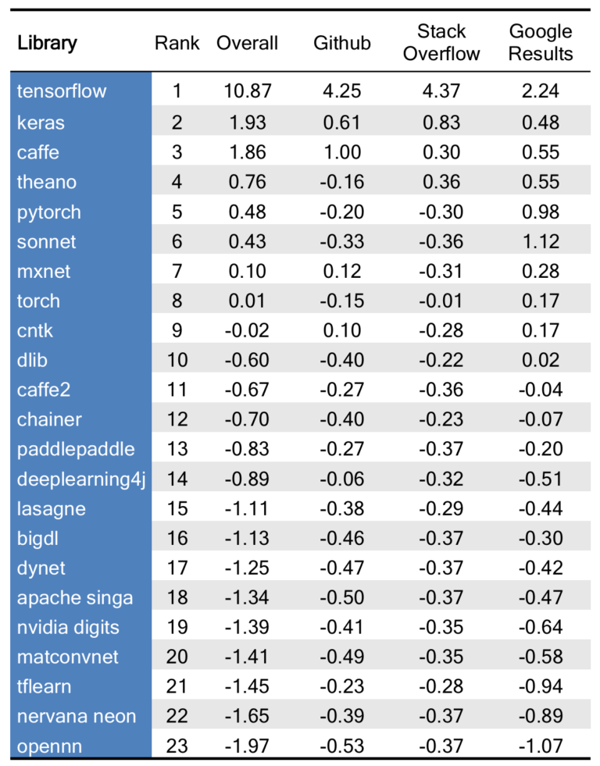
Deep learning libraries
https://blog.thedataincubator.com/2017/10/ranking-popular-deep-learning-libraries-for-data-science/
Table is a ranking of 23 open-source deep learning libraries that are useful for Data Science, based on Github and Stack Overflow activity, as well as Google search results

Slide 5
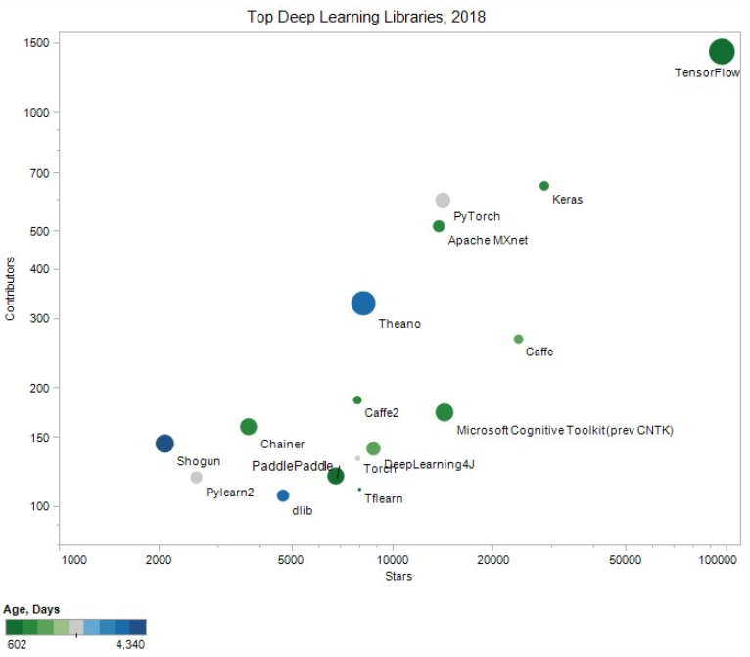
Deep learning libraries
By all measures, TensorFlow is the undisputed leader. Keras, Caffe, Microsoft Cognitive Toolkit, and PyTorch completing the top five.

Slide 6
Install TensorFlow
Provided in a separate document

Slide 7
References
https://www.tensorflow.org/
https://www.tensorflow.org/api_docs/
Stanford cs20si
Ref: 텐서플로 기초 이해하기, by 문용준
https://www.slideshare.net/dahlmoon/20160623-63318427

Slide 8
Tensor and Graph
import tensorflow as tf
tf.reset_default_graph()
a = tf.add(3, 5)
writer = tf.summary.FileWriter('./graphs', tf.get_default_graph())
writer.close()
Go to terminal and run
$ python3 [yourprogram].py $ tensorboard --logdir="./graphs" --port 6006
Then open your browser and go to: http://localhost:6006/

Slide 9
Tensor and Graph
import tensorflow as tf
tf.reset_default_graph()
a = tf.add(3, 5)
writer = tf.summary.FileWriter('./graphs', tf.get_default_graph())
writer.close()
Tensor : An n-dimensional array
0-d tensor : scalar
1-d tensor : vector
2-d tensor : matrix
For example, a 2-by-3-by-2 tensor is [[[1,2], [3,4], [5,6]], [[7,8], [9,10], [11,12]]], which can be thought of as two matrices, each of size 3-by-2. Consequently, we say this tensor has a rank of 3.

Slide 10
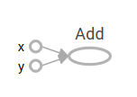
Tensor and Graph
import tensorflow as tf
tf.reset_default_graph()
a = tf.add(3, 5)
writer = tf.summary.FileWriter('./graphs', tf.get_default_graph())
writer.close()
TF automatically names the nodes when you don’t explicitly name them, e.g., a=3, a=5

Slide 11
Tensor and Graph
import tensorflow as tf
tf.reset_default_graph()
x = 3
z = 5
a = tf.add(x, z)
writer = tf.summary.FileWriter('./graphs', tf.get_default_graph())
writer.close()

Slide 12

Tensor and Graph
import tensorflow as tf
tf.reset_default_graph()
x = tf.constant(3)
z = tf.constant(5)
print(x)
print(z)
a = tf.add(x, z)
writer = tf.summary.FileWriter('./graphs', tf.get_default_graph())
writer.close()
How to name x and z as we want?
How to get the value of x and z?

Slide 13
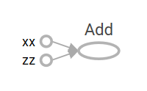
Tensor and Graph
import tensorflow as tf
tf.reset_default_graph()
x = tf.constant(3, name='xx')
z = tf.constant(5, name='zz')
a = tf.add(x, z, name='Add')
writer = tf.summary.FileWriter('./graphs', tf.get_default_graph())
sess = tf.Session()
print(sess.run(x))
print(sess.run(z))
print(sess.run(a))
sess.close()
writer.close()
Create as session
Within a session, evaluate the graph to fetch the value of the variables

Slide 14
Tensor and Graph
import tensorflow as tf
tf.reset_default_graph()
x = tf.constant(3, name='xx')
z = tf.constant(5, name='zz')
a = tf.add(x, z)
writer = tf.summary.FileWriter('./graphs', tf.get_default_graph())
with tf.Session() as sess:
print(sess.run([x, z, a]))
writer.close()
tf.Session()
A Session object encapsulates the environment in which Operation objects are executed, and Tensor objects are evaluated.
Session will also allocate memory to store the current values of variables.
With : __enter__() & __exit__()
About “with” : http://effbot.org/zone/python-with-statement.htm

Slide 15

Executing operators with sessions
A session sets up how the hardware devices (such as CPU and GPU) talk to each other. Of course, you can later configure the session to change its behavior without changing a line of the machine learning code.
To execute an operation and retrieve its calculated value, TensorFlow requires a session. To do so, you must create a session class using tf.Session() and tell it to run an operator.
import tensorflow as tf
tf.reset_default_graph()
x = tf.constant([[1., 2.]]) #Define an arbitrary matrix
neg_op = tf.negative(x) #Run the negation operator on it
writer = tf.summary.FileWriter('./graphs', tf.get_default_graph())
with tf.Session() as sess: # Start a session to be able to run operations
result = sess.run(neg_op) # Tell the session to evaluate negMatrix
print(result)
print(neg_op)
print(neg_op.eval())
writer.close()
tf.Session.run( fetches, feed_dict=None, options=None, run_metadata=None)
: Runs operations and evaluates tensors in fetches.
The fetches argument may be a single graph element, or an arbitrarily nested list, tuple, namedtuple, dict, or OrderedDict containing graph elements at its leaves.
Return: Either a single value if fetches is a single graph element, or a list of values if fetches is a list, or a dictionary with the same keys as fetches if that is a dictionary

Slide 16
Understanding code as a graph
Every operator is a strongly typed function that takes input tensors of a dimension and produces output of the same dimension. So, whenever you see a plus symbol “+” or any mathematical concept, just picture it as one of many nodes.
The edges between these nodes represent the composition of mathematical functions.
Specifically, the negative operator we’ve been studying so far is a node, and the incoming/outgoing edges of this node are how the Tensor transforms.
TensorFlow algorithms are easy to visualize. They can be simply described by flowcharts. The technical (and more correct) term for such a flowchart is a dataflow graph.
Every arrow in a dataflow graph is called the edge. In addition, every state of the dataflow graph is called a node.
The purpose of the session is to interpret your Python code into a dataflow graph, and then associate the computation of each node of the graph to the CPU or GPU.

Slide 17
tf.Session
import tensorflow as tf
tf.reset_default_graph()
x = 2
y = 3
add_op = tf.add(x, y)
mul_op = tf.multiply(x, y)
useless = tf.multiply(x, add_op)
pow_op = tf.pow(add_op, mul_op)
writer = tf.summary.FileWriter('./graphs', tf.get_default_graph())
with tf.Session() as sess:
z = sess.run([pow_op])
writer.close()
Because we only want the value of pow_op and pow_op doesn’t depend on useless, session won’t compute value of useless → save computation

Slide 18
Sessions
https://github.com/Kulbear/tensorflow-for-deep-learning-research/issues/1
Save computation (only run sub-graphs that lead to the values you want to fetch)
import tensorflow as tf
variable = tf.Variable(5, name='variable')
add = tf.add(variable, 5)
initialize = tf.global_variables_initializer()
assign = variable.assign(15)
# Note that the "add" operation is actually omitted in this session
with tf.Session() as sess:
sess.run(initialize)
sess.run(assign)
print(sess.run(variable))
# In this session, we only execute the initialize operation
# other sub-graphs will not be even computed, which saves computation
with tf.Session() as sess:
sess.run(initialize)
print(sess.run(variable))

Slide 19
tf.constant, tf.zeros, tf.zeros_like
tf.constant()
Broadcasting similar to NumPy
import tensorflow as tf
a = tf.constant([1, 2], name='a')
b = tf.constant([[0, 1], [2, 3]], name='b')
x = tf.multiply(a, b, name='mul')
with tf.Session() as sess:
print(sess.run(x))
Tensors filled with a specific value
import tensorflow as tf
a = tf.zeros([2, 3], tf.int32)
input_tensor= tf.constant([[0, 1], [2, 3], [4, 5]])
b = tf.zeros_like(input_tensor)
with tf.Session() as sess:
print(sess.run(b))

Slide 20
tf.constant, tf.zeros, tf.zeros_like, tf.ones, tf.ones_like
tf.constant(
value, #
dtype=None,
shape=None,
name='Const',
verify_shape=False
)
Broadcasting similar to NumPy
import tensorflow as tf
a = tf.constant([1, 2], name='a')
b = tf.constant([[0, 1], [2, 3]], name='b')
x = tf.multiply(a, b, name='mul')
with tf.Session() as sess:
print(sess.run(x))
Tensors filled with a specific value, cf. numpy.ones, numpy,ones_like
import tensorflow as tf
a = tf.zeros([2, 3], tf.int32)
input_tensor= tf.constant([[0, 1], [2, 3], [4, 5]])
b = tf.zeros_like(input_tensor)
with tf.Session() as sess:
print(sess.run(b))

Slide 21
Create Tensors
tf.fill([2, 3], 8) # [[8, 8, 8], [8, 8, 8]], tf.fill(dims, value, name=None), = numpy.full
tf.lin_space(10.0, 13.0, 4) # [10. 11. 12. 13.], tf.lin_space(start, stop, num, name=None)
a = tf.range(3, 18, 3) # [3 6 9 12 15], range(limit, delta=1, dtype=None, name='range')
b = tf.range(5) # [0 1 2 3 4], range(start, limit, delta=1, dtype=None, name='range')
NOT THE SAME AS NUMPY SEQUENCES, Tensor objects are not iterable
E.g., for _ in tf.range(4): # TypeError

Slide 22

Randomly generated constants
tf.random_normal([2,3]) # random_normal(shape,mean=0.0,stddev=1.0,dtype=tf.float32,seed=None,name=None)
tf.truncated_normal(shape, mean=0.0, stddev=1.0, dtype=tf.float32, seed=None,name=None)
tf.random_uniform(shape, minval=0, maxval=None, dtype=tf.float32, seed=None, name=None)
tf.random_shuffle(value, seed=None, name=None)
tf.random_crop(value, size, seed=None, name=None)
tf.random_gamma(shape, alpha, beta=None, dtype=tf.float32, seed=None, name=None)
tf.set_random_seed(seed)

Slide 23

tf.random_shuffle
Tf.random_shuffle( value, seed=None, name=None )
Randomly shuffles a tensor along its first dimension.
c = tf.constant([[1,2],[3,4],[5,6]])
shuff = tf.random_shuffle(c)
with tf.Session() as sess:
print(sess.run(shuff))

Slide 24
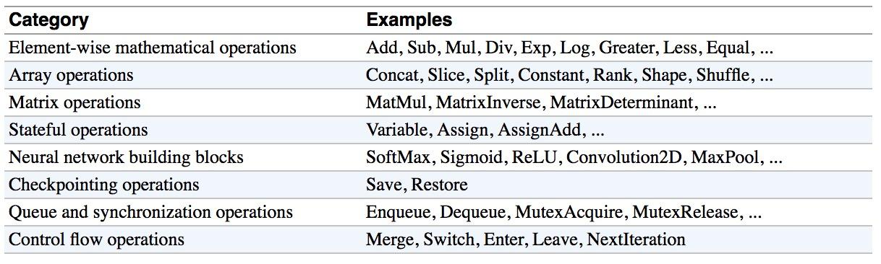
Operations
Buduma. Fundamentals of Deep Learning. O’Reilly, 2017

Slide 25
Creating operators
Useful TensorFlow operators
The official documentation carefully lays out all available math ops:
https://www.tensorflow.org/api_guides/python/math_ops.
Some specific examples of commonly used operators include:
tf.add(x, y) : Add two tensors of the same type, x + y
tf.subtract(x, y) : Subtract tensors of the same type, x - y
tf.multiply(x, y) : Multiply two tensors element-wise
tf.pow(x, y) : Take the element-wise power of x to y
tf.exp(x) : Equivalent to pow(e, x), where e is Euler’s number (2.718…)
tf.sqrt(x) : Equivalent to pow(x, 0.5)
tf.div(x, y) : Take the element-wise division of x and y
tf.truediv(x, y) : Same as tf.div, except casts the arguments as a float
tf.floordiv(x, y) : Same as truediv, except rounds down the final answer into an integer
tf.mod(x, y) : Takes the element-wise remainder from division

Slide 26
Operations
a = tf.constant([3, 6])
b = tf.constant([2, 2])
tf.add(a, b) # >> [5 8]
tf.add_n([a, b, b]) # >> [7 10]. Equivalent to a + b + b
tf.multiply(a, b) # >> [6 12] because mul is element wise
tf.matmul(a, b) # >> ValueError
tf.matmul(tf.reshape(a, [1, 2]), tf.reshape(b, [2, 1])) # >> = tf.matmul([[3,6]], [[2],[2]]), [[18]]
tf.div(a, b) # >> [1 3]
tf.mod(a, b) # >> [1 0]
tf.reset_default_graph()
a = tf.constant([2, 2], name='a')
b = tf.constant([[0, 1], [2, 3]], name='b')
with tf.Session() as sess:
print(sess.run(tf.div(b, a))) #[[0 0] [1 1]]
print(sess.run(tf.divide(b, a))) # [[0. 0.5] [1. 1.5]]
print(sess.run(tf.floordiv(b, a))) # [[0 0] [1 1]], toward negative infinity
print(sess.run(tf.truncatediv(b, a))) # [[0 0] [1 1]], toward zero

Slide 27
Data Types
* b prefix is to indicate byte strings rather than unicode strings
tf.reset_default_graph()
t_1 = [b"apple", b"peach", b"grape"] # 1-d arrays are treated like 1-d tensors
c = tf.zeros_like(t_1) # ==> [b'' b'' b''], refer to tf.zero_like
#d = tf.ones_like(t_1) # ==> TypeError: Expected string, got 1 of type 'int' instead.
with tf.Session() as sess:
print(sess.run(c))
t_2 = [[True, False, False],
[False, False, True],
[False, True, False]]
tf.zeros_like(t_2) # ==> 2x2 tensor, all elements are False
tf.ones_like(t_2) # ==> 2x2 tensor, all elements are True
#for your information
d = tf.constant("hello")
with tf.Session() as sess:
print(sess.run(d))
print(sess.run(d).decode('utf-8'))

Slide 28
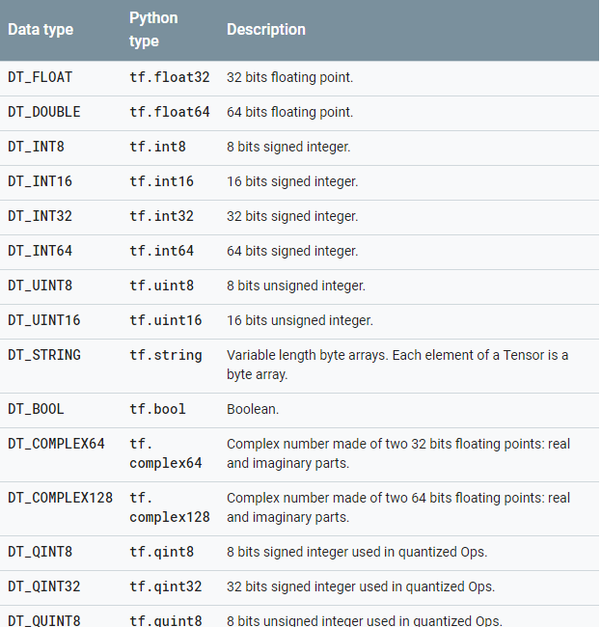
Data types
https://www.tensorflow.org/versions/r0.12/resources/dims_types

Slide 29

TensorFlow vs Numpy Data Types
import numpy as np
assert tf.int32 == np.int32 # ⇒ True
#Can pass numpy types to TensorFlow ops
tf.ones([2, 2], np.float32) # ⇒ [[1.0 1.0], [1.0 1.0]]
#For tf.Session.run(fetches), if the requested fetch is a Tensor, output will be a NumPy ndarray.
a = tf.zeros([2, 3], np.int32)
print(type(a)) # ⇒ <class 'tensorflow.python.framework.ops.Tensor'>
with tf.Session() as sess:
a = sess.run(a)
print(type(a)) # ⇒ <class 'numpy.ndarray'>. Thus, use a_out = sess.run(a)
Python native types: TensorFlow has to infer Python type
Use TF data types when possible

Slide 30
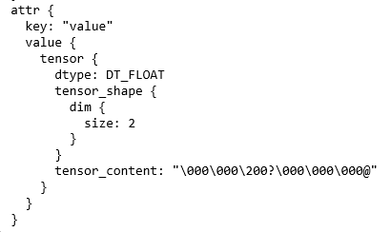
Print out the graph def
tf.reset_default_graph()
my_const = tf.constant([1.0, 2.0], name="my_const")
with tf.Session() as sess:
print(sess.graph.as_graph_def()) #Returns a serialized GraphDef representation of this graph.
This makes loading graphs expensive when constants are big
Only use constants for primitive types.
Use variables or readers for more data that requires more memory

Slide 31
Variables
# create variables with tf.Variable
s = tf.Variable(2, name="scalar")
m = tf.Variable([[0, 1], [2, 3]], name="matrix")
W = tf.Variable(tf.zeros([784,10]))
# create variables with tf.get_variable, PREFERRED
s = tf.get_variable("scalar", initializer=tf.constant(2))
m = tf.get_variable("matrix", initializer=tf.constant([[0, 1], [2, 3]]))
W = tf.get_variable("big_matrix", shape=(784, 10), initializer=tf.zeros_initializer())
Why tf.constant but tf.Variable?
tf.constant is an op. tf.Variable is a class with many ops
Tf.Variable holds several operations:
x = tf.Variable(...)
x.initializer # init op
x.value() # read op
x.assign(...) # write op
x.assign_add(...) # and more
* Variable vs get_variable()
(1) tf.Variable always creates a new variable, whereas tf.get_variable gets from the graph an existing variable with those parameters, and if it does not exists, it creates a new one. (reuse should be set to True)
(2) tf.Variable requires that an initial value be specified.

Slide 32
Variables : Creating a variable
The best way to create a variable is to call the tf.get_variable function.
tf.get_variable() also allows you to reuse a previously created variable of the same name
It returns the created or existing Variable
my_variable = tf.get_variable("my_variable", [1, 2, 3])
Create a variable named "my_variable“, a three-dimensional tensor with shape [1, 2, 3].
dtype = tf.float32, its initial value will be randomized via tf.glorot_uniform_initializer.
import tensorflow as tf
tf.reset_default_graph()
other_variable = tf.get_variable("other_variable", dtype=tf.int32, \
initializer=tf.constant([23, 42]))
my_int_variable = tf.get_variable("my_int_variable", [1, 2, 3], dtype=tf.int32, \
initializer=tf.zeros_initializer())
print(other_variable)
print(my_int_variable)
https://stackoverflow.com/questions/37098546/difference-between-variable-and-get-variable-in-tensorflow

Slide 33
Variables : Creating a variable
Use Variable class
a = tf.Variable(5, name="scalar")
b = tf.Variable(4, name="scalar")
with tf.Session() as sess:
sess.run(tf.global_variables_initializer())
print(sess.run([a, b])) # [5, 4]
a = tf.get_variable("scalar1", initializer=5)
b = tf.get_variable("scalar2", initializer=4)
with tf.Session() as sess:
sess.run(tf.global_variables_initializer())
print(sess.run([a, b])) # [5, 4]

Slide 34
Variables : Initialize variables
import tensorflow as tf
tf.reset_default_graph()
# create variables with tf.get_variable
s = tf.get_variable("scalar", initializer=tf.constant(2))
m = tf.get_variable("matrix", initializer=tf.constant([[0, 1], [2, 3]]))
W = tf.get_variable("big_matrix", shape=(784, 10), initializer=tf.zeros_initializer())
# initialize all variables at once:
with tf.Session() as sess:
sess.run(tf.global_variables_initializer())
sess.run(W)
Before you can use a variable, it must be initialized. To initialize all trainable variables, before training starts, call tf.global_variables_initializer(). This function returns a single operation responsible for initializing all variables in the tf.GraphKeys.GLOBAL_VARIABLES collection.
→ tf.get_collection(tf.GraphKeys.GLOBAL_VARIABLES)
By default every tf.Variable gets placed in the following two collections: * tf.GraphKeys.GLOBAL_VARIABLES --- variables that can be shared across multiple devices, * tf.GraphKeys.TRAINABLE_VARIABLES--- variables for which TensorFlow will calculate gradients.

Slide 35
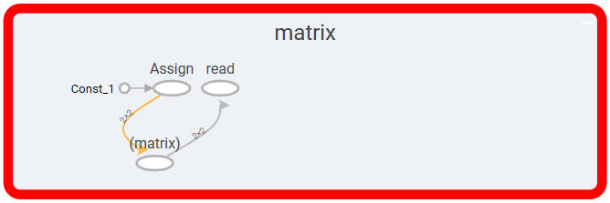
Variables : Initialize variables
import tensorflow as tf
tf.reset_default_graph()
# create variables with tf.get_variable
s = tf.get_variable("scalar", initializer=tf.constant(2))
m = tf.get_variable("matrix", initializer=tf.constant([[0, 1], [2, 3]]))
W = tf.get_variable("big_matrix", shape=(784, 10), initializer=tf.zeros_initializer())
# initialize all variables at once:
with tf.Session() as sess:
sess.run([W.initializer,m.initializer])
# sess.run(tf.variables_initializer([W,m])) # it also works
sess.run(W)
Or, you can run the variable's initializer operation

Slide 36
Variables : Initialize variables
By default tf.global_variables_initializer does not specify the order in which variables are initialized. Therefore, if the initial value of a variable depends on another variable's value, it's likely that you'll get an error.
v = tf.get_variable("v", shape=(), initializer=tf.zeros_initializer())
w = tf.get_variable("w", initializer=v.initialized_value() + 1)

Slide 37
Variables : tf.Variable vs tf.get_variable()
First is that tf.Variable will always create a new variable, whether tf.get_variable gets from the graph an existing variable with those parameters, and if it does not exists, it creates a new one.
tf.Variable requires that an initial value be specified.
Ref: https://stackoverflow.com/questions/37098546/difference-between-variable-and-get-variable-in-tensorflow
import tensorflow as tf
tf.reset_default_graph()
with tf.variable_scope("one"):
a = tf.get_variable("v", [1]) #a.name == "one/v:0"
#with tf.variable_scope("one"):
# b = tf.get_variable("v", [1])
#ValueError: Variable one/v already exists
with tf.variable_scope("one", reuse = True):
c = tf.get_variable("v", [1]) #c.name == "one/v:0"
with tf.variable_scope("two"):
d = tf.get_variable("v", [1]) #d.name == "two/v:0"
e = tf.Variable(1, name = "v", expected_shape = [1])
#e.name == "two/v_1:0"
assert(a is c) #Assertion is true, they refer to the same object.
assert(a is d) #AssertionError: they are different objects
assert(d is e) #AssertionError: they are different objects

Slide 38
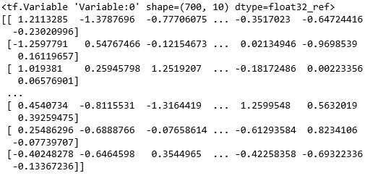
Eval() a variable
# W is a random 700 x 100 variable object
W = tf.Variable(tf.truncated_normal([700, 10]))
with tf.Session() as sess:
sess.run(W.initializer)
print(W)
print(W.eval()) # == print(sess.run(W))
* Both tf.Session.run() and tf.Tensor.eval() get results from the session where tf.Tensor.eval() is a shortcut for calling tf.get_default_session().run(t) (from stackoverflow)

Slide 39
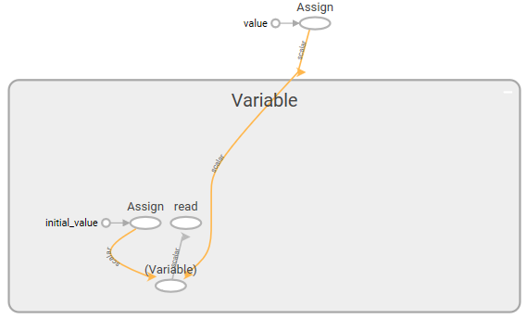
tf.Variable.assign()
import tensorflow as tf
tf.reset_default_graph()
W = tf.Variable(10)
W.assign(100)
writer = tf.summary.FileWriter('./graphs', tf.get_default_graph())
with tf.Session() as sess:
sess.run(W.initializer)
print(W.eval())
writer.close()
The output is 10
W.assign(100) creates an assign op. That op needs to be executed in a session to take effect.

Slide 40
tf.Variable.assign()
import tensorflow as tf
tf.reset_default_graph()
W = tf.Variable(10)
assign_op = W.assign(100)
writer = tf.summary.FileWriter('./graphs', tf.get_default_graph())
with tf.Session() as sess:
sess.run(W.initializer)
sess.run(assign_op)
print(W.eval())
writer.close()
The output is 100

Slide 41
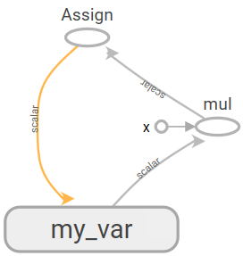
tf.Variable.assign()
import tensorflow as tf
tf.reset_default_graph()
# create a variable whose original value is 2
my_var = tf.Variable(2, name="my_var")
# assign a * 2 to a and call that op a_times_two
my_var_times_two = my_var.assign(2 * my_var )
writer = tf.summary.FileWriter('./graphs', tf.get_default_graph())
with tf.Session() as sess:
sess.run(my_var.initializer)
sess.run(my_var_times_two)
sess.run(my_var_times_two) # >> what’s the value of my_var now?
print(my_var.eval())
writer.close()
The output is 8

Slide 42
tf.Variable.assign_add() and assign_sub()
my_var = tf.Variable(10)
with tf.Session() as sess:
sess.run(my_var.initializer)
# increment by 10
sess.run(my_var.assign_add(10)) # >> 20
# decrement by 2
sess.run(my_var.assign_sub(2)) # >> 18

Slide 43
Each session maintains its own copy of variables
W = tf.Variable(10)
sess1 = tf.Session()
sess2 = tf.Session()
sess1.run(W.initializer)
sess2.run(W.initializer)
print(sess1.run(W.assign_add(10))) # >> 20
print(sess2.run(W.assign_sub(2))) # >> ?
sess1.close()
sess2.close()

Slide 44
Each session maintains its own copy of variables
W = tf.Variable(10)
sess1 = tf.Session()
sess2 = tf.Session()
sess1.run(W.initializer)
sess2.run(W.initializer)
print(sess1.run(W.assign_add(10))) # >> 20
print(sess2.run(W.assign_sub(2))) # >> 8
print(sess1.run(W.assign_add(100))) # >> 120
print(sess2.run(W.assign_sub(50))) # >> -42
sess1.close()
sess2.close()

Slide 45

Variables : Scope
a = tf.get_variable("scalar", initializer=5)
b = tf.get_variable("scalar", initializer=4)
ValueError: Variable scalar already exists, disallowed.
with tf.variable_scope("model1"):
a = tf.get_variable("scalar", initializer=5)
with tf.variable_scope("model2"):
b = tf.get_variable("scalar", initializer=4)
print(a)
print(b)
tf.reset_default_graph()
with tf.variable_scope("model1"):
a = tf.get_variable(name="scalar", initializer=5)
with tf.variable_scope("model2"):
b = tf.get_variable(name="scalar", initializer=4)
with tf.Session() as sess:
ops = sess.graph.get_operations()
for op in ops:
print(op.name, op.values())

Slide 46
Control Dependencies
tf.Graph.control_dependencies(control_inputs) defines which ops should be run first
# your graph g have 5 ops: a, b, c, d, e
g = tf.get_default_graph()
with g.control_dependencies([a, b, c]):
# 'd' and 'e' will only run after 'a', 'b', and 'c' have executed.
d = ...
e = …

Slide 47
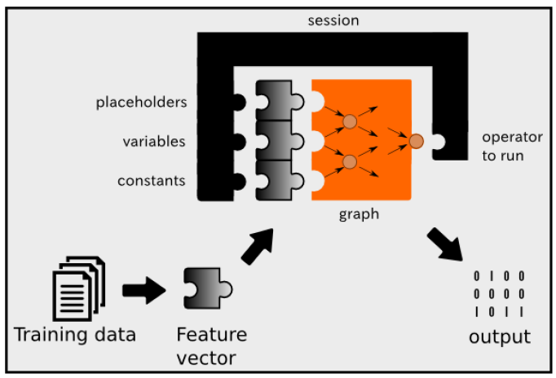
Session configurations
A session not only runs a graph operation, but can also take placeholders, variables, and constants as input. We’ve used constants so far, but in later sections we’ll start using variables and placeholders. Here’s a quick overview of these three types of values.
Constant : A value that does not change, such as hyper-parameters or settings.
Variable : A value that can change, such as parameters of a machine learning model. Variables must me initialized by the session before they are used.
Placeholder : A value that is unassigned, but will be initialized by the session wherever it is run. Typically, placeholders are the input and output of your model.

Slide 48
Placeholders
A TF program often has 2 phases:
Assemble a graph
Use a session to execute operations in the graph.
⇒ Assemble the graph first without knowing the values needed for computation
Analogy: Define the function f(x, y) = 2 * x + y without knowing value of x or y. x, y are placeholders for the actual values.
We, or our clients, can later supply their own data when they need to execute the computation.

Slide 49
Placeholders
tf.placeholder(dtype, shape=None, name=None)
# create a placeholder for a vector of 3 elements, type tf.float32
a = tf.placeholder(tf.float32, shape=[3])
b = tf.constant([5, 5, 5], tf.float32)
# use the placeholder as you would a constant or a variable
c = a + b # short for tf.add(a, b)
with tf.Session() as sess:
print(sess.run(c)) # >> ???
>> InvalidArgumentError

Slide 50
Placeholders
Supplement the values to placeholders using a dictionary
# create a placeholder for a vector of 3 elements, type tf.float32
a = tf.placeholder(tf.float32, shape=[3])
b = tf.constant([5, 5, 5], tf.float32)
# use the placeholder as you would a constant or a variable
c = a + b # short for tf.add(a, b)
with tf.Session() as sess:
print(sess.run(c, feed_dict={a: [1, 2, 3]})) # the tensor a is the key, not the string ‘a’
>> [6. 7. 8.]

Slide 51
tf.placeholder_with_default
placeholder_with_default( input, shape, name=None)
import numpy as np
rand_array = np.random.rand(10,10)
x = tf.placeholder_with_default( rand_array, shape=(10,10))
y = tf.matmul(x,x)
with tf.Session() as sess:
print(sess.run(y))
No feed_dict

Slide 52
Defer creating/initializing an object until it is needed
x = tf.Variable(10, name='x')
y = tf.Variable(20, name='y')
z = tf.add(x, y) # create the node before executing the graph
writer = tf.summary.FileWriter('./graphs', tf.get_default_graph())
with tf.Session() as sess:
sess.run(tf.global_variables_initializer())
for _ in range(10):
print(sess.run(z))
writer.close()
tf.reset_default_graph()
x = tf.Variable(10, name='x')
y = tf.Variable(20, name='y')
with tf.Session() as sess:
sess.run(tf.global_variables_initializer())
for _ in range(10):
print(sess.run(tf.add(x, y))) # someone decides to be clever to save one line of code
writer = tf.summary.FileWriter('./graphs', tf.get_default_graph())
writer.close()

Slide 53
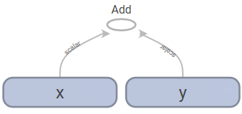
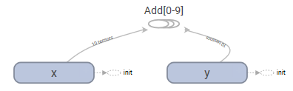
Defer creating/initializing an object until it is needed
x = tf.Variable(10, name='x')
y = tf.Variable(20, name='y')
z = tf.add(x, y) # create the node before executing the graph
writer = tf.summary.FileWriter('./graphs', tf.get_default_graph())
with tf.Session() as sess:
sess.run(tf.global_variables_initializer())
for _ in range(10):
print(sess.run(z))
writer.close()
tf.reset_default_graph()
x = tf.Variable(10, name='x')
y = tf.Variable(20, name='y')
with tf.Session() as sess:
sess.run(tf.global_variables_initializer())
for _ in range(10):
print(sess.run(tf.add(x, y))) # someone decides to be clever to save one line of code
writer = tf.summary.FileWriter('./graphs', tf.get_default_graph())
writer.close()

Slide 54
Defer creating/initializing an object until it is needed
Node “Add” added 10 times to the graph definition
Imagine you want to compute an op thousands, or millions of times. Your graph gets bloated Slow to load and Expensive to pass around
Solutions : Separate definition of ops from computing/running ops

Slide 55
Some useful operations…

Slide 56
tf.reduce_sum
reduce_sum( input_tensor, axis=None, keep_dims=False, name=None, reduction_indices=None )
Computes the sum of elements across dimensions of a tensor.
tf.reset_default_graph()
a = tf.constant([[1,2],[3,4]])
b = tf.reduce_sum(a, axis=0)
c = tf.reduce_sum(a, axis=1)
with tf.Session() as sess:
print(sess.run([b,c]))
>> [array([4, 6]), array([3, 7])]

Slide 57
tf.reduce_max, etc.
tf.reset_default_graph()
a = tf.constant([[1,2],[3,4]])
b = tf.reduce_max(a, axis=0)
c = tf.reduce_min(a, axis=1)
d = tf.reduce_mean(a, axis=1)
with tf.Session() as sess:
print(sess.run([b,c,d]))
>> [array([3, 4]), array([1, 3]), array([1, 3])]
tf.reset_default_graph()
a = tf.constant([[1,2],[3,4]])
b = tf.reduce_max(a)
c = tf.reduce_min(a)
d = tf.reduce_mean(a)
with tf.Session() as sess:
print(sess.run([b,c,d]))
>> [4, 1, 2]

Slide 58
tf.segment_sum
segment_sum( data, segment_ids, name=None )
Compute the sum along segments of a tensor
import tensorflow as tf
tf.reset_default_graph()
a = tf.constant([[1,2,3,4],[-1,-2,-3,-4],[5,6,7,8],[-5,-6,-7,-8]])
b = tf.constant([[1,2,3,4],[-1,-2,-3,-4]])
c = tf.segment_sum(a, tf.constant([0,0,1,1]))
with tf.Session() as sess:
print(sess.run([c]))
>> [array([[0, 0, 0, 0],
[0, 0, 0, 0]])]
Here a segmentation is a partitioning of a tensor along the first dimension, i.e. it defines a mapping from the first dimension onto segment_ids. (*segment_ides should start from 0.)

Slide 59
tf.transpose
transpos( a, perm=None, name=‘transpose’ )
Transposes a. Permutes the dimensions according to perm
x = tf.constant([[1, 2, 3], [4, 5, 6]])
tf.transpose(x) # [[1, 4]
# [2, 5]
# [3, 6]]
tf.transpose(x, perm=[1, 0]) # # Equivalently, [[1, 4]
# [2, 5]
# [3, 6]]
# 'perm' is more useful for n-dimensional tensors, for n > 2
x = tf.constant([[[ 1, 2, 3],
[ 4, 5, 6]],
[[ 7, 8, 9],
[10, 11, 12]]])
# Take the transpose of the matrices in dimension-0
tf.transpose(x, perm=[0, 2, 1]) # [[[1, 4],
# [2, 5],
# [3, 6]],
# [[7, 10],
# [8, 11],
# [9, 12]]]

Slide 60
tf.identity
identity( input, name=None )
Return a tensor with the same shape and contents as input
norm = tf.random_normal([2,3], seed=123)
anorm = tf.identity(norm)

Slide 61
tf.where
select( condition, t, e , name=None )
Select elements from t or e, depending on condition
condition1 = tf.constant([[True, False],[False,True]])
t1 = tf.constant([[1,2],[3,4]])
e1 = tf.constant([[5,6],[7,8]])
result1 = tf.where(condition1, t1, e1)
condition2 = tf.constant([True, False])
t2 = tf.constant( [[1, 2], [3, 4]] )
e2 = tf.constant( [[5, 6], [7, 8]] )
result2 = tf.where(condition2, t2, e2)
with tf.Session() as sess:
print(sess.run(result1))
print(sess.run(result2))

Slide 62
tf.argmin / tf.argmax
argmin( input, axis=None, name=None, dimension=None, output_type=tf.int64 )
Returns the index with the smallest value across axes of a tensor.
x = tf.constant([[1,2],[3,4],[5,6]], dtype=tf.int32)
a = tf.argmin(x, axis=0)
b = tf.argmax(x, axis=1)
with tf.Session() as sess:
print(sess.run([a,b]))
>>> [array([0, 0], dtype=int64), array([1, 1, 1], dtype=int64)]

Slide 63
tf.argmin / tf.argmax
argmin( input, axis=None, name=None, dimension=None, output_type=tf.int64 )
Returns the index with the smallest value across axes of a tensor.
x = tf.constant([[1,2],[3,4],[5,6]], dtype=tf.int32)
a = tf.argmin(x, axis=0)
b = tf.argmax(x, axis=1)
with tf.Session() as sess:
print(sess.run([a,b]))
>>> [array([0, 0], dtype=int64), array([1, 1, 1], dtype=int64)]

Slide 64
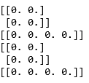
tf.reshape
reshape( tensor, shape, name=None )
Reshapes a tensor
import tensorflow as tf
import numpy as np
tf.reset_default_graph()
a = np.zeros([2,2])
print(a)
print(a.reshape([1,4]))
t = tf.zeros([2,2])
with tf.Session() as sess:
print( sess.run(t) )
print( sess.run(tf.reshape(t,[1,4])) )

Slide 65
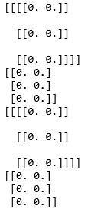
tf.squeeze
squeeze( input, axis=None, name=None, squeeze_dim = None )
Removes dimensions of size 1 from the shape of a tensor
tf.reset_default_graph()
a = np.zeros([1,3,1,2])
print(a)
print(np.squeeze(a))
t = tf.zeros([1,3,1,2])
with tf.Session() as sess:
print(sess.run(t))
print(sess.run(tf.squeeze(t)))

Slide 66
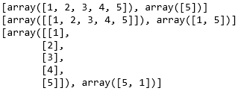
tf.expand_dims
expand( input, axis=None, name=None, dim = None )
Inserts a dimension of 1 into a tensor's shape.
import tensorflow as tf
tf.reset_default_graph()
t = tf.constant([1,2,3,4,5])
e0 = tf.expand_dims( t, axis=0 )
e1 = tf.expand_dims( t, axis=1 )
with tf.Session() as sess:
print(sess.run([t, tf.shape(t)]))
print(sess.run([e0, tf.shape(e0)]))
print(sess.run([e1, tf.shape(e1)]))

Slide 67

tf.slice
slice( input_, begin, size, name=None )
Extract a slice from a tensor
import tensorflow as tf
tf.reset_default_graph()
c1 = tf.constant([1,2,3,4,5,6,7,8,9,0])
v1 = tf.constant([[3,4,5,6,7,8],[9,0,1,2,3,4]])
with tf.Session() as sess:
print(sess.run(tf.slice(c1,[2],[3])))
print(sess.run(tf.slice(v1,[0,2],[2,2])))
print(sess.run(tf.slice(v1,[0,2],[1,2])))
print(sess.run(tf.slice(v1,[0,2],[2,-1])))
import tensorflow as tf
tf.reset_default_graph()
c1 = tf.constant([1,2,3,4,5,6,7,8,9,0])
v1 = tf.constant([[3,4,5,6,7,8],[9,0,1,2,3,4]])
with tf.Session() as sess:
print(sess.run(c1[2:5]))
print(sess.run(v1[0:2,2:4]))
print(sess.run(v1[0:1,2:4]))
print(sess.run(v1[0:2,2:]))

Slide 68
tf.reverse
# tensor 't' is [[[[ 0, 1, 2, 3],
# [ 4, 5, 6, 7],
# [ 8, 9, 10, 11]],
# [[12, 13, 14, 15],
# [16, 17, 18, 19],
# [20, 21, 22, 23]]]]
# tensor 't' shape is [1, 2, 3, 4]
# 'dims' is [3] or 'dims' is [-1]
reverse(t, dims) ==> [[[[ 3, 2, 1, 0],
[ 7, 6, 5, 4],
[ 11, 10, 9, 8]],
[[15, 14, 13, 12],
[19, 18, 17, 16],
[23, 22, 21, 20]]]]
# 'dims' is '[1]' (or 'dims' is '[-3]')
reverse(t, dims) ==> [[[[12, 13, 14, 15],
[16, 17, 18, 19],
[20, 21, 22, 23]
[[ 0, 1, 2, 3],
[ 4, 5, 6, 7],
[ 8, 9, 10, 11]]]]
reverse( input_, begin, size, name=None )
Reverses specific dimensions of a tensor

Slide 69
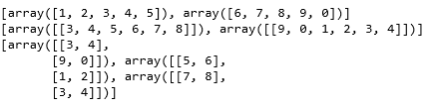
tf.split
split( value, num_or_size_splits, axis=0, num=None, name=‘split’)
Split a tensor into sub tensors
import tensorflow as tf
tf.reset_default_graph()
c1 = tf.constant([1,2,3,4,5,6,7,8,9,0])
v1 = tf.constant([[3,4,5,6,7,8],[9,0,1,2,3,4]])
with tf.Session() as sess:
print(sess.run(tf.split(c1, 2, axis=0)))
print(sess.run(tf.split(v1, 2, axis=0)))
print(sess.run(tf.split(v1, 3, axis=1)))

Slide 70
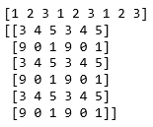
tf.tile
tile( input, muliples, name=None )
Constructs a tensor by tiling a given tensor
The output tensor's i'th dimension has input.dims(i) * multiples[i] elements,
The return tensor has the same rank as that of input
import tensorflow as tf
tf.reset_default_graph()
c1 = tf.constant([1,2,3])
v1 = tf.constant([[3,4,5],[9,0,1]])
with tf.Session() as sess:
print(sess.run(tf.tile(c1, [3])))
print(sess.run(tf.tile(v1, [3, 2])))

Slide 71
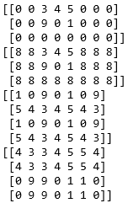
tf.pad
pad( tensor, paddings, mode=‘CONSTANT’, name=None, constant_values=0 )
Pad a tensor
v1 = tf.constant([[3,4,5],[9,0,1]])
with tf.Session() as sess:
print(sess.run(tf.pad(v1, [[0,1],[2,3]], 'CONSTANT')))
print(sess.run(tf.pad(v1, [[0,1],[2,3]], 'CONSTANT', constant_values=8 )))
print(sess.run(tf.pad(v1, [[1,1],[2,2]], 'REFLECT' )))
print(sess.run(tf.pad(v1, [[1,1],[2,2]], 'SYMMETRIC' )))

Slide 72
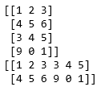
tf.concat
concat( values, axis, name=‘concat’ )
Constructs a tensor by tiling a given tensor
import tensorflow as tf
tf.reset_default_graph()
c1 = tf.constant([[1,2,3],[4,5,6]])
v1 = tf.constant([[3,4,5],[9,0,1]])
with tf.Session() as sess:
print(sess.run(tf.concat([c1,v1],axis=0)))
print(sess.run(tf.concat([c1,v1],axis=1)))

Slide 73

tf.stack
stack( values, axis=0, name=‘stack’ )
Stack a list of rank-R tensors into one rank-(R+1) tensor
import tensorflow as tf
tf.reset_default_graph()
x = tf.constant([1, 4])
y = tf.constant([2, 5])
z = tf.constant([3, 6])
with tf.Session() as sess:
print(sess.run(tf.stack([x, y, z]))) # [[1, 4], [2, 5], [3, 6]] (Pack along first dim.)
print(sess.run(tf.stack([x, y, z], axis=1))) # [[1, 2, 3], [4, 5, 6]]
# consider [[1],[4]], [[2], [5]], [[3], [6]]

Slide 74
Let’s rethink graph and session
TensorFlow creates a default graph for you, so we don’t need the first two lines of the code above. The default graph is also what the sessions in the next section use when not manually specifying a graph.
tf.reset_default_graph()
graph = tf.Graph()
with graph.as_default(): # Returns a context manager that makes this Graph the default graph.
variable = tf.Variable(42, name='foo')
initialize = tf.global_variables_initializer()
assign = variable.assign(13)
with tf.Session(graph=graph) as sess:
sess.run(initialize)
sess.run(assign)
print(sess.run(variable))
print(assign.eval(session=sess))
https://danijar.com/what-is-a-tensorflow-session/

Slide 75
tf.reset_default_graph()
g_1 = tf.Graph()
with g_1.as_default():
# Operations created in this scope will be added to `g_1`.
c = tf.constant("Node in g_1")
# Sessions created in this scope will run operations from `g_1`.
sess_1 = tf.Session()
g_2 = tf.Graph()
with g_2.as_default():
# Operations created in this scope will be added to `g_2`.
d = tf.constant("Node in g_2")
# Alternatively, you can pass a graph when constructing a `tf.Session`:
# `sess_2` will run operations from `g_2`.
sess_2 = tf.Session(graph=g_2)
assert c.graph is g_1
assert sess_1.graph is g_1
assert d.graph is g_2
assert sess_2.graph is g_2
print(sess_1.run(c))
print(sess_2.run(d))

Slide 76
Interactive Sessions
import tensorflow as tf
sess = tf.InteractiveSession()
x = tf.constant([[1., 2.]])
neg_x = tf.negative(x)
result = neg_x.eval()
print(result)
sess.close()
When running TensorFlow code through an interactive environment (for debugging or presentation purposes), it is often easier to create the session in interactive mode, where the session is implicitly part of any call to eval(). That way, the session variable does not need to be passed around throughout the code, making it easier to focus on the relevant parts of the algorithm.
The only difference with a regular Session is that an InteractiveSession installs itself as the default session on construction. The methods Tensor.eval() and Operation.run() will use that session to run ops.

Slide 77
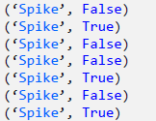
Interactive Sessions : Variables
import tensorflow as tf
sess = tf.InteractiveSession()
raw_data = [1., 2., 8., -1., 0., 5.5, 6., 13]
spike = tf.Variable(False)
spike.initializer.run()
for i in range(1, len(raw_data)):
if raw_data[i] - raw_data[i-1] > 5:
updater = tf.assign(spike, True)
updater.eval()
else:
tf.assign(spike, False).eval()
print("Spike", spike.eval())
sess.close()
Because all variables must be initialized, initialize the variable by calling run() on its initializer
To update a variable, assign it a new value using tf.assign(<var name>, <new value>).
Creating a variable
Initializing variables
Using variables

Slide 78
Interactive Sessions: Saving and Loading Variables
import tensorflow as tf
sess = tf.InteractiveSession()
raw_data = [1., 2., 8., -1., 0., 5.5, 6., 13]
spike = tf.Variable(False)
spike.initializer.run()
for i in range(1, len(raw_data)):
if raw_data[i] - raw_data[i-1] > 5:
updater = tf.assign(spike, True)
updater.eval()
else:
tf.assign(spike, False).eval()
print("Spike", spike.eval())
sess.close()
Because all variables must be initialized, initialize the variable by calling run() on its initializer
To update a variable, assign it a new value using tf.assign(<var name>, <new value>).

Slide 79
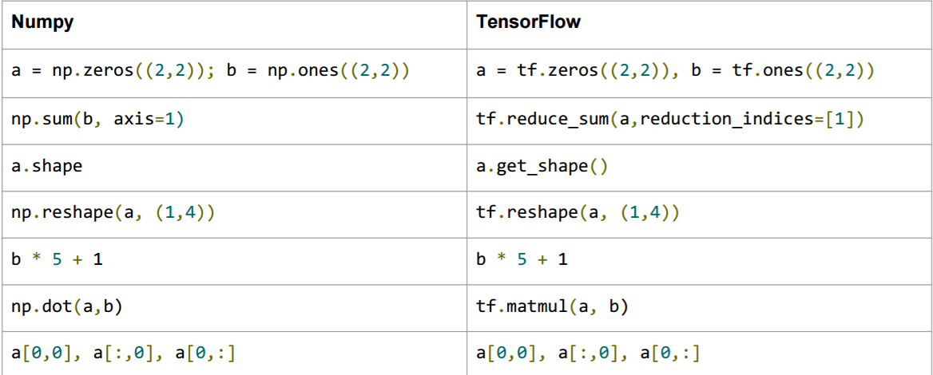
TensorFlow vs. Numpy

Slide 80

TensorFlow vs. Numpy
import numpy as np
a = np.array([[1,2],[3,4]])
print(a)
print( np.sum(a, axis=1))
print( np.reshape(a, (4,1)))
import tensorflow as tf
sess = tf.InteractiveSession()
a = tf.convert_to_tensor( [[1,2],[3,4]] )
print(a.eval())
print( tf.reduce_sum(a, axis=1).eval() )
print( tf.reshape(a, (4,1)).eval() )
sess.close()
Ref: 텐서플로 기초 이해하기, by 문용준
https://www.slideshare.net/dahlmoon/20160623-63318427

