Slide 1
Chapter 1
The Machine Learning Landscape

Slide 2
References
Andrew Ng, “Deep learning”, Coursera
김성훈, “모두를 위한 머신러닝/딥러닝“, https://hunkim.github.io/ml/
Géron, Aurélien, “Hands-On Machine Learning with Scikit-Learn and TensorFlow: Concepts, Tools, and Techniques to Build Intelligent Systems”
etc.

Slide 3
Machine Learning (ML)
Machine Learning is the field of study that gives computers the ability to learn without being explicitly programmed. <Arthur Samuel, 1959>
A computer program is said to learn from experience E with respect to some task T and some performance measure P, if its performance on T, as measured by P, improves with experience E. <Tom Mitchell, 1997>

Slide 4
Housing Price Prediction
price
size x
price y
size of house

Slide 5
Housing Price Prediction
ReLU
price
size x
price y
size of house

Slide 6
Housing Price Prediction
size
family size
#bedrooms
walkability
price of house
zip code
school quality
Wealth

Slide 7
Housing Price Prediction
x1
x2
y
x3
x4

Slide 8
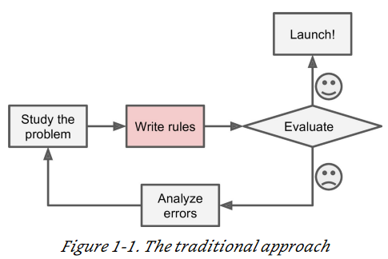
Example of applications : Spam filter
Traditional programming technique:
look at what spam typically looks like.
notice that some words or phrases (such as “4U,” “credit card,” “free,” and “amazing”) tend to come up a lot in the subject. Perhaps you would also notice a few other patterns in the sender’s name, the email’s body, and so on.
Write a detection algorithm for each of the patterns that you noticed
Your program would flag emails as spam if a number of these patterns are detected.
Since the problem is not trivial, your program will likely become a long list of complex rules — pretty hard to maintain.

Slide 9
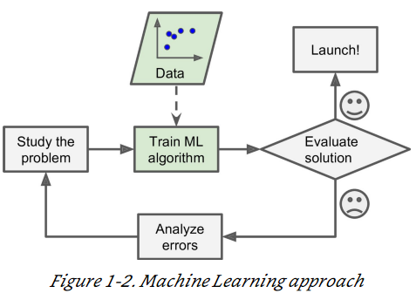
Example of applications : Spam filter
A spam filter based on ML
Automatically learns which words and phrases are good predictors of spam by detecting unusually frequent patterns of words in the spam examples compared to the ham examples.
The program is much shorter, easier to maintain, and most likely more accurate.

Slide 10
Example of applications : Speech recognition
Say you want to start simple and write a program capable of distinguishing the words “one” and “two.”
You might notice that the word “two” starts with a high-pitch sound (“T”), so you could hardcode an algorithm that measures high-pitch sound intensity and use that to distinguish ones and twos.
Not scale to thousands of words spoken by millions of very different people in noisy environments and in dozens of languages.
The best solution (at least today) is to write an algorithm that learns by itself, given many example recordings for each word.

Slide 11
ML is great for
Problems for which existing solutions require a lot of hand-tuning or long lists of rules: one Machine Learning algorithm can often simplify code and perform better.
Complex problems for which there is no good solution at all using a traditional approach: the best ML techniques can find a solution.
Fluctuating environments: a ML system can adapt to new data.
Let’s think about what area ML is bad for…

Slide 12
Types of ML
Whether or not they are trained with human supervision (supervised, unsupervised, semisupervised, and reinforcement Learning)
Whether or not they can learn incrementally on the fly (online versus batch learning)
Whether they work by simply comparing new data points to known data points, or instead detect patterns in the training data and build a predictive model, much like scientists do (instance-based versus model-based learning)
These criteria are not exclusive;

Slide 13
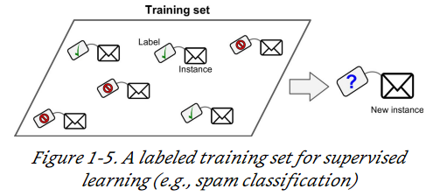
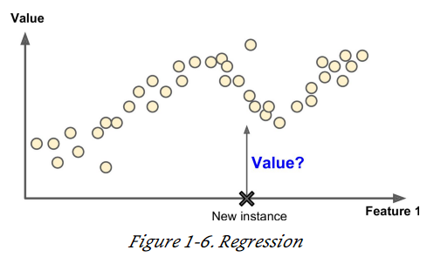
Types of ML : Supervised Learning
The training data you feed to the algorithm includes the desired solutions, called labels
A typical supervised learning task is classification.
Another typical task is to predict a target numeric value, such as the price of a car, given a set of features (mileage, age, brand, etc.) called predictors. This sort of task is called regression
Note that some regression algorithms can be used for classification as well, and vice versa. For example, Logistic regression is commonly used for classification, as it can output a value that corresponds to the probability of belonging to a given class (e.g., 20% chance of being spam).

Slide 14
Supervised learning : applications
Input(x) | Output(y) | Applications
Home features Ad, user info Images Audio English Image, Radar info | Price Click on ad? (0/1) Objects Text transcript Other languages Position of other cars | Real estate Online advertising Photo tagging Speech recognition Machine translation Autonomous driving

Slide 15
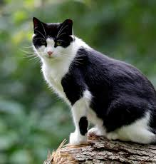
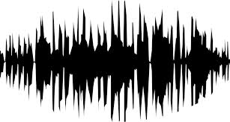
Supervised learning : data types
Structured data
Unstructured data
size | #bedrooms | … | Price
audio
Machine Learning is the field of study that gives computers the ability to learn without being explicitly programmed.
images
text

Slide 16
Supervised learning : data types
Why is deep learning taking off recently?
Scale drives deep learning progress
Data : huge amount of data from emerging areas
Computation : GPGPU, etc.
Algorithms: large NNs, RELUs, etc.

Slide 17
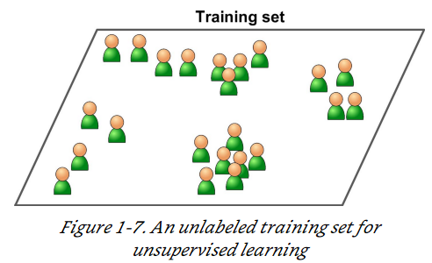
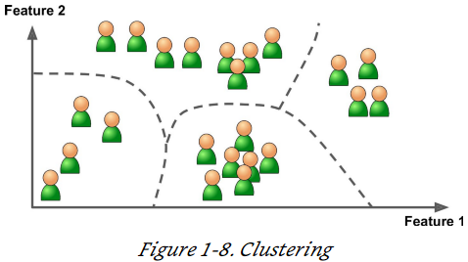
Types of ML : Unsupervised learning
The training data is unlabeled.
For example, say you have a lot of data about your blog’s visitors. You may want to run a clustering algorithm to try to detect groups of similar visitors
For example, it might notice that 40% of your visitors are males who love comic books and generally read your blog in the evening, while 20% are young sci-fi lovers who visit during the weekends, and so on.

Slide 18
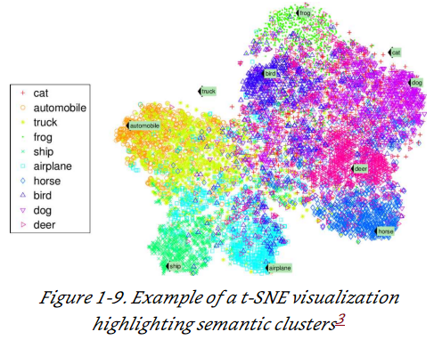
Types of ML : Unsupervised learning
Visualization algorithms are also good examples of unsupervised learning algorithms: you feed them a lot of complex and unlabeled data, and they output a 2D or 3D representation of your data that can easily be plotted.
A related task is dimensionality reduction, in which the goal is to simplify the data without losing too much information. One way to do this is to merge several correlated features into one. This is called feature extraction.

Slide 19
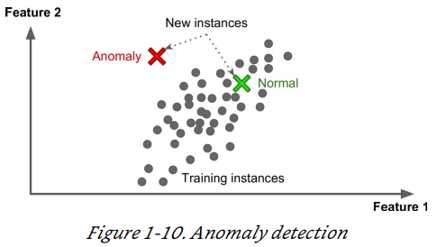
Types of ML : Unsupervised learning
Yet another important unsupervised task is anomaly detection — for example, detecting unusual credit card transactions to prevent fraud, catching manufacturing defects, or automatically removing outliers from a dataset before feeding it to another learning algorithm.
Another common unsupervised task is association rule learning, in which the goal is to dig into large amounts of data and discover interesting relations between attributes.
For example, suppose you own a supermarket. Running an association rule on your sales logs may reveal that people who purchase barbecue sauce and potato chips also tend to buy steak. Thus, you may want to place these items close to each other.

Slide 20
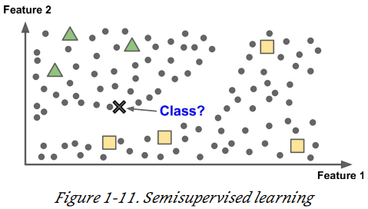
Types of ML : Semisupervised learning
Some algorithms can deal with partially labeled training data. usually a lot of unlabeled data and a little bit of labeled data.
Example, Google Photos
Once you upload all your family photos to the service, it automatically recognizes that the same person A shows up in photos 1, 5, and 11, while another person B shows up in photos 2, 5, and 7. This is the unsupervised part of the algorithm (clustering). Now all the system needs is for you to tell it who these people are.

Slide 21
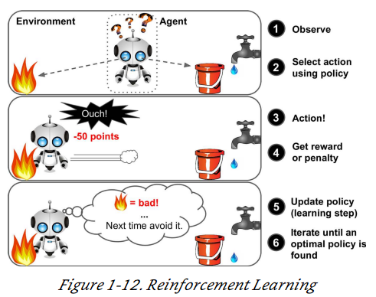
Types of ML : Reinforcement Learning
The learning system, called an agent in this context, can observe the environment, select and perform actions, and get rewards in return (or penalties in the form of negative rewards.
It must then learn by itself what is the best strategy, called a policy, to get the most reward over time.

Slide 22
Types of ML : Batch learning
The system is incapable of learning incrementally: it must be trained using all the available data.→ offline learning
If you want a batch learning system to know about new data (such as a new type of spam), you need to train a new version of the system from scratch on the full dataset (not just the new data, but also the old data), then stop the old system and replace it with the new one.
This solution is simple and often works fine, but training using the full set of data can take many hours,
Also, training on the full set of data requires a lot of computing resources (CPU, memory space, disk space, disk I/ O, network I/ O, etc.).

Slide 23
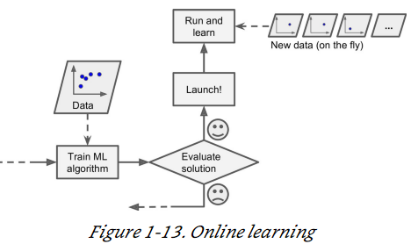
Types of ML : Online learning (Incremental learning)
you train the system incrementally by feeding it data instances sequentially, either individually or by small groups called mini-batches.
Each learning step is fast and cheap, so the system can learn about new data on the fly, as it arrives
Online learning is great for systems that receive data as a continuous flow (e.g., stock prices) and need to adapt to change rapidly

Slide 24
Types of ML : Online learning (Incremental learning)
how fast they should adapt to changing data → called the learning rate.
high learning rate → your system will rapidly adapt to new data, but it will also tend to quickly forget the old data
low learning rate → it will learn more slowly, but it will also be less sensitive to noise in the new data or to sequences of non-representative data points.
If bad data is fed to the system, the system’s performance will gradually decline.
To reduce this risk, you need to monitor your system closely and promptly switch learning off (and possibly revert to a previously working state) if you detect a drop in performance.

Slide 25
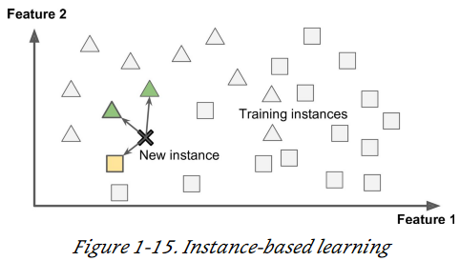
Types of ML : Instance-based learning
Having a good performance measure on the training data is good, but insufficient; the true goal is to perform well on new instances. → generalization
Instead of just flagging emails that are identical to known spam emails, your spam filter could be programmed to also flag emails that are very similar to known spam emails. This requires a measure of similarity between two emails.
This is called instance-based learning: the system learns the examples by heart, then generalizes to new cases using a similarity

Slide 26
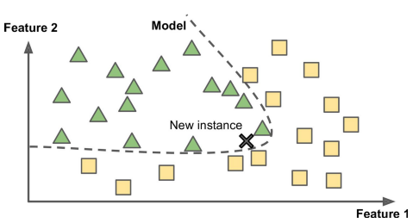
Types of ML : Model-based learning
Another way to generalize from a set of examples is to build a model of these examples, then use that model to make predictions.

Slide 27
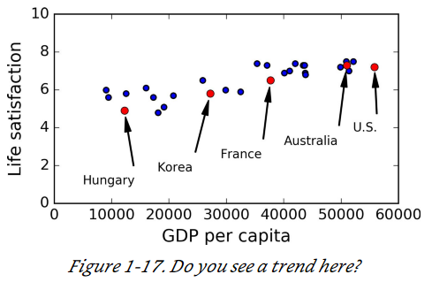
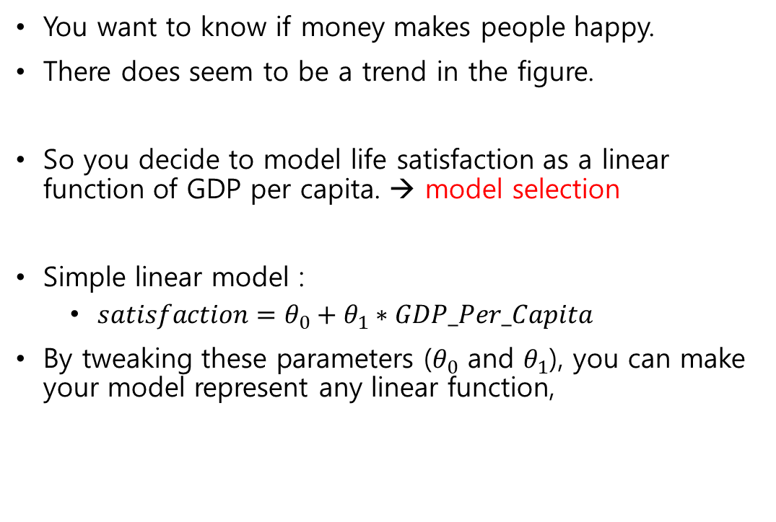
Types of ML : Example of Model-based learning
You want to know if money makes people happy.
There does seem to be a trend in the figure.
So you decide to model life satisfaction as a linear function of GDP per capita. → model selection
Simple linear model :
$satisfaction=θ_{0}+θ_{1}∗GDP_Per_Capita$
By tweaking these parameters ($θ_{0}$ and $θ_{1}$), you can make your model represent any linear function,

Slide 28
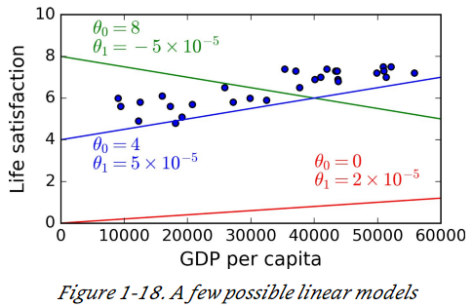
Types of ML : Example of Model-based learning
How can you know which values will make your model perform best?
performance measure
utility function (or fitness function) that measures how good your model is
cost function that measures how bad it is.
For linear regression problems, people typically use a cost function that measures the distance between the linear model’s predictions and the training examples; the objective is to minimize this distance.

Slide 29
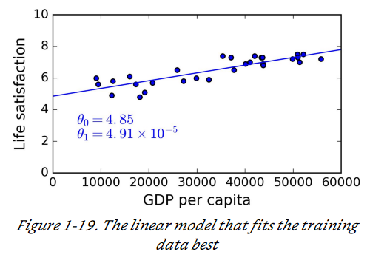
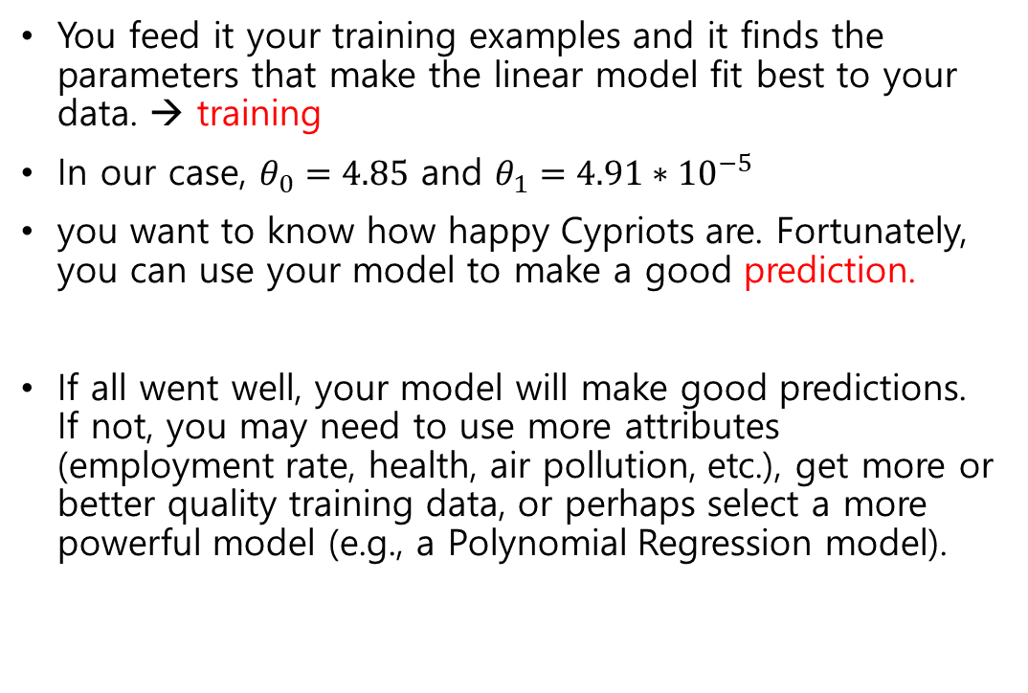
Types of ML : Example of Model-based learning
You feed it your training examples and it finds the parameters that make the linear model fit best to your data. → training
In our case, $θ_{0}=4.85$ and $θ_{1}=4.91∗{10}^{−5}$
you want to know how happy Cypriots are. Fortunately, you can use your model to make a good prediction.
If all went well, your model will make good predictions. If not, you may need to use more attributes (employment rate, health, air pollution, etc.), get more or better quality training data, or perhaps select a more powerful model (e.g., a Polynomial Regression model).

Slide 30
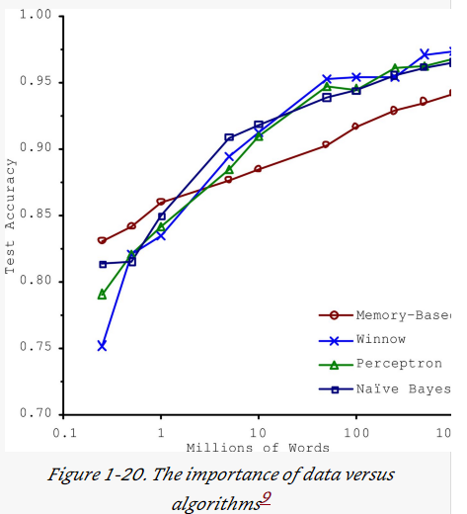
Main Challenges of ML: Insufficient Quantity of Training Data
Even for very simple problems you typically need thousands of examples, and for complex problems such as image or speech recognition you may need millions of examples
Very different ML algorithms, including fairly simple ones, performed almost identically well on a complex problem of natural language disambiguation once they were given enough data (Michele Banko et al, 2001)
As the authors put it: “these results suggest that we may want to reconsider the trade-off between spending time and money on algorithm development versus spending it on corpus development.”

Slide 31
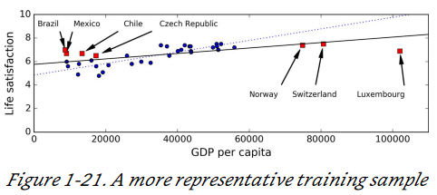
Main Challenges of ML: Non-representative Training Data
In order to generalize well, it is crucial that your training data be representative of the new cases you want to generalize to.
For example, the set of countries we used earlier for training the linear model was not perfectly representative; a few countries were missing.
By using a nonrepresentative training set, we trained a model that is unlikely to make accurate predictions, especially for very poor and very rich countries.

Slide 32
Main Challenges of ML: Poor-Quality Data
If your training data is full of errors, outliers, and noise (e.g., due to poor-quality measurements), it will make it harder for the system to detect the underlying patterns.
most data scientists spend a significant part of their time doing just that.
If some instances are clearly outliers, it may help to simply discard them or try to fix the errors manually.
If some instances are missing a few features (e.g., 5% of your customers did not specify their age), you must decide whether you want to ignore this attribute altogether, ignore these instances, fill in the missing values (e.g., with the median age), or train one model with the feature and one model without it, and so on.

Slide 33
Main Challenges of ML: Irrelevant features
Your system will only be capable of learning if the training data contains enough relevant features and not too many irrelevant ones.
Feature engineering involves:
Feature selection: selecting the most useful features to train on among existing features.
Feature extraction: combining existing features to produce a more useful one
Creating new features by gathering new data.

Slide 34
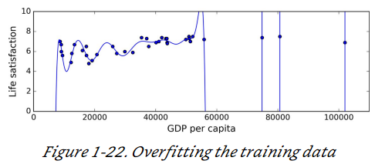
Main Challenges of ML: Overfitting the training data
The model performs well on the training data, but it does not generalize well
For example, say you feed your life satisfaction model many more attributes, including uninformative ones such as the country’s name. complex model may detect patterns like the fact that all countries in the training data with a w in their name have a life satisfaction greater than 7: New Zealand (7.3), Norway (7.4), Sweden (7.2), and Switzerland (7.5).

Slide 35
Main Challenges of ML: Overfitting the training data
Overfitting happens when the model is too complex relative to the amount and noisiness of the training data.
Possible solutions are :
To simplify the model by selecting one with fewer parameters, by reducing the number of attributes in the training data or by constraining the model
To gather more training data
To reduce the noise in the training data (e.g., fix data errors and remove outliers)

Slide 36
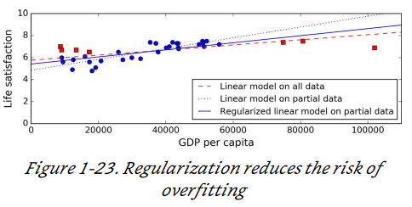
Main Challenges of ML: Overfitting the training data
Constraining a model to make it simpler and reduce the risk of overfitting → regularization
For example, the linear model we defined earlier has two parameters, θ₀ and θ₁. This gives the learning algorithm two degrees of freedom.
If we allow the algorithm to modify θ1 but we force it to keep it small, then the learning algorithm will effectively have somewhere in between one and two degrees of freedom.

Slide 37
Main Challenges of ML: Overfitting the training data
The amount of regularization to apply during learning can be controlled by a hyperparameter.
A hyperparameter is a parameter of a learning algorithm.
If you set the regularization hyperparameter to a very large value, you will get an almost flat model (a slope close to zero); the learning algorithm will almost certainly not overfit the training data, but it will be less likely to find a good solution.
Tuning hyperparameters is an important part of building a Machine Learning system

Slide 38
Main Challenges of ML: Underfitting the Training Data
underfitting is the opposite of overfitting: it occurs when your model is too simple to learn the underlying structure of the data.
For example, a linear model of life satisfaction is prone to underfit; reality is just more complex than the model, so its predictions are bound to be inaccurate, even on the training examples.
The main options to fix this problem are:
Selecting a more powerful model, with more parameters
Feeding better features to the learning algorithm (feature engineering)
Reducing the constraints on the model (e.g., reducing the regularization hyperparameter)

Slide 39
Testing and Validating
The only way to know how well a model will generalize to new cases is to actually try it out on new cases.
One way to do that is to put your model in production and monitor how well it performs. → Bad
Instead, split your data into two sets: the training set and the test set.
It is common to use 80% of the data for training and hold out 20% for testing.
The error rate on new cases is called the generalization error (or out-of-sample error)
If the training error is low (i.e., your model makes few mistakes on the training set) but the generalization error is high, it means that your model is overfitting the training data.

Slide 40
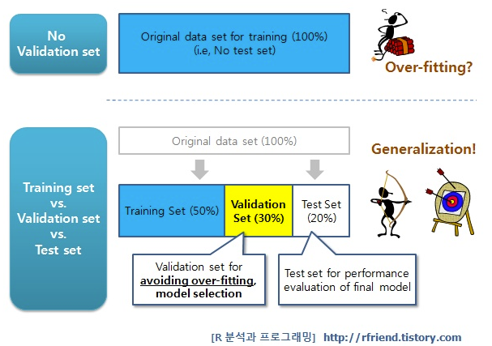
Testing and Validating
To detect the overfitting, split the dataset into three groups, i.e., training set (50%~60%), validation set (20%~25%), test set (20%~25%).
Training set is for training the model,
Validation set is for detecting the overfitting or underfitting,
Test set is for evaluating the final model <http://rfriend.tistory.com/188 >

Slide 41
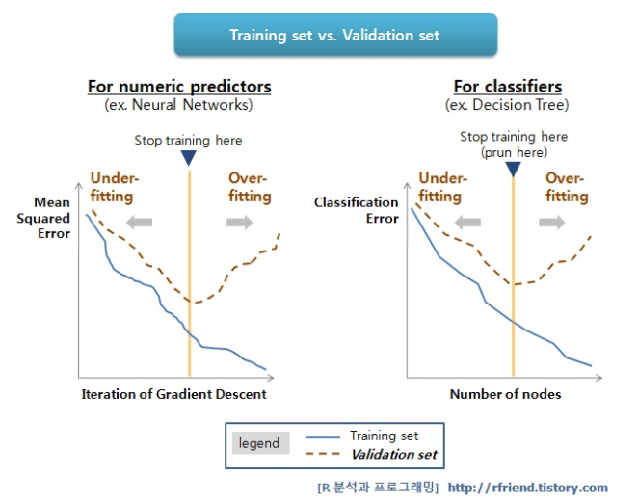
Testing and Validating
The inflection point of the dotted line could be the starting point of the overfitting

Slide 42
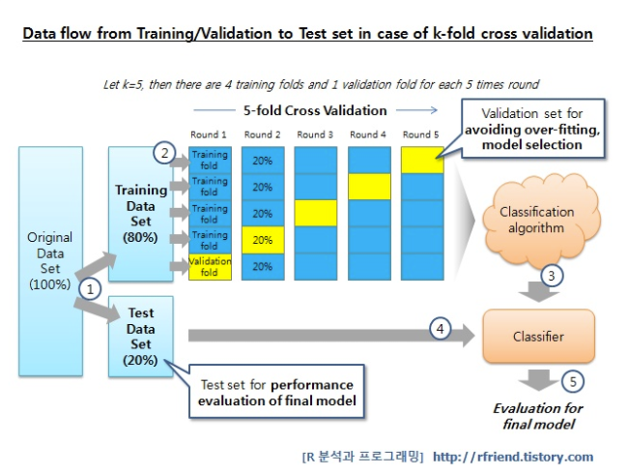
Testing and Validating : k-fold cross validation
To avoid wasting too much training data in validation sets, we use cross validation.

