Slide 1
Machine Learning Practice
Logistic Regression for Binary Classification

Slide 2
References
Andrew Ng’s ML class
https://class.coursera.org/ml-003/lecture
http://www.holehouse.org/mlclass/ (note)
Convolutional Neural Networks for Visual Recognition.
http://cs231n.github.io/
Tensorflow
https://www.tensorflow.org
https://github.com/aymericdamien/TensorFlow-Examples
모두의 머신러닝
Wikipedia

Slide 3

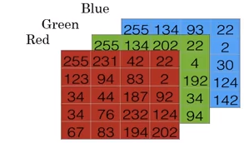
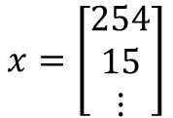
Binary Classification
Problem :
Input : an image
Output : Binary 1 (cat) or 0 (non cat)
Color representation in computers
$$x=\left[\begin{matrix}254 \\ 15 \\ ⋮\end{matrix}\right]$$
Unroll all pixel values into feature vectors
Feature vector
(n=64*64*3)
Three color channel
e.g., 64*64

Slide 4

Notations
A single training example $\left(x,y\right)$: $x∈R^{n_{x}}$, $y∈\left\{0,1\right\}$
m training example : ($x^{(1)},y^{(1)})$, ($x^{(2)},y^{(2)})$, …, ($x^{(m)},y^{(m)})$
# training set : $m_{train}$ , # test set : $m_{test}$
$X=\left[\begin{matrix}⋮ & ⋮ & ⋮ \\ x^{(1)} & x^{(2)} & x^{(m)} \\ ⋮ & ⋮ & ⋮\end{matrix}\right]$, $X∈R^{n_{x}×m}$
$Y=\left[\begin{matrix}y^{(1)} & y^{(2)} & y^{(m)}\end{matrix}\right]$, $Y∈R^{1×m}$

Slide 5
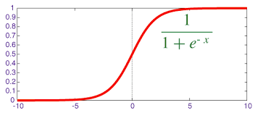

Logistic regression
Given x, assume that we want to find its prediction(or estimate)$\hat{y}=P(y=1|x)$
,where $x∈R^{n_{x}}$.
Use parameters : $w∈R^{n_{x}}$ and $b∈R$
Try an output : $\hat{y}=w^{T}x+b$ (linear regression)
Problems?
$\hat{y}$ should be between 0 and 1
An alternative called sigmoid : $\hat{y}={σ(w}^{T}x+b)$

Slide 6
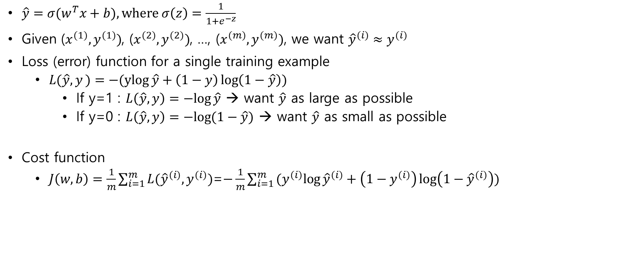
Cost function
$\hat{y}={σ(w}^{T}x+b), where σ\left(z\right)=\frac{1}{1+e^{−z}}$
Given ($x^{(1)},y^{(1)})$, ($x^{(2)},y^{(2)})$, …, ($x^{(m)},y^{(m)})$, we want ${\hat{y}}^{(i)}≈y^{(i)}$
Loss (error) function for a single training example
$L(\hat{y},y)=−(ylog{\hat{y}+\left(1−y\right)}\log\left(1−\hat{y}\right))$
If y=1 : $L\left(\hat{y},y\right)=−log{\hat{y}}$ → want $\hat{y}$ as large as possible
If y=0 : $L\left(\hat{y},y\right)=−log{(1−\hat{y})}$ → want $\hat{y}$ as small as possible
Cost function
$J\left(w,b\right)=\frac{1}{m}\sum_{i=1}^{m}{L({\hat{y}}^{(i)}, y^{(i)})}$=$−\frac{1}{m}\sum_{i=1}^{m}{(y^{(i)}log{{\hat{y}}^{(i)}+\left(1−y^{(i)}\right)}\log\left(1−{\hat{y}}^{(i)}\right))}$

Slide 7

Cost function – derivation 1
$\hat{y}={σ(w}^{T}x+b), where σ\left(z\right)=\frac{1}{1+e^{−z}}$
Interpret $\hat{y}=P\left(y=1 | x\right)$
Note that $y$ is binary and $\hat{y}$ is a real number
If y=1 : $P(y|x)=\hat{y}$
If y=0 : $P(y|x)= 1−\hat{y}$
→ $P\left(y | x\right)={\hat{y}}^{y}{\left(1−\hat{y}\right)}^{1−y}$
$logP\left(y | x\right)={log⁡\{\hat{y}}^{y}{\left(1−\hat{y}\right)}^{1−y}\}=ylog \hat{y}+\left(1−y\right)log⁡(1−\hat{y})$
→ loss function for a single data

Slide 8
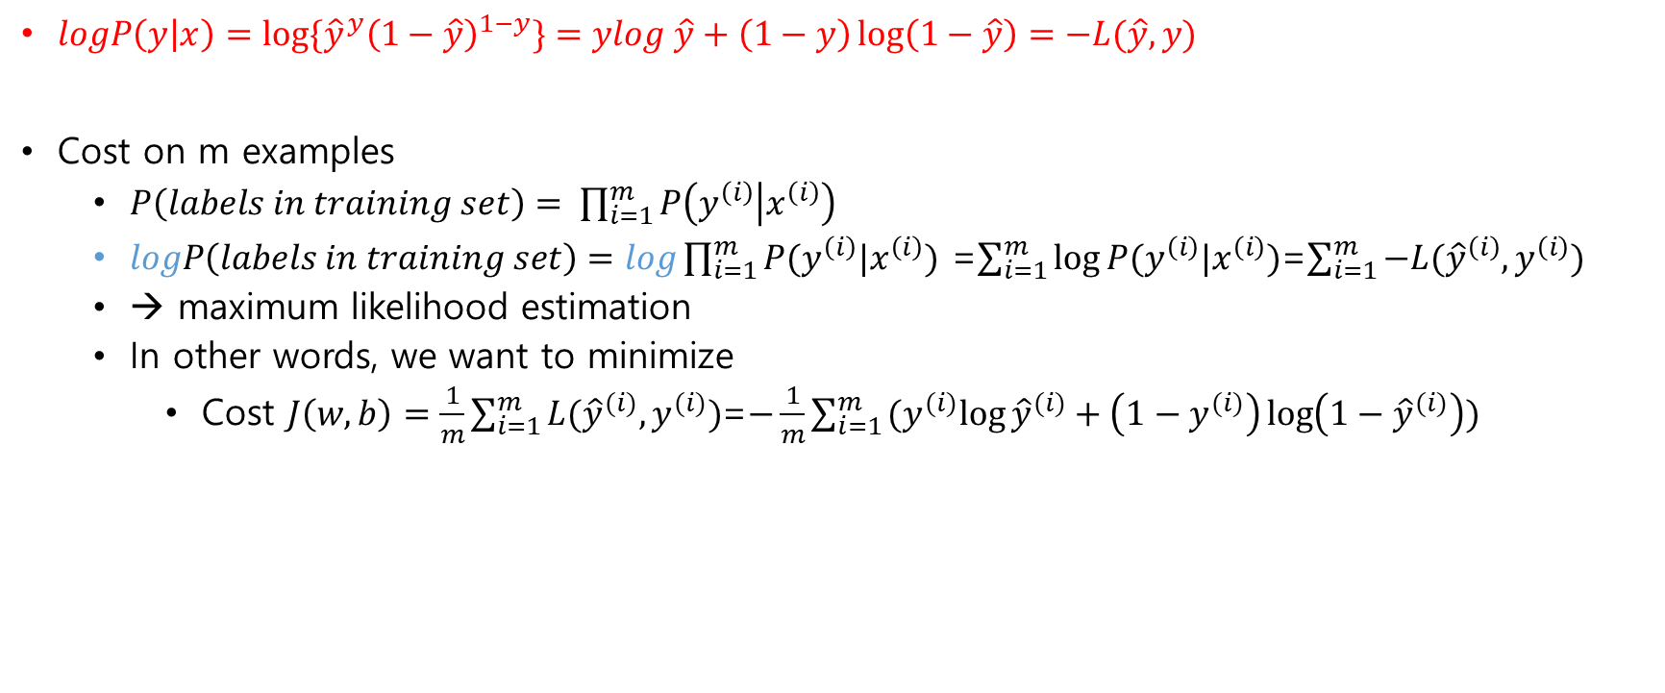
Cost function – derivation 2
$logP\left(y | x\right)={log⁡\{\hat{y}}^{y}{\left(1−\hat{y}\right)}^{1−y}\}=ylog \hat{y}+\left(1−y\right)\log\left(1−\hat{y}\right)=−L(\hat{y},y)$
Cost on m examples
$P\left(labels in training set\right)= \prod_{i=1}^{m}{P\left(y^{\left(i\right)} | x^{\left(i\right)}\right)}$
$logP\left(labels in training set\right)=log\prod_{i=1}^{m}{P(y^{\left(i\right)}|x^{\left(i\right)})}$ =$\sum_{i=1}^{m}{\log{P(y^{\left(i\right)}|x^{\left(i\right)})}}$=$\sum_{i=1}^{m}{−L({\hat{y}}^{\left(i\right)},y^{\left(i\right)})}$
→ maximum likelihood estimation
In other words, we want to minimize
Cost $J\left(w,b\right)=\frac{1}{m}\sum_{i=1}^{m}{L({\hat{y}}^{(i)}, y^{(i)})}$=$−\frac{1}{m}\sum_{i=1}^{m}{(y^{(i)}log{{\hat{y}}^{(i)}+\left(1−y^{(i)}\right)}\log\left(1−{\hat{y}}^{(i)}\right))}$

Slide 9
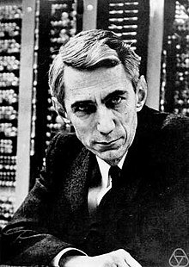
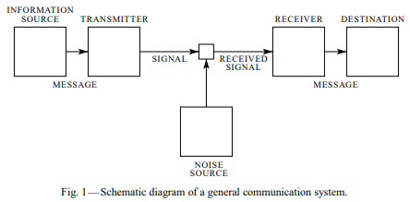
More thoughts on the cost function
Information theory by Claude Shannon
“A Mathematical Theory of Communication” in 1948
Claude Shannon, 1916~2001
https://www.youtube.com/watch?v=ErfnhcEV1O8&t=538s
https://en.wikipedia.org/wiki/Claude_Shannon

Slide 10



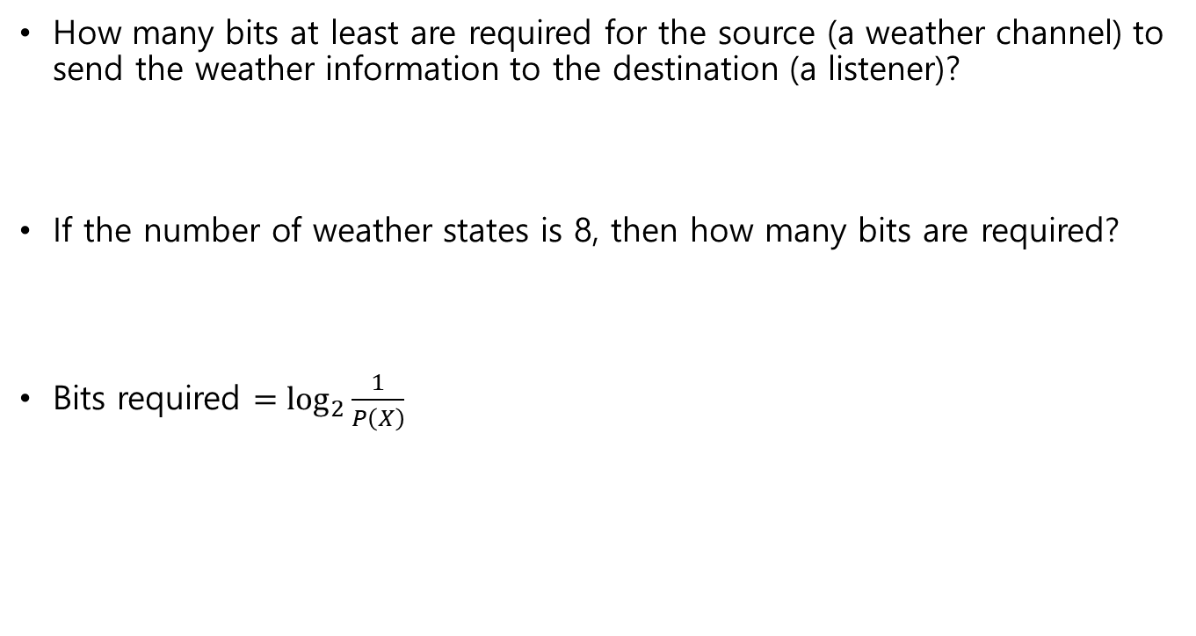
Entropy
How many bits at least are required for the source (a weather channel) to send the weather information to the destination (a listener)?
If the number of weather states is 8, then how many bits are required?
Bits required $=\log_{2}{\frac{1}{P\left(X\right)}}$
1/2
1/2
1/8
1/8
1/8
1/8
1/8
1/8
1/8
1/8

Slide 11
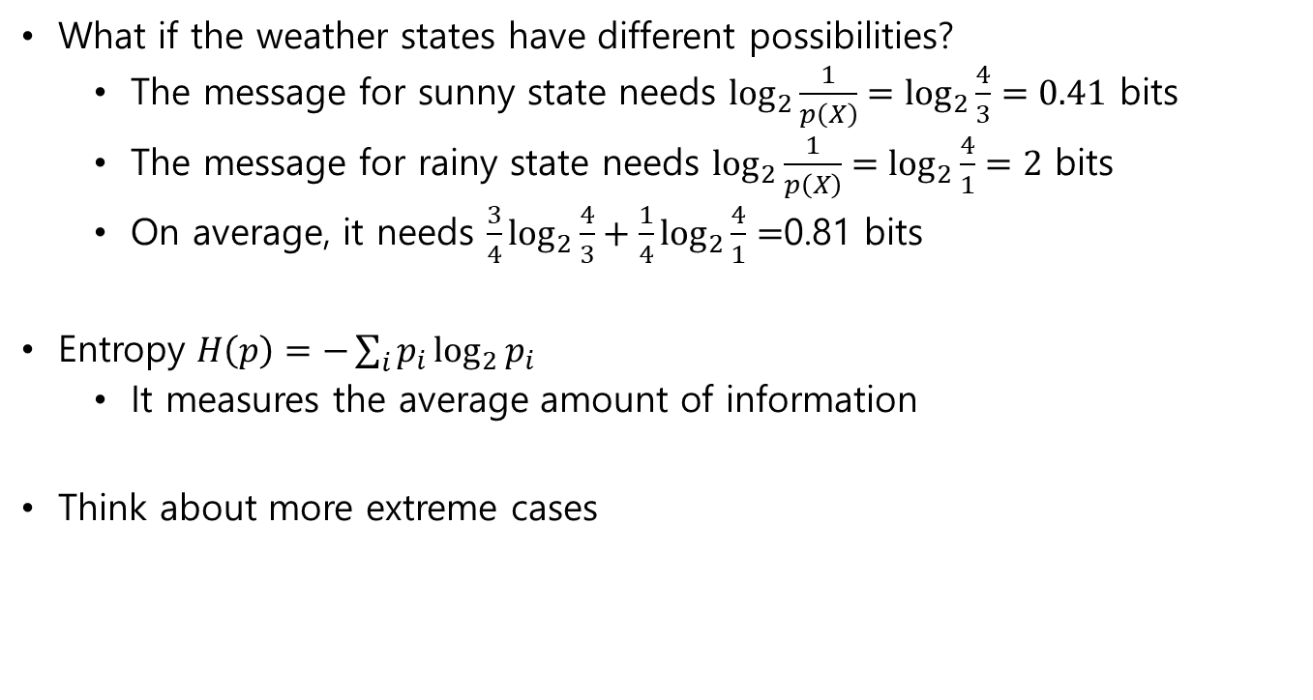
Entropy
What if the weather states have different possibilities?
The message for sunny state needs $\log_{2}\frac{1}{p\left(X\right)}=\log_{2}{\frac{4}{3}}=0.41$ bits
The message for rainy state needs $\log_{2}\frac{1}{p\left(X\right)}=\log_{2}{\frac{4}{1}}=2$ bits
On average, it needs $\frac{3}{4}\log_{2}{\frac{4}{3}+\frac{1}{4}\log_{2}{\frac{4}{1}}=}$0.81 bits
Entropy $H\left(p\right)=−\sum_{i}{p_{i}\log_{2}{p_{i}}}$
It measures the average amount of information
Think about more extreme cases
3/4
1/4

Slide 12
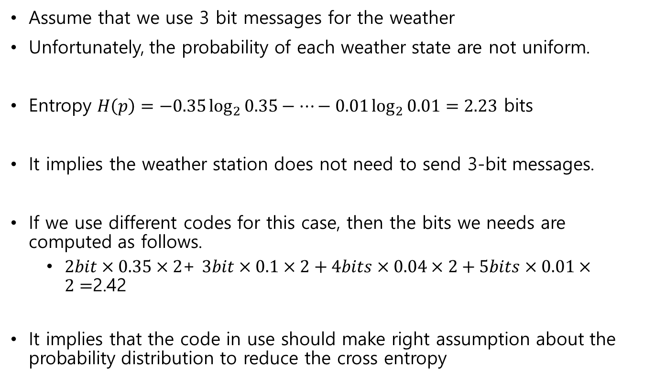
Cross-entropy
Assume that we use 3 bit messages for the weather
Unfortunately, the probability of each weather state are not uniform.
Entropy $H\left(p\right)=−0.35\log_{2}{0.35}−…−0.01\log_{2}{0.01}=2.23$ bits
It implies the weather station does not need to send 3-bit messages.
If we use different codes for this case, then the bits we needs are computed as follows.
$2bit×0.35×2$+ $3bit×0.1×2+4bits×0.04×2+5bits×0.01×2=$2.42
It implies that the code in use should make right assumption about the probability distribution to reduce the cross entropy
35%
35%
10%
10%
4%
4%
1%
1%
00
01
100
101
1100
1101
11101
11100

Slide 13
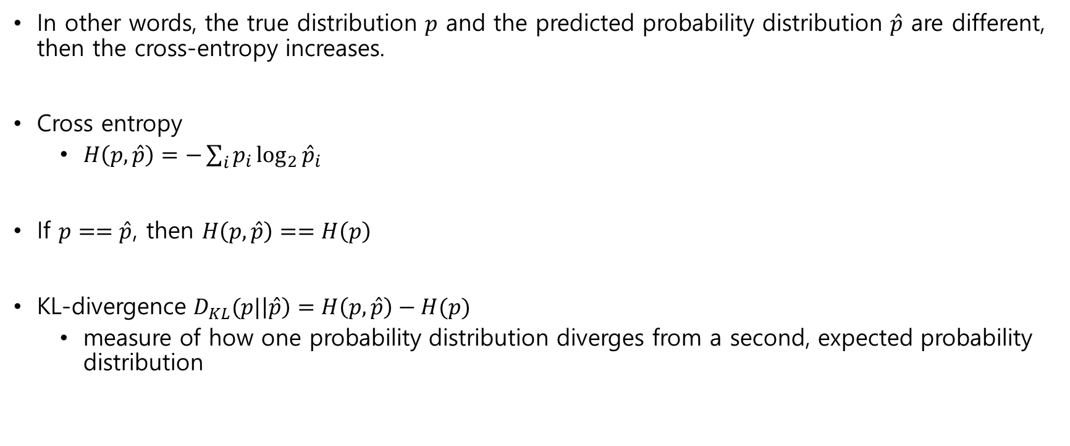
Cross-entropy
In other words, the true distribution $p$ and the predicted probability distribution $\hat{p}$ are different, then the cross-entropy increases.
Cross entropy
$H\left(p, \hat{p}\right)=−\sum_{i}{p_{i}\log_{2}{{\hat{p}}_{i}}}$
If $p==\hat{p}$, then $H\left(p, \hat{p}\right)==H\left(p\right)$
KL-divergence $D_{KL}(p|\left|\hat{p}\right)=H\left(p,\hat{p}\right)−H(p)$
measure of how one probability distribution diverges from a second, expected probability distribution

Slide 14

Cross-entropy vs. MSE (mean square error)
The cross-entropy function of logistic regression is convex!
$\frac{d^{2}L}{dw^{2}}≥0$
Faster learning (No $σ^{′}\left(z\right)$term in $\frac{∂}{∂w}J\left(w\right)$)

Slide 15
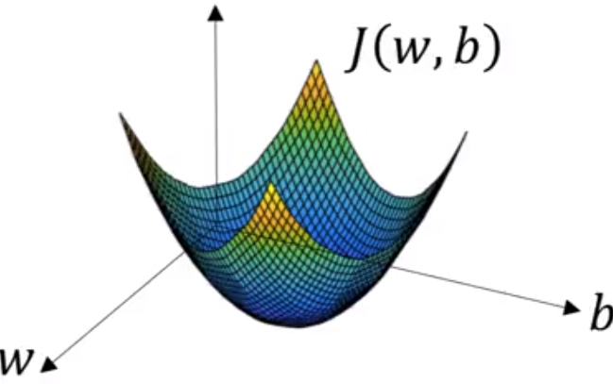
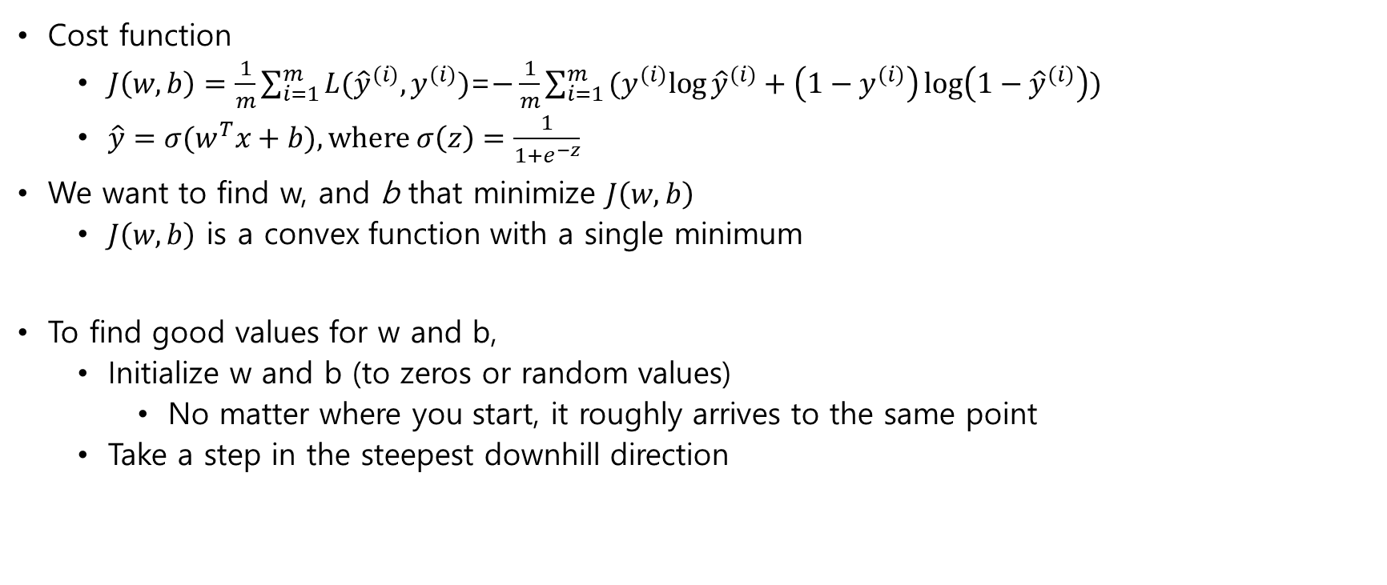
Gradient Descent
Cost function
$J\left(w,b\right)=\frac{1}{m}\sum_{i=1}^{m}{L({\hat{y}}^{(i)}, y^{(i)})}$=$−\frac{1}{m}\sum_{i=1}^{m}{(y^{(i)}log{{\hat{y}}^{(i)}+\left(1−y^{(i)}\right)}\log\left(1−{\hat{y}}^{(i)}\right))}$
$\hat{y}={σ(w}^{T}x+b), where σ\left(z\right)=\frac{1}{1+e^{−z}}$
We want to find w, and b that minimize $J\left(w,b\right)$
$J\left(w,b\right)$ is a convex function with a single minimum
To find good values for w and b,
Initialize w and b (to zeros or random values)
No matter where you start, it roughly arrives to the same point
Take a step in the steepest downhill direction

Slide 16


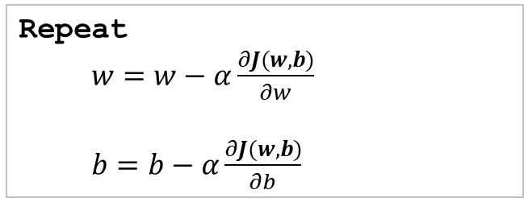


Gradient Descent
Just for illustration, ignore b temporarily
Cost : J(w)
Algorithm
J(w)
$$\frac{dJ(w)}{dw}<0$$
Repeat
$w=w−α\frac{dJ(w)}{dw}$
$$\frac{dJ(w)}{dw}>0$$
$α$: learning rate
w
Extended algorithm for w and b
Repeat
$w=w−α\frac{∂J(w,b)}{∂w}$
$b=b−α\frac{∂J(w,b)}{∂b}$

Slide 17

Computation graph
$J\left(a,b,c\right)$=3(a+bc)
U = bc
V = a + u
J = 3V
a=5
v=a+u
J=3v
b=3
u=bc
c=2
Forward propagation in the graph gives a result
Backward propagation yields derivatives

Slide 18
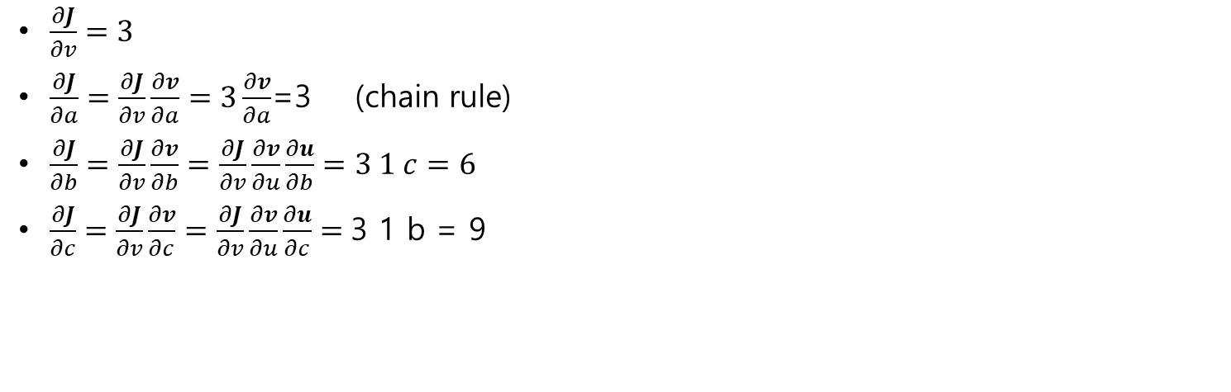
Computation graph with back propagation
a=5
b=3
v=a+u
J=3v
u=bc
c=2
$\frac{∂J}{∂v}=3$
$\frac{∂J}{∂a}=\frac{∂J}{∂v}\frac{∂v}{∂a}=3\frac{∂v}{∂a}$=3 (chain rule)
$\frac{∂J}{∂b}=\frac{∂J}{∂v}\frac{∂v}{∂b}=\frac{∂J}{∂v}\frac{∂v}{∂u}\frac{∂u}{∂b}=3 1 c=6$
$\frac{∂J}{∂c}=\frac{∂J}{∂v}\frac{∂v}{∂c}=\frac{∂J}{∂v}\frac{∂v}{∂u}\frac{∂u}{∂c}=$3 1 b = 9

Slide 19

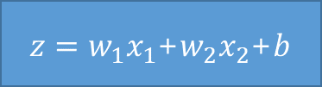

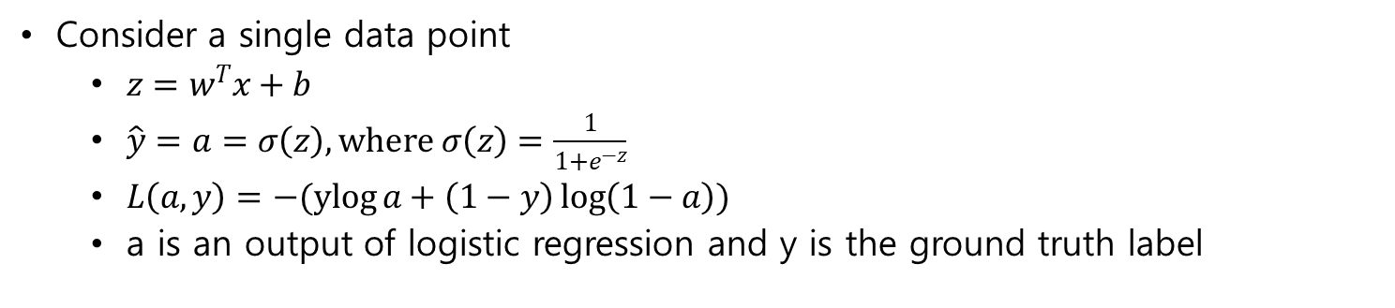


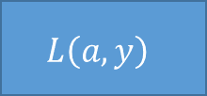

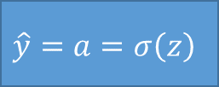
Logistic regression
Consider a single data point
${z=w}^{T}x+b$
$\hat{y}=a=σ\left(z\right), where σ\left(z\right)=\frac{1}{1+e^{−z}}$
$L\left(a,y\right)=−(ylog{a+\left(1−y\right)}\log\left(1−a\right))$
a is an output of logistic regression and y is the ground truth label
$$x_{1}$$
$$w_{1}$$
$$x_{2}$$
$z=w_{1}x_{1}$+$w_{2}x_{2}$+$b$
$$\hat{y}=a=σ\left(z\right)$$
$$L\left(a,y\right)$$
$$w_{2}$$
$$b$$
How to change w1, w2 and b to reduce the loss?

Slide 20




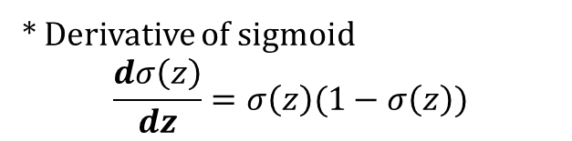
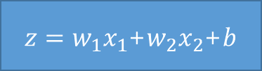





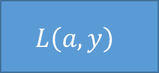
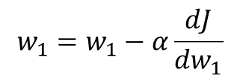
Logistic regression derivatives
$$x_{1}$$
$$w_{1}$$
$$x_{2}$$
$z=w_{1}x_{1}$+$w_{2}x_{2}$+$b$
$$\hat{y}=a=σ\left(z\right)$$
$$L\left(a,y\right)$$
$$w_{2}$$
$$b$$
$$\frac{dL(a,y)}{da}=−\frac{y}{a}+\frac{1−y}{1−a}$$
$\frac{dL(a,y)}{dw_{1}}=\frac{dL}{dz}\frac{dz}{dw_{1}}$=$(a−y)x_{1}$
$\frac{dL(a,y)}{dz}=\frac{dL}{da}\frac{da}{dz}$=$\frac{dL}{da}\left(a\left(1−a\right)\right)=a−y$
* Derivative of sigmoid
$$\frac{dσ\left(z\right)}{dz}=σ\left(z\right)(1−σ\left(z\right))$$
$$w_{1}=w_{1}−α\frac{dJ}{dw_{1}}$$

Slide 21



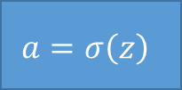

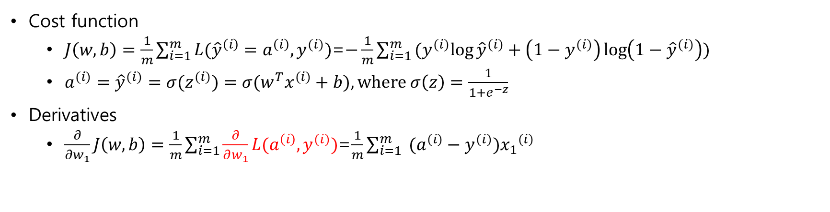






Logistic regression on m example
Cost function
$J\left(w,b\right)=\frac{1}{m}\sum_{i=1}^{m}{L({\hat{y}}^{\left(i\right)}=a^{\left(i\right)}, y^{(i)})}$=$−\frac{1}{m}\sum_{i=1}^{m}{(y^{(i)}log{{\hat{y}}^{(i)}+\left(1−y^{(i)}\right)}\log\left(1−{\hat{y}}^{(i)}\right))}$
$a^{(i)}={\hat{y}}^{(i)}=σ(z^{(i)})={σ(w}^{T}x^{(i)}+b), where σ\left(z\right)=\frac{1}{1+e^{−z}}$
Derivatives
$\frac{∂}{∂w_{1}}J\left(w,b\right)=\frac{1}{m}\sum_{i=1}^{m}{\frac{∂}{∂w_{1}}L(a^{\left(i\right)}, y^{(i)})}$=$\frac{1}{m}\sum_{i=1}^{m}{ (a^{(i)}−y^{(i)}){x_{1}}^{(i)}}$
$$L\left(a,y\right)$$
$${x_{1}}^{(i)}$$
$$w_{1}$$
$$w_{2}$$
$$z^{(i)}$$
$${x_{2}}^{(i)}$$
$$z=\sum{input}$$
$$a=σ\left(z\right)$$
$${\hat{y}}^{(i)}$$
$$b$$
$$1$$

Slide 22
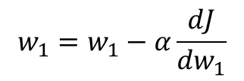
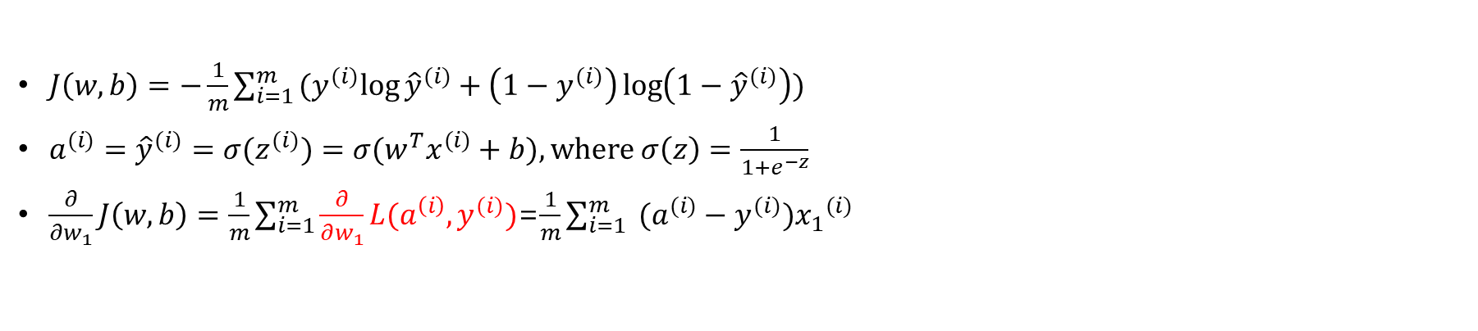
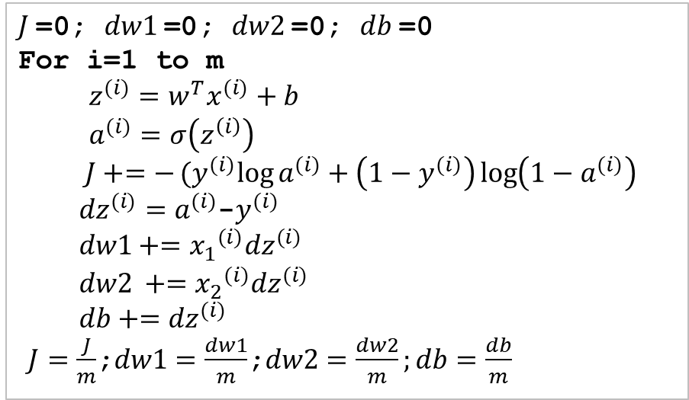
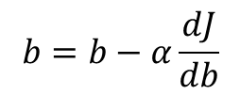
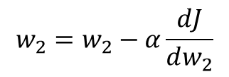
Logistic regression on m example
$J\left(w,b\right)=−\frac{1}{m}\sum_{i=1}^{m}{(y^{(i)}log{{\hat{y}}^{(i)}+\left(1−y^{(i)}\right)}\log\left(1−{\hat{y}}^{(i)}\right))}$
$a^{(i)}={\hat{y}}^{(i)}=σ(z^{(i)})={σ(w}^{T}x^{(i)}+b), where σ\left(z\right)=\frac{1}{1+e^{−z}}$
$\frac{∂}{∂w_{1}}J\left(w,b\right)=\frac{1}{m}\sum_{i=1}^{m}{\frac{∂}{∂w_{1}}L(a^{\left(i\right)}, y^{(i)})}$=$\frac{1}{m}\sum_{i=1}^{m}{ (a^{(i)}−y^{(i)}){x_{1}}^{(i)}}$
Algorithm for a single step of GD
$J$=0; $dw1$=0; $dw2$=0; $db$=0
For i=1 to m
$z^{(i)}=w^{T}x^{(i)}+b$
$a^{(i)}=σ\left(z^{\left(i\right)}\right)$
$J+=−(y^{(i)}log{a^{(i)}+\left(1−y^{(i)}\right)}\log\left(1−a^{(i)}\right)$
${dz}^{(i)}=a^{(i)}$-$y^{(i)}$
$dw1+={x_{1}}^{(i)}{dz}^{(i)}$
${dw2}^{ }+={x_{2}}^{(i)}{dz}^{(i)}$
$db+={dz}^{(i)}$
$J=\frac{J}{m}$;$dw1=\frac{dw1}{m}$;$dw2=\frac{dw2}{m};db=\frac{db}{m}$
$$w_{1}=w_{1}−α\frac{dJ}{dw_{1}}$$
$$w_{2}=w_{2}−α\frac{dJ}{dw_{2}}$$
$$b=b−α\frac{dJ}{db}$$

Slide 23




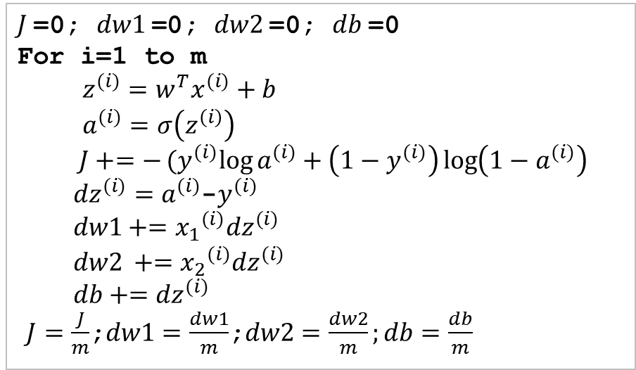






Logistic regression on m example
Algorithm for a single step of GD
$J$=0; $dw1$=0; $dw2$=0; $db$=0
For i=1 to m
$z^{(i)}=w^{T}x^{(i)}+b$
$a^{(i)}=σ\left(z^{\left(i\right)}\right)$
$J+=−(y^{(i)}log{a^{(i)}+\left(1−y^{(i)}\right)}\log\left(1−a^{(i)}\right)$
${dz}^{(i)}=a^{(i)}$-$y^{(i)}$
$dw1+={x_{1}}^{(i)}{dz}^{(i)}$
${dw2}^{ }+={x_{2}}^{(i)}{dz}^{(i)}$
$db+={dz}^{(i)}$
$J=\frac{J}{m}$;$dw1=\frac{dw1}{m}$;$dw2=\frac{dw2}{m};db=\frac{db}{m}$
$$L\left(a,y\right)$$
$${x_{1}}^{(i)}$$
$$w_{1}$$
$$w_{2}$$
$$z=\sum{input}$$
$$z^{(i)}$$
$$a=σ\left(z\right)$$
$${x_{2}}^{(i)}$$
$$a^{(i)}={\hat{y}}^{(i)}$$
$$1$$
$$b$$
Weakness : Running two for-loops for m and n takes long time

Slide 24
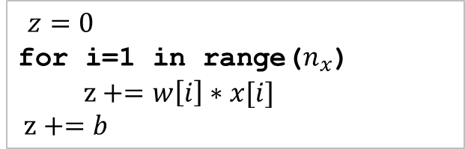
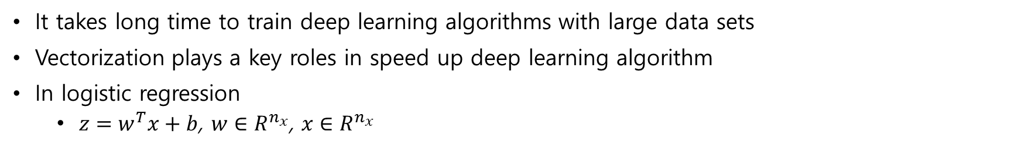
Vectorization
It takes long time to train deep learning algorithms with large data sets
Vectorization plays a key roles in speed up deep learning algorithm
In logistic regression
${z=w}^{T}x+b$, $w∈R^{n_{x}}$, $x∈R^{n_{x}}$
Non-vectorized
Vectorized
$z=0$
for i=1 in range($n_{x}$)
$z+=w\left[i\right]∗x[i]$
$z+=b$
Z=np.dot(w,x)+b

Slide 25
Experimental comparison
import numpy as np
import time
dim = 100000
a = np.random.rand(dim)
b = np.random.rand(dim)
tic = time.time()
c = np.dot(a,b)
toc = time.time()
print("Vectorized version: {:f} ms".format( (toc-tic)*1000 ) )
c = 0
tic = time.time()
for i in range(dim):
c += a[i]*b[i]
toc = time.time()
print("Non-vectorized version: {:f} ms".format( (toc-tic)*1000 ) )
Rule:
Whenever possible,
avoid explicit for-loops

Slide 26
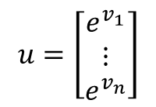
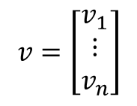
Neural network programming guideline
Whenever possible, avoid explicit for-loops
$$v=\left[\begin{matrix}v_{1} \\ ⋮ \\ v_{n}\end{matrix}\right]$$
$$u=\left[\begin{matrix}e^{v_{1}} \\ ⋮ \\ e^{v_{n}}\end{matrix}\right]$$
Non-vectorized
Vectorized
import math
n=10000
v = np.zeros((n,1))
for i in range(n):
u[i]=math.exp(v[i])
import numpy as np
n=10000
v = np.zeros((n,1))
u = np.exp(v)

Slide 27
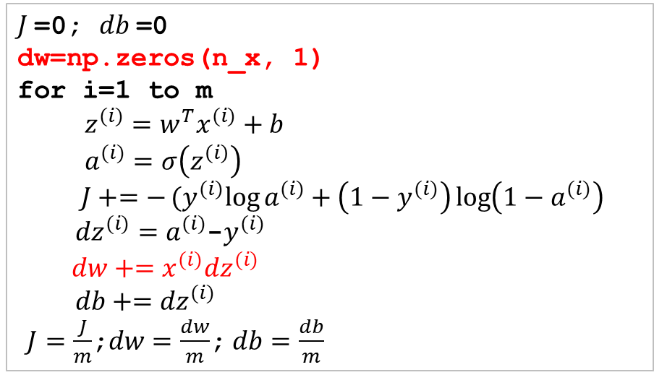
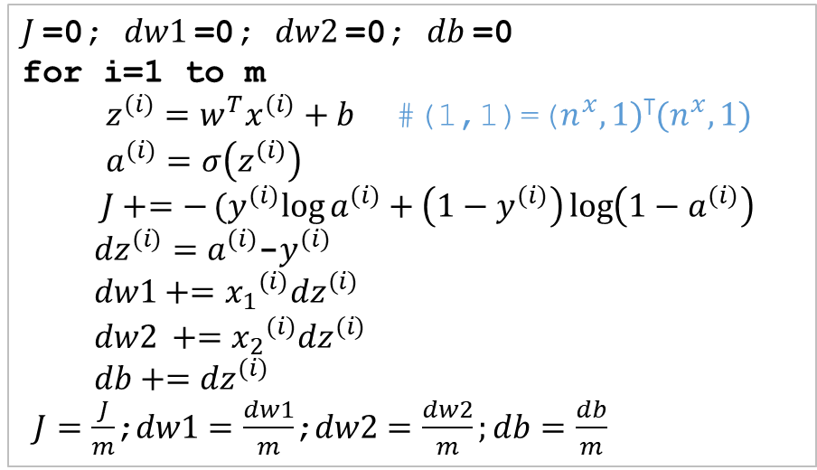

Logistic regression derivative
$J$=0; $dw1$=0; $dw2$=0; $db$=0
for i=1 to m
$z^{(i)}=w^{T}x^{(i)}+b$ #(1,1)=($n^{x},1)$^{T}$(n^{x},1)$
$a^{(i)}=σ\left(z^{\left(i\right)}\right)$
$J+=−(y^{(i)}log{a^{(i)}+\left(1−y^{(i)}\right)}\log\left(1−a^{(i)}\right)$
${dz}^{(i)}=a^{(i)}$-$y^{(i)}$
$dw1+={x_{1}}^{(i)}{dz}^{(i)}$
${dw2}^{ }+={x_{2}}^{(i)}{dz}^{(i)}$
$db+={dz}^{(i)}$
$J=\frac{J}{m}$;$dw1=\frac{dw1}{m}$;$dw2=\frac{dw2}{m};db=\frac{db}{m}$
$J$=0; $db$=0
dw=np.zeros(n_x, 1)
for i=1 to m
$z^{(i)}=w^{T}x^{(i)}+b$
$a^{(i)}=σ\left(z^{\left(i\right)}\right)$
$J+=−(y^{(i)}log{a^{(i)}+\left(1−y^{(i)}\right)}\log\left(1−a^{(i)}\right)$
${dz}^{(i)}=a^{(i)}$-$y^{(i)}$
$dw+=x^{(i)}{dz}^{(i)}$
$db+={dz}^{(i)}$
$J=\frac{J}{m}$;$dw=\frac{dw}{m}$;$db=\frac{db}{m}$
#dim $\left(n^{x},1\right)=(n^{x},1)(1,1)$
Two for-loops
One for-loop

Slide 28
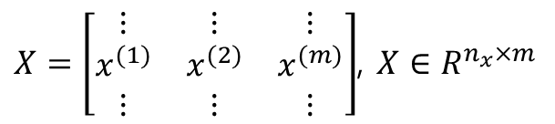

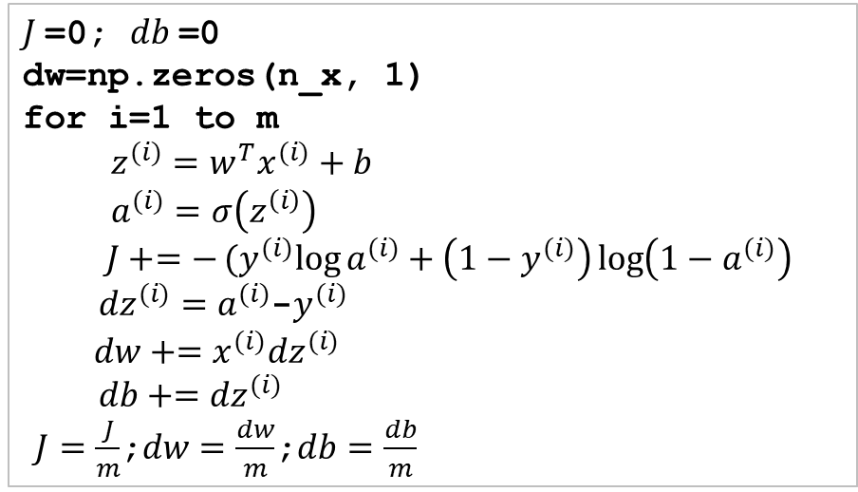



Logistic regression derivative – further vectorization
$J$=0; $db$=0
dw=np.zeros(n_x, 1)
for i=1 to m
$z^{(i)}=w^{T}x^{(i)}+b$
$a^{(i)}=σ\left(z^{\left(i\right)}\right)$
$J+=−(y^{(i)}log{a^{(i)}+\left(1−y^{(i)}\right)}\log\left(1−a^{(i)}\right)$
${dz}^{(i)}=a^{(i)}$-$y^{(i)}$
$dw+=x^{(i)}{dz}^{(i)}$
$db+={dz}^{(i)}$
$J=\frac{J}{m}$;$dw=\frac{dw}{m}$;$db=\frac{db}{m}$
Given
$X=\left[\begin{matrix}⋮ & ⋮ & ⋮ \\ x^{(1)} & x^{(2)} & x^{(m)} \\ ⋮ & ⋮ & ⋮\end{matrix}\right]$, $X∈R^{n_{x}×m}$
$\left[\begin{matrix}z^{(1)} & … & z^{(m)}\end{matrix}\right]$
$=w^{T}X+[\begin{matrix}b & b & … b\end{matrix}]$
= $\left[\begin{matrix}{w^{T}x}^{(1)}+b, & … & {w^{T}x}^{(m)}+b\end{matrix}\right]$
X
w^{T}
$$n^{x}$$
$$n^{x}$$
$$m$$
#python command
Z=np.dot(w.T,X)+b

Slide 29
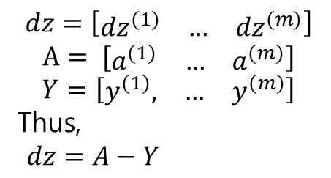

Logistic regression derivative – much further vectorization
$J$=0; $db$=0
dw=np.zeros(n_x, 1)
for i=1 to m
$z^{(i)}=w^{T}x^{(i)}+b$
$a^{(i)}=σ\left(z^{\left(i\right)}\right)$
$J+=−(y^{(i)}log{a^{(i)}+\left(1−y^{(i)}\right)}\log\left(1−a^{(i)}\right)$
${dz}^{(i)}=a^{(i)}$-$y^{(i)}$
$dw+=x^{(i)}{dz}^{(i)}$
$db+={dz}^{(i)}$
$J=\frac{J}{m}$;$dw=\frac{dw}{m}$;$db=\frac{db}{m}$
$$dz=\left[\begin{matrix}{dz}^{(1)} & … & {dz}^{(m)}\end{matrix}\right]$$
$$A= [\begin{matrix}a^{(1)} & … & a^{(m)}\end{matrix}]$$
$$Y=\left[\begin{matrix}y^{(1)}, & … & y^{(m)}\end{matrix}\right]$$
Thus,
$dz=A−Y$
One for-loop

Slide 30


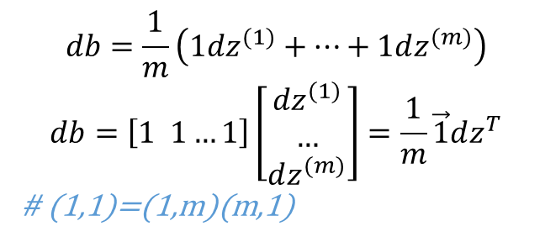
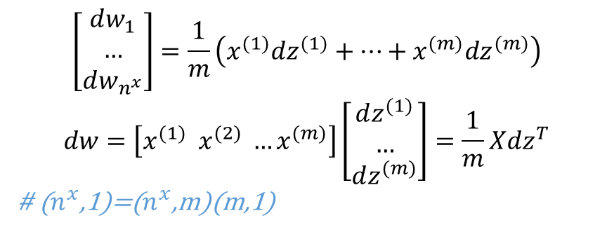
Logistic regression derivative – much further vectorization
$$dz=\left[\begin{matrix}{dz}^{(1)} & … & {dz}^{(m)}\end{matrix}\right]$$
$$\left[\begin{aligned}dw_{1} \\ … \\ dw_{n^{x}}\end{aligned}\right]=\frac{1}{m}\left(x^{(1)}dz^{(1)}+…+x^{(m)}dz^{(m)}\right)$$
$$dw=\left[x^{(1)} x^{(2)} …x^{(m)}\right]\left[\begin{aligned}dz^{(1)} \\ … \\ dz^{(m)}\end{aligned}\right]=\frac{1}{m}Xdz^{T}$$
# ($n^{x}$,1)=($n^{x}$,m)(m,1)
$J$=0; $db$=0
dw=np.zeros(n_x, 1)
for i=1 to m
$z^{(i)}=w^{T}x^{(i)}+b$
$a^{(i)}=σ\left(z^{\left(i\right)}\right)$
$J+=−(y^{(i)}log{a^{(i)}+\left(1−y^{(i)}\right)}\log\left(1−a^{(i)}\right)$
${dz}^{(i)}=a^{(i)}$-$y^{(i)}$
$dw+=x^{(i)}{dz}^{(i)}$
$db+={dz}^{(i)}$
$J=\frac{J}{m}$;$dw=\frac{dw}{m};db=\frac{db}{m}$
#python command
dw=np.dot(X,dz.T)/m
$$db=\frac{1}{m}\left(1dz^{(1)}+…+1dz^{(m)}\right)$$
$$db=\left[1 1…1\right]\left[\begin{aligned}dz^{(1)} \\ … \\ dz^{(m)}\end{aligned}\right]=\frac{1}{m}\vec{1}dz^{T}$$
# (1,1)=(1,m)(m,1)
One for-loop
#python command
db=np.sum(dz)/m

Slide 31
Logistic regression derivative – much further vectorization
$J$=0; $db$=0
dw=np.zeros(n_x, 1)
for i=1 to m
$z^{(i)}=w^{T}x^{(i)}+b$
$a^{(i)}=σ\left(z^{\left(i\right)}\right)$
$J+=−(y^{(i)}log{a^{(i)}+\left(1−y^{(i)}\right)}\log\left(1−a^{(i)}\right)$
${dz}^{(i)}=a^{(i)}$-$y^{(i)}$
$dw+=x^{(i)}{dz}^{(i)}$
$db+={dz}^{(i)}$
$J=\frac{J}{m}$;$dw=\frac{dw}{m};db=\frac{db}{m}$
#pseudo code
dw =np.zeros(n_x, 1)
Z = np.dot(w.T,X)+b
A = sigmoid(Z)
dz = A-Y
dw = np.dot(X,dz.T)/m
db = np.sum(dz)/m
w = w-alpha*dw
b = b-alpha*db

Slide 32
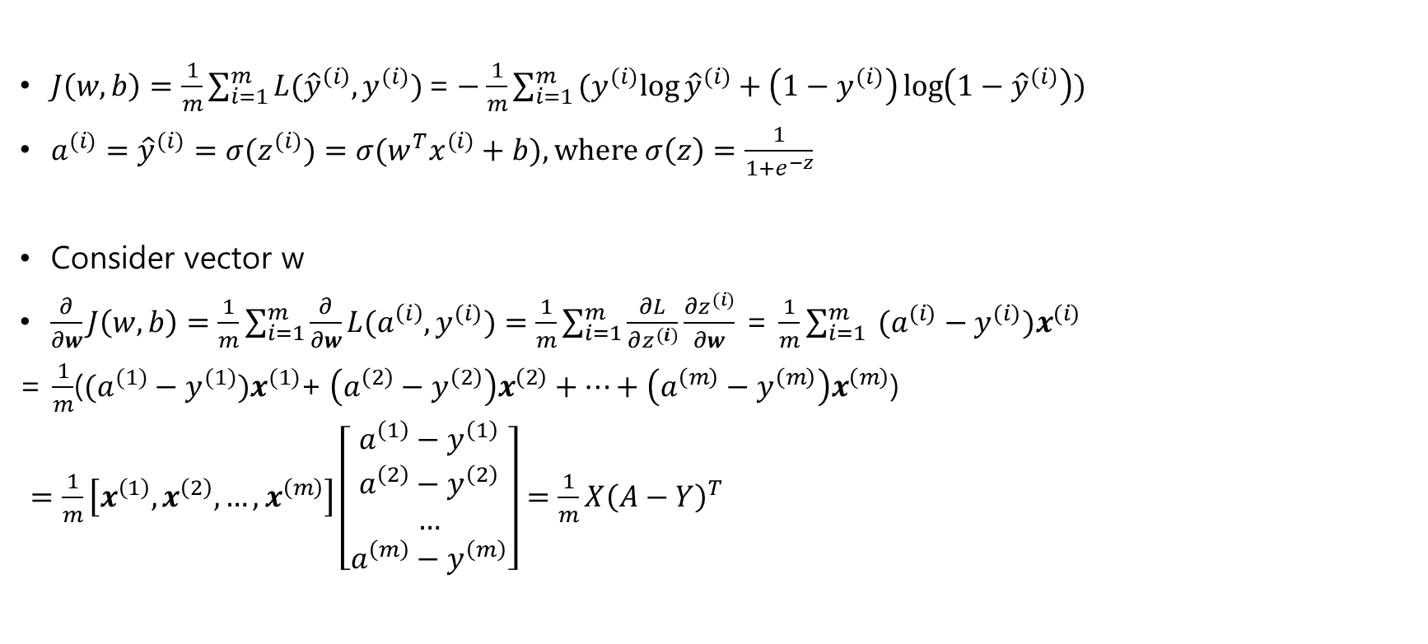
Alternative
$J\left(w,b\right)=\frac{1}{m}\sum_{i=1}^{m}{L({\hat{y}}^{\left(i\right)}, y^{(i)})}\text{=}−\frac{1}{m}\sum_{i=1}^{m}{(y^{(i)}log{{\hat{y}}^{(i)}+\left(1−y^{(i)}\right)}\log\left(1−{\hat{y}}^{(i)}\right))}$
$a^{(i)}={\hat{y}}^{(i)}=σ(z^{(i)})={σ(w}^{T}x^{(i)}+b), where σ\left(z\right)=\frac{1}{1+e^{−z}}$
Consider vector w
$\frac{∂}{∂w}J\left(w,b\right)=\frac{1}{m}\sum_{i=1}^{m}{\frac{∂}{∂w}L(a^{\left(i\right)}, y^{(i)})}=\frac{1}{m}\sum_{i=1}^{m}{\frac{∂L}{∂z^{(i)}}}\frac{∂z^{(i)}}{∂w}$ = $\frac{1}{m}\sum_{i=1}^{m}{ (a^{(i)}−y^{(i)})x^{(i)}}$
= $\frac{1}{m}$($(a^{(1)}−y^{(1)})x^{(1)}$+$\left(a^{\left(2\right)}−y^{\left(2\right)}\right)x^{\left(2\right)}+…+\left(a^{\left(m\right)}−y^{\left(m\right)}\right)x^{\left(m\right)}$)
$=\frac{1}{m}\left[x^{\left(1\right)},x^{\left(2\right)},…,x^{\left(m\right)}\right]\left[\begin{aligned}a^{\left(1\right)}−y^{\left(1\right)} \\ a^{\left(2\right)}−y^{\left(2\right)} \\ … \\ a^{\left(m\right)}−y^{\left(m\right)}\end{aligned}\right]=\frac{1}{m}X{\left(A−Y\right)}^{T}$

