Slide 1
Useful tips for lab. - CNNs

Slide 2


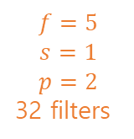







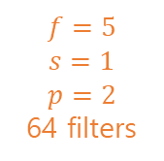



What we build
CONV1
POOL1
CONV2
POOL2
Maxpool
Maxpool
=
$$f=5$$
$$s=1$$
$$p=2$$
32 filters
$$f=2$$
$$s=2$$
$$f=5$$
$$s=1$$
$$p=2$$
64 filters
$$f=2$$
$$s=2$$
$$28×28×32$$
$$14×14×32$$
$$14×14×64$$
$$7×7×64$$
$$28×28×1$$
(grey scale)
$$3136$$
Layer 1
Layer 2
FC3
FC4
$$W^{\left[3\right]}:\left(1024,3136\right)$$
$$b^{\left[3\right]}:(1024)$$
$$W^{\left[4\right]}:\left(10,1024\right)$$
$$b^{\left[4\right]}:(10)$$
$$1024$$
$$10$$
LeCun et al. 1988, Gradient-based learning applied to document recognition

Slide 3
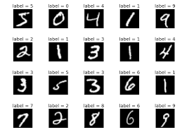
MNIST
Modified National Institute of Standards and Technology database
http://yann.lecun.com/exdb/mnist/
The MNIST database of handwritten digits, available from this page, has a training set of 60,000 examples, and a test set of 10,000 examples
Modified National Institute of Standards and Technology database

Slide 4
tf.nn.conv2d()
tf.nn.conv2d(
input, # a tensor
filter, # a tensor having the shape [filter_height, filter_width, in_channels, out_channels]
strides, # A list of ints. 1-D tensor of length 4.
padding, # "SAME“ for padding or "VALID“ for no padding
use_cudnn_on_gpu=True,
data_format='NHWC', # [batch, height, width, channels].
dilations=[1, 1, 1, 1],
name=None
)
return a tensor having the same type as input
For “SAME” padding, out_height = ceil(float(in_height) / float(strides[1]))
For “VALID” padding, out_width = ceil( (float(in_width)-(filter_width-1)*dialation_rate[2])) / float(strides[2] )

Slide 5
tf.nn.bias_add()
tf.nn.bias_add(
value,
bias,
data_format=None,
name=None
)
value: A Tensor with type float, double, int64, int32, uint8, int16, int8, complex64, or complex128.
bias: A 1-D Tensor with size matching the last dimension of value. Must be the same type as value unless value is a quantized type, in which case a different quantized type may be used.
data_format: A string. 'NHWC' and 'NCHW' are supported.
name: A name for the operation (optional).

Slide 6
tf.nn.relu(conv.+B)
tf.nn.relu(
features, # a tensor
name=None
)
Return a tensor

Slide 7
tf.nn.max_pool
tf.nn.max_pool(
value, # 4-D tensor
ksize, # 1-D int tensor of 4 element, The size of the window
strides, # 1-D int tensor of 4 elements
padding, # ‘VALID’ or ‘SAME’
data_format='NHWC',
name=None
)

Slide 8


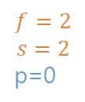
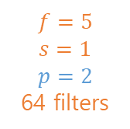

Example
# P1’s shape : (None, 14, 14, 32)
# W2’s shape : (5,5,32,64)
# Z2’s shape : (None, 14, 14, 64)
# P2’s shape : (None, 7, 7, 64)
Z2 = tf.nn.conv2d(P1, W2, strides = [1,1,1,1], padding = 'SAME’)
Z2 = tf.nn.bias_add(Z2, B2)
A2 = tf.nn.relu(Z2)
P2 = tf.nn.max_pool(A2, ksize = [1,2,2,1], strides = [1,2,2,1], padding = 'SAME’)
CONV
POOL
Maxpool
P1
Z2=A2
$$f=5$$
$$s=1$$
$$p=2$$
64 filters
$$f=2$$
$$s=2$$
p=0
P2
$$14×14×32$$
$$14×14×64$$
$$7×7×64$$

Slide 9
tf.contrib.layers.flatten(P2)
tf.contrib.layers.flatten(
inputs, # a tensor of size [batch_size,…]
outputs_collections=None, # collection to add the outputs
scope=None
)
Return a flattened tensor with shape [batch_size, k]

Slide 10
tf.nn.softmax_cross_entropy_with_logits_v2()
tf.nn.softmax_cross_entropy_with_logits_v2(
labels, # Each row labels[i] must be a valid probability distribution
logits, # Unscaled log probabilities
axis=None,
name=None,
dim=None
)
Return A 1-D Tensor of length batch_size of the same type as logits with the softmax cross entropy loss.

Slide 11
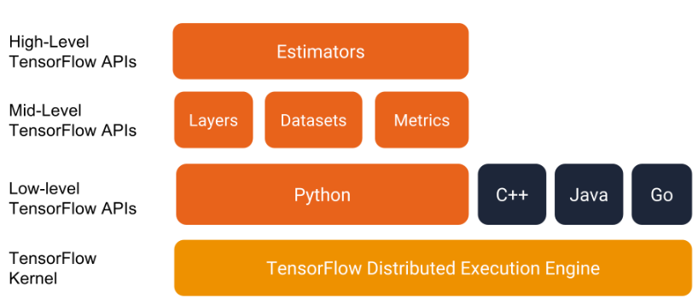
The programming stack
https://www.tensorflow.org/get_started/premade_estimators

Slide 12
datasets
The tf.data API enables you to build complex input pipelines from simple, reusable pieces.
In order to use a Dataset we need three steps:
Import data : Create a Dataset instance from data
Create an Iterator : By using the created dataset to make an Iterator instance to iterate through the dataset
Consume data : By using the created iterator we can get the elements from the dataset to feed the model
https://www.tensorflow.org/programmers_guide/datasets
https://towardsdatascience.com/how-to-use-dataset-in-tensorflow-c758ef9e4428

Slide 13
Datasets : importing data
From numpy arraies
# create a random vector of shape (100,2)
x = np.random.sample((100,2))
# make a dataset from a numpy array
dataset = tf.data.Dataset.from_tensor_slices(x)
From tensors
# using a tensor
dataset = tf.data.Dataset.from_tensor_slices(tf.random_uniform([100, 2]))
From placeholder
x = tf.placeholder(tf.float32, shape=[None,2])
dataset = tf.data.Dataset.from_tensor_slices(x)

Slide 14
Datasets : create an iterator
Once you have built a Dataset to represent your input data, the next step is to create an Iterator to access elements from that dataset.
one-shot,
initializable,
reinitializable, and
feedable.
An initializable iterator requires you to run an explicit iterator.initializer operation before using it. In exchange for this inconvenience, it enables you to parameterize the definition of the dataset, using one or more tf.placeholder() tensors that can be fed when you initialize the iterator.

Slide 15
Datasets : create an iterator
Once you have built a Dataset to represent your input data, the next step is to create an Iterator to access elements from that dataset.
# initializable iterator to switch between dataset
EPOCHS = 10
train_data = (np.random.sample((100,2)), np.random.sample((100,1)))
test_data = (np.array([[1,2]]), np.array([[0]]))
x, y = tf.placeholder(tf.float32, shape=[None,2]), tf.placeholder(tf.float32, shape=[None,1])
dataset = tf.data.Dataset.from_tensor_slices((x, y))
iter = dataset.make_initializable_iterator()
features, labels = iter.get_next()
with tf.Session() as sess:
# initialize iterator with train data (or use iterator.make_initializer() )
sess.run(iter.initializer, feed_dict={ x: train_data[0], y: train_data[1]})
for _ in range(EPOCHS):
sess.run([features, labels])
# switch to test data
sess.run(iter.initializer, feed_dict={ x: test_data[0], y: test_data[1]})
print(sess.run([features, labels]))

