Slide 1
Machine Learning Practices
CNNs

Slide 2
References
Andrew Ng’s ML class
https://class.coursera.org/ml-003/lecture
http://www.holehouse.org/mlclass/ (note)
Convolutional Neural Networks for Visual Recognition.
http://cs231n.github.io/
Tensorflow
https://www.tensorflow.org
https://github.com/aymericdamien/TensorFlow-Examples
모두의 머신러닝
Wikipedia
Neural Network and Deep Learning, Michael Nielsen,
http://neuralnetworksanddepplearning.com

Slide 3
Computer vision problems
Image classification
Object detection
Neural style transfer
Etc…

Slide 4
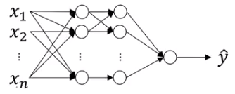
Deep learning on large images
If the resolution of an input image is 64 x 64 x 3 (=12,228), the number of hyperparameters (i.e. W) will be:
Assume that we use 1,000 hidden units
Dim of X : (12,288, m)
Dim of W in the 1st layer: (1,000, 12,288) → 12M
If the resolution of an input image is 1,000 x 1,000 x 3 (=3M), the number of hyperparameters (i.e. W) will be:
Assume that we use 1,000 hidden units
Dim of X : (3M, m)
Dim of W in the 1st layer: (1,000, 3M) → 3B

Slide 5
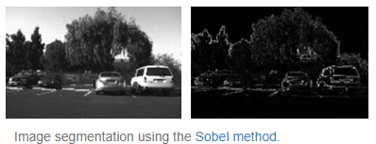
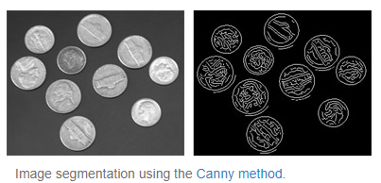
Edge detection
Edge detection is an image processing technique for finding the boundaries of objects within images
Source : https://www.mathworks.com/discovery/edge-detection.html

Slide 6
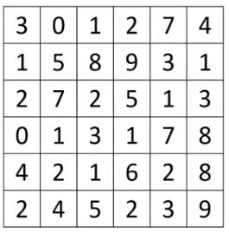
Vertical edge detection by convolution
$$3×1+1×1+2×1+0×0+5×0+7×0+1×\left(−1\right)+8×\left(−1\right)+2×\left(−1\right)=−5$$
$$0×1+5×1+7×1+1×0+8×0+2×0+2×\left(−1\right)+9×\left(−1\right)+5×\left(−1\right)=−5$$
-5 | -4
1 | 0 | -1
1 | 0 | -1
1 | 0 | -1
*
3x3 filter

Slide 7
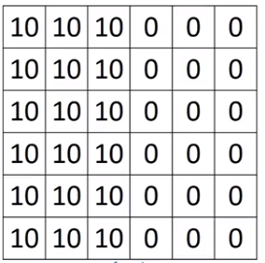



Vertical edge detection by convolution
$$3×1+1×1+2×1+0×0+5×0+7×0+1×\left(−1\right)+8×\left(−1\right)+2×\left(−1\right)=−5$$
$$0×1+5×1+7×1+1×0+8×0+2×0+2×\left(−1\right)+9×\left(−1\right)+5×\left(−1\right)=−5$$
0 | 30 | 30 | 0
0 | 30 | 30 | 0
0 | 30 | 30 | 0
0 | 30 | 30 | 0
1 | 0 | -1
1 | 0 | -1
1 | 0 | -1
*
3x3 filter
*

Slide 8
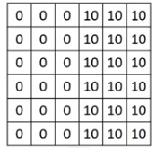

Vertical edge detection by convolution
1 | 0 | -1
1 | 0 | -1
1 | 0 | -1
-30 | 0 | 0 | -30
-30 | 0 | 0 | -30
-30 | 0 | 0 | -30
-30 | 0 | 0 | -30
*
3x3 filter
*

Slide 9
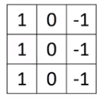
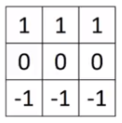
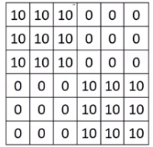
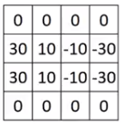
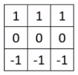
Vertical and horizontal edge detection
*

Slide 10
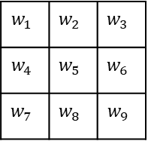
Learning to detect edges
3 | 0 | -3
10 | 0 | -10
3 | 0 | -3
1 | 0 | -1
2 | 0 | -2
1 | 0 | -1
Sobel filter
Scharr filter
$$w_{1}$$ | $$w_{2}$$ | $$w_{3}$$
$$w_{4}$$ | $$w_{5}$$ | $$w_{6}$$
$$w_{7}$$ | $$w_{8}$$ | $$w_{9}$$
*

Slide 11
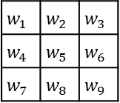
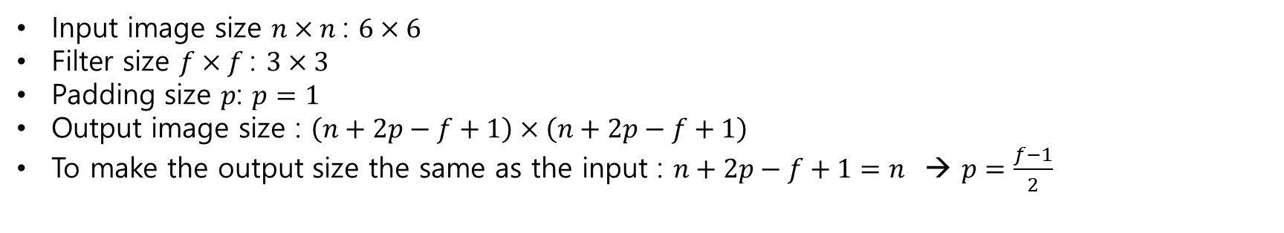
Padding
$$w_{1}$$ | $$w_{2}$$ | $$w_{3}$$
$$w_{4}$$ | $$w_{5}$$ | $$w_{6}$$
$$w_{7}$$ | $$w_{8}$$ | $$w_{9}$$
*
Input image size $n×n$: $6×6$
Filter size $f×f$: $3×3$
Padding size $p$: $p=1$
Output image size : $\left(n+2p−f+1\right)×\left(n+2p−f+1\right)$
To make the output size the same as the input : $n+2p−f+1=n$ → $p=\frac{f−1}{2}$

Slide 12
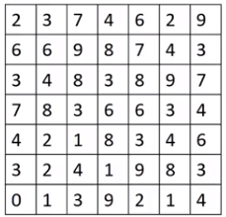
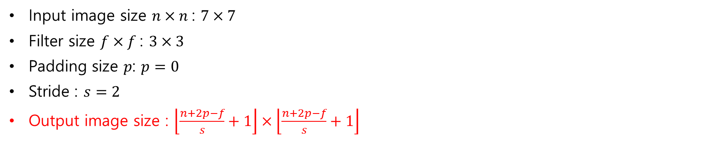
Stride
*
Input image size $n×n$: $7×7$
Filter size $f×f$: $3×3$
Padding size $p$: $p=0$
Stride : $s=2$
Output image size : $\left\lfloor \frac{n+2p−f}{s}+1\right\rfloor ×\left\lfloor \frac{n+2p−f}{s}+1\right\rfloor$
* cross-correlation vs. convolution

Slide 13



Convolution on RGB images
*
$$3×3×3$$
$$5×5×1$$
$$height×width×\#channels$$
$$7×7×3$$
*

Slide 14
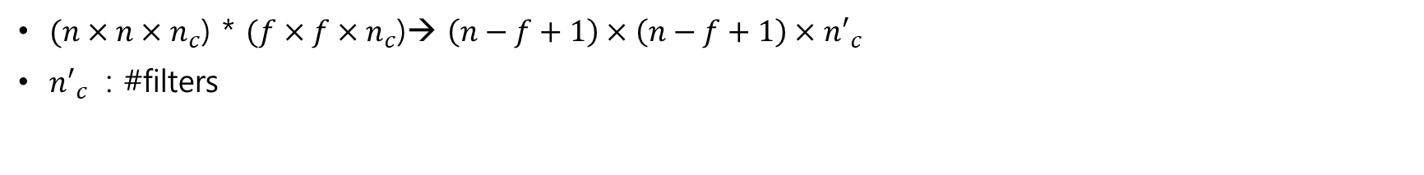


Multiple filters
*
$$3×3×3$$
*
$$5×5×2$$
$$height×width×\#channels$$
$$7×7×3$$
$$3×3×3$$
$(n×n×n_{c}$) * $(f×f×n_{c}$)→ $\left(n−f+1\right)×\left(n−f+1\right)×{n′}_{c}$
${n′}_{c}$ : #filters

Slide 15




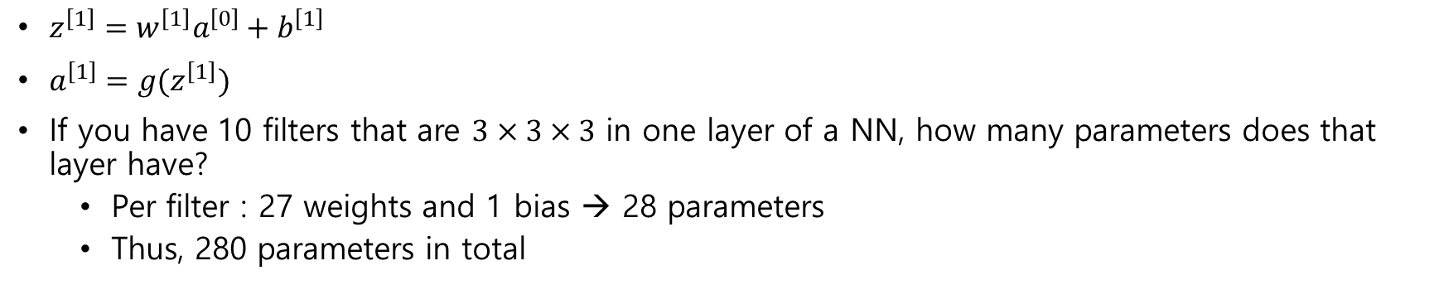




A single conv. layer
ReLU( $+b_{1})$
*
$$w^{\left[1\right]}a^{\left[0\right]}$$
$$3×3×3$$
$$height×width×\#channels$$
$$7×7×3$$
$$w^{\left[1\right]}a^{\left[0\right]}$$
*
ReLU( $+b_{2})$
$$5×5×2$$
$$3×3×3$$
$$a^{\left[1\right]}$$
$$z^{\left[1\right]}$$
$z^{\left[1\right]}=w^{\left[1\right]}a^{\left[0\right]}+b^{\left[1\right]}$
$a^{\left[1\right]}=g(z^{\left[1\right]})$
If you have 10 filters that are $3×3×3$ in one layer of a NN, how many parameters does that layer have?
Per filter : 27 weights and 1 bias → 28 parameters
Thus, 280 parameters in total

Slide 16
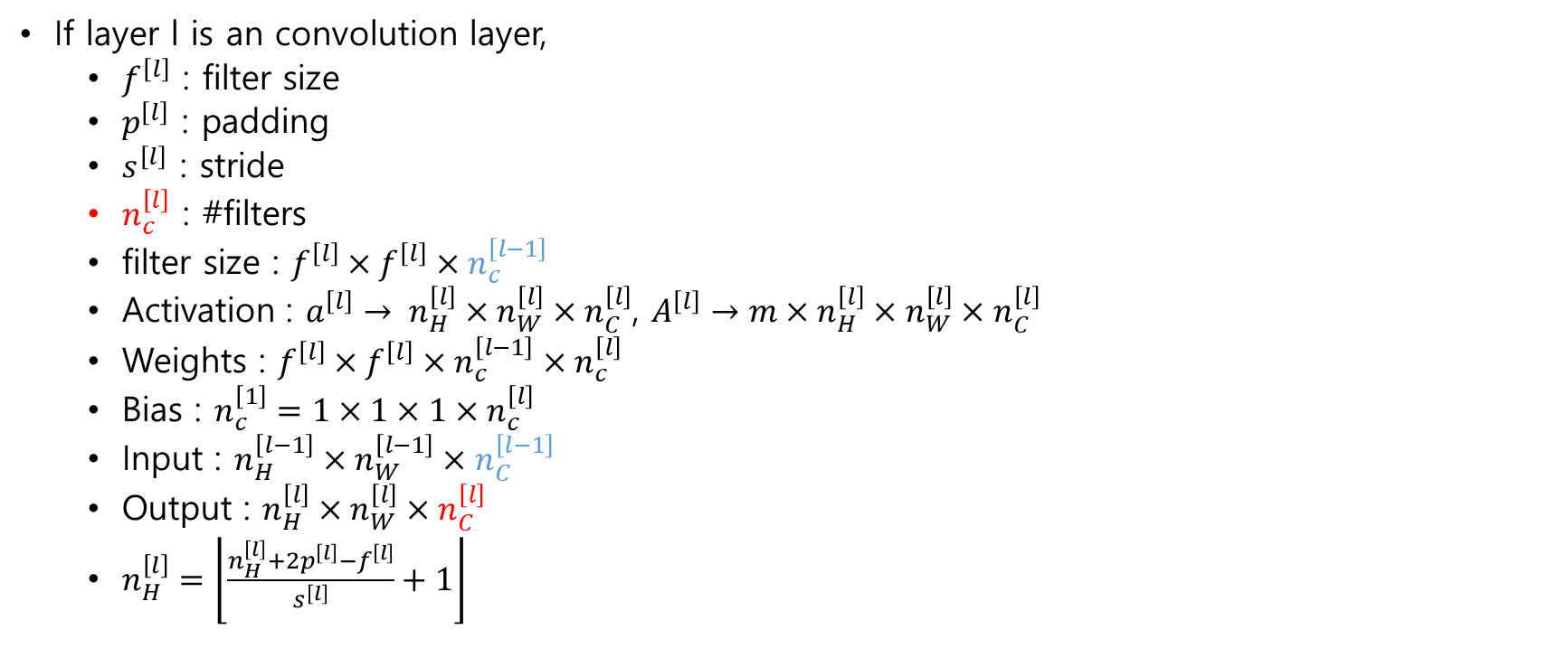
Notations
If layer l is an convolution layer,
$f^{\left[l\right]}$ : filter size
$p^{\left[l\right]}$ : padding
$s^{\left[l\right]}$ : stride
$n_{c}^{\left[l\right]}$ : #filters
filter size : $f^{\left[l\right]}×f^{\left[l\right]}×n_{c}^{\left[l−1\right]}$
Activation : $a^{\left[l\right]}→ n_{H}^{\left[l\right]}×n_{W}^{\left[l\right]}×n_{C}^{\left[l\right]}$, $A^{\left[l\right]}→m×n_{H}^{\left[l\right]}×n_{W}^{\left[l\right]}×n_{C}^{\left[l\right]}$
Weights : $f^{\left[l\right]}×f^{\left[l\right]}×n_{c}^{\left[l−1\right]}×n_{c}^{\left[l\right]}$
Bias : $n_{c}^{\left[1\right]}=1×1×1×n_{c}^{\left[l\right]}$
Input : $n_{H}^{\left[l−1\right]}×n_{W}^{\left[l−1\right]}×n_{C}^{\left[l−1\right]}$
Output : $n_{H}^{\left[l\right]}×n_{W}^{\left[l\right]}×n_{C}^{\left[l\right]}$
$n_{H}^{\left[l\right]}=\left\lfloor \frac{n_{H}^{\left[l\right]}+2p^{\left[l\right]}−f^{\left[l\right]}}{s^{\left[l\right]}}+1\right\rfloor$

Slide 17


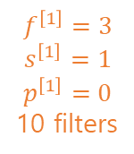


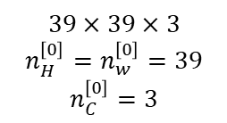
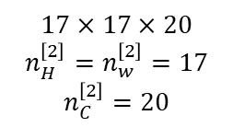

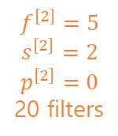

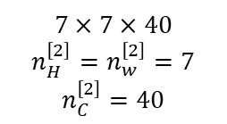
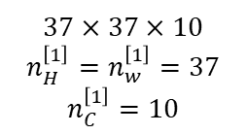


Example
$$a^{\left[1\right]}$$
$$a^{\left[2\right]}$$
$$a^{\left[3\right]}$$
$$f^{\left[1\right]}=3$$
$$s^{\left[1\right]}=1$$
$$p^{\left[1\right]}=0$$
10 filters
$$f^{\left[2\right]}=5$$
$$s^{\left[2\right]}=2$$
$$p^{\left[2\right]}=0$$
20 filters
$$f^{\left[3\right]}=5$$
$$s^{\left[3\right]}=2$$
$$p^{\left[2\right]}=0$$
40 filters
$$39×39×3$$
$$n_{H}^{\left[0\right]}=n_{w}^{\left[0\right]}=39$$
$$n_{C}^{\left[0\right]}=3$$
$$37×37×10$$
$$n_{H}^{\left[1\right]}=n_{w}^{\left[1\right]}=37$$
$$n_{C}^{\left[1\right]}=10$$
$$17×17×20$$
$$n_{H}^{\left[2\right]}=n_{w}^{\left[2\right]}=17$$
$$n_{C}^{\left[2\right]}=20$$
$$7×7×40$$
$$n_{H}^{\left[2\right]}=n_{w}^{\left[2\right]}=7$$
$$n_{C}^{\left[2\right]}=40$$
$$a^{\left[3\right]}$$
Types of layer in CNNs
Convolution (CONV)
Pooling (POOL)
Fully Connected (FN)
$$\hat{y}$$
$$logistic/softmax$$
$7×7×40$=1960

Slide 18
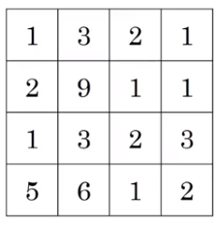
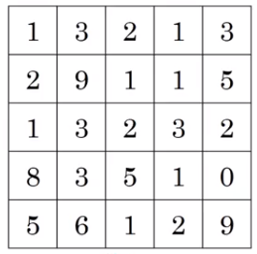
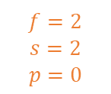
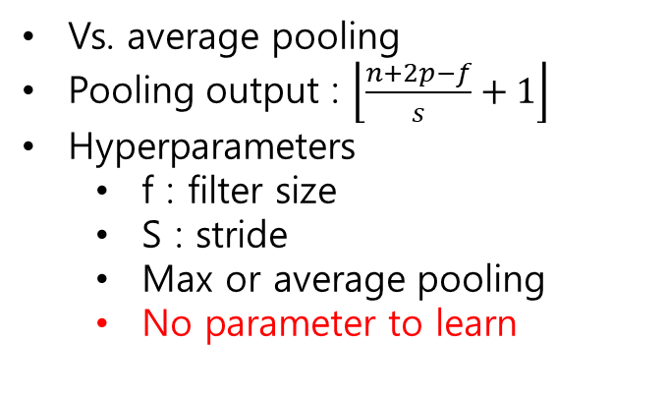
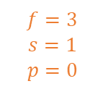
Pooling layer : Max pooling
9 | 2
6 | 3
$$f=2$$
$$s=2$$
$$p=0$$
Vs. average pooling
Pooling output : $\left\lfloor \frac{n+2p−f}{s}+1\right\rfloor$
Hyperparameters
f : filter size
S : stride
Max or average pooling
No parameter to learn
9 | 9 | 5
9
$$f=3$$
$$s=1$$
$$p=0$$

Slide 19


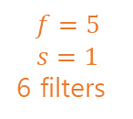








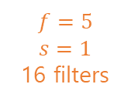

NN example (LeNet-5)
CONV1
POOL1
CONV2
POOL2
Maxpool
Maxpool
=
$$f=5$$
$$s=1$$
6 filters
$$f=2$$
$$s=2$$
$$f=5$$
$$s=1$$
16 filters
$$f=2$$
$$s=2$$
$$28×28×6$$
$$14×14×6$$
$$10×10×16$$
$$5×5×16$$
$$32×32×3$$
$$400$$
Layer 1
Layer 2
FC3
FC4
Common pattern:
CONV-POOL-CONV-POOL-FC-FC-Softmax
$$W^{\left[3\right]}:\left(120,400\right)$$
$$b^{\left[3\right]}:(120)$$
Softmax
(10 output)
$$120$$
$$84$$
LeCun et al. 1988, Gradient-based learning applied to document recognition
Demo, 1993, https://www.youtube.com/watch?v=FwFduRA_L6Q

Slide 20
NN example (error
 | Activation shape | Activation size | #parameters
Input | (32,32,3) | 3,072 | 0
CONV1(f=5,s=1) | (28,28,6)
POOL1 | (14,14,6)
CONV2(f=5,s=1) | (10,10,16)
POOL2 | (5,5,16)
FC3 | (120,1)
FC4 | (84,1)
Softmax | (10,1)

Slide 21

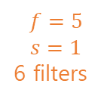



Why convolutions
FC
CONV
$$f=5$$
$$s=1$$
6 filters
$$f=5$$
$$s=1$$
6 filters
$$32×32×3$$
$$28×28×6$$
$$32×32×3$$
$$28×28×6$$
#parameters$:3072×4,704≈14M$
#parameters : $76×6=456$
Two advantages
Parameter sharing : A feature detector (such as a vertical edge detector) that’s useful in one part of the image is probably useful in another part of the image
Sparse connection : In each layer, each output value depends only on a small number of inputs.

