Slide 1


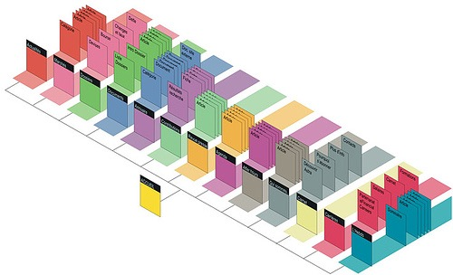

Configuration Management Systems
Automated migration in a large corporate fusion scenario
Students:
Siem Hermans
Bram ter Borch
LIA Project
System and Network Engineering
System and Network Engineering
Notes:
Introductie
Namen
Research question, focus on geographically dispersed environments

Slide 2

Research Question
How can a node be automatically migrated between two configuration management systems?
The Channel
A large-scale corporate fusion scenario
Notes:
Waarom onderzoeksvraag interessant?
Gaining traction, distributed microservices are coming in demand
Grotendeels al verteld door Jeroen (voorgaande presentatie)
Korte samenvatting containers en rol van Docker binnen containers
Voordelen/Nadelen virtuele machines
Distributed microservices -> Latency is becoming important
In tegenstelling tot Jeroen focussen wij op networking

Slide 3
No Configuration management system
Notes:
DSL 2.0, full mesh
Prague unstable

Slide 4



Configuration management systems
Ansible
Puppet
MGMT
2012
PUSH
YAML
Sequential execution
2005
PULL
Puppet DSL
Random execution
2015
Distributed
Experimental DSL
Parallel execution
Notes:
Talk about libnetwork, CAM model.

Slide 5
class shellshock {
class shellshock::fix (
$bash_url = $shellshock::fix::params::bash_url,
) inherits shellshock::fix::params {
anchor {'shellshock::fix::repo':
}->
class {'shellshock::fix::package':
bash_url => $bash_url,
}
}
class shellshock::fix::params {
$bash_url = $::architecture ? {
'i386' => 'http://ftp.linux.it/pub/People/md/bash/bash_3.2-4.2_i386.deb',
'amd64' => 'http://ftp.linux.it/pub/People/md/bash/bash_3.2-4.2_amd64.deb',
default => 'http://ftp.linux.it/pub/People/md/bash/bash_3.2-4.2_i386.deb',
}
}
}
define shellshock::fix::url-package (
$url,
$provider,
$package = undef,
) {
if $package {
$package_real = $package
} else {
$package_real = $title
}
$package_path = "/tmp/${package_real}"
exec {'download':
command => "/usr/bin/wget -O ${package_path} ${url}"
}
package {'install':
ensure => installed,
name => "${package}",
provider => 'dpkg',
source => "${package_path}",
}
file {'cleanup':
ensure => absent,
path => "${package_path}",
}
Exec['download'] -> Package['install'] -> File['cleanup']
}
Code snippet
— hosts: all
gather_facts: yes
remote_user: administrator
sudo: yes
tasks:
- name: Update Shellshock (Debian)
apt: name=bash
state=latest
update_cache=yes
when: ansible_os_family == "Debian"
- name: Update Shellshock (RedHat)
yum: name=bash
state=latest
update_cache=yes
when: ansible_os_family == "RedHat"

Slide 6
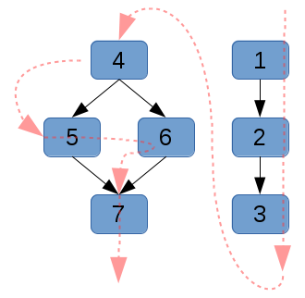
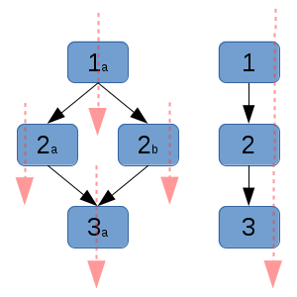
Architecture 1/2
Sequential execution
Parallel execution

Slide 7
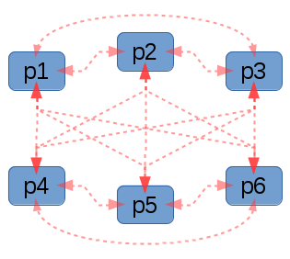
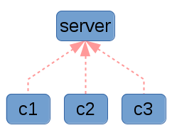
Architecture 2/2
Client - Server
Distributed

Slide 8
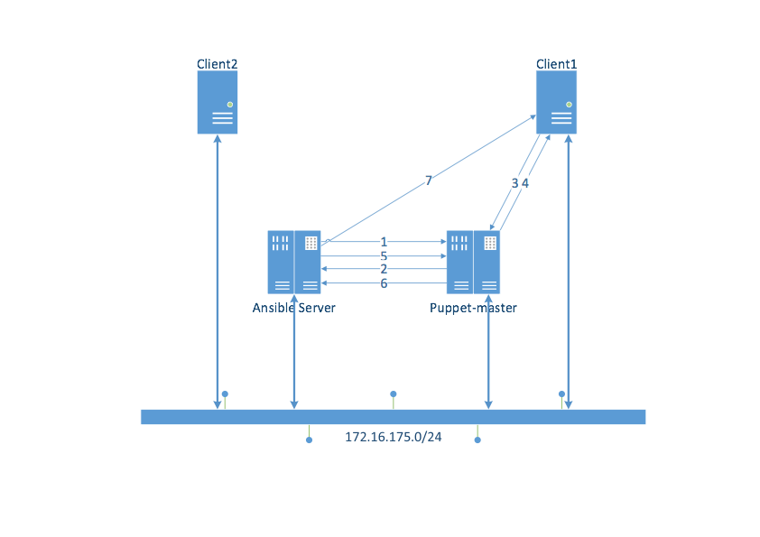
Methodology
Migrating from
Puppet to Ansible
Notes:
Placement of virtual machines on nodes is impossible with DSL.
- 24H baseline to confirm placement of nodes does not have an effect
During the course of the project we quantify performance as jitter, throughput, latency and when doing the streaming media test; bitrate.
Effects of overlays are important. Performance deterioration by overlay.

Slide 9
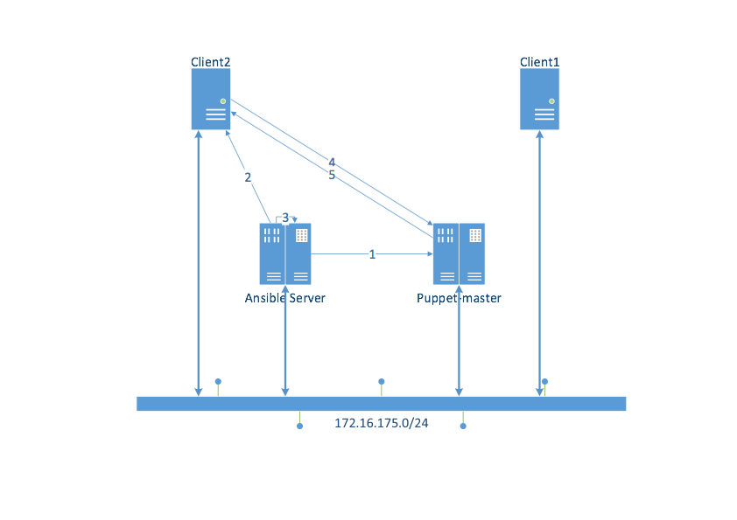
Methodology
Migrating from
Ansible to Puppet
Notes:
Placement of virtual machines on nodes is impossible with DSL.
- 24H baseline to confirm placement of nodes does not have an effect
During the course of the project we quantify performance as jitter, throughput, latency and when doing the streaming media test; bitrate.
Effects of overlays are important. Performance deterioration by overlay.

Slide 10
Results / Conclusion
Migration is feasible in large environments
Not applicable in small organizations using small clusters
Specific research into migrating between Puppet and Ansible
Prerequisites for migrating with this model
MGMT not ready for production
Notes:
Results of using GÉANT
Provisioning problems (general issues)
CPU provisioning limited (throughput measurements), DSL limits CPU GHz, deploying with faster CPU fails to deploy
Support (Positive)

Slide 11
LIA Project
System and Network Engineering
System and Network Engineering
Questions
Thank you
Science Park 904, Amsterdam NH
siem.hermans@os3.nl
bram.terborch@os3.nl

