Slide 1
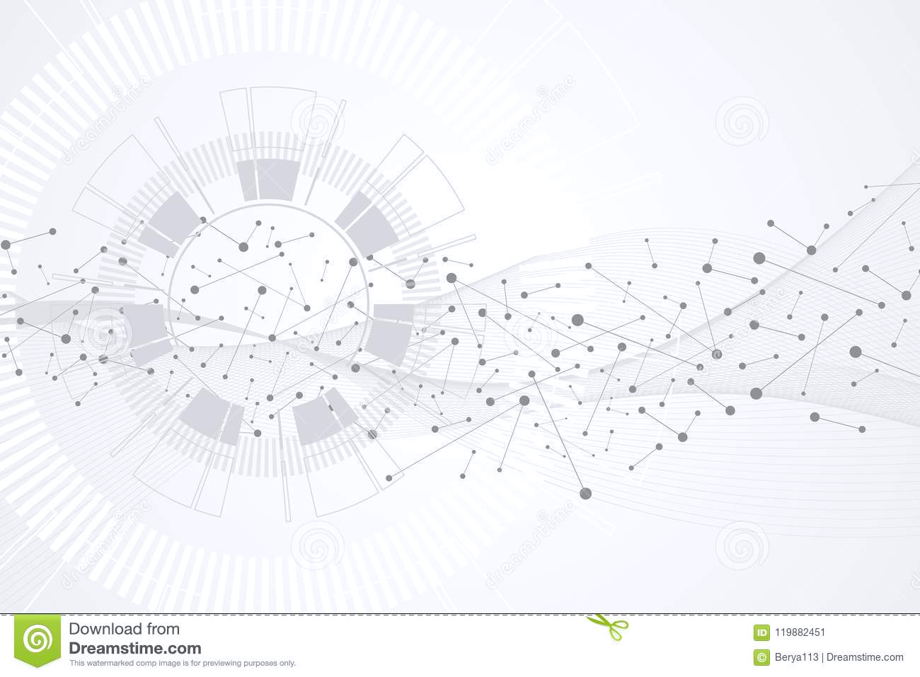
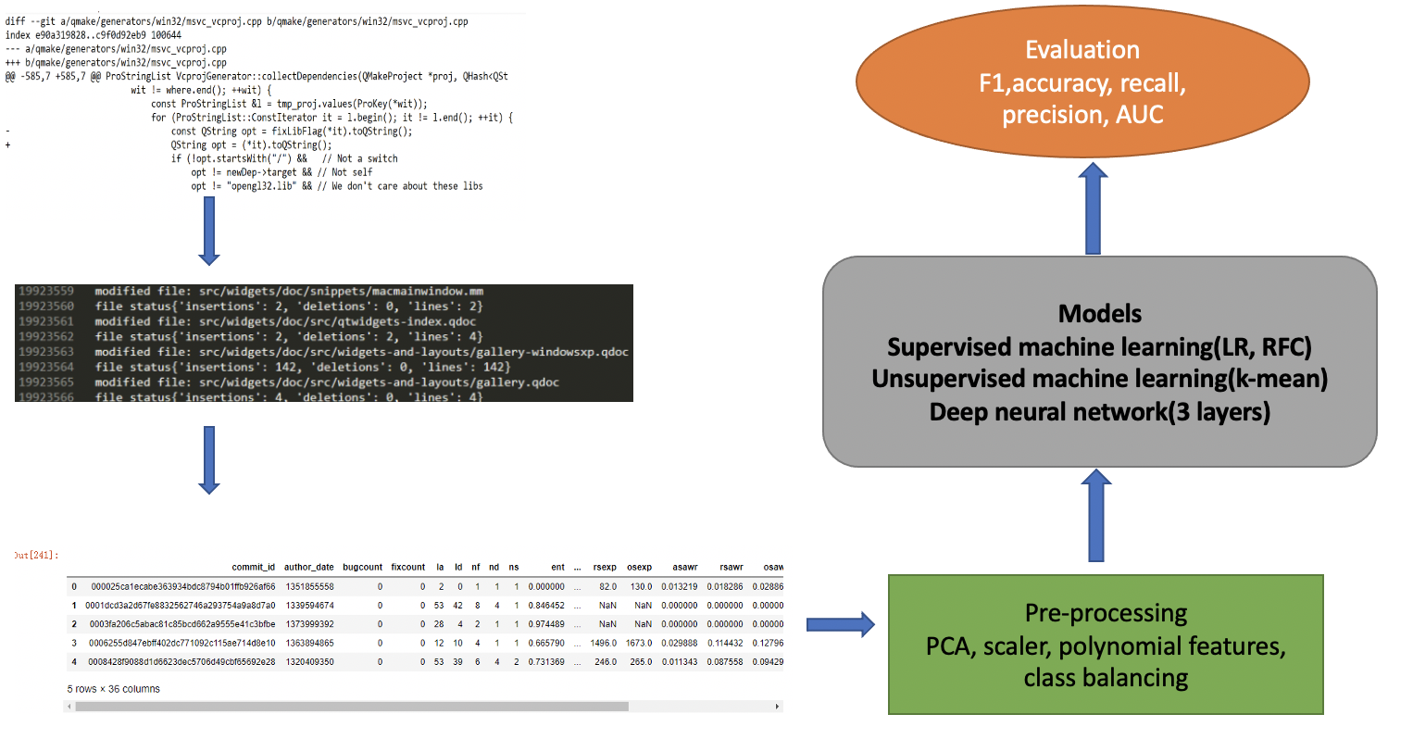
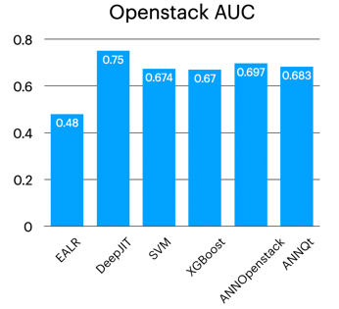
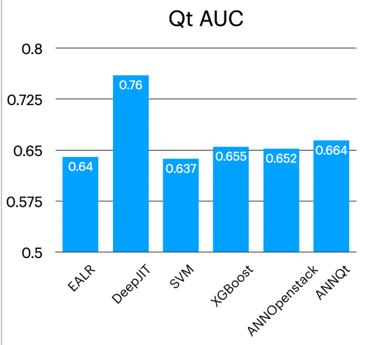
Just-In-Time Software Defect Prediction
Ali Mohamed, Yifei Gong, Yunhua Zhao
Project Category: binary classification for buggy commits
Data: two datasets:
Openstack and Qt
Openstack (10658 negative samples, 1616 positive samples), Qt (23148 negative samples, 2002 positive samples).
Each sample contains information from a GitHub commit.
Each sample has 35 features extracted from that commit (lines modified, developer experience, etc.) and 1 target values (buggy or not).
Goals: compete with state-of-the-art work by using handcrafted features
Hypothesis 1: two datasets may share intrinsic similarities that can
render better results when trained together
EALR and DeepJIT are state-of-the-art work . The rest four models are trained on combined oversampled datasets.
ANNOpenstack and ANNQt uses feed forward neural network.
4 models can outperform EALR
Still a gap with DeepJIT

