Slide 1
Use gossip training in behavioral cloning for autonomous driving car
Decentral optimization learning
Fall 2021

Slide 2
Gossip training:
K deep learning networks training separately
The goal is to find optimal weights that
Minimize loss for the set of data and labels
Behavioral cloning
One imitation learning algorithm
Receive state and proper action pairs
Learns to do appropriate action in state with classification

Slide 3
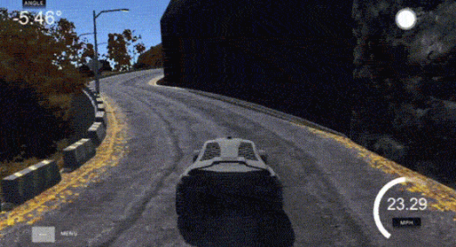
Dataset
Scene and actions collected from Udacity driving simulator

Slide 4
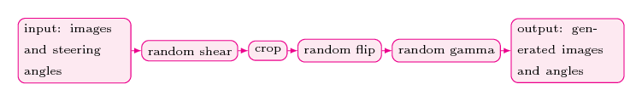
Data Processing Pipeline
Scene and actions collected from Udacity driving simulator

Slide 5
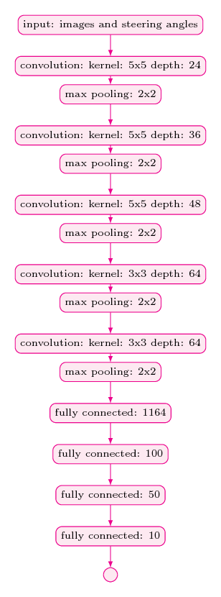
Architecture

Slide 6
reference
[1] M. Blot, D. Picard, M. Cord, and N. Thome, “Gossip training for deep learning,” arXiv [cs.CV], 2016.
[2] M. Bojarski et al., “End to end learning for self-driving cars,” arXiv [cs.CV], 2016.

Slide 7
extra
Other data processing:
Adding light effects and etc.
Random Shadow
Use genetic algorithm for finding best neighbors

