Slide 1
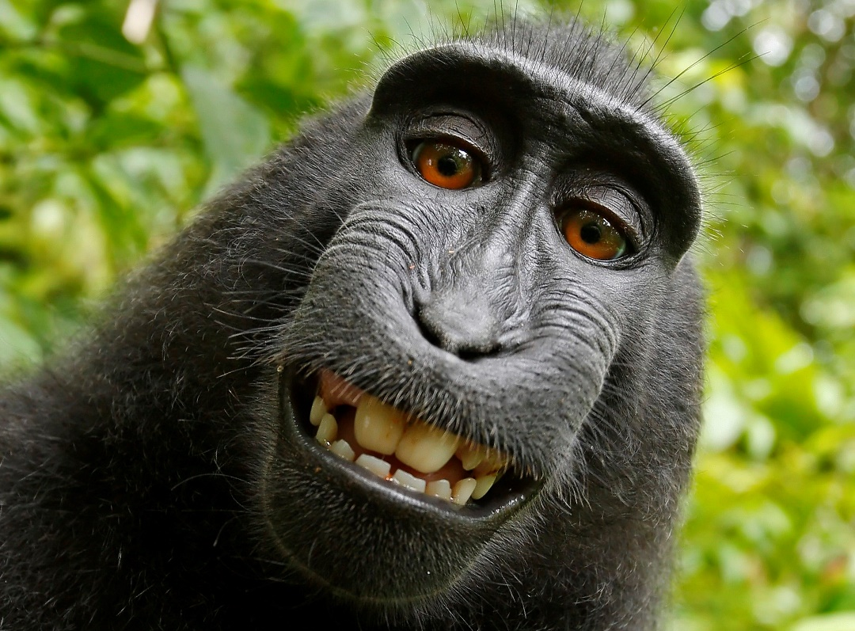
Affair Terminator 外遇終結者
Member：黃泰源 胥景然
Team：11
1

Slide 2
目錄
簡介
需求及功能說明
系統架構圖
類別圖
Resource Required
人員分配
Schedule

Slide 3
1.簡介
背景趨勢、動機、目的、需求分析、構想
3

Slide 4
背景趨勢與動機
背景趨勢
現代網路發達、交友更加容易，且生活步調快速，壓力龐大，加上個人主觀意識抬頭，和以前的社會相比，外遇已經是司空見慣的事。
動機
一般人面對外遇或潛在外遇的可能時，通常都手足無措，因為情緒難以控制而失去理智，或基於面子問題不敢向家人好友尋求協助。
目的
我們希望可以建立一個優良完善的徵信社網路平台，消除用戶的不安，省去他們的麻煩，以最有效率的方式解決各種問題，成為用戶最有力的靠山。

Slide 5
需求分析與構想
需求分析
1.想徵求他人意見和過去經驗
2.想選擇自己信任的調查人員
3.想隨時關注偵查進度或查詢歷史紀錄
4.想了解相關法律
構想
1.建立分類明確的討論區、匿名聊天系統，讓用戶方便針對自己的問題和其他人做交流
2.提供法律名詞解釋，並將內容解釋得淺顯易懂，讓用戶更了解自己的權益
3.詳細的偵探個人簡介和評分系統，讓用戶依個人喜好選擇偵探
4.建立雙向的查詢系統，讓用戶可以對偵查進度查詢，隨時和偵探交流和提供新的證據，並保存所有資訊

Slide 6
2.需求及功能說明
一般用戶、會員、偵探、後台管理者
6

Slide 7
功能架構圖

Slide 8
一般用戶
功能項目操作 | 說明
討論區 | 使用者可以在首頁按下【討論區】按鈕進入<討論區>頁面，在討論區頁面有【新增文章】、【回復文章】、【管理文章】等按鈕，文章有不同的分類：心情小語、婚姻關係、個人經濟、工商貿易、疑難雜症、法律諮詢等。
個人簡介 | 使用者可在右上方之使用者狀態欄按下【個人簡介】按鈕進入<個人簡介>頁面，可按下【修改簡介】按鈕進行個人資料修改。可修改的資料有:綽號、頭像、信箱、生日、血型、性別、興趣、個人描述。
對話系統 | 使用者可以使用對話框與其他使用者進行訊息傳遞。
線上學習 | 使用者可以在首頁按下【線上學習】按鈕進入<線上學習>頁面，以不同徵信業務分類，提供學習案例與影片，與相關法律學習。 徵信的業務: 工商徵信、家庭關係、私人調查、疑難雜症

Slide 9
會員
功能項目操作 | 說明
會員註冊 | 使用者可在首頁按下【會員註冊】按鈕進入<會員註冊>頁面，填妥帳號密碼與個人簡介後便完成註冊。
委託任務 | 使用者可以在首頁透過<偵探推薦>，藉由不同的業務分類，找到自己適合的偵探並按下【委託】按鈕進入<委託事件>頁面填妥委託事件的詳細內容。
任務布告欄 | 會員可以透過用戶介面進入<任務布告欄>頁面，根據不同的業務分類發布委託任務。
目前事件進度查詢 | 會員可在右上方之使用者狀態欄按下【事件進度查詢】按鈕進入入事件處理儀表板查看<目前事件狀態>，可以了解目前所委託之任務的詳細資料與歷史進程。
偵探評分 | 任務結束時，可在<事件處理儀表板>對偵探進行評分。

Slide 10
偵探
功能項目操作 | 說明
偵探註冊 | 使用者可在首頁按下【會員註冊】按鈕進入<會員註冊>頁面，填妥帳號密碼與個人簡介後便完成註冊。
委託任務 | 使用者可以在首頁透過<偵探推薦>，藉由不同的業務分類，找到自己適合的偵探並按下【委託】按鈕進入<委託事件>頁面填妥委託事件的詳細內容。
任務布告欄 | 會員可以透過用戶介面進入<任務布告欄>頁面，根據不同的業務分類發布委託任務。
目前事件進度查詢 | 會員可在右上方之使用者狀態欄按下【事件進度查詢】按鈕進入入事件處理儀表板查看<目前事件狀態>，可以了解目前所委託之任務的詳細資料與歷史進程。
偵探評分 | 任務結束時，可在<事件處理儀表板>對偵探進行評分。

Slide 11

Hello!
I am Jayden Smith
I am here because I love to give presentations.
You can find me at @username

Slide 12
Big concept
Bring the attention of your audience over a key concept using icons or illustrations

Slide 13
1.
Transition headline
Let’s start with the first set of slides

Slide 14
“Quotations are commonly printed as a means of inspiration and to invoke philosophical thoughts from the reader”

Slide 15
This is a slide title
Here you have a list of items
And some text
But remember not to overload your slides with content
Your audience will listen to you or read the content, but won’t do both.

Slide 16
This is a slide title
Here you have a list of items
And some text
But remember not to overload your slides with content
Your audience will listen to you or read the content, but won’t do both.

Slide 17
Big concept
Bring the attention of your audience over a key concept using icons or illustrations

Slide 18
You can also split your content
White
Is the color of milk and fresh snow, the color produced by the combination of all the colors of the visible spectrum.
Black
Is the color of coal, ebony, and of outer space. It is the darkest color, the result of the absence of or complete absorption of light.

Slide 19
In two or three columns
Yellow
Is the color of gold, butter and ripe lemons. In the spectrum of visible light, yellow is found between green and orange.
Blue
Is the colour of the clear sky and the deep sea. It is located between violet and green on the optical spectrum.
Red
Is the color of blood, and because of this it has historically been associated with sacrifice, danger and courage.

Slide 20
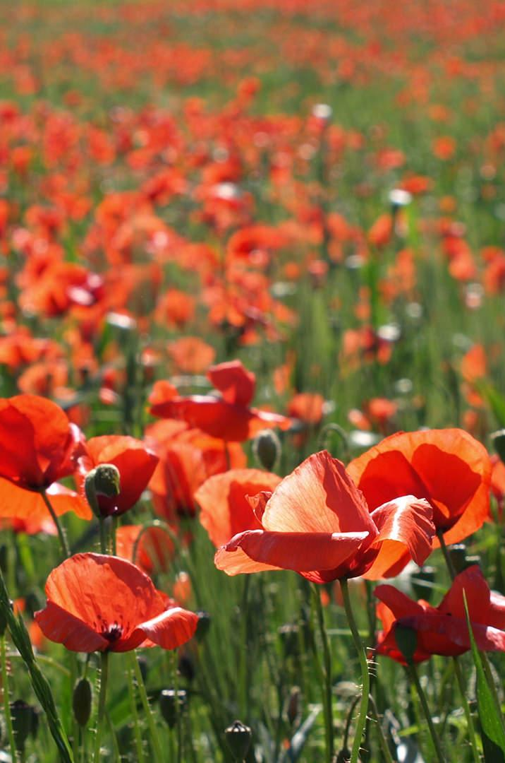
A picture is worth a thousand words
A complex idea can be conveyed with just a single still image, namely making it possible to absorb large amounts of data quickly.

Slide 21

Want big impact?
Use big image.

Slide 22
Use charts to explain your ideas
White
Gray
Black

Slide 23
And tables to compare data
 | A | B | C
Yellow | 10 | 20 | 7
Blue | 30 | 15 | 10
Orange | 5 | 24 | 16

Slide 24
Maps
our office

Slide 25
89,526,124
Whoa! That’s a big number, aren’t you proud?

Slide 26
89,526,124$
185,244 users
100%
That’s a lot of money
And a lot of users
Total success!

Slide 27
Our process is easy
First
Second
Last

Slide 28
Let’s review some concepts
Yellow
Is the color of gold, butter and ripe lemons. In the spectrum of visible light, yellow is found between green and orange.
Blue
Is the colour of the clear sky and the deep sea. It is located between violet and green on the optical spectrum.
Red
Is the color of blood, and because of this it has historically been associated with sacrifice, danger and courage.
Yellow
Is the color of gold, butter and ripe lemons. In the spectrum of visible light, yellow is found between green and orange.
Blue
Is the colour of the clear sky and the deep sea. It is located between violet and green on the optical spectrum.
Red
Is the color of blood, and because of this it has historically been associated with sacrifice, danger and courage.

Slide 29
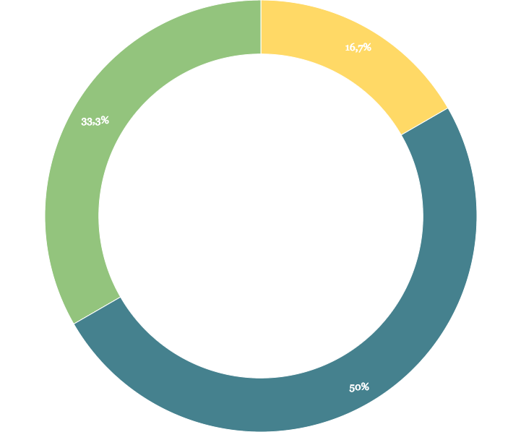
You can insert graphs from Google Sheets

Slide 30
Android
project
Show and explain your web, app or software projects using these gadget templates.
Place your screenshot here

Slide 31
iPhone
project
Show and explain your web, app or software projects using these gadget templates.
Place your screenshot here

Slide 32
Tablet
project
Show and explain your web, app or software projects using these gadget templates.
Place your screenshot here

Slide 33
Desktop
project
Show and explain your web, app or software projects using these gadget templates.
Place your screenshot here

Slide 34
Thanks!
Any questions?
You can find me at
@username · user@mail.me

Slide 35
Credits
Special thanks to all the people who made and released these awesome resources for free:
Presentation template by SlidesCarnival
Photographs by Unsplash

Slide 36
Presentation design
This presentation uses the following typographies and colors:
Titles: Yellowtail
Body copy: Neuton
You can download the fonts on these pages:
https://www.fontsquirrel.com/fonts/yellowtail
https://www.fontsquirrel.com/fonts/neuton
Gray #666666 / Pastel green #97bfac / Leaf green #bdcc64
You don’t need to keep this slide in your presentation. It’s only here to serve you as a design guide if you need to create new slides or download the fonts to edit the presentation in PowerPoint®

Slide 37
SlidesCarnival icons are editable shapes.
This means that you can:
Resize them without losing quality.
Change fill color and opacity.
Isn’t that nice? :)
Examples:

Slide 38
😉
Now you can use any emoji as an icon!
And of course it resizes without losing quality and you can change the color.
How? Follow Google instructions https://twitter.com/googledocs/status/730087240156643328
✋👆👉👍👤👦👧👨👩👪💃🏃💑❤😂😉😋😒😭👶😸🐟🍒🍔💣📌📖🔨🎃🎈🎨🏈🏰🌏🔌🔑 and many more...

