Slide 1
Project proposal: Sōkoban-A NP hard problem
Team_1
Member: 0551076 Terry Huang
0551083 Jacky Lin
0551051 Jia huan Hong
Department: Computer and Communication engineering

Slide 2

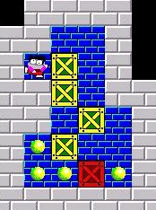
Project Statement
Sōkoban is a classical puzzle game. Player need to control a porter to push the cargo to designated locations. We want to design an AI to play Sōkoban.
The Sōkoban game online: http://my-gamer.com/games/gc11660.html
More info about the Sōkoban game: https://zh.wikipedia.org/wiki/%E5%80%89%E5%BA%AB%E7%95%AA

Slide 3

Motivation
My first computer in my life is Windows dos computer, there are two games in it. One is Mahjong, another is Sōkoban. My sister and I used to play Sōkoban in our childhood, which is a great memory in my life. My motivation is: I want to create an AI to play Sōkoban to give my sister a surprise, and I also want to pass the course.
The Sōkoban game online: http://my-gamer.com/games/gc11660.html
More info about the Sōkoban game: https://zh.wikipedia.org/wiki/%E5%80%89%E5%BA%AB%E7%95%AA

Slide 4

Challenge
Game implementaion
There is only Sōkoban online version. We need to craft a Sōkoban game environment such that the agent can play in it.(No reverse engineering!)
Method design
Sōkoban is a single agent and single goal game but it is difficult because it has many box, box can effect other boxes. And its rooms have some narrow aisles which is a obstacle for agent and for boxes.

Slide 5

Potential Solution
Solution for game implementaion
We will cost one or two weeks to implement the game and design a good environment for game agent.
Some idea for method design
We will find out all situations that the box could not push any more. I think it must be a constraint. May be we will use some CSP problem’s spirits. Also,I will research which search method is suitable for Sōkoban.

Slide 6


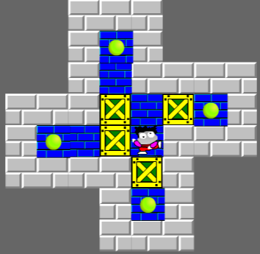
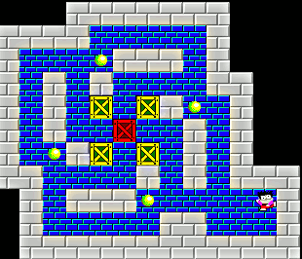
Contribution or Novelty
Maybe in the future a carrier robot will suffer from this scenario in warehouse, then the method will solve such situation.

Slide 7



Resource Required
Device and tools
Human Resource
Computer or notebook
Fresh liver
Terry Huang
Task: Method design
Jacky Lin
Task: Game implementation,
Method design
Jia huan Hong
Task: Presentation design,odds and ends

Slide 8

Schedule

Slide 9

Reference
SOKOBAN and other motion planning problems .Dorit Dor .Uri Zwick. June 25, 1996
Willy A Sokoban Solving Agent. Luis Rei, Rui Teixeira

