Slide 1
Project proposal: Sōkoban-A NP hard problem
Team_1
Member: 0551076 Terry Huang
0551083 Jacky Lin
0551051 Jia huan Hong
Department: Computer and Communication engineering

Slide 2

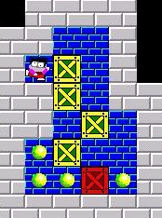
Project Statement
「推箱子」是款經典的遊戲，玩家只須推動箱子至目標地點來達成目標。而我們讓AI來玩這款遊戲，尋求解答。
The Sōkoban game online: http://my-gamer.com/games/gc11660.html
More info about the Sōkoban game: https://zh.wikipedia.org/wiki/%E5%80%89%E5%BA%AB%E7%95%AA

Slide 3

Motivation
「推箱子」是款十分容易辨識結果的遊戲， 也因這項原因在結果的觀察上能清楚的看出我們的想法是否出錯， 這是由於我們的想法會影響agent自身找到的解答， 這也是我們為何使用它來做本次專案的動機。
The Sōkoban game online: http://my-gamer.com/games/gc11660.html
More info about the Sōkoban game: https://zh.wikipedia.org/wiki/%E5%80%89%E5%BA%AB%E7%95%AA

Slide 4
簡介製作過程
Row 1 : 5 5
( Graph ) Column * Row
Row 1 :
5 5 1 1 1 3 3 3 3 3 3 3 3 1 0 0 3 3 0 2 0 3 3 0 0 0 3 3 3 3 3 3
Row 2 :
Row 3 :
Row 2 : 1 1
Player Start Point
Row 4 :
Row 5 :
Row 3 : 1
How many Goal ?
Row 6 :
Row 7 :
Row 8 :
Row 4 : 3 3
Goal(s) = Column , Row
Row 9 :
Row 5 ~ 9 :
NEXT PAGE TO EXPLANE
( simple.txt )

Slide 5

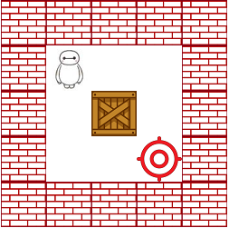




簡介製作過程
0 (路徑)
Row 1 :
5 5 3 3 3 3 3 3 1 0 0 3 3 0 2 0 3 3 0 0 0 3 3 3 3 3 3
1 (角色)
Row 5 :
Row 6 :
2 (箱子)
Row 7 :
Row 8 :
Row 9 :
3 (牆壁)
4 (牆外)

Slide 6
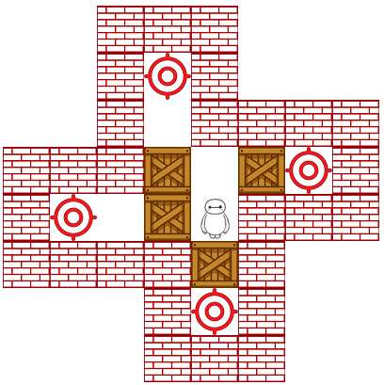
簡介製作過程
4 4 3 3 3 4 4 4 4 4 3 0 3 4 4 4 4 4 3 0 3 3 3 3 3 3 3 2 0 2 0 3 3 0 0 2 1 3 3 3 3 3 3 3 2 3 4 4 4 4 4 3 0 3 4 4 4 4 4 3 3 3 4 4

Slide 7
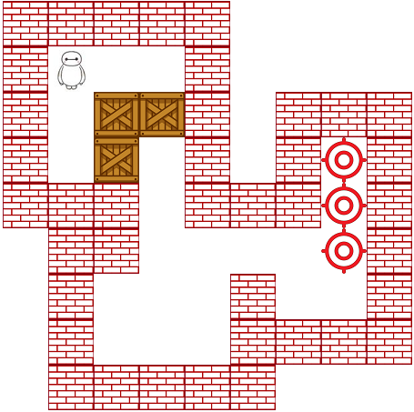
簡介製作過程
3 3 3 3 3 4 4 4 4 3 1 0 0 3 4 4 4 4 3 0 2 2 3 4 3 3 3 3 0 2 0 3 4 3 0 3 3 3 3 0 3 3 3 0 3 4 3 3 0 0 0 0 0 3 4 3 0 0 0 3 0 0 3 4 3 0 0 0 3 3 3 3 4 3 3 3 3 3 4 4 4

Slide 8
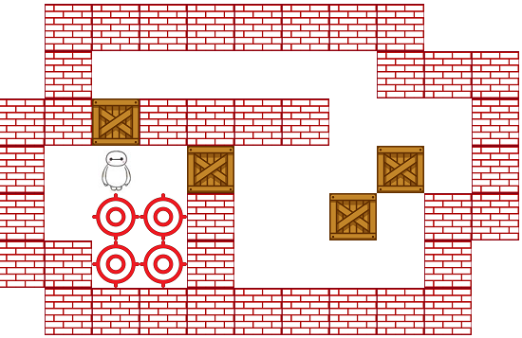
簡介製作過程
4 3 3 3 3 3 3 3 3 4 4 4 3 0 0 0 0 0 0 3 3 3 3 3 2 3 3 3 3 0 0 0 3 3 0 1 0 2 0 0 0 2 0 3 3 0 0 0 3 0 0 2 0 3 3 3 3 0 0 3 0 0 0 0 3 4 4 3 3 3 3 3 3 3 3 3 4

Slide 9


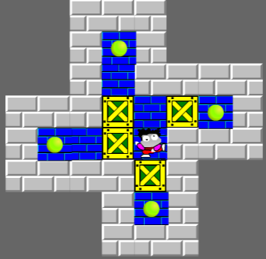
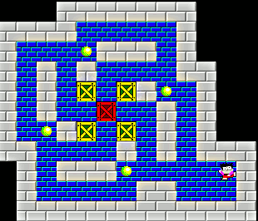
Contribution or Novelty
Maybe in the future a carrier robot will suffer from this scenario in warehouse, then the method will solve such situation.

Slide 10
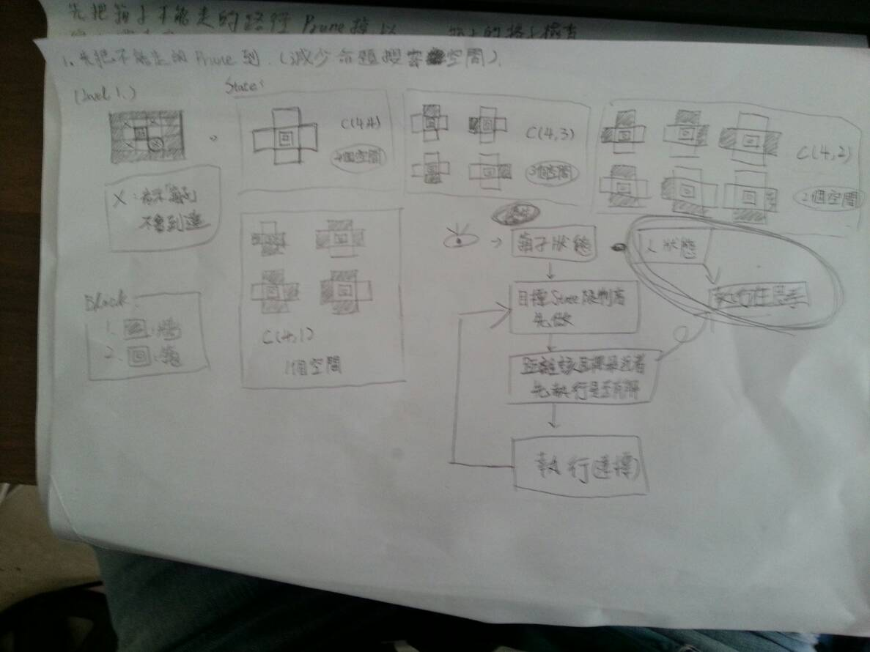
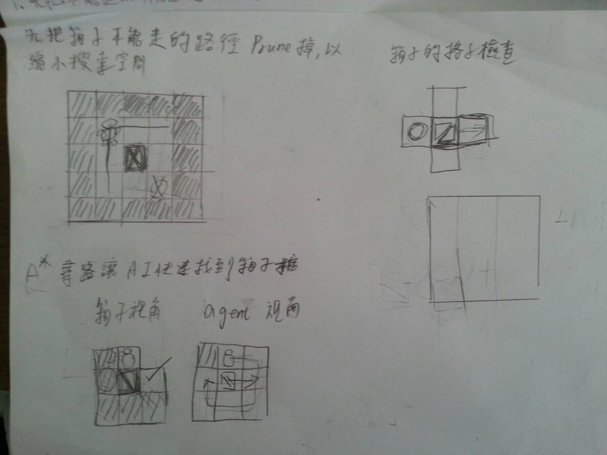
討論過程

Slide 11
討論結果
Step 1 : 先砍掉不可能的移動到的點，減少搜索範圍。

Slide 12
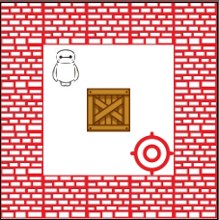
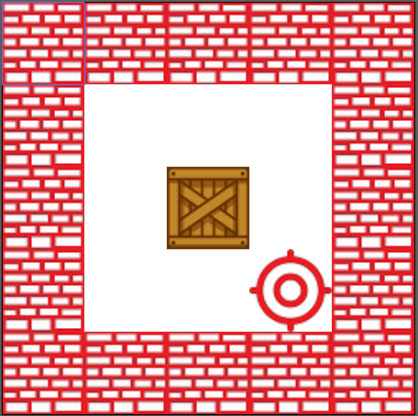
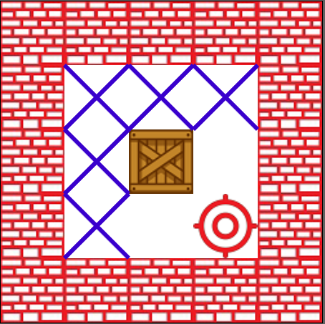
解說原因
( 視角 : 箱子的狀態 )

Slide 13
討論結果
Step 2 : 由箱子狀態的視角切入，將限制較多者先做

Slide 14
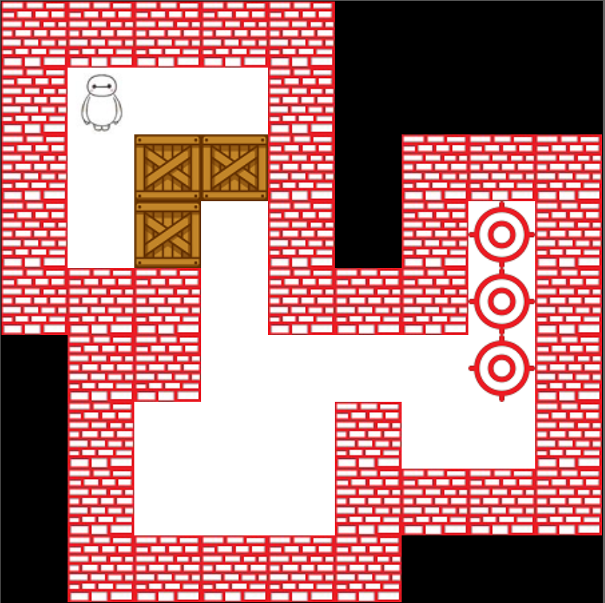
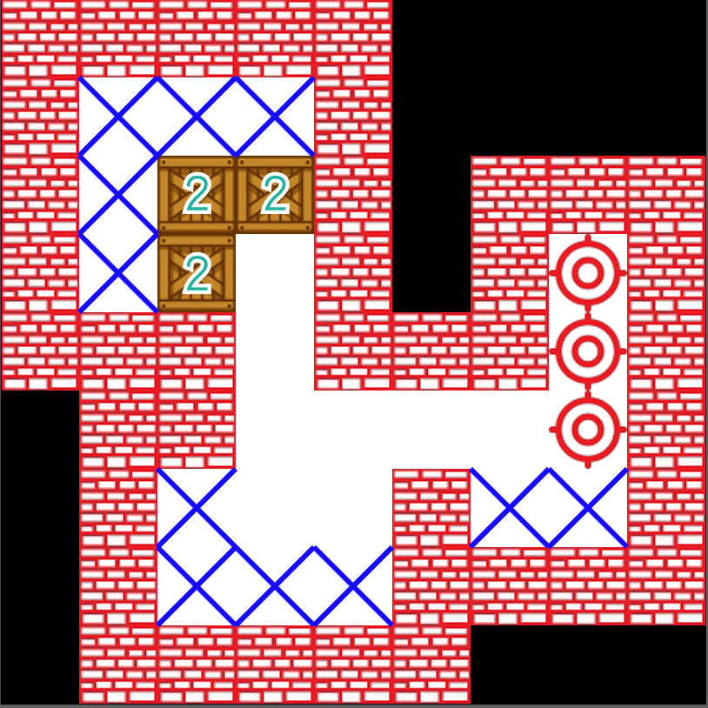
解說原因
( Step 2 )

Slide 15
討論結果
Step 3 : 將限制較多者，先執行是否有解。 若限制相同則將距離較近者，先執行是否有解。

Slide 16

Challenge
Game implementaion
There is only Sōkoban online version. We need to craft a Sōkoban game environment such that the agent can play in it.(No reverse engineering!)
Method design
Sōkoban is a single agent and single goal game but it is difficult because it has many box, box can effect other boxes. And its rooms have some narrow aisles which is a obstacle for agent and for boxes.

Slide 17

Potential Solution
Solution for game implementaion
We will cost one or two weeks to implement the game and design a good environment for game agent.
Some idea for method design
We will find out all situations that the box could not push any more. I think it must be a constraint. May be we will use some CSP problem’s spirits. Also,I will research which search method is suitable for Sōkoban.

Slide 18



Resource Required
Device and tools
Human Resource
IDE : VScode、Qtcreato Compiler : MSVC2017
GNU C++ compiler
Debugger: GNU Project Debugger
素材 : google圖片、小畫家、illustrator
簡報與文件製作工具 : word、 powerpoint、visio
Terry Huang
Task: Method design
Jacky Lin
Task: Game implementation,
Method design
Jia huan Hong
Task: Presentation design,
odds and ends

Slide 19

Schedule

Slide 20

Reference
SOKOBAN and other motion planning problems .Dorit Dor .Uri Zwick. June 25, 1996
Willy A Sokoban Solving Agent. Luis Rei, Rui Teixeira

