Slide 1
Project proposal: Sōkoban-A NP hard problem
Team_1
Member: 0551076 Terry Huang
0551083 Jacky Lin
0551051 Jia huan Hong
Department: Computer and Communication engineering

Slide 2

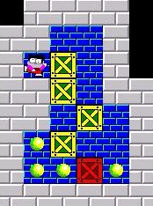
Project Statement
「推箱子」是款經典的遊戲，玩家只須推動箱子至目標地點來達成目標。而我們讓AI來玩這款遊戲，尋求解答。
The Sōkoban game online: http://my-gamer.com/games/gc11660.html
More info about the Sōkoban game: https://zh.wikipedia.org/wiki/%E5%80%89%E5%BA%AB%E7%95%AA

Slide 3

Motivation
「推箱子」是款十分容易辨識結果的遊戲， 也因這項原因在結果的觀察上能清楚的看出我們的想法是否出錯， 這是由於我們的想法會影響agent自身找到的解答， 這也是我們為何使用它來做本次專案的動機。
The Sōkoban game online: http://my-gamer.com/games/gc11660.html
More info about the Sōkoban game: https://zh.wikipedia.org/wiki/%E5%80%89%E5%BA%AB%E7%95%AA

Slide 4
簡介製作過程
Row 1 : 5 5
( Graph ) Column * Row
Row 1 :
5 5 1 1 1 3 3 3 3 3 3 3 3 1 0 0 3 3 0 2 0 3 3 0 0 0 3 3 3 3 3 3
Row 2 :
Row 3 :
Row 2 : 1 1
Player Start Point
Row 4 :
Row 5 :
Row 3 : 1
How many Goal ?
Row 6 :
Row 7 :
Row 8 :
Row 4 : 3 3
Goal(s) = Column , Row
Row 9 :
Row 5 ~ 9 :
NEXT PAGE TO EXPLANE
( simple.txt )

Slide 5

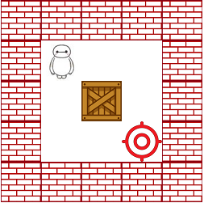




簡介製作過程
0 (路徑)
Row 1 :
5 5 3 3 3 3 3 3 1 0 0 3 3 0 2 0 3 3 0 0 0 3 3 3 3 3 3
1 (角色)
Row 5 :
Row 6 :
2 (箱子)
Row 7 :
Row 8 :
Row 9 :
3 (牆壁)
4 (牆外)

Slide 6
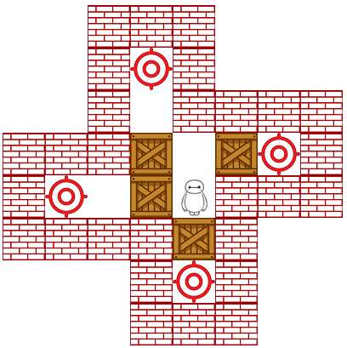
簡介製作過程
4 4 3 3 3 4 4 4 4 4 3 0 3 4 4 4 4 4 3 0 3 3 3 3 3 3 3 2 0 2 0 3 3 0 0 2 1 3 3 3 3 3 3 3 2 3 4 4 4 4 4 3 0 3 4 4 4 4 4 3 3 3 4 4

Slide 7
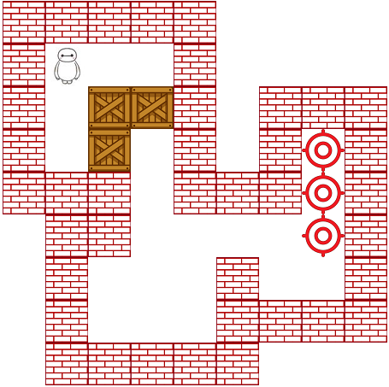
簡介製作過程
3 3 3 3 3 4 4 4 4 3 1 0 0 3 4 4 4 4 3 0 2 2 3 4 3 3 3 3 0 2 0 3 4 3 0 3 3 3 3 0 3 3 3 0 3 4 3 3 0 0 0 0 0 3 4 3 0 0 0 3 0 0 3 4 3 0 0 0 3 3 3 3 4 3 3 3 3 3 4 4 4

Slide 8
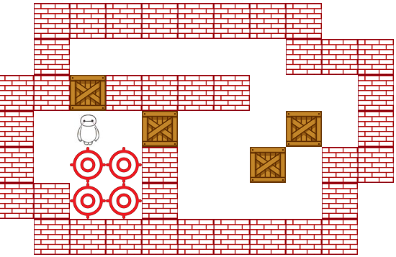
簡介製作過程
4 3 3 3 3 3 3 3 3 4 4 4 3 0 0 0 0 0 0 3 3 3 3 3 2 3 3 3 3 0 0 0 3 3 0 1 0 2 0 0 0 2 0 3 3 0 0 0 3 0 0 2 0 3 3 3 3 0 0 3 0 0 0 0 3 4 4 3 3 3 3 3 3 3 3 3 4

Slide 9


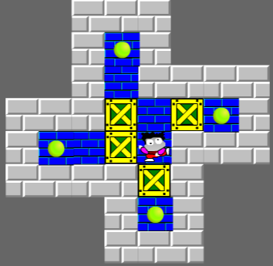
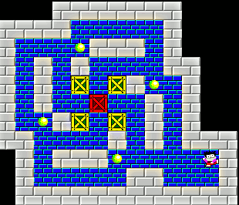
Contribution or Novelty
Maybe in the future a carrier robot will suffer from this scenario in warehouse, then the method will solve such situation.

Slide 10
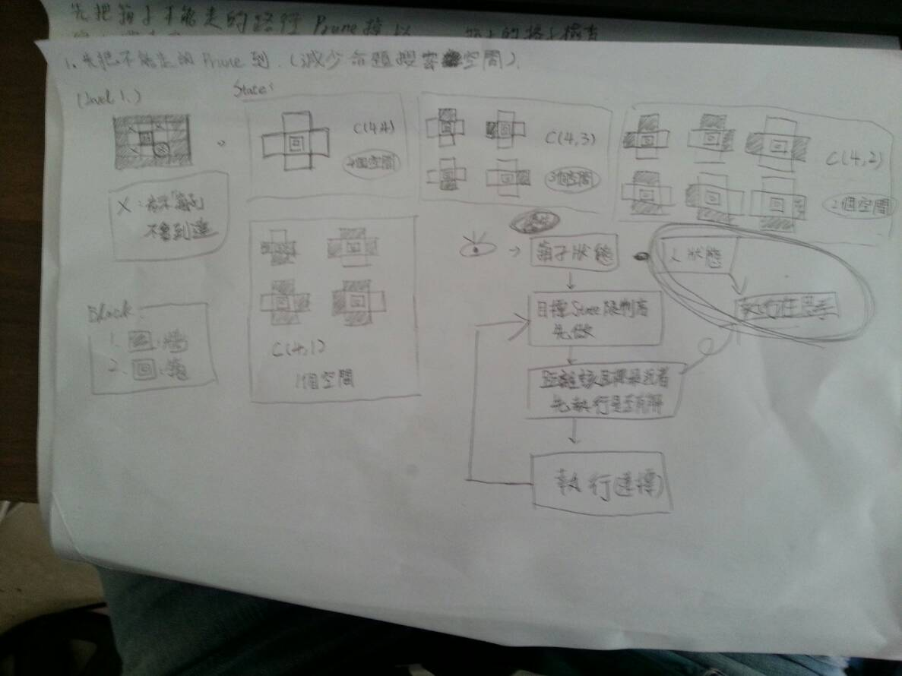
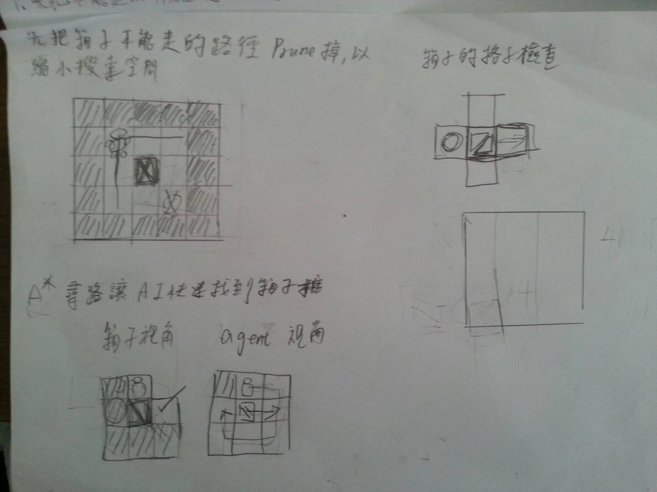
討論過程

Slide 11
討論結果
Step 1 : 先砍掉不可能的移動到的點，減少搜索範圍。

Slide 12
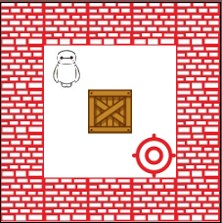
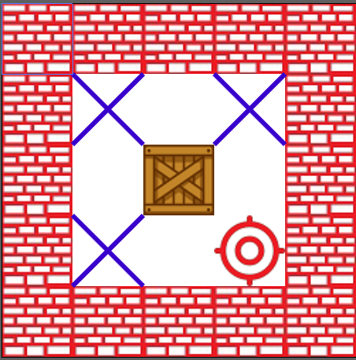
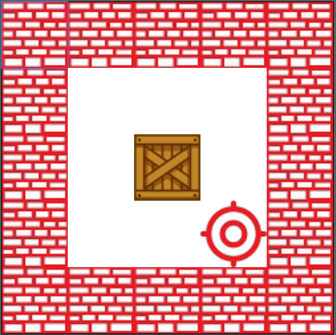
解說原因
( 視角 : 箱子的狀態 )

Slide 13
討論結果
Step 2 : 由箱子狀態的視角切入，將限制較多者先做

Slide 14
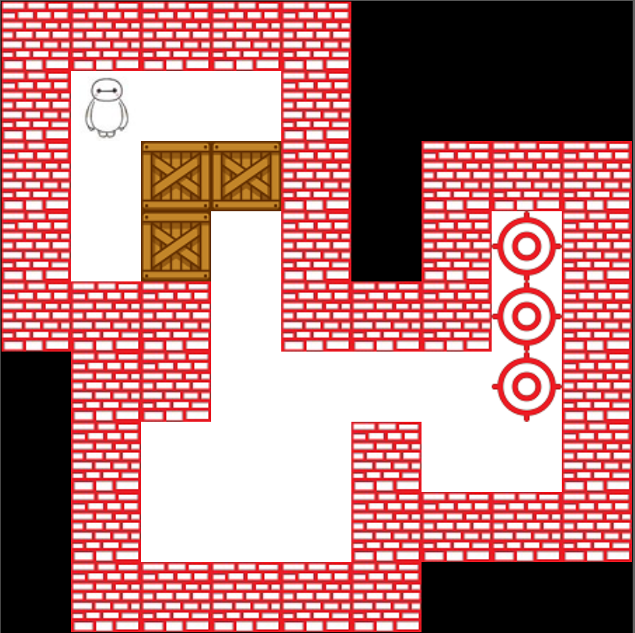
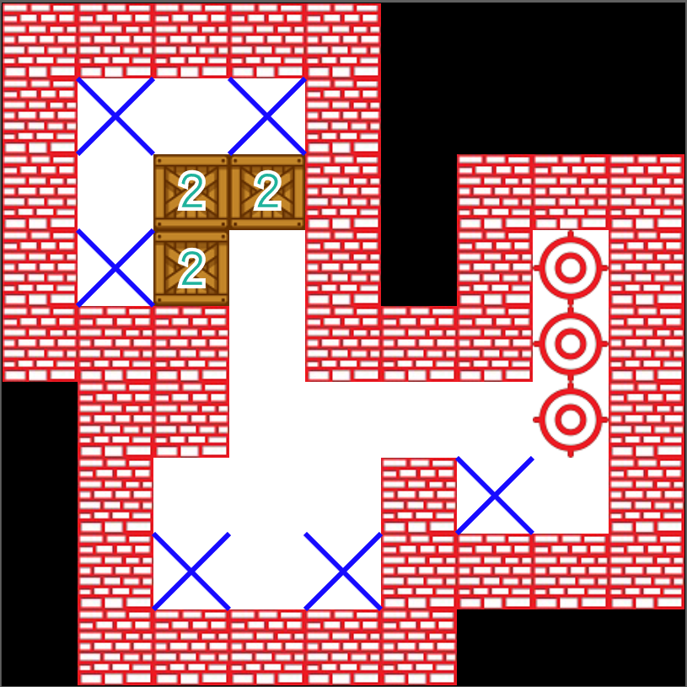
解說原因
( Step 2 )

Slide 15
討論結果
Step 3 : 將限制較多者，先執行是否有解。 若限制相同則將距離較近者，先執行是否有解。

Slide 16

Challenge
Game implementaion
There is only Sōkoban online version. We need to craft a Sōkoban game environment such that the agent can play in it.(No reverse engineering!)
Method design
Sōkoban is a single agent and single goal game but it is difficult because it has many box, box can effect other boxes. And its rooms have some narrow aisles which is a obstacle for agent and for boxes.

Slide 17

Potential Solution
Solution for game implementaion
We will cost one or two weeks to implement the game and design a good environment for game agent.
Some idea for method design
We will find out all situations that the box could not push any more. I think it must be a constraint. May be we will use some CSP problem’s spirits. Also,I will research which search method is suitable for Sōkoban.

Slide 18



Resource Required
Device and tools
Human Resource
Computer or notebook
Fresh liver
Terry Huang
Task: Method design
Jacky Lin
Task: Game implementation,
Method design
Jia huan Hong
Task: Presentation design,
odds and ends

Slide 19

Schedule

Slide 20

Reference
SOKOBAN and other motion planning problems .Dorit Dor .Uri Zwick. June 25, 1996
Willy A Sokoban Solving Agent. Luis Rei, Rui Teixeira

