Slide 1
Project proposal: Sōkoban-A NP hard problem
Team_1
Member: 0551076 Terry Huang
0551083 Jacky Lin
0551051 Jia huan Hong
Department: Computer and Communication engineering

Slide 2

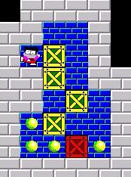
Project Statement
Sōkoban is a classical puzzle game. Player need to control a porter to push the cargo to designated locations. We want to design an AI to play Sōkoban.
The Sōkoban game online: http://my-gamer.com/games/gc11660.html
More info about the Sōkoban game: https://zh.wikipedia.org/wiki/%E5%80%89%E5%BA%AB%E7%95%AA

Slide 3

Motivation
Sōkoban is a good Puzzle game in design . In this game, you can use some math formula or algorithm to prove that does the solution exist in this case. In Player perspective, It also can let player step by step to prove that does the player thinking is right in this level.
To sum up, it’s easily recognizable and that’s why we would like to used it to do this project.
The Sōkoban game online: http://my-gamer.com/games/gc11660.html
More info about the Sōkoban game: https://zh.wikipedia.org/wiki/%E5%80%89%E5%BA%AB%E7%95%AA

Slide 4
簡介製作過程
Row 1 : 5 5
( Graph ) Column * Row
Row 1 :
5 5 1 1 1 3 3 3 3 3 3 3 3 1 0 0 3 3 0 2 0 3 3 0 0 0 3 3 3 3 3 3
Row 2 : 1 1
Player Start Point
Row 2 :
Row 3 :
Row 4 :
Row 3 : 1
How many Goal ?
Row 5 :
Row 6 :
Row 7 :
Row 4 : 3 3
Goal(s) = Column , Row
Row 8 :
Row 9 :
Row 5 ~ 9 :
NEXT PAGE TO EXPLANE
( simple.txt )

Slide 5
簡介製作過程
0 (路徑)
Row 1 :
5 5 3 3 3 3 3 3 1 0 0 3 3 0 2 0 3 3 0 0 0 3 3 3 3 3 3
1 (角色)
Row 5 :
Row 6 :
Row 7 :
2 (箱子)
Row 8 :
Row 9 :
3 (牆壁)
4 (牆外)

Slide 6
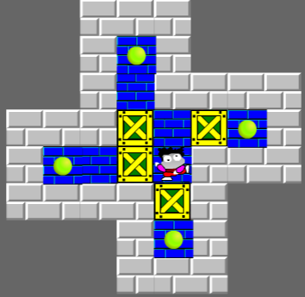
簡介製作過程
4 4 3 3 3 4 4 4 4 4 3 0 3 4 4 4 4 4 3 0 3 3 3 3 3 3 3 2 0 2 0 3 3 0 0 2 1 3 3 3 3 3 3 3 2 3 4 4 4 4 4 3 0 3 4 4 4 4 4 3 3 3 4 4

Slide 7
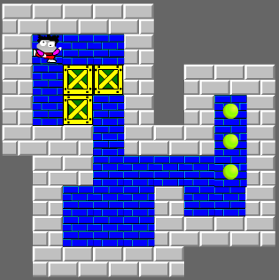
簡介製作過程
3 3 3 3 3 4 4 4 4 3 1 0 0 3 4 4 4 4 3 0 2 2 3 4 3 3 3 3 0 2 0 3 4 3 0 3 3 3 3 0 3 3 3 0 3 4 3 3 0 0 0 0 0 3 4 3 0 0 0 3 0 0 3 4 3 0 0 0 3 3 3 3 4 3 3 3 3 3 4 4 4

Slide 8
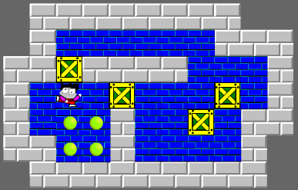
簡介製作過程
4 3 3 3 3 3 3 3 3 4 4 4 3 0 0 0 0 0 0 3 3 3 3 3 2 3 3 3 3 0 0 0 3 3 0 1 0 2 0 0 0 2 0 3 3 0 0 0 3 0 0 2 0 3 3 3 3 0 0 3 0 0 0 0 3 4 4 3 3 3 3 3 3 3 3 3 4

Slide 9


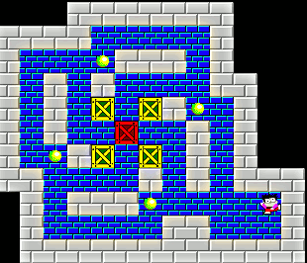
Contribution or Novelty
Maybe in the future a carrier robot will suffer from this scenario in warehouse, then the method will solve such situation.

Slide 10
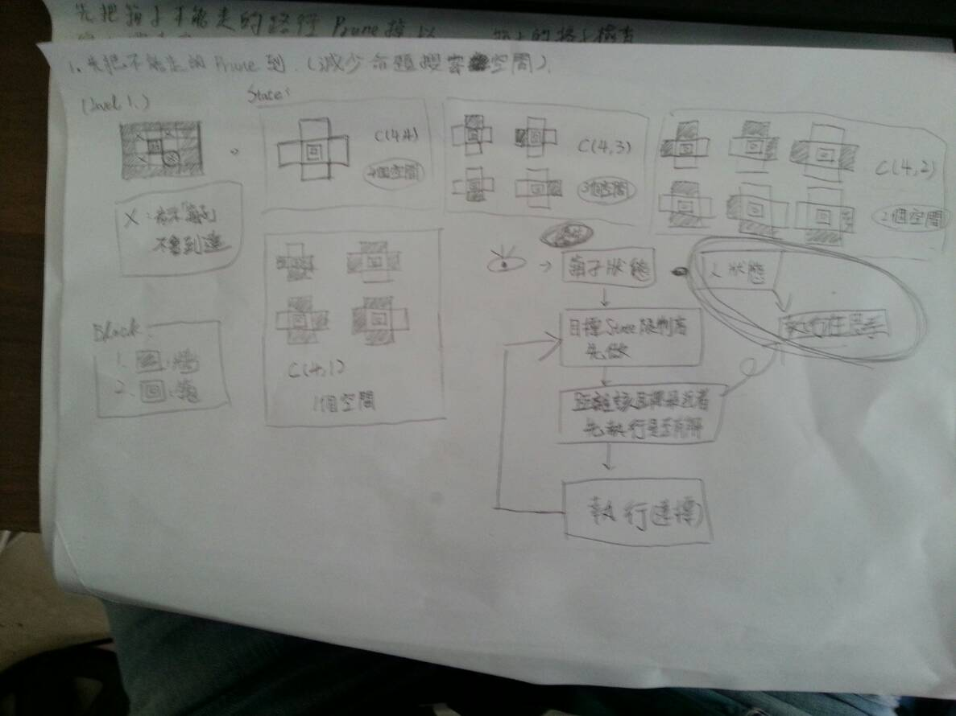
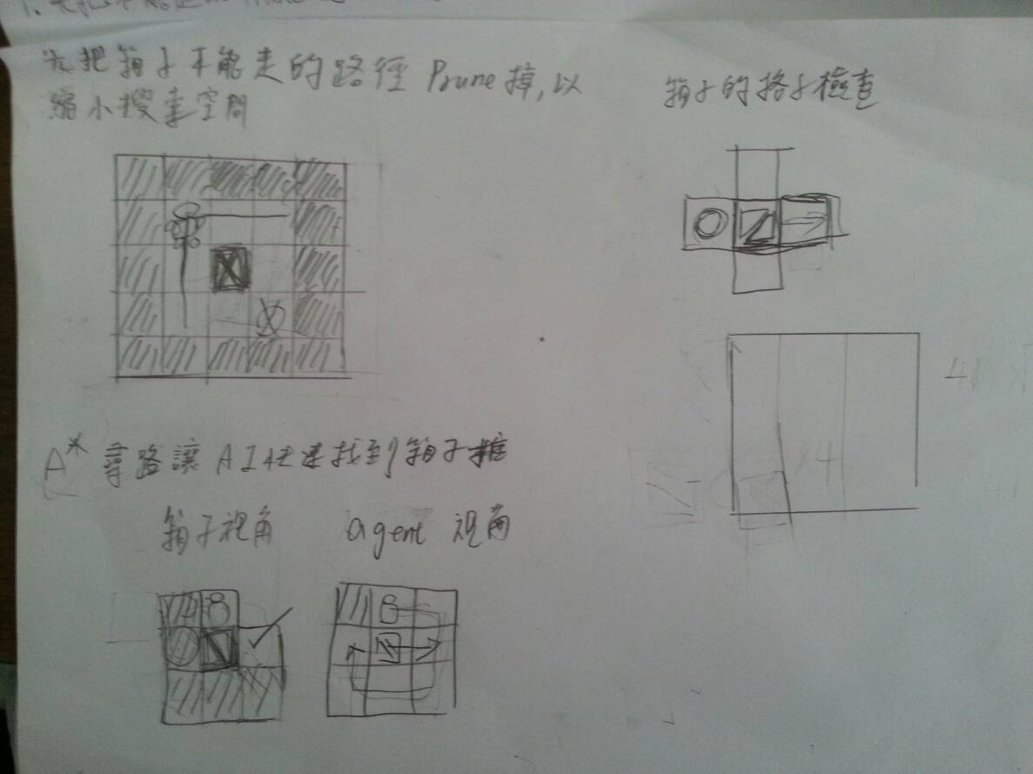
討論過程

Slide 12

Challenge
Game implementaion
There is only Sōkoban online version. We need to craft a Sōkoban game environment such that the agent can play in it.(No reverse engineering!)
Method design
Sōkoban is a single agent and single goal game but it is difficult because it has many box, box can effect other boxes. And its rooms have some narrow aisles which is a obstacle for agent and for boxes.

Slide 13

Potential Solution
Solution for game implementaion
We will cost one or two weeks to implement the game and design a good environment for game agent.
Some idea for method design
We will find out all situations that the box could not push any more. I think it must be a constraint. May be we will use some CSP problem’s spirits. Also,I will research which search method is suitable for Sōkoban.

Slide 14



Resource Required
Device and tools
Human Resource
Computer or notebook
Fresh liver
Terry Huang
Task: Method design
Jacky Lin
Task: Game implementation,
Method design
Jia huan Hong
Task: Presentation design,
odds and ends

Slide 15

Schedule

Slide 16

Reference
SOKOBAN and other motion planning problems .Dorit Dor .Uri Zwick. June 25, 1996
Willy A Sokoban Solving Agent. Luis Rei, Rui Teixeira

