Slide 1
Per-Capita Population Growth Rate
Justin Butler

Slide 2
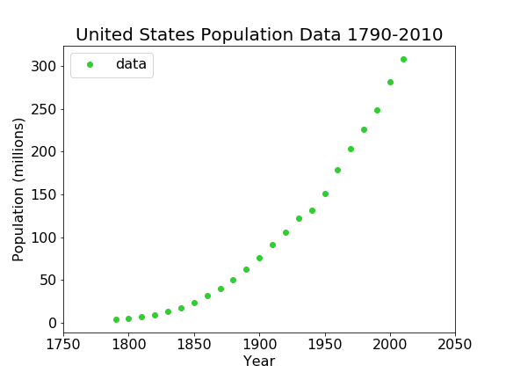
US Population since 1790
US Population from the Census
Year | Population
1790 | 3929214
1800 | 5308483
1810 | 7239861
1820 | 9638453
1830 | 12866020
1840 | 17069453
1850 | 23191876
1860 | 31443321
1870 | 39818449
1880 | 50155783
1890 | 62947714
1900 | 75994575
1910 | 91972266
1920 | 1.06E+08
1930 | 1.23E+08
1940 | 1.32E+08
1950 | 1.51E+08
1960 | 1.79E+08
1970 | 2.03E+08
1980 | 2.27E+08
1990 | 2.49E+08
2000 | 2.81E+08
2010 | 3.09E+08

Slide 3

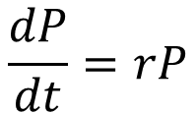
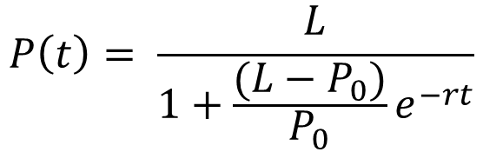
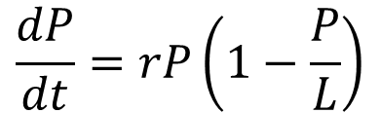
Modeling the Data:
Differential
Solution
$$\frac{dP}{dt}=rP$$
$$P\left(t\right)=P_{0}e^{rt}$$
Exponential:
$$\frac{dP}{dt}=rP\left(1−\frac{P}{L}\right)$$
$$P\left(t\right)= \frac{L}{1+\frac{(L−P_{0})}{P_{0}}e^{−rt}}$$
Logistic:

Slide 4





Per-Capita Population Growth Rate
Definition
$$PPGR= \frac{1}{P}⋅\frac{dP}{dt}$$
Change in Population, per person, over time
Exponential Model
Logistic Model
$$\frac{dP}{dt}=rP\left(1−\frac{P}{L}\right)$$
$$\frac{dP}{dt}=rP$$
$$PPGR=r\left(1−\frac{P}{L}\right)$$
$$PPGR=r$$

Slide 5
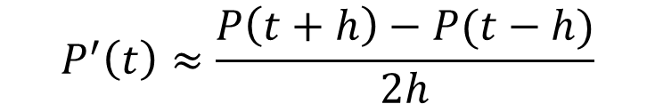



Using PPGR to find ‘r’ and ‘L’: Method of Centered Differences
Want to find the rate of change from one point to another.
$$P^{′}\left(t\right)≈\frac{P\left(t+h\right)−P(t−h)}{2h}$$
Use this formula for all data points (except the two end points)
Where ‘h’ is the distance between any two given data points.
In our set, 10 years.
$$P(t+h)$$
$$P(t)$$
$$P(t−h)$$

Slide 6
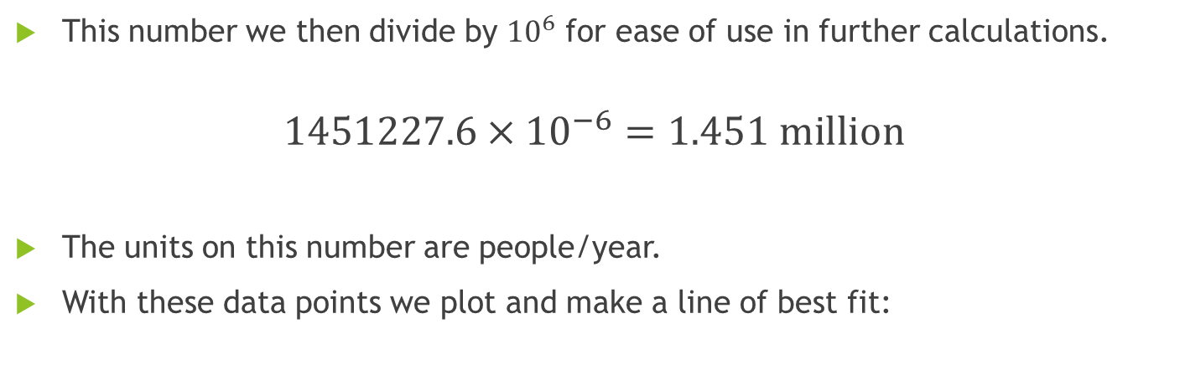
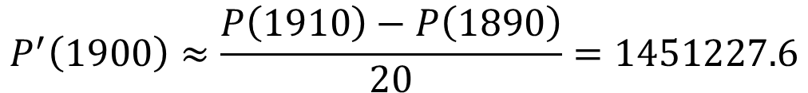
Example Calculation:
$$P^{′}\left(1900\right)≈\frac{P\left(1910\right)−P\left(1890\right)}{20}=1451227.6$$
This number we then divide by ${10}^{6}$ for ease of use in further calculations.
$$1451227.6×{10}^{−6}=1.451 \text{million}$$
The units on this number are people/year.
With these data points we plot and make a line of best fit:

Slide 7
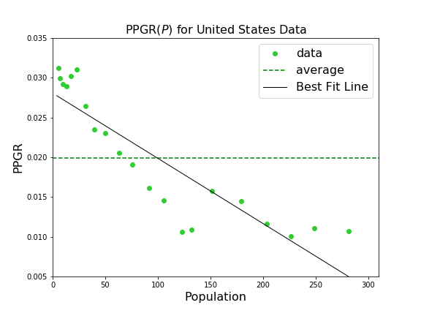
PPGR vs Population
Exponential Model
Average PPGR = r
Logistic Model
L = x-intercept
r = y-intercept

Slide 8
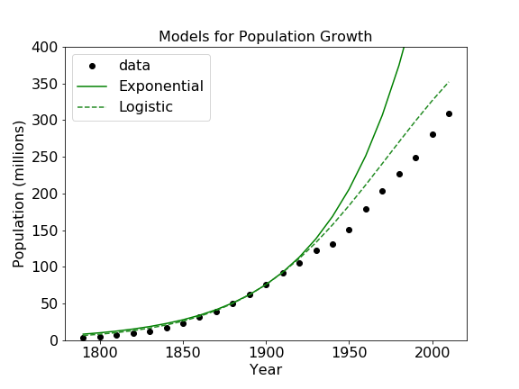
Models from this Method
Clearly begin to see a distinction between the exponential model and logistic model.
Logistic still not a perfect model
A third, more accurate model?

Slide 9
Thank you!
References:
Jean Marie Linhart. 2017. Population Modeling with Census Data. Department of Mathematics, Central Washington University.
Wikipedia Contributors. 2017. Demography of the United States. Wikipedia, The Free Encyclopedia, 24 August 2017. https://en.Wikipedia.org/wiki/Deomgraphy_of_the_United_States. Accessed 24 August 2017.

