Slide 1
Per-Capita Population Growth Rate
Justin Butler

Slide 2
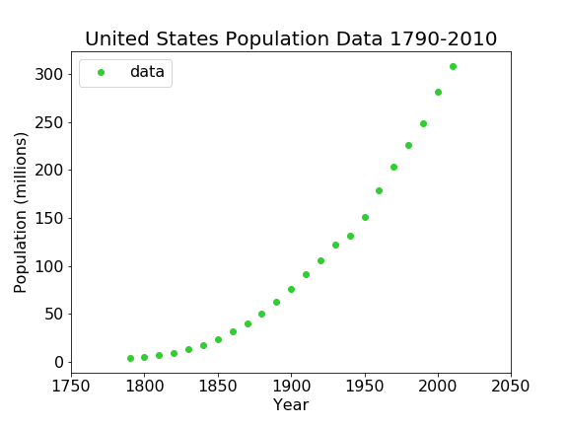
US Population since 1790
US Population from the Census
Year | Population
1790 | 3929214
1800 | 5308483
1810 | 7239861
1820 | 9638453
1830 | 12866020
1840 | 17069453
1850 | 23191876
1860 | 31443321
1870 | 39818449
1880 | 50155783
1890 | 62947714
1900 | 75994575
1910 | 91972266
1920 | 1.06E+08
1930 | 1.23E+08
1940 | 1.32E+08
1950 | 1.51E+08
1960 | 1.79E+08
1970 | 2.03E+08
1980 | 2.27E+08
1990 | 2.49E+08
2000 | 2.81E+08
2010 | 3.09E+08

Slide 3

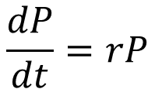
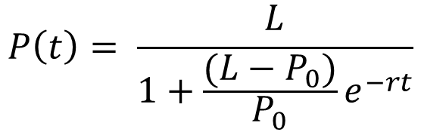
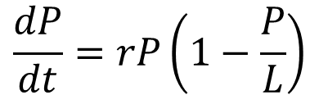
Modeling the Data:
Differential
Solution
$$\frac{dP}{dt}=rP$$
$$P\left(t\right)=P_{0}e^{rt}$$
Exponential:
$$\frac{dP}{dt}=rP\left(1−\frac{P}{L}\right)$$
$$P\left(t\right)= \frac{L}{1+\frac{(L−P_{0})}{P_{0}}e^{−rt}}$$
Logistic:

Slide 4
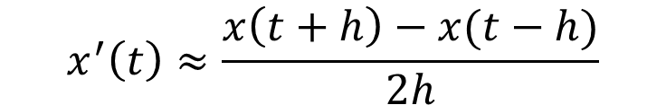
Solving for Parameters: Method of Centered Differences
Want to find the rate of change from one point to another.
Use the following formula:
$$x^{′}\left(t\right)≈\frac{x\left(t+h\right)−x(t−h)}{2h}$$
Where ‘h’ is the distance between any two given data points.
In our set, 10 years.

Slide 5

Example Calculation:
$$P^{′}\left(1900\right)≈\frac{P\left(1890\right)−P\left(1910\right)}{20}=\frac{91972266−62947714}{20}=1451227.6$$
This number we then divide by ${10}^{6}$ for ease of use in further calculations.
The units on this number are population/year.

Slide 6
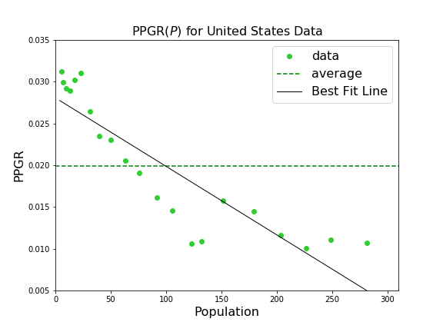
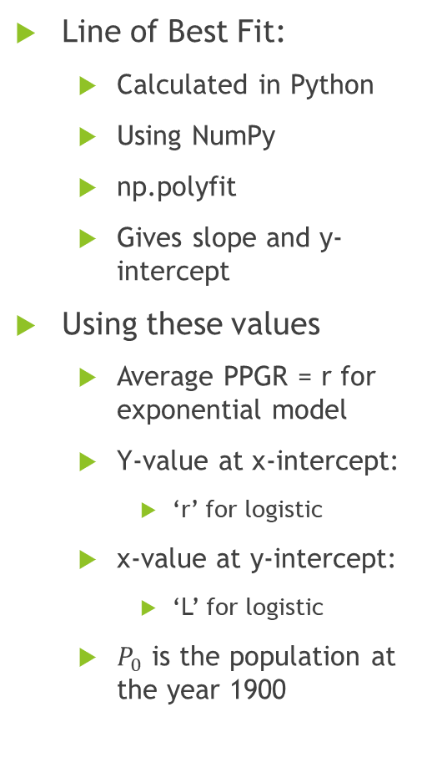
PPGR vs Population
Line of Best Fit:
Calculated in Python
Using NumPy
np.polyfit
Gives slope and y-intercept
Using these values
Average PPGR = r for exponential model
Y-value at x-intercept:
‘r’ for logistic
x-value at y-intercept:
‘L’ for logistic
$P_{0}$ is the population at the year 1900

Slide 7
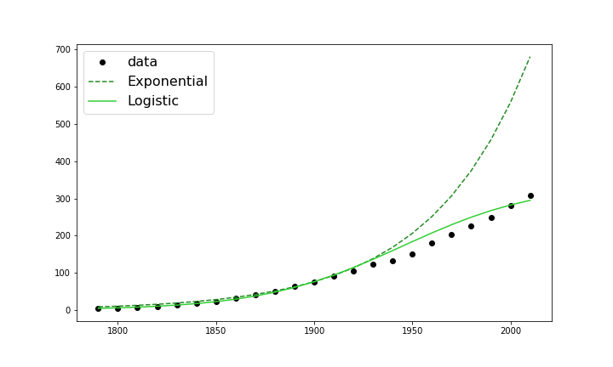
Models from this Method
Clearly begin to see a distinction between the exponential model and logistic model.
Logistic still not a perfect model
A third, more accurate model?

Slide 8
Thank you for your participation!

