Slide 1
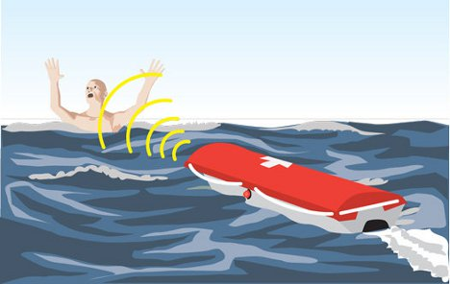
Autonomous Lifeguard
Darrel R. Deo (Project Lead)
Shehadeh H. Dajani
John P. Ash
David A. Goodman
University of California at Santa Cruz
Notes:
Hello, We are the autonomous Lifeguard group, My name is …, I am a … year … Engineer. Hello my name is ...... I am a ..... with a focus in ......

Slide 2
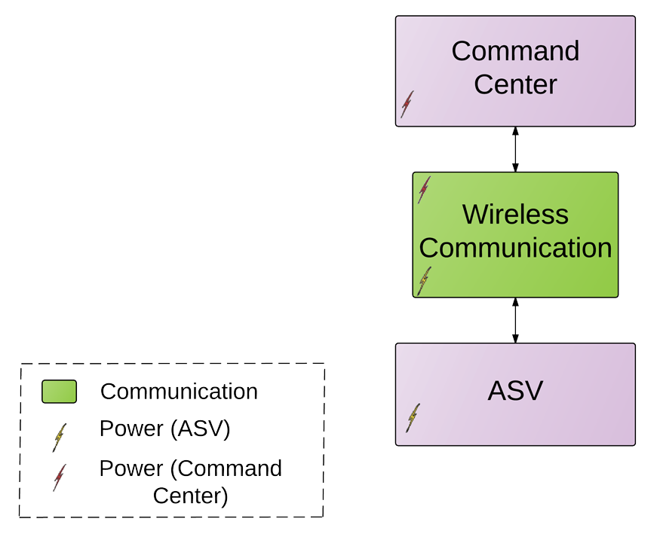
Mission Statement
Autonomous surface vessel (ASV) to aid and assist drowning victims.
2-part system:
Command Center
ASV
Notes:
We are proposing an autonomous surface vehicle to aid a drowning individual in the critical minutes that it takes a lifeguard to make it out to a person.
We are interested in the case beyond the breaks where it would take a lifeguard a while to make it out to the person.
Our system is composed of two subsystems

Slide 3
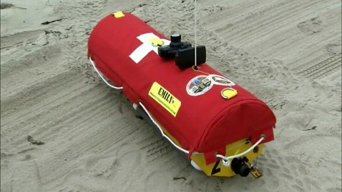
Motivation
Santa Cruz - “Surf City”
E.M.I.L.Y - Emergency Integrated Lifesaving Lanyard
Remote controlled
Deployed from beach
Non-practical
Notes:
range is

Slide 4
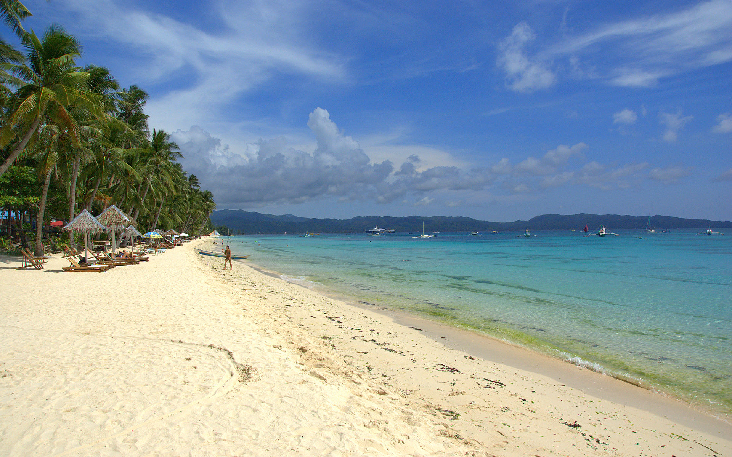
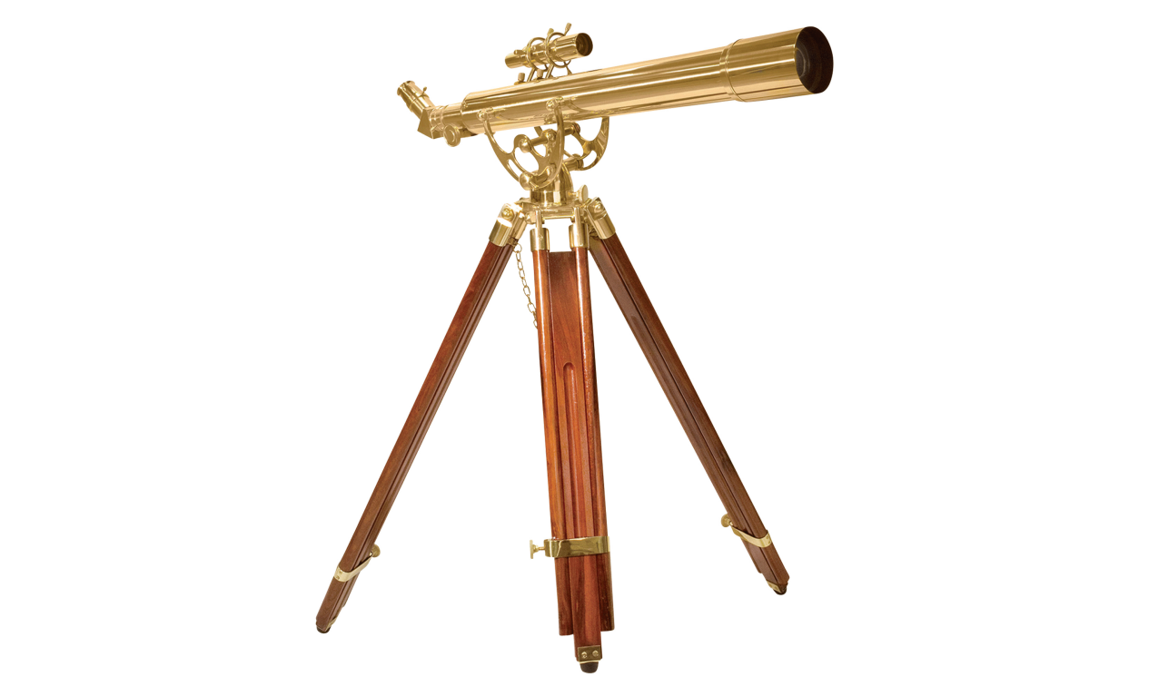
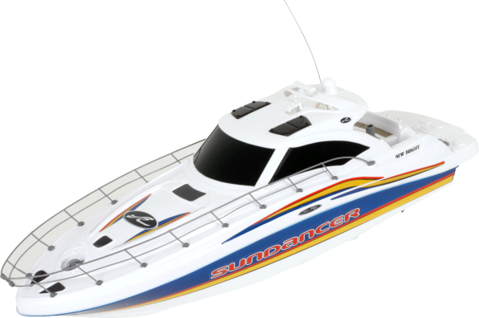
Objective
Develop a system that will aid drowning victims.

Slide 5
Scope of Specifications
Range of rescue will be from beyond surf breaks to 600ft.
ASV will be anchored at a specified waypoint in the water.
Command Center will be located on a lifeguard post.
Both subsystems will communicate via wireless protocol.
Notes:
Range: It will take the average swimmer to swim up to 600 ft, at which point a lifeguard will be able to swim out in 5 minutes.

Slide 6
Minimum Functionality
Command Center
Obtain the drowning victim’s location within +/- 50 ft.
Required to send wireless information at least 600 ft.
Must have an override remote control function allowing full control of ASV.

Slide 7
Minimum Functionality
Autonomous Surface Vehicle:
Speed of ASV must, at least, double that of a lifeguard’s swim speed (3.7 MPH).
Batteries must last for at least 12 hours without recharge.
Must be able to navigate to a specified GPS coordinate within +/- 20 ft.

Slide 8
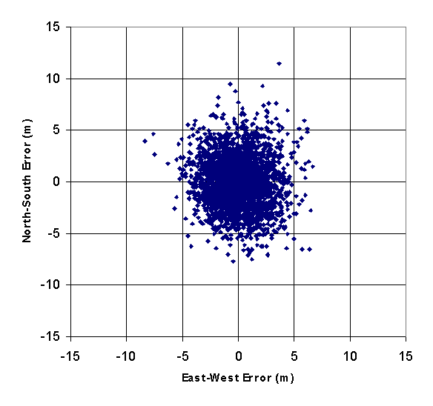
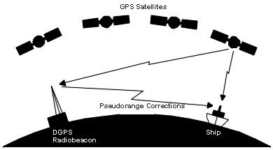
Differential GPS
Calibrate reference station position average over time
Calculate instantaneous GPS error
Transmit error to rover for corrections
1.1cm to 3.2ft of accuracy achieved

Slide 9
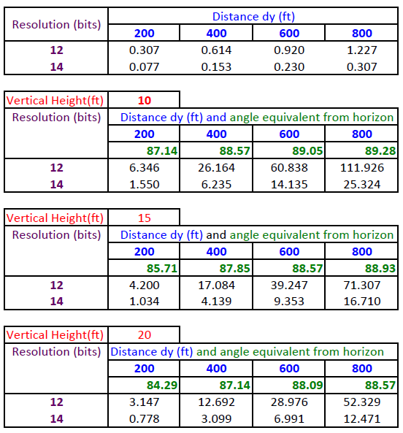
Encoder Accuracy

Slide 10
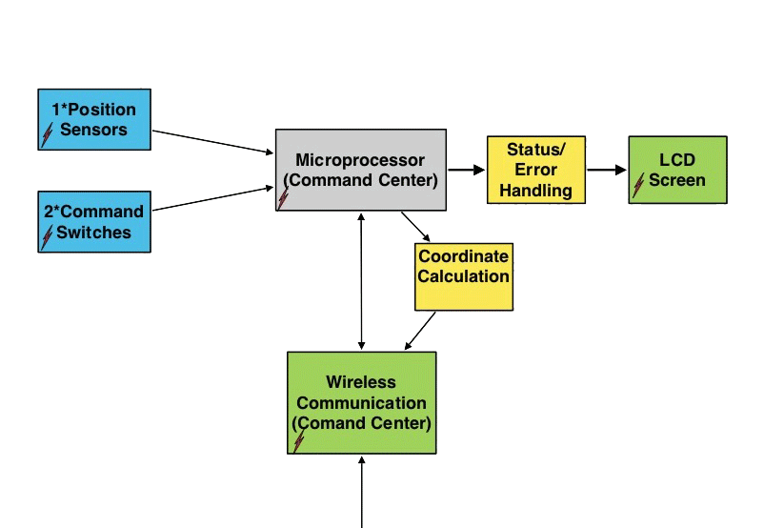
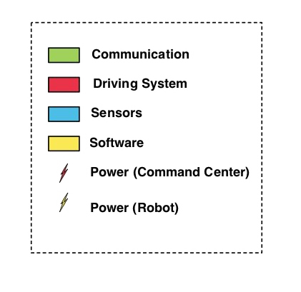
Block Diagram
Command Center
Notes:
Add sensor blocks
Switches can be put into interface sensors

Slide 11
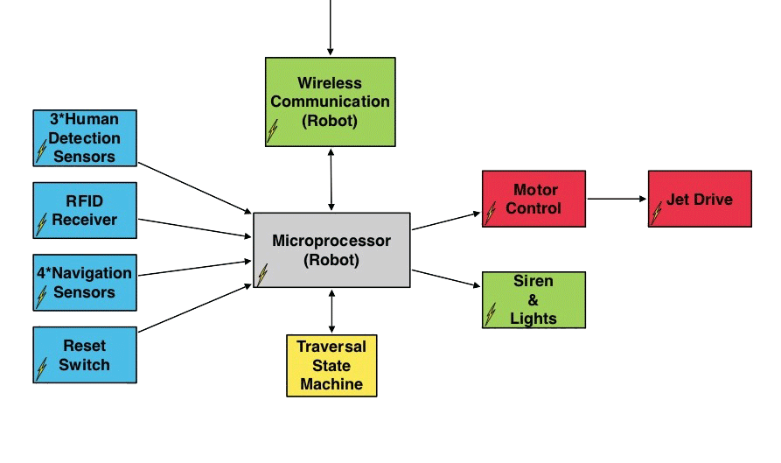
Block Diagram
ASV

Slide 12
Division of Labor
John Ash – Schedule Planner
Wireless Protocol, Power Management, PCB Routing
Shehadeh Dajani – Budget Coordinator
Motor Control, PCB Design/Layout, Vehicle Design
Darrel Deo – Team Leader
Sensor Integration, Tripod Design, Modeling
David Goodman - Document Administrator
Software Test Harnesses, FSM Design, GPS Integration
Notes:
John: qualifications: XBee experience (121 expansion), autonomous boat for ASL,
David: software eng. for 5yrs industry exp., DSP, and GPS (ASL)
Shehadeh: Quals: Mechatronics motor control, solidworks fiend, board layout exp.
Darrel : Quals: Sensor Technology experience, math modeling--Solid Mechanics

Slide 13
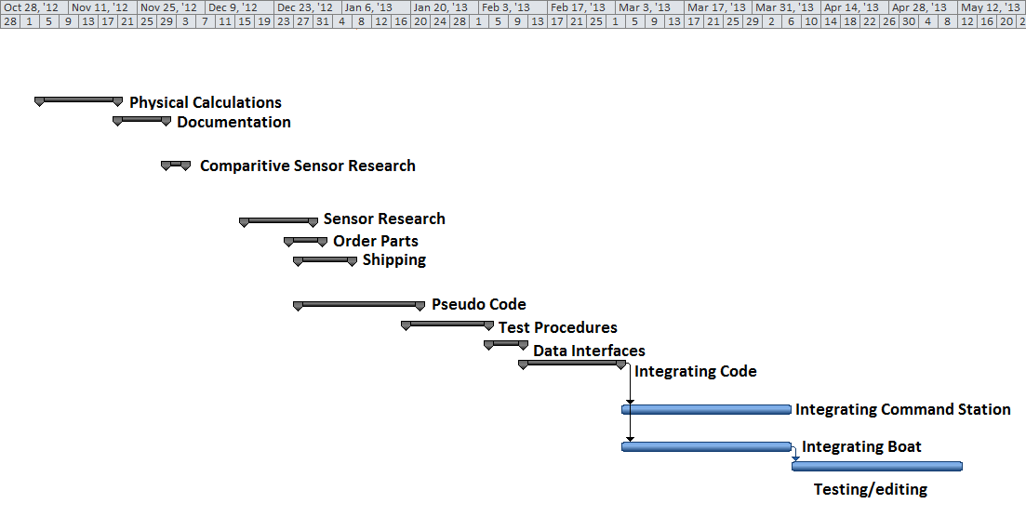
Gantt Chart

Slide 14
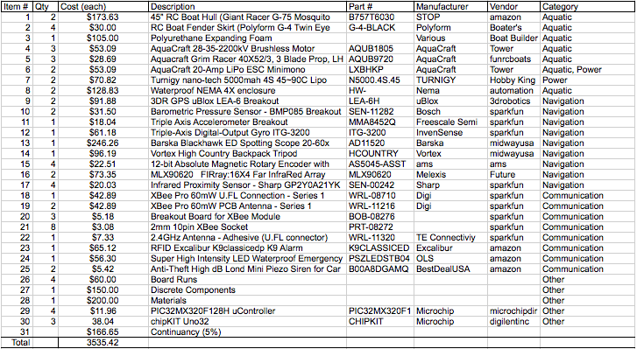
Itemized Budget

Slide 15
Progress
Boat Hull has been ordered and is in route.
Started extracting coordinate data from GPS devices.
Established Xbee communication.
Beginning to interface decoder wheels with Micro.
Currently seeking funding sources (Kresge, Oakes, Crown, and Corporations.)

Slide 16
Conclusion
All team members are proficient in their field of responsibility.
Gabriel Elkaim has shown support and offered mentorship.
We have access to field testing environments (e.g. pool, lake, ocean).
This project has the real potential to be an asset to lifeguards and save lives.
Marketable to beaches across the country.

Slide 17
References
EMILY:
http://www.popsci.com/gadgets/article/2010-06/invention-month-robot-lifeguard

