Slide 1
Ancient Egyptian Art - Etruscan Art(12-14)
By: Matija Benko

Slide 2


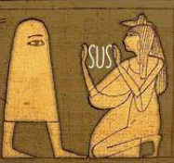
Ancient Egyptian art
Ancient Egyptian civilization - from 3000 B.C., following predynastic period, to when Alexander conquered Egypt (c. 332 B.C.)
Egyptian art emphasizes hierarchical scale - uses size to show a figure’s status

Slide 3


Presentation of Figures
(Ancient Egyptian Art part 2)
Figures are presented so each body part is shown clearly(fractional representation)
  Head, lower body, legs, & feet are in profile, the eye in frontal view w/ the head, & torso is in full frontal view
Excellent preservation was in much of Egypt
  Mummies preserved egyptians well
    King Tut’s tomb was hidden cleverly

Slide 4
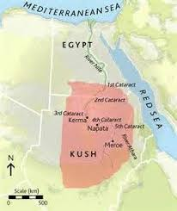

Nubian Art
Nubia covered much of Africa(southern Egypt included)
  Nubia completely controlled Egypt(Pharos were Nubian too)
    Influenced ancient Egyptian art a bit
Contemporary historians researched Nubia(info could change as people research Nubia more{maybe})

Slide 5
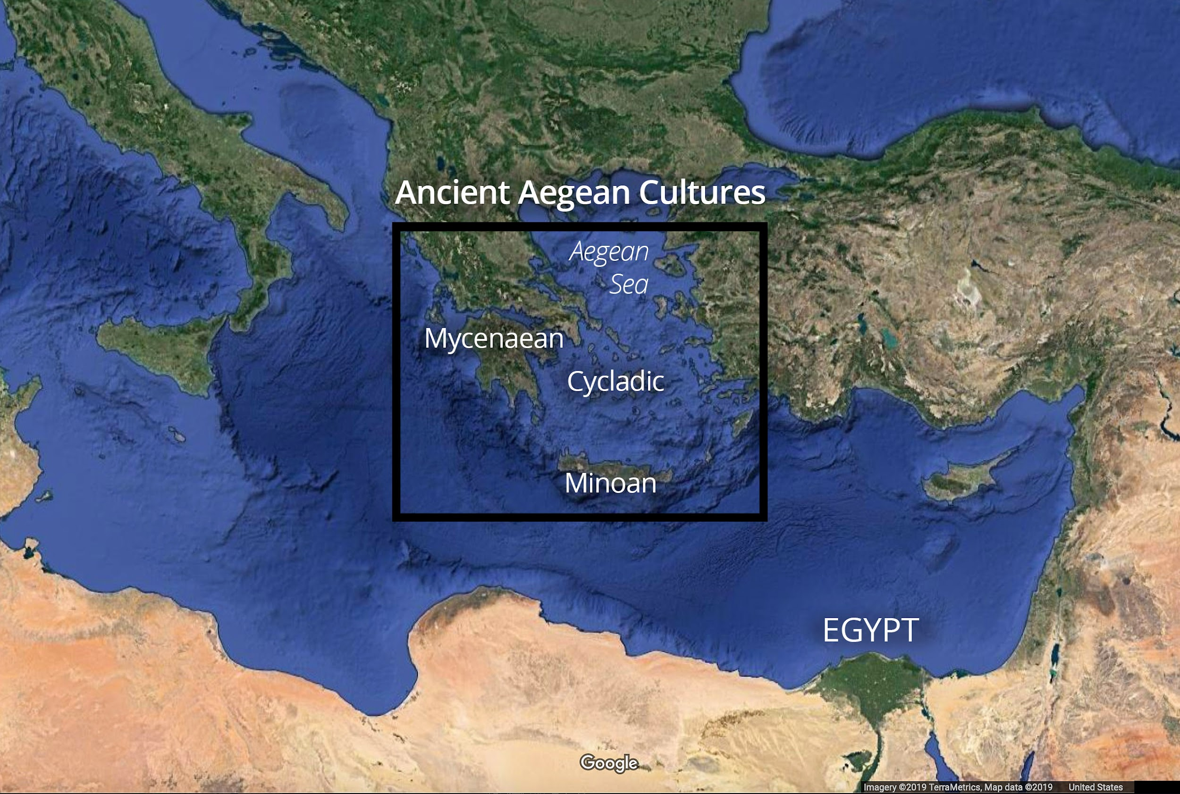
Cycladic, Minoan, & Mycenaean Art(context)
The Aegean island art was important to our understanding of before ancient Greeks was an idea
Three cultures flourished on the islands in the Aegean Sea, on Crete, & along the Aegean coast

Slide 6
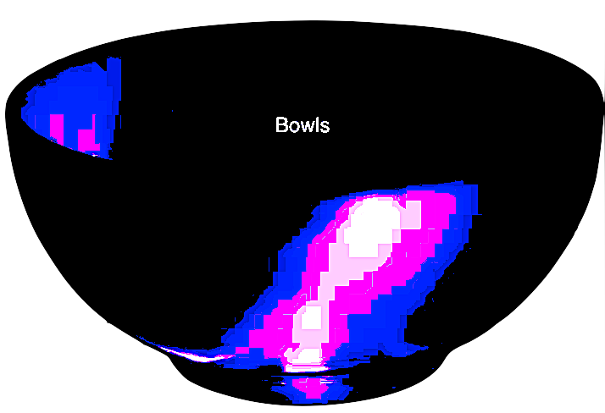
Cycladic Art
Cycladic, earliest of the three, flourished about 3200-2000B.C.
  “the simplified, geometric nude female figures from this area are highly appealing to modern sensibilities.”
  produced decorated pieces of pottery as well as marble bowls & jars

Slide 7


Minoan art
The maze where the minotaur lives is a royal palace. They lied to us! >:(
Minoans peaked in 2,000 B.C.(took over Cycladic)
  Centered around Knossos, Crete
Art of Minoans depict sea life, include statues of a snake goddess(?)
  Frescoes on palace walls
  Pottery designs
Minoans built four palaces, completely unfortified & designed in a natural style(wow)

Slide 8
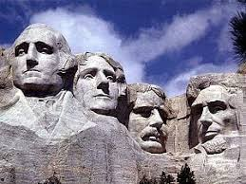

Mycenaean Art
Peak was at Minoan collapse(people think Mycenaeans beat Minoans), Centered around Mycenae
  Built fancy tombs, burial practices allowed many things to preserve
    Best known are made of gold & show mastery in goldsmithing
  Made 3D engravings on flat surfaces(relief sculpture)

Slide 9

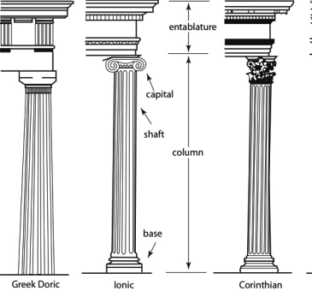
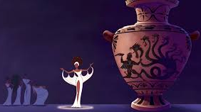
Ancient Greek Art
During 660 to 475 B.C., Greek art copied Egyptian & Mesopotamian art
  Made sculpture w/ marble & limestone
    Placed emphasis on human proportions
  Columns were in Doric & Ionic style
  Also painted vases
    Corinthian style used flowers, Athenian style is black/red figures
Here are the legends

Slide 10

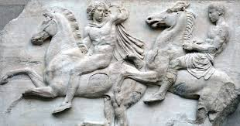
Ancient Greek Art(part 2)
Best known art is from Classical period Athens
  Temples were typically built w/ Doric columns(much of the sculptures have not survived)
    Roman copies gave people clues of how these sculptures looked
  Characterized by dignity, strength, & simplicity, often focused on a figure/scene either before/after an important action
They took stiff positions of Egyptian art & gave them life
Finna go to school

Slide 11
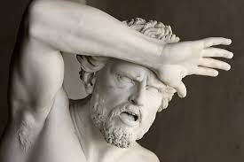

Presentation of figures(Greek Edition)
“Contrapposto” (counter positioning)- shows the body to its best advantage
Architecture declined in Late Classical Period
  (Athens was beaten in Peloponnesian War)
Temples still used Doric columns
  Corinthian columns became more popular
Hellenstic Period saw increasing influence of the East (Greek style blended more w/ Asia Minor)
Me after discord light mode:

Slide 12

Thank You!

