Slide 1


2 Min Review: Harriet Powers, Pictorial Quilt
You must pay, Matija!
By: Matija Benko

Slide 2
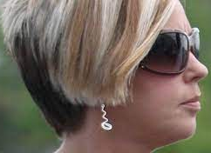

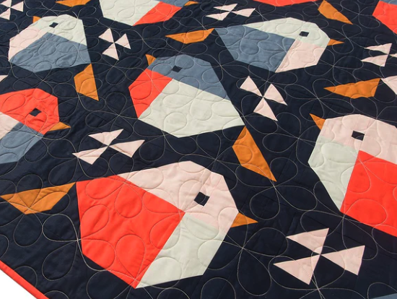
Appetizer
I wanna sew the manager so bad
Most paintings were produced by men
  Women mostly did art in other ways (sewing & needlepoint)
Quilts: treasured family objects, some even signed w/ the quilter(their name was a part of the design), often seen in wills and passed down through generations
Quilts were more popular bc. of industrialization
19th-century quilts had three layers: quilt top, an inner layer, and a backing

Slide 3
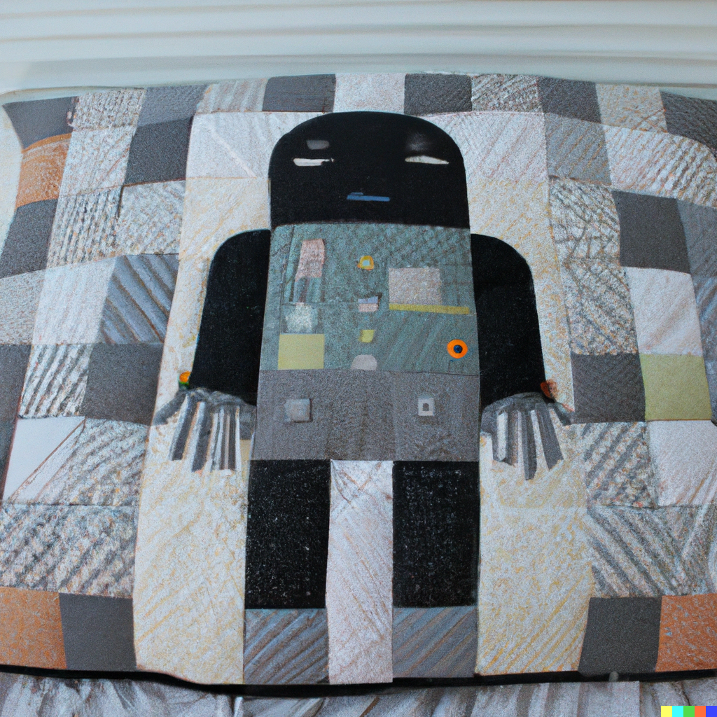
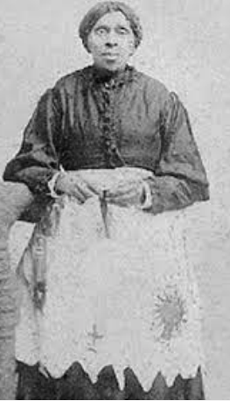
Appetizer (part 2)
Born enslaved in Georgia, 1837, Harriet later married Armstead Powers, and had > nine children
Became landowners after they were freed
Her gravestone, found in Athens’ Gospel Pilgrim Cemetery, gives her death date as January 1st 1910
Harriet Powers made the Pictorial Quilt, now in the collection of the Museum of Fine Arts in Boston

Slide 4
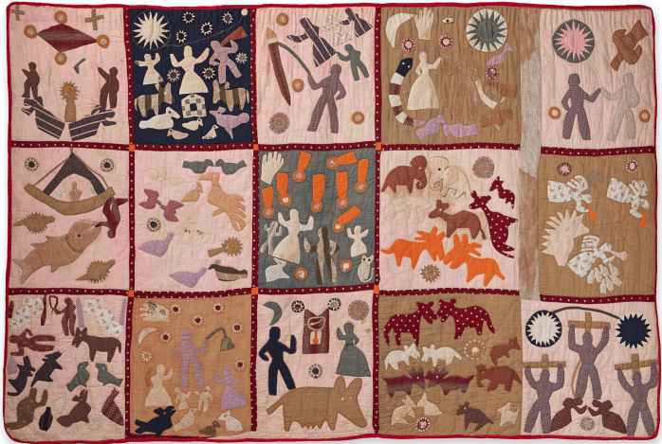

Main Course
Cotton plain weave, pieced, appliqued, embroidered; 175 x 266.7 cm
storytelling is similar to textiles from Dahomey
most panels are people and scenes from The Bible
meteor storms of 1833 and 1846 and “Black Friday” of 1780, when smoke from forest fires made the sky go dark
A panel tells the story of a hog that ran from Georgia to Virginia
The center panel is the Leonid meteor storm on November 13, 1833

Slide 5

Thank You!
We know what you did, Matija, and you are approaching your doom!

