Slide 1

2 Min Review: Robert S. Duncanson, View of Cincinnati, Ohio from Covington, Kentucky
By: Matija Benko

Slide 2
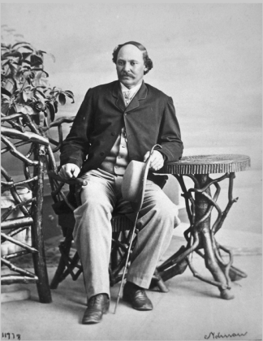
Background of Artist
Robert Seldon Duncanson:born ˜ 1821 in Fayette, New York(near Seneca Falls); Family moved to Monroe, MI
1st African-American artist to get international acclaim
self-taught (copied prints+painting portraits)
1841:he pursues a career as a fine artist in Cincinnati, Ohio(a regional art center leaning to abolitionism)

Slide 3


Background of Artist 2
Abolitionists loved Duncanson
After 1850: in a group (defined Ohio River Valley style)
toured Europe in 1853
By early 1860s he moved to Montreal(bc of civil war), then left for Britain in 1865( exhibited several important paintings)
He died in 1872 in Detroit after having a seizure @ 51
Duncanson’s work fell into obscurity for yrs

Slide 4

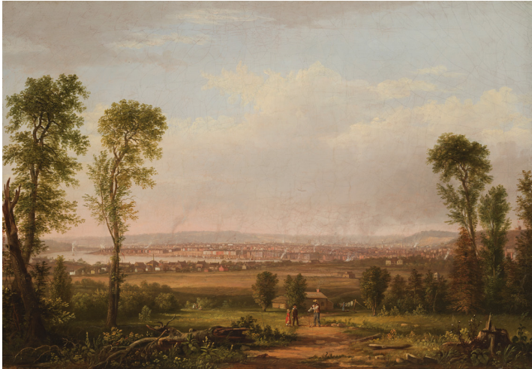
The Art
Title: View of Cincinnati, Ohio from Covington, Kentucky
Made in 1850
Medium: Oil on canvas(couldn’t get size{sorry})
Ohio River separated the Slave state of Kentucky from the more industrialized, Free state of Ohio(slavery was banned since 1802)
When the Ohio river freezes, slaves cross to go to Ohio

Slide 5

Thank You!

