Slide 1
Elements of Art - Color (35-37)
By: Matija Benko

Slide 2

ELEMENTS OF ART
Need to focus what sort of techniques the art piece uses
  Line
  Shape
  Form
  Space
  Colo(u)r(can’t do [ :( ])
  Texture(can’t do [ :( ])
  Ect.
  This vocab. is needed to understand artwork

Slide 3
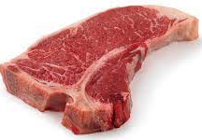

Line
Basicest element
Any mark-making tool can make lines
Path of a point moving thru space
Have varying length, width(boldness), & direction
  Vert. lines move up(churches)
  Horizont. lines are peaceful
  Diagon. lines & curves are energetic
Lines can be dashed(- - - -)
Can be edges/corners

Slide 4

Shæpe
what defines the 2D area of an object(square is shape)
  A drawn apple is a shape representing it
In 2D artwork, artist may try making illusion of form thru other techniques
if use math it is geometric(conveys order), if not, it is organic(living things are irregular shapes/forms)(conveys moving)

Slide 5
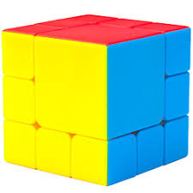
Form
Related to Shape
  what defines the 3D volume of an object(cube is form)
    A molded apple made of clay is a form
  Forms can also be geometric/organic

Slide 6


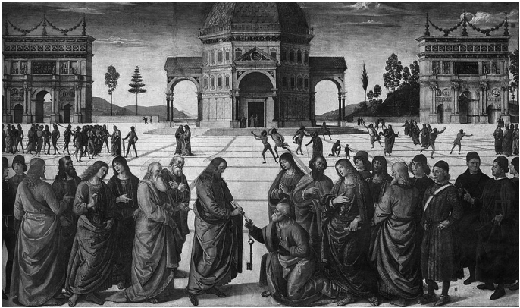
Spæce & Perspective
3D art includes architecture, sculpture & ceramic objects. Sculptures can be freestanding/relief
Space - Area in artwork(Associated w/ organization of objects)
  Objects occupy + space
  Space not occupied is - space
Perspective - fake depth in 2D art
  Shading, highlighting borders to copy how light shining objects give depth, place objects lower/higher, overlap objects/change size & detail make them close/far
  Aerial perspective - technique regards particles change appearance of things for afar

Slide 7
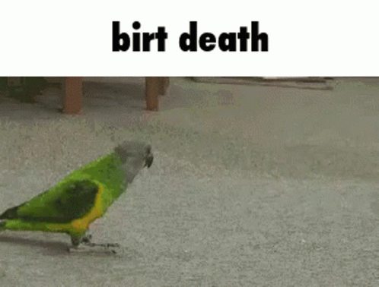
Thank You!

