Slide 1
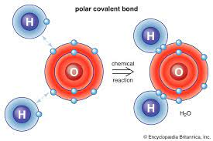
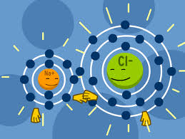
The Effect of Bond Types on the Structures of Solid Compounds - Molecular Models(pg 20-22)
Written by Matija Benko

Slide 2
Slides for Presentation
Covalent Network or Molecular Solid
01
02
Ionic Lattice

Slide 3
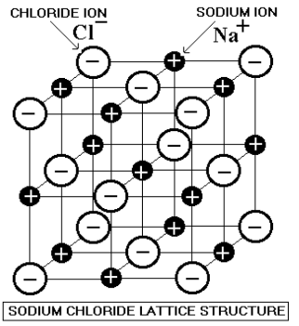
Ionic Lattice
electrostatic forces created by the positive and negative charges (opposites attract) in an ionic bond extend in all directions
  compounds with ionic bonds exist as lattice networks extending in 3D
  Example: sodium chloride, which consists of a lattice of alternating + sodium and - chlorine ions [chlorine stole some electrons from sodium] repeated until the edge of a salt crystal is reached

Slide 4
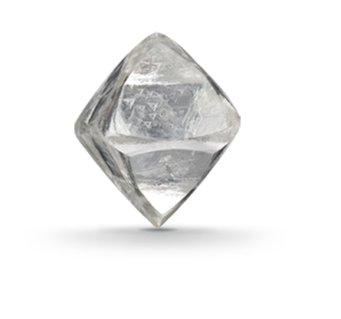
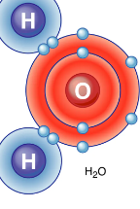
Covalent Network or Molecular Solid
The force creating a covalent bond is focused on just the two atoms involved
  The atoms share electrons and that makes them stick together (people sharing internet in houses)
    while hydrogen only forms a single covalent bond in the compound, carbon can form four covalent bonds with other atoms
  Covalently bonded molecules can exist as small units, such as methane and water, or as a covalent network, like diamonds, which consists of carbon, each atom bonds to four other carbon atoms in a lattice of such bonds, forming a diamond (streets connecting other roads, houses, or highway)

Slide 5
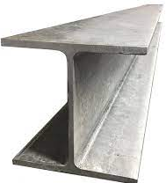
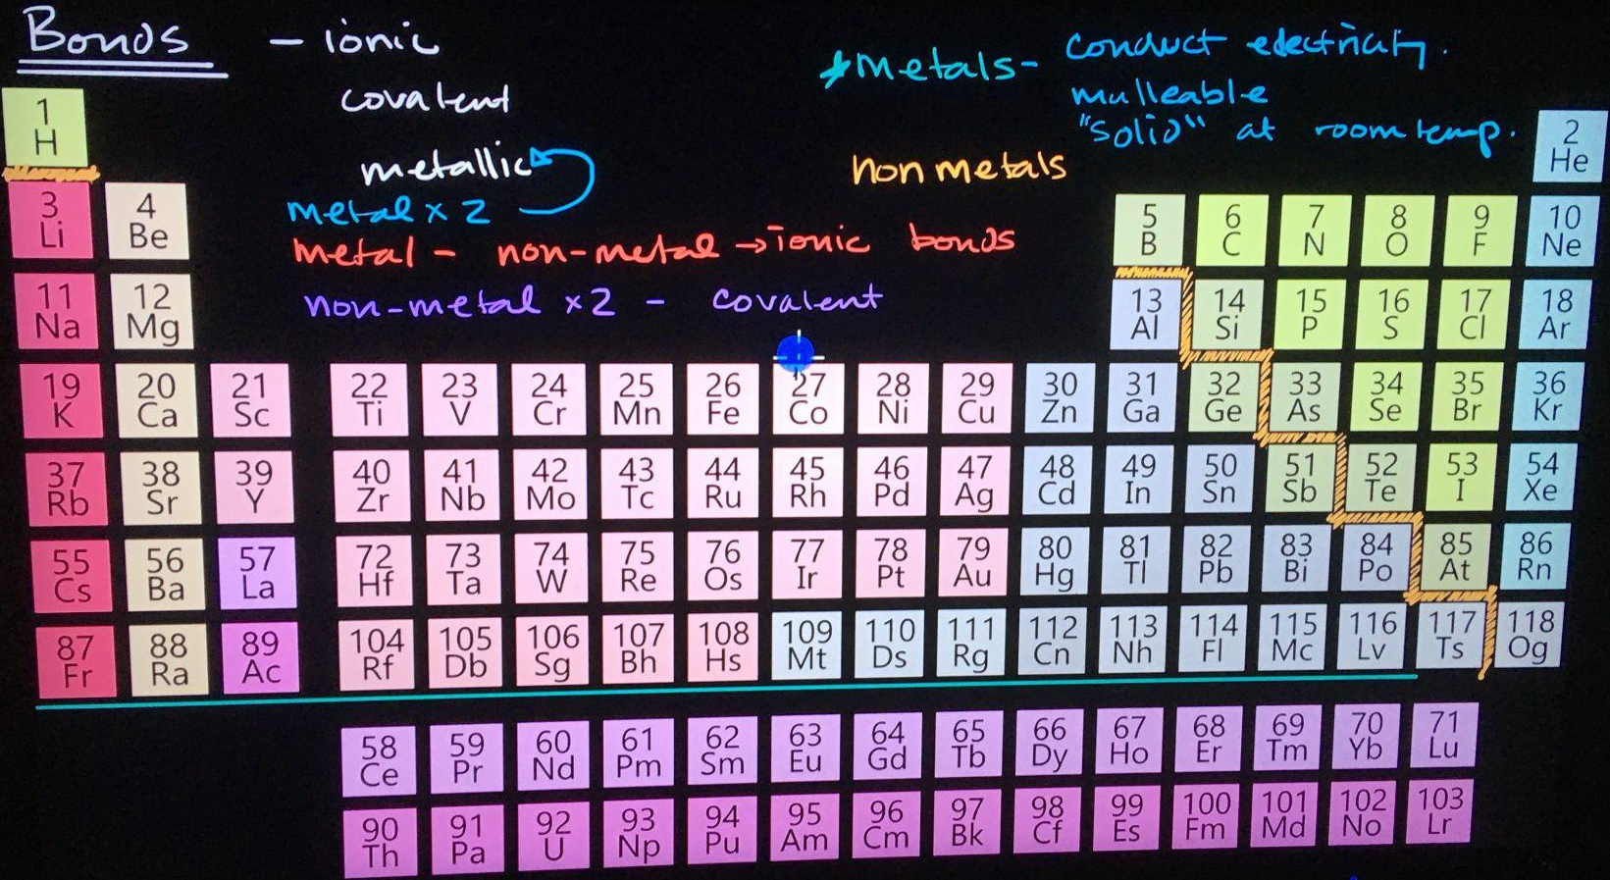

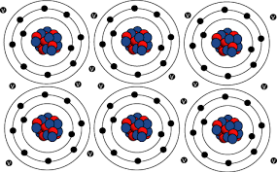
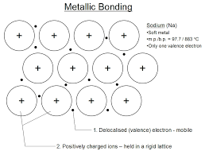
EXTRA SLIDE: METALLIC BONDS
Metals easily lose electrons
Metallic bonds are highly ordered solids with metal atoms with free-flowing electrons
They form a grid of atoms that, have electrons hold the atoms tightly
  Similar to how ionic bonds form lattice structures
    Makes metals strong, but also can change shape as layers of the atoms can slide over one another relatively easily.

Slide 6
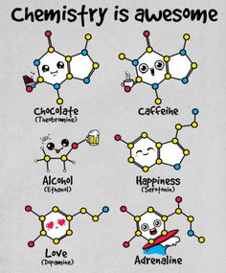
Thank You for Coming to My Presentation!

