Slide 1
OXIDATION-REDUCTION
REACTIONS-Luigi Brugnatelli and The Development of Electroplating(62-66)
No Luigia For you!
By Matija Benko

Slide 2


What is Oxidation?
Oxidation frees electrons from one reactant, then are used in the reduction of other reactant
  sodium has 11 electrons, one is valence electron; when sodium changes to an ion with +1 charge, it frees an electron
NECESSARY

Slide 3

What is Reduction?
The freed electron from Na goes into a positive Ag ion, making the latter turn into a Ag atom(reduction)
Oxidation-reduction(Redox) reaction is one or more electrons getting sent between reactants

Slide 4

Oxidation Numbers
Oxidation # is # of electrons an atom has to get/give to separate from a compound
  Can be positive/negative/zero
    In AgCl, Ag is +1 and Cl is –1
    in Al₂O₃, each Al atom # is +3, each O atom # is –2

Slide 5
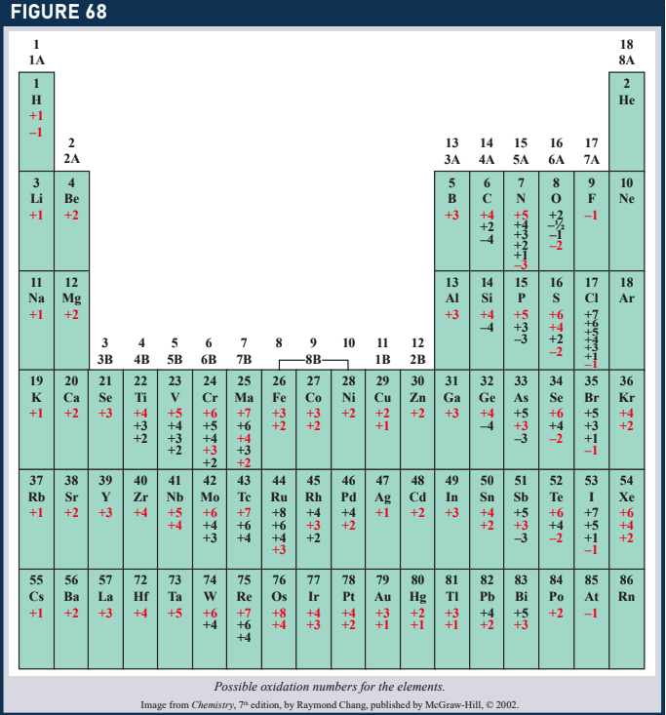
Rules for Oxidation Numbers
There are two regular* rules for knowing compounds that form these elements:
  H and group 1 elements have oxidation #s of +1
  The oxidation # of O is –2

Slide 6

Rules for Oxidation Numbers (part 2)
Lovius dobivius these rules are very obvious
More rules for oxidation #s in general:
  Oxidation # of an ion is its charge
  Neutral atoms have an oxidation # of 0
  Oxidation #s of atoms in neutral compounds must add up to 0(neutral compounds have no charge)
  Sum of the oxidation #s of atoms inside ions made with atoms must be equal to the charge on said ion
These rules can turn a chemical equation into an Algebraic one

Slide 7

The Role of the Electron in Oxidation-Reduction
# of electrons freed during oxidation must equal # of electrons added during reduction
  Redox reaction equation use Half reaction, which shows the Oxidation and Reduction in two equations
    Half reaction of Cu + 2Ag⁺→ Cu²⁺ + 2Ag:
      1. Cu → Cu²⁺ +2e–
      2. 2Ag⁺ 2e–→2Ag
CU+2Ag⁺ Cu²⁺ + 2Ag

Slide 8
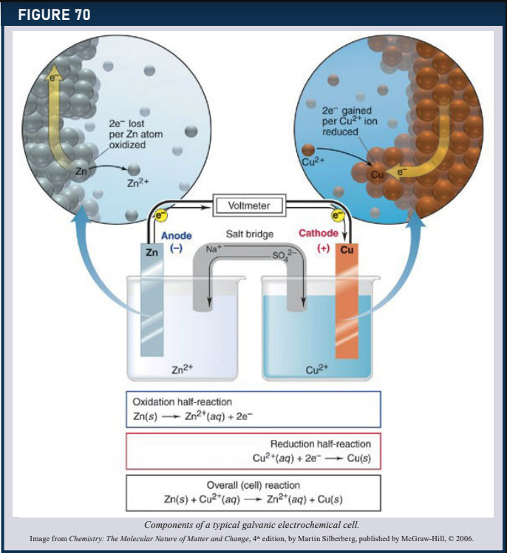
ELECTROCHEMISTRY
Electrochemistry the study of chemical processes that cause electricity
  Chrome plating is used for reflective surfaces on cars and appliances

Slide 9

Cell potentials
Volts: How much an electron wants to get away/join an atom/Ion
  Cell potential: potential energy for a redox reaction(measured in Volts)
    Batteries has cell potential
    When all of the reaction in a cell potential has been done, there is no more potential energy left
    Each half reaction can be assigned a potential
    Standard half-cell potentials are measured relative to 2H⁺+ 2e–→ H₂

Slide 10
Explanation of Cell potentials
Oxidation is just the reverse of reduction, so sign of the volts are opposites
  if the oxidation reaction is Cu → Cu²⁺ + 2e–, then the standard oxidation potential of the half-cell is –0.34V(Volts)
Half-cell potentials are combined to provide information on a complete reaction
  Eº_{red} – Eº_{ox}

Slide 11

Example of Cell potentials
For the reaction Cu + 2Ag⁺→ Cu²⁺ + 2Ag, voltage of the reaction is determined by first identifying the potential of each half reaction:
Cu → Cu2⁺ +2e– E⁰= –0.34 V
Ag⁺+ 1e–→ Ag E⁰=+0.80 V
  Sign of the Cu half-reaction voltage was changed since it was the oxidizing half-reaction
Add the voltage of both half reactions to get the voltage of the redox reaction
  -0.34V+0.80V=0.46V(spontaneous occurring)

Slide 12

Example of Cell potentials(part 2)
Spontaneously occurring: found often in nature
Non-spontaneously occurring: not found often in nature
  Li⁺+ Fe³⁺→ Li + Fe²⁺
  The two half-reactions are as follows:
    Li⁺+ e–→ Li E° = –3.05 V
    Fe²⁺ → Fe³⁺ + e– E° = –0.77 V
      Of course, the final result is a negative number (because -n-m is negative)
    This reaction happens naturally in reverse, so the result would be positive

Slide 13

Thank You!

