Slide 1
Ancient Mesopotamian Art - Greek and Roman Art (11-13)
By: Matija Benko

Slide 2
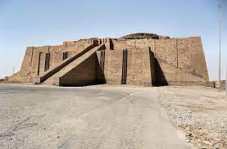

Ancient Mesopotamian Art
2334 BC-2150: Sumer in control of Akkadians
  loyalty to King
    freestanding/relief sculptures
1729 BC: Babylonians(Hammurabi)
  Code & relief sculpture at top(Hammurabi inspired by Shamash)
  Neo-Babylonians: Ishtar Gate(Animals superimposed on wall) & hanging gardens
Example of a Ziggurat
Akkadian rulers

Slide 3
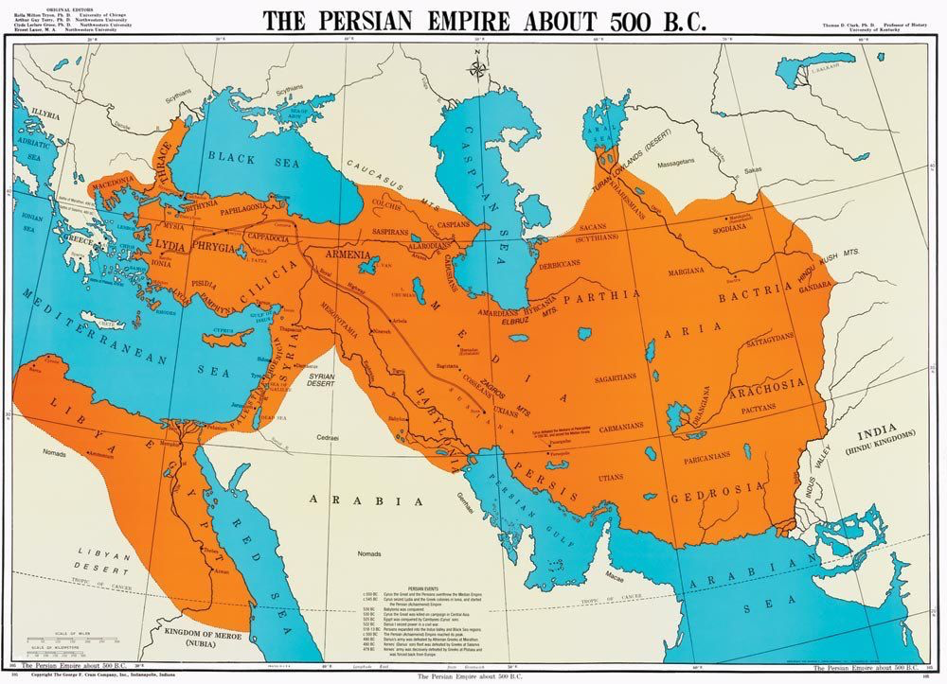
Persian Art
538 BC–330 BC: Persian Empire (present-day Iran)
  Palace at Persepolis (made of stone, brick, & wood)
    Reflects influence of Egyptian architecture

Slide 4
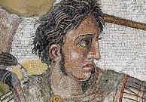
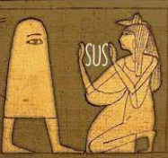
Ancient Egyptian Art
3000 B.C. - 332 B.C.: Ancient Egypt
Emphasizes size to show a figure’s status(hierarchical scale)& showed all parts(fractional representation)

Slide 5
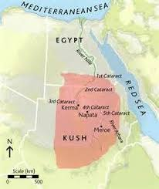

Nubian Art
Nubia covered around southern Egypt
  completely controlled Egypt
    Influenced Egypt
Info could change as people find new stuff
Info about Nubia Loading …

Slide 6

Thank You!

