Slide 1
The Advent of Oil Paint and Canvas - The Invention of Cristallo Glass (72-74)
By: Matija Benko

Slide 2
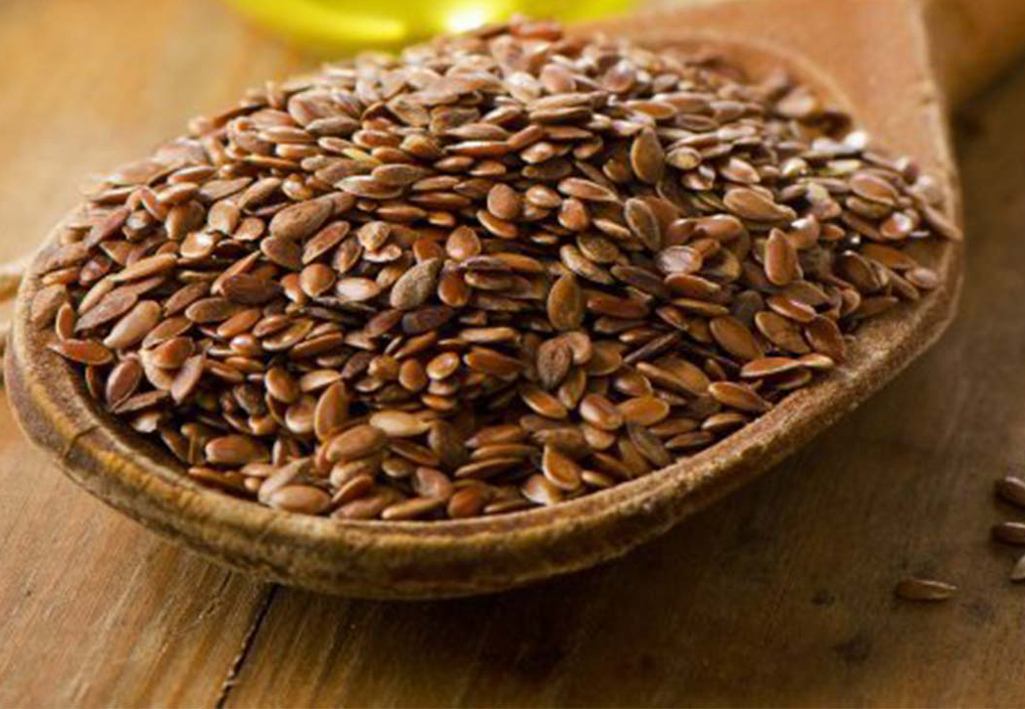

THE ADVENT OF OIL PAINT AND CANVAS
Tempera dried fast, but not blend smoothly(for 3D effect)
Jan van Eyck & Robert Campin(oil paint in Flanders, Belgium)
Oil Paint: suspend pigments in oil
Canvas adds support, cheaper & smaller, & primed w/ binder{gesso}(14th-cent. Venice->mid-16th-cent. Europe)

Slide 3
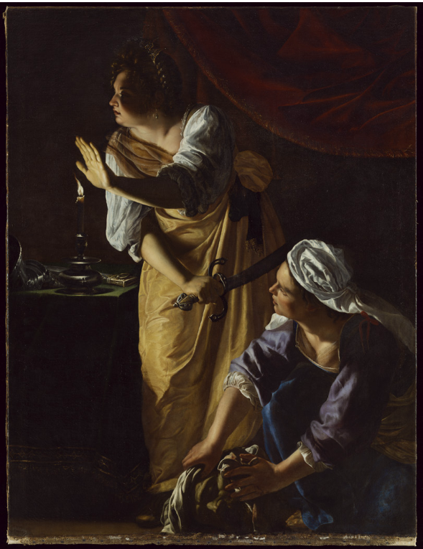
SELECTED WORK: Judith and Her Maidservant with the Head of Holofernes, Artemisia Gentileschi, c.1623–25
Artemisia Gentileschi - successful (Baroque artist)
  Tapped into violent topics
  Glorifies women
Realistic images b/c oil paint
Judith is in Old Testament
Tenebrism seen used

Slide 4

Thank You!

