Slide 1
The Action Potential - Synaptic Transmission (31-36)
By: Matija Benko

Slide 2


The Action Potential
Action potential:electrical potential across neuronal membrane when neuron is firing signals
Measured in volts(V)
Few milliseconds
Triggered by any stimulus
Involves rapid ion channel opening/closing
AKA spikes/nerve impulses/APs
https://www.youtube.com/watch?v=UZthGjcuTDs

Slide 3
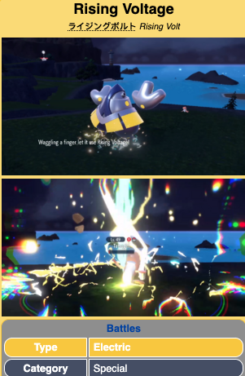
Rising Phase
Resting neuron potential: -60 to -80 mV
Membrane potential rises in voltage
  Positive ions enter neuron
  Neuron’s charge approaches charge outside (depolarization)
Potential get to around +30 to +40 mV(peak)
When rising phase starts, full action potential has to finish

Slide 4

Falling Phase
Membrane potential decreases
  Positive ions leave neuron
  Repolarization/hyperpolarization
continues to fall until −80 mV
  undershoot/afterhyperpolarization
Na-K pump works to reset voltage

Slide 5
Sodium Channels
Channels that let ions move at certain membrane potentials or voltages(Voltage-gated)
Outside more positive than inside(Positive ions try to go inside)
Rising phase due to Na+ influx
Peak(+30 to +40 mV), channels become inactive
  Absolute refractory period prevents second AP

Slide 6
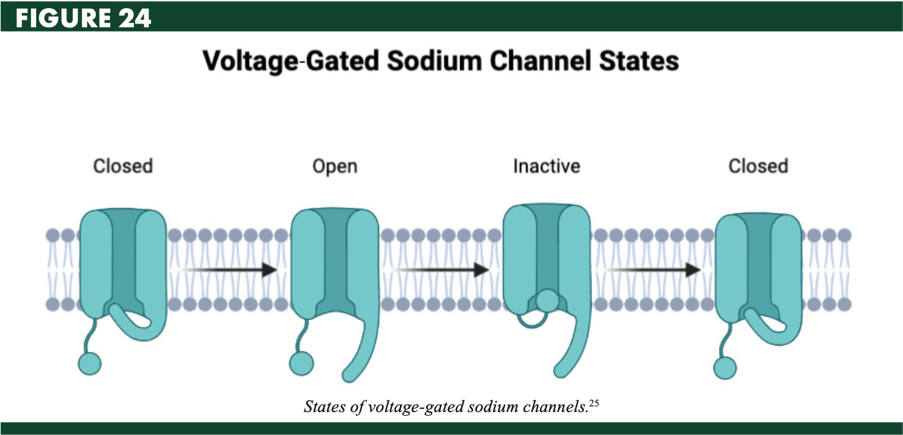

Slide 7
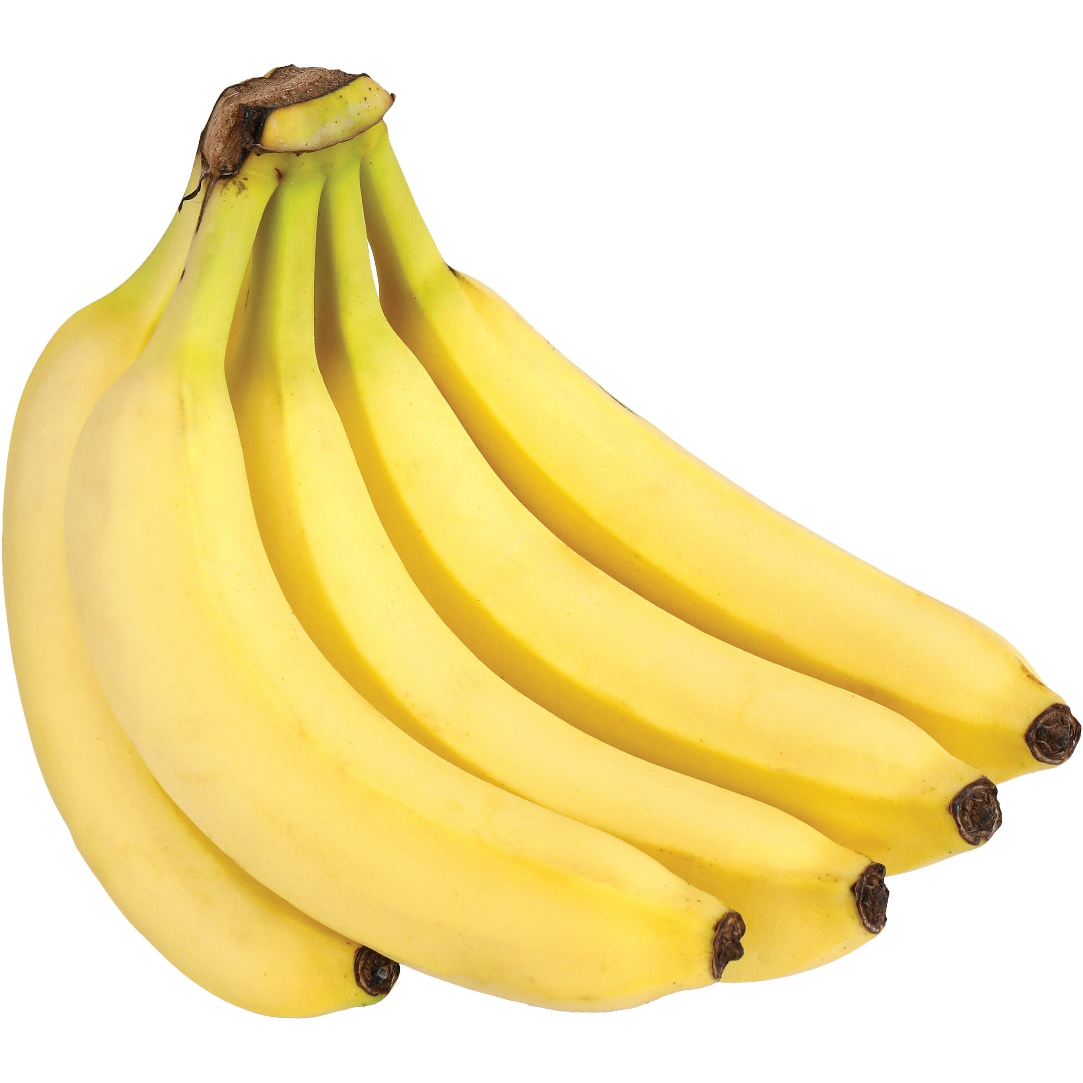

Potassium Channels
Potassium channels start to open at 0 mV
  Slow opening and closing, fully open at peak
K+ rushes out (K+ Efflux)
Start to close near resting potential
  K keeps leaving
Referred as delayed rectifier
Still is impossible to start another AP(relative refractory period)
Reset by with Sodium-potassium pump

Slide 8
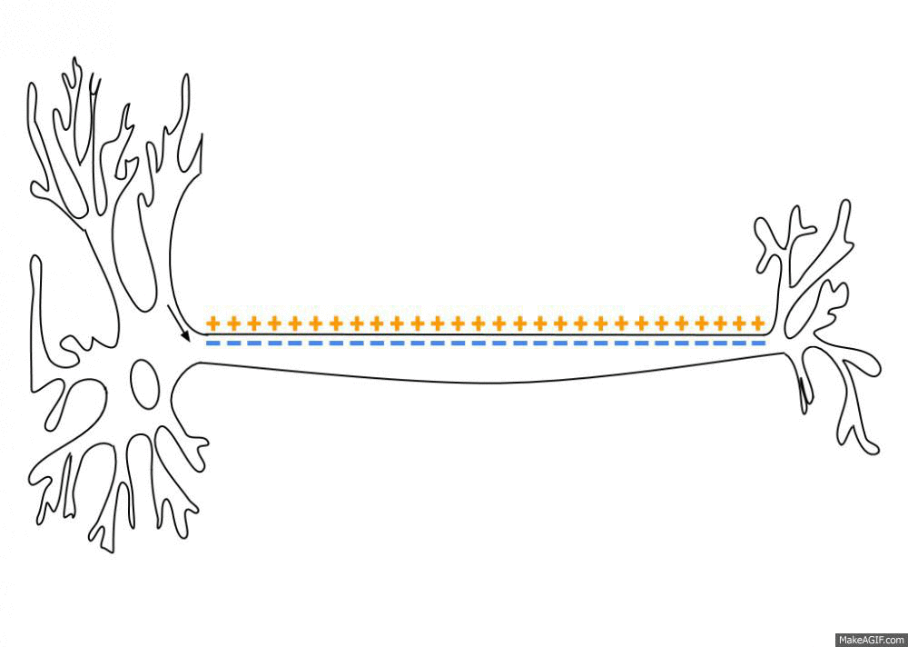
Action Potential Conduction
Initiated at the cell body(soma)
Travels down Axon
  Repeating the action potential sequence
    Can trigger another sequence
  Only goes in one way

Slide 9
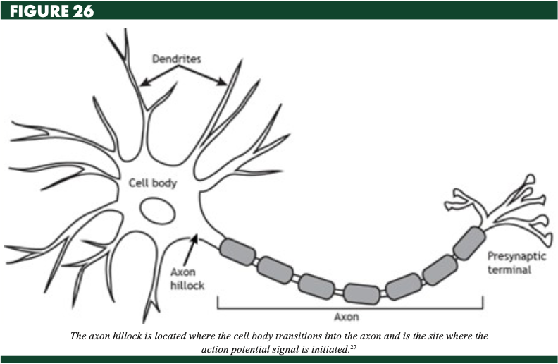

Slide 10

The Nodes of Ranvier and Saltatory Conduction
Areas of axon is covered in myelin
  Sheath made by glial cells
  Similar to insulation on wires
Nodes of Ranvier: gaps between Sheaths
Na & K channels clumped in Nodes of Ranvier
Saltatory conduction: conduction happening in myelin sheaths

Slide 11

Thank You!

