Slide 1
SELECTED WORK 4: Will Wilson, Church Rock Spill Evaporation Ponds, Church Rock, New Mexico, Dinétah, 2019 (56-58)
By: Matija Benko

Slide 2
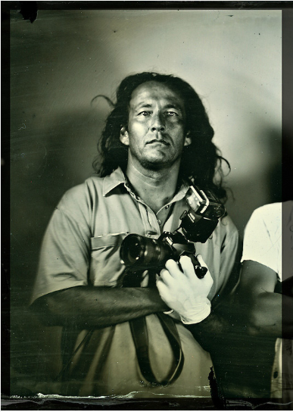
SELECTED WORK: Will Wilson, Church Rock Spill Evaporation Ponds, Church Rock, New Mexico, Dinétah, 2019
Will Wilson: contemporary Diné (Navajo) artist
  photography, sculpture, art history (Dinétah/Navajo Nation)
  bachelor’s in studio art & art history in 1993(Oberlin College)
  Master of Fine Arts degree in 2002(University of New Mexico)
  “Survey”: pollution in Dinétah

Slide 3
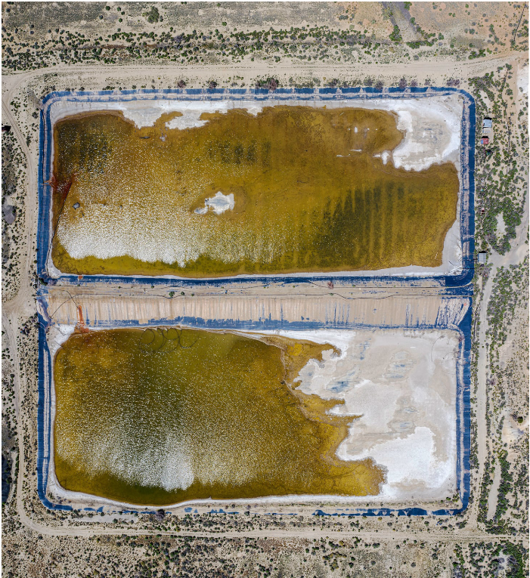
SELECTED WORK: Will Wilson, Church Rock Spill Evaporation Ponds, Church Rock, New Mexico, Dinétah, 2019
4 Mil tons of uranium was extracted from the Dinétah
Church Rock Spill is an aerial view
  two ponds used to evaporate water contaminated with tailings(waste product from uranium mining-contains heavy metals and radium)
dam holding contaminated water at the Church Rock uranium mill breached, sent 93 million gallons of radioactive liquid to the Dinétah
Notes:
Underreported

Slide 4

SELECTED WORK: Will Wilson, Church Rock Spill Evaporation Ponds, Church Rock, New Mexico, Dinétah, 2019
“Survey” emphasizes that the polluted lands were not unpopulated
  “Survey” uses every definition
Activities of military and mining industries repeated a false notion that Indigenous peoples basically don’t exist/matter
  Wilson noticed this w/ Edward S. Curtis
    created portraits in a studio using large format wet plate collodion photographs(response)
    glass-plate negative: 8in.*10in.(high detail)
    emphasizing uniqueness
Notes:
Underreported

Slide 5

Thank You!

