Slide 1
Overview of Solar Storms - Plot and Structure: Chapter Summaries (20-22)
By: Matija Benko

Slide 2


Overview of Solar Storms
Solar Storms(1994)
  Bildungsroman(1970s)
  Angela Jensen(17-year-old Native American)[MC]
    Process of Angel’s self-discovery w/ personal know, Ls & Ws
  Audience can read her thinks(& her grandmas)
  Abusive Mother makes her live in foster
  Hydrodam will change rivers & dams

Slide 3
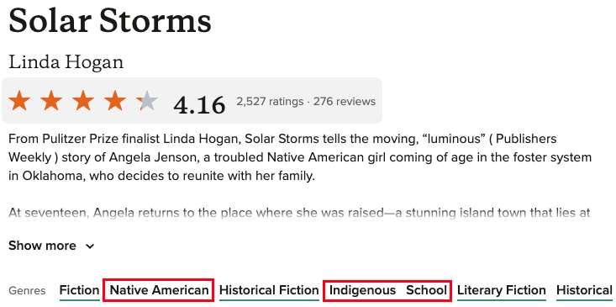
Overview of Solar Storms(part 2)
Angel is greeted by Dora-Rouge and Agnes(grandmas), Bush(Angel’s caretaker)
  Live in the US
  Grandmas & bush share stories
2 indians warn town about reservoir expanding
  Protest & find Hannah Wing(Angel’s mother)
  Angel leaves Tommy(crush)

Slide 4
Angel’s ‘connection’ to water(plus other stuff)
Can see through water & makes medicinal plants
all find history in water, which is different from settlers
  Dora-Rouge makes a deal w/ a river
as they go to Two-Town, Agnes dies(later)
Tulik(Dora’s relative) & protest[US gvmt. & BEEVCO moved rivers without permission]
Meets Hannah & she denies hitting her
  Supports her in Hannah’s last moments
  Aurora(baby sister)

Slide 5
Overview of Solar Storms(part 4)
Protests turn more violent(corporation & government reject Native people’s pleas)
  blockades & using military
  To violence or not to violence?
Tulik’s is burned & workers & police threaten violence vs. Angel and Dora-Rouge
Bush, Angel, & Aurora esc w/ Mr. Orensen’s help after Aurora’s tear gassed

Slide 6
Overview of Solar Storms(part 5)
Bush’s home is mostly submerged(take as much as they can)[Go back to walking]
Tommy & Angel reunite and marry
Angel keeps fighting for water & land
  W/Tulik in court as testimony on behalf of Native communities
  Hopes that humanity can know and protect Earth

Slide 7

Thank You!

