Slide 1
Poetry; “Evergreen” By Oliver Baez Bendorf - Poetry: “The Air Smelled Dirty” By Marge Piercy (52-54)
By: Matija Benko

Slide 2

OLIVER BAEZ BENDORF: Biography
Poet, Professor, librarian, & activist
Iowa(1987)»Colorado
3 poetry books(Considering the Rooster[2024])
  praised
Many awards
‘Poems are bodies on the page’
  Poems explore becoming & transforming
  Intersecting nature, writing, & body

Slide 3
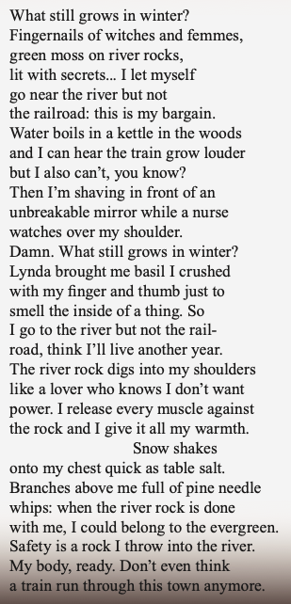
SELECTED WORK: “Evergreen” (2018) by Oliver Baez Bendorf

Slide 4
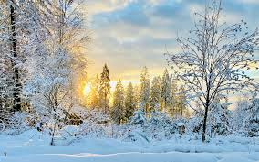
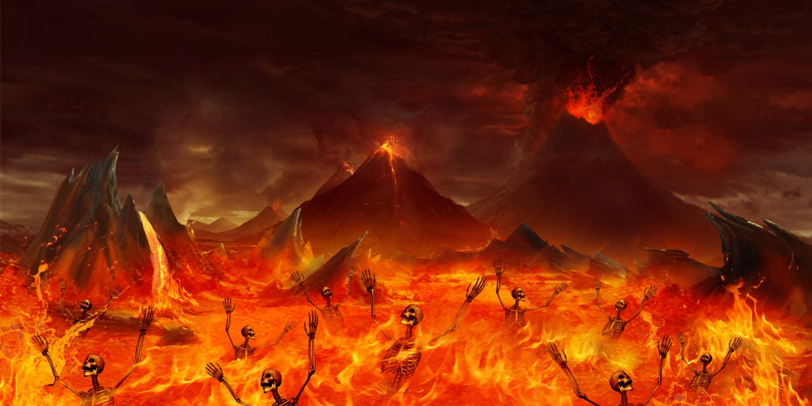
Analysis of “Evergreen”: Nature and the Self
Written in 2016[Vermont Studio Center]
woods during winter —> meditates on living in despair
  reflecting on a previous suicide attempt
  Winter & forests —— contemplation of death
  Shifts to positive
    Like winter
Evergreen trees keep green leaves(resilience)

Slide 5

Thank You!

