Slide 1
Why Don’t We Listen-LISTENING COMPANION 13: “Feels Like Summer” (111-113)
By: Matija Benko

Slide 2
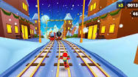
Why Don’t We Listen?
“Despite Repeated Warnings” highlighted leaders not caring
  Regular people are ignorant bc we are distracted
  Donald McKinley Glover, Jr. explored the possibility

Slide 3
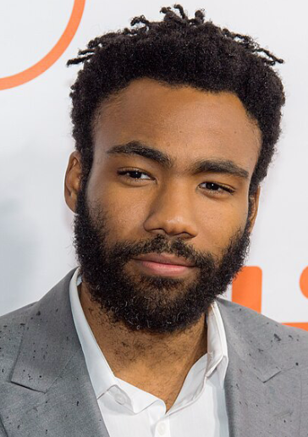
Celebrity Obsession
Renaissance man/polymath(done everything)
  Made stories and puppet shows as a child
  Wrote for The Simpsons
  Made rap under Childish Gambino
  Stand-up comedy
  Appeared in TV
  Lando Calrissian in Solo: A Star Wars Story(2018)

Slide 4
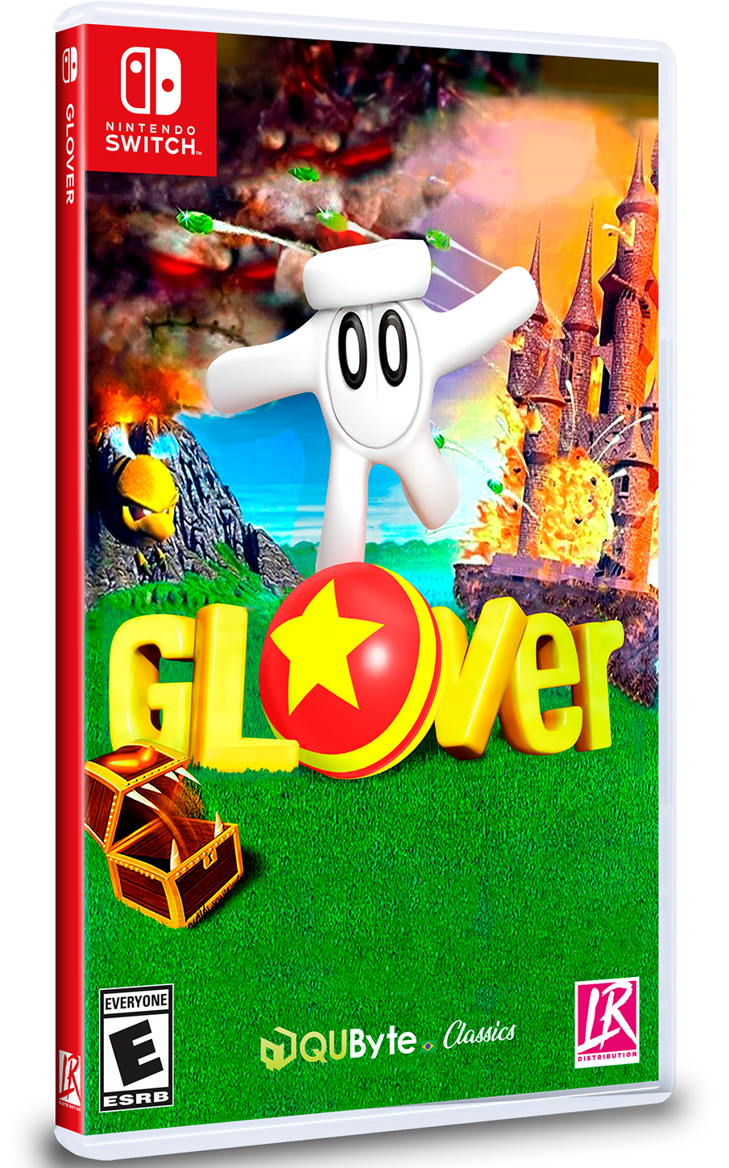
Celebrity Obsession
“Redbone” in Get Out(2018)
guest host and the musical guest on SNL
  Premier of This is America
    1st #1 Billboard song
two-track EP titled Summer Pack
“Summertime Magic”:
  Happy-go-lucky
  Different from “Feels Like Summer”

Slide 5
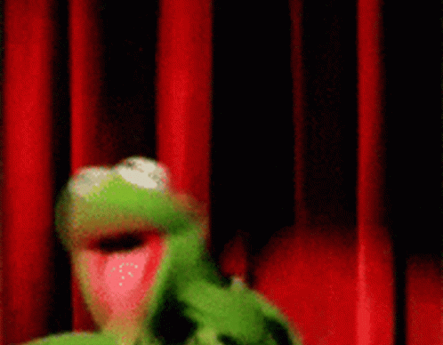
Thank You!

