Slide 1
Stormy Weather- LISTENING COMPANION 2: Symphony No. 6, op. 68 “Pastoral,” Mvt. 4, “Gewitter Sturm: Allegro" (“Thunderstorm: Allegro”) (50-52)
By: Matija Benko

Slide 2
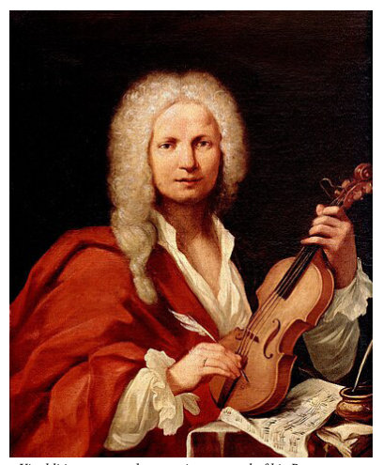
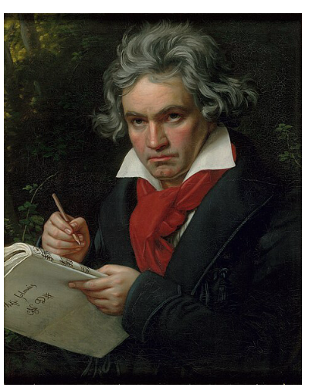
Stormy Weather
Baroque:(1600 - 1730)
Antonio Vivaldi (1678–1741)
Classic:(1730 - early 1800s)
  Symphony: multi-movement work w/ orchestra
Romantic:(rest of 1800s)
  Beethoven (1770–1827)

Slide 3
Beethoven Lets It Thunder
Independent
Storm & nature motifs
Improvised well for his concerts
Praised for his songs

Slide 4

Thank You!

