Slide 1
Trees of Green, Red Roses Too-LISTENING COMPANION 7: “What a Wonderful World” (76-79)
By: Matija Benko

Slide 2
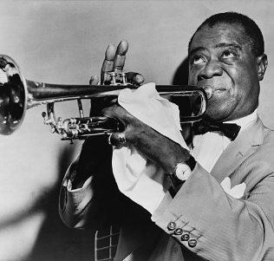
Trees of Green, Red Roses Too & Counting the Blessings
Earth inspired music
  “What a Wonderful World”[kind of obscure]
Louis Armstrong(1901-1971)
  “What a Wonderful World” was written for him & was first sung by him
  Disadvantaged
  Broke away from a band

Slide 3
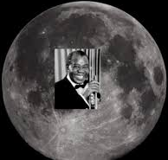
Counting the Blessings(part 2)
Armstrong stars in Jazz
  “Repressive governments found jazz, with its emphasis on ‘free expression of the individual,’ to be deeply threatening.”
  Celebrated for his expression
Hard to make the song happen
  Disruptions occured constantly
  Larry Newton refused to promote the song
  Spread everywhere

Slide 4
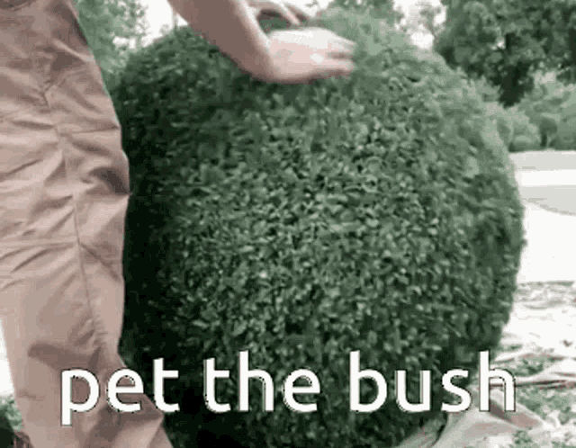
Thank You!

