Slide 1
Music Review Section IV
By: Matija Benko

Slide 2

Words of Warning-YOU DON’T KNOW WHAT YOU’VE
GOT ʼTIL IT’S GONE
Zeno(450 BC) said we need to be “living in agreement with nature”
Ecology: relationship between organisms & their physical environment
cleanliness of air is a longstanding concern
  King Edward I banned it, then Britain’s & U.S.’ Clean Air Acts
19th-century writers showed off nature spurred some early activist groups & U.S. national parks
Rachel Carson wrote Silent Spring(1962)
  Said “how DDT entered the food chain & accumulated in the fatty tissues of animals, including human beings, & caused cancer & genetic damage”
DDT was banned(People realized how much we affect Earth)
Ron Cobb made an “ecology” symbol (1969)
Earth Day (4/22/1970)

Slide 3
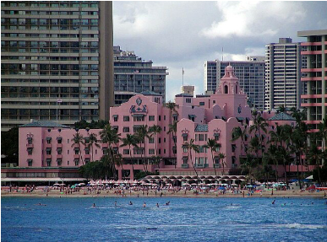
Paving Paradise-Listening Guide 9: “Big Yellow Taxi” – 1970 Joni Mitchell
Joni Mitchell made music
  Siquomb Publishing - published her work
  “Joni Mitchell (Song to a Seagull)”[1968]
  Clouds rose to Number 31 on Billboard
Ladies of the Canyon was more diverse(included “Big Yellow Taxi”)
  Referenced how Hawaii’s nature is being removed so infrastructure can be built
  Folk → Rock(still used Acoustic Guitar)
  “bop vocal” is multi-tracking
  Verse-Chorus form
    changes harmonies in each chorus
  Mitchell says it’s a “nursery rhyme,” but also a “good little workhouse of a song”
  covered 575 times & BMI recognized it for reaching one million performances

Slide 4

POISON IS THE WIND THAT BLOWS-Listening Guide 10: “Mercy Mercy Me (The Ecology)” – 1971 Marvin Gaye
70s: environmental & social messages in music got popular
  Marvin Gaye wanted to record protest songs, but Gordy though it would damage his career
Motown Records(1959): producing major stars
Gaye’s I Heard It Through the Grapevine(1968) was #1 for 7 weeks
Gordy blocked What’s Going On(1971)(released without Gordy’s approval)
  addressed war, peace, ecology, & social justice, blending R&B w/ gospel influences
  introduced multi-tracked vocals & listing lyrics & musicians on the cover
Mercy Mercy Me (The Ecology) & Inner City Blues (Make Me Wanna Holler) became popular hit singles
  Marvin Gaye was one of the first R&B artists to address environmental issues in a song
  only track on What’s Going On written solely by Gaye
  straightforward strophic, but unique instruments
  In 2002, Mercy Mercy Me (The Ecology) was inducted into Grammy Hall of Fame

Slide 5
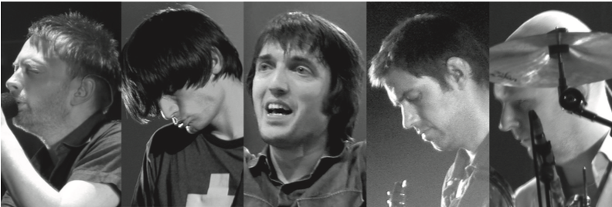
POST-MODERN ANXIETY - Listening Guide 11: “Idioteque” – 2000 Radiohead: Thomas Yorke; Philip Selway; Edward O’Brien; Colin Greenwood; Jonathan Greenwood / Paul Lansky
“Idioteque”(2000) environmental themes & technological experimentation
Radiohead(mid-80s): Thom Yorke, Phil Selway, Ed O’Brien, Colin Greenwood, & Jonny Greenwood
“Creep”(1993) became their 1st American hit
  grunge → weirder w/ The Bends (1995) & OK Computer (1997)
  OK Computer won Best Alternative Music Album(1998)
  Nigel Godrich suggested splitting into groups to experiment w/ electrophones
led to Kid A (2000) & Amnesiac (2001)
old synthesizers, radio noise & record (unclear about its genre)
Paul Lansky used Richard Wagner’s “Tristan chord” in mild und leise(1973)
  Lansky is a co-author
Everything is completely misaligned
Yorke’s lyrics talk about fear for the future

Slide 6
CALLING FOR ACTION-LISTENING COMPANION 12: “Despite Repeated Warnings” (2018) – Paul McCartney
Paul McCartney: a member of The Beatles
  started by covering American songs but began writing originals
  Please Please Me (1963), featuring eight original songs
  Sgt. Pepper’s Lonely Hearts Club Band (1967): 32 million copies sold
solo album McCartney (1970), featuring Maybe I’m Amazed
Egypt Station (2018) became his 1st album to debut at No. 1 in 36 years
  Inspired by a newspaper article about climate change & political inaction
Uses a symbolic sea captain steering a ship toward icebergs, representing climate change denial
multi-section symphonic rock, shifting between ballad, blues-rock, & driving rock
unexpected harmonic shifts (chromatic mediants)
Aims to raise awareness that climate change is real & prevent reckless leadership

Slide 7

Why Don’t We Listen?-LISTENING COMPANION 13: “Feels Like Summer” (2018) – Donald Glover [“Childish Gambino”]
people are ignorant bc we are distracted
award for “Redbone” for a song in Get Out(2018)
Premier of This is America on SNL(1st #1 on Billboard)
two-track EP Summer Pack
“Summertime Magic”:
  Happy-go-lucky(Different from “Feels Like Summer”)
darker message about overpopulation & loss of control
Chorus expresses hope but ends in resignation
explicitly mentions climate issues
Word-painting
music video overshadowed the song’s environmental message

Slide 8
IS IT TOO LATE?-Listening Guide 14: Elegy for the Arctic – 2016 Ludovico Einaudi
The Tempo Project (2020): Dr. Lucy Jones-use music to change sentiment around climate change & inspire action
Jones made In Nomine Terra Calens(138 years of Earth’s temperature data)
  final note represents uncertain future of Earth
Elegy for the Arctic (2016):Ludovico Einaudi-commissioned by Greenpeace to raise awareness about Arctic’s damage
  Premiered on a floating piano in Arctic Sea with Arctic Sunrise ship
  reflects sorrow for ecological harm already done to Arctic, especially through F minor
Although Greenpeace’s campaign to create a sanctuary was blocked, has been viewed over 20 million times
Greenpeace collected 8M messages supporting creation of a sanctuary for Arctic
Greenpeace remains determined to continue advocating for Arctic

