Slide 1
Adaptation Through Natural Selection - Changes in Environmental Conditions and Extinctions (47-51)
By: Matija Benko

Slide 2
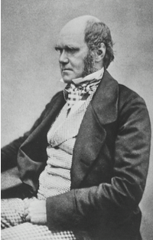
Adaptation Through Natural Selection
Charles Darwin
  theory of evolution through natural selection
  Journey on HMS Beagle[found diverse species and extinct species]
1859:“The Origin of Species by Means of Natural Selection”
  Organisms reproduce diverse offspring
  Most offspring will die, while some survive to reproduce
Notes:
Fitness = how easily an organism can reproduce

Slide 3
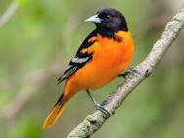

Adapting to a Changing Environment
Animals cannot respond to too big of a change
  Either die out or adapt
Adaptability of a species to change depends on how much, and how fast, change happens
  Birds eating nuts
Slowly harder nuts => birds have strong beaks
Suddenly all super hard nuts => birds can’t crack nuts
Notes:
Fitness = how easily an organism can reproduce

Slide 4
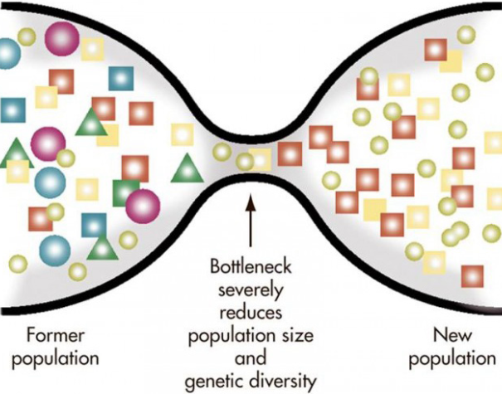
Nonadaptive Evolutionary Processes
Gene flow: different populations of the same species mix
Genetic Drift: mutation in genotypes among small populations of a species
low genetic variation is correlated to increased disease risk and low fertility
  Cheetah populations and genetic diversity dropped so much that every cheetah is identical
Notes:
Fitness = how easily an organism can reproduce

Slide 5
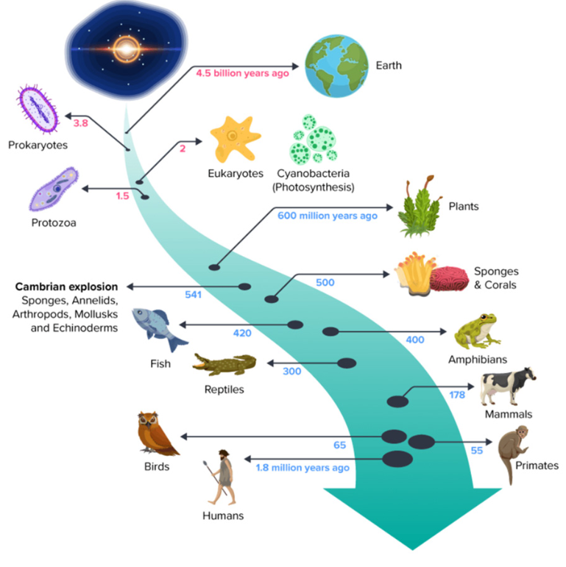
The Pace of Evolution
an adaptation can take centuries or millennia
3 things affect pace of adaptation
  Rate of change in environment
  Genetic variation
  Population size
    Smaller populations undergo nonadaptive mechanisms
Notes:
Fitness = how easily an organism can reproduce

Slide 6

Thank You!

