Slide 1
The Human Impact on Natural Resources - Life Expectancy and Infant Mortality (93 - 97)
By: Matija Benko

Slide 2
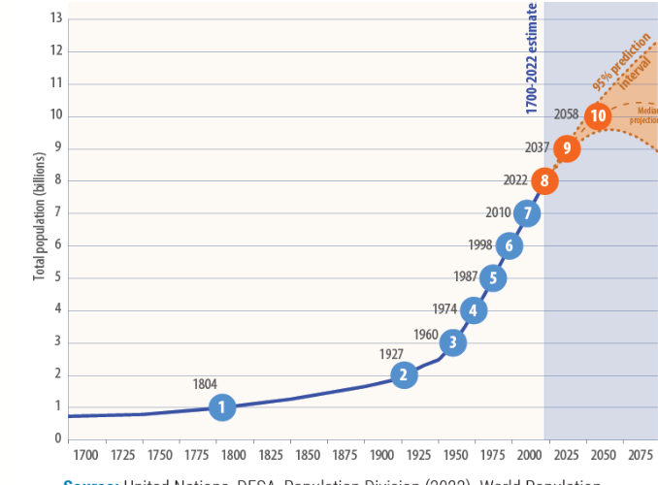
Human Population & Growth Rate
H.S.Sapiens population is exponential
%Growth rate=
  ((Births + immigration)-(deaths+emigration)/total population *100
Crude Birth/death rate: # irl births/deaths per person Homo Sapien Sapiens per year
(CBR-CDR)/10=%GR(excluding migration)

Slide 3
Lower- and Higher-Income Countries
1.3B live in High-income
6.7B live in low-income
  haven’t yet industrialized/currently industrializing
lower-income countries, particularly sub-Saharan Africa grow fast
  1.5% per year
GRs in higher-income countries leveled off
  0.2% per year

Slide 4
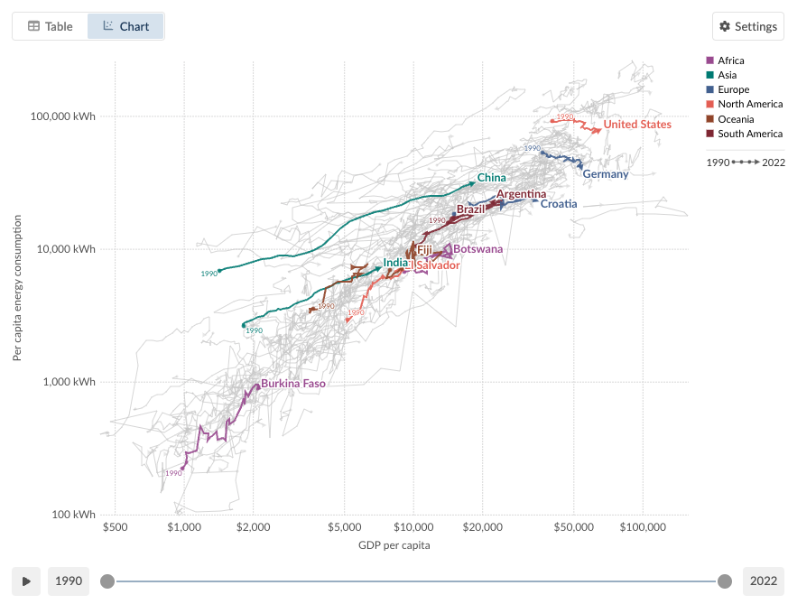
Population size and Resource Use
We H.S.Sapiens use a LOT of resources
  WATER, FOOD, LAND, ELECTRICITY, and NATURAL MATERIALS
Taxing on Earth
Environmental Impact = Population*Resource Use Per Person H.S.S.*Impact of Resource Used

Slide 5
Factors Affecting Growth(Fertility)
H.S.S. population is a system
  Births are input, deaths are output
fertility rate: mean of children offspring a woman mother H.S.S has
replacement fertility rate: number of children offspring on average to replace the current population
  Mostly 2.1
  Can be made up for in immigration

Slide 6

Thank You!

