Slide 1
The “Great Acceleration” and the Beginning of the Anthropocene- The History of Oil Extraction(40-43)
By: Matija Benko

Slide 2
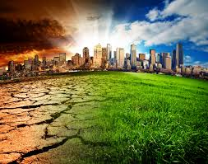
The “Great Acceleration” and the Beginning of the Anthropocene
Great Acceleration(~1950 - today): more people did more things that change climate(J. R. McNeill)
  More people, more things being done[1780:>1B, 1930:~2B, 2024:8B]
  Obvious, unprecedented, & powerful changes to earth
    Stronger & faster than natural climate change

Slide 3
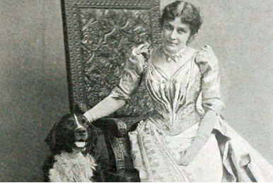
THE CAUSES OF THE ANTHROPOCENE
More greenhouse gases -> more warming😱
Lowest level increases temp. Highest levels decrease temp.[unstable😱]
Eunice Newton Foote(1819−1888): water vapor & carbon dioxide could interact w/ sunlight to raise Earth’s temp.
We kinda run on fossil fuels
  didn't see it coming

Slide 4
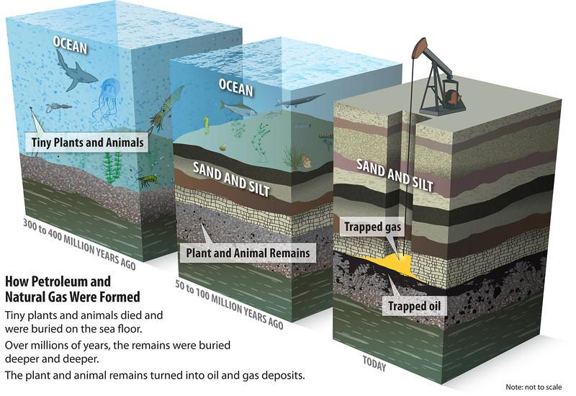
Global Production of Greenhouse Gasses
Fossil Fuels: Ancient compressed life
  Burning -> steam -> energy
  Carbon & misc. Chemicals are released[become greenhouse gasses]
19th & 20th cent.: fossil fuel use was in the West
  Became dependent
  Countries on fossil fuels extract them
  More countries depend on fossil fuels

Slide 5
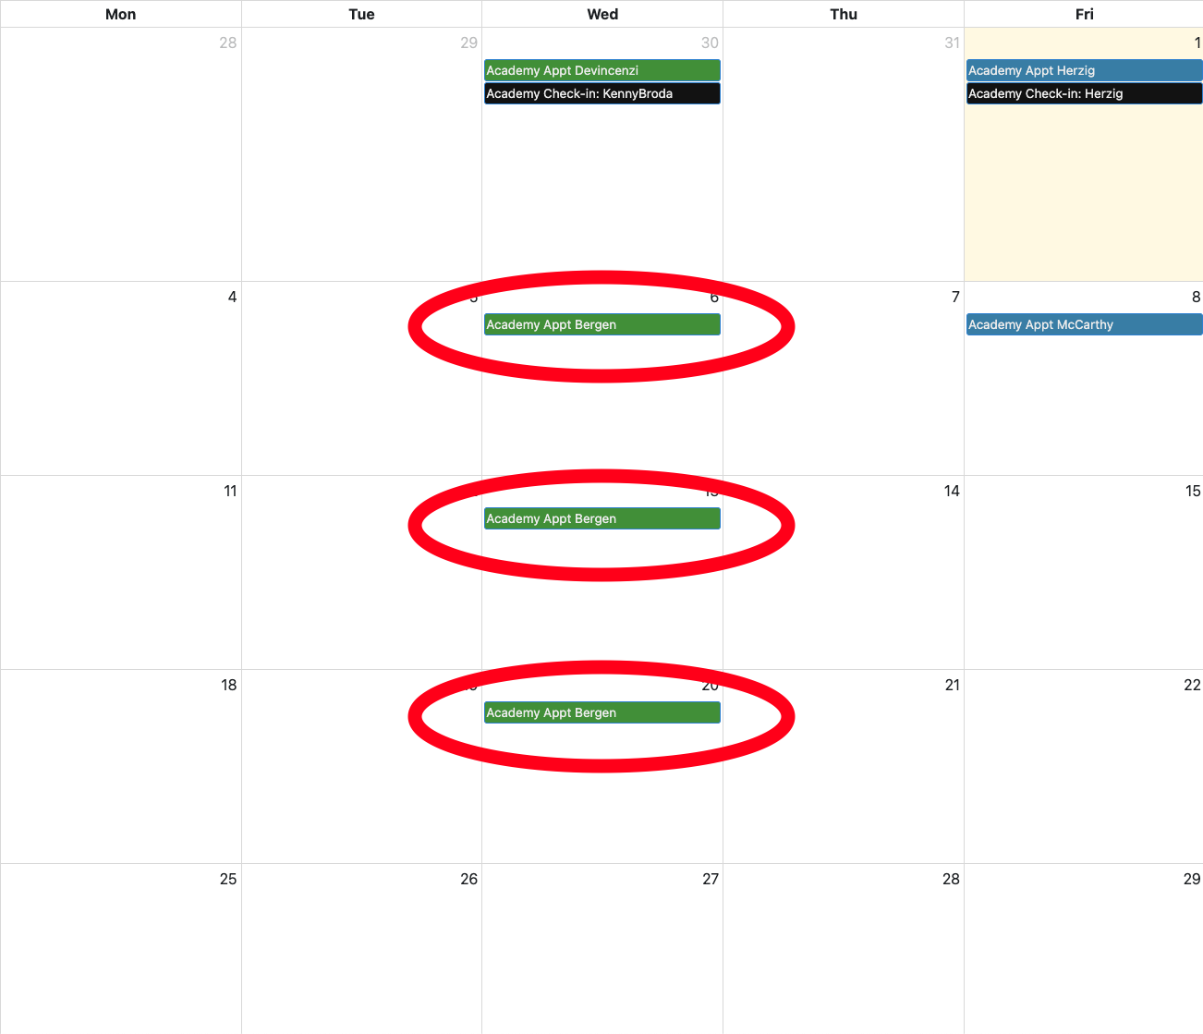

Thank You!

