Slide 1
Modernism at Home and Abroad (19-20)
By: Matija Benko

Slide 2
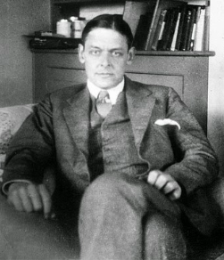
MODERNISM AT HOME AND ABROAD
Modernism: efforts of artists to cope with fast changes everywhere
artists wanted to break from old traditions & experiment
Literary modernism:
  direct presentation of experience, heavy use of language, symbolism, & casual style
  original, non-rhyming forms and musical or conversational style
T. S. Eliot’s The Waste Land defied old use of poetry
F. Scott Fitzgerald was influenced(person is the focal point)
  philosophical concerns mentioned

Slide 3
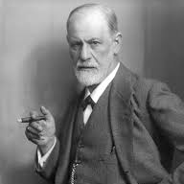
Sigmund Freud
challenged beliefs about
  human development & desire
  more urbanization and loneliness
  destruction of traditional ideas of home, country, and region
  How WWI was bad

Slide 4

Thank You!

