Slide 1
Poetry: Shall I say, ‘My Son You’re Branded’?” by Georgia Douglas Johnson - Poetry: “The Weary Blues” by Langston Hughes (77-80)
By: Matija Benko

Slide 2
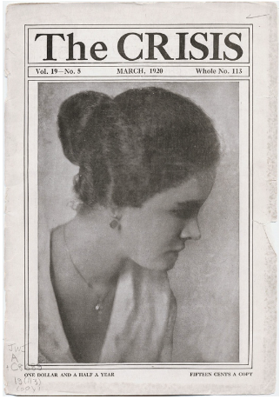
Georgia Douglas Johnson: Biography & Background
Georgia Douglas Johnson (1880–1966) major Harlem Renaissance poet
hosted Langston Hughes, Zora Neale Hurston, & Countee Cullen
poetry explored women’s emotional struggles & social limits, especially in her first book, The Heart of a Woman (1918)
Critics said early work lacked racial focus
  Bronze (1922) addresses both race & gender
Offers important perspective on Black women’s experiences in early 20th century

Slide 3
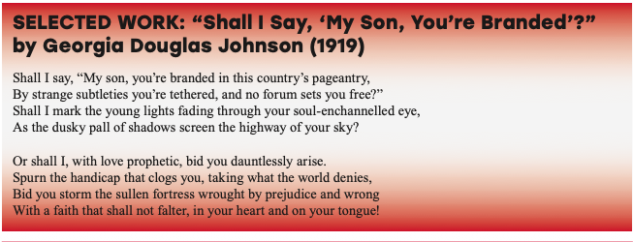
Analysis of Georgia Douglas Johnson’s “Shall I Say, ‘My Son, You’re Branded’?”
Black mother doesn’t know how to prepare son for racism & giving him hope(“The Talk”)
Racism = staged performance
  Black people are “branded” & restricted
speaker fears that telling her son truth may be sad, but silence isn’t good
builds his inner strength, identity, & courage to face injustice
reflects real threat of racial violence
believed art & language could make a more just future
highlights role of mothers & home in shaping resilience & social change

Slide 4

Thank You!

