Slide 1
Jazz for Chamber Musicians - Jazz for the Concert Pianist (107-112)
By: Matija Benko

Slide 2
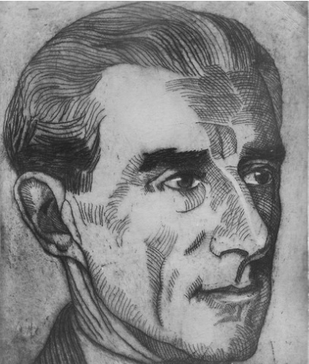

Bringing Jazz Back Home
Maurice Ravel related w/ Les Six
Société Musicale Indépendante(Independent Musical Society) promoted Copeland
WWI Constrained Ravel’s creativity(slow to conducting, but had best works)
French ambassador(guaranteed minimum fee of $10,000) thru US & Canada
met Douglas Fairbanks Sr. & lecture-recital 4 Pro Musica Society
listeners
Encore of “Blues” movement

Slide 3
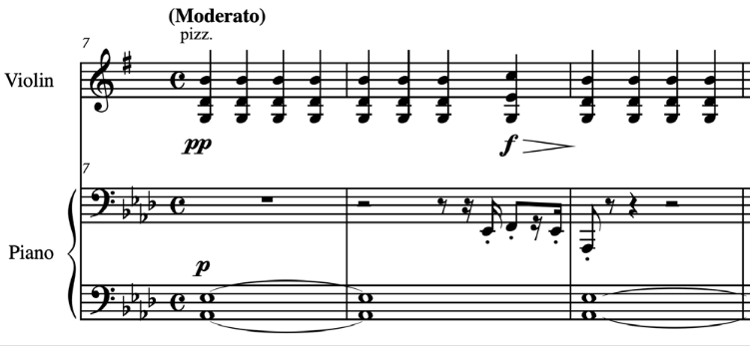
LISTENING COMPANION 13: Violin Sonata [No. 2], Mvt. II: “Blues” (1927) – Maurice Ravel
Thought piano & violin were incompatible(Kept them separate)
  each hand of piano is separate(more of a trio)
Violin starts & plucking chords(guitar)
interrupts steadiness by shifting to new harmonies & sudden dynamic contrasts
No 12-bar but has its I IV & V harmonies
piano’s left introduces a perfect 5th interval for eight counts
short, bluesy riff on right, then violin kind of merges with piano
Ending w/ call-and-response
Notes:
Series of pizzicato block chords

Slide 4
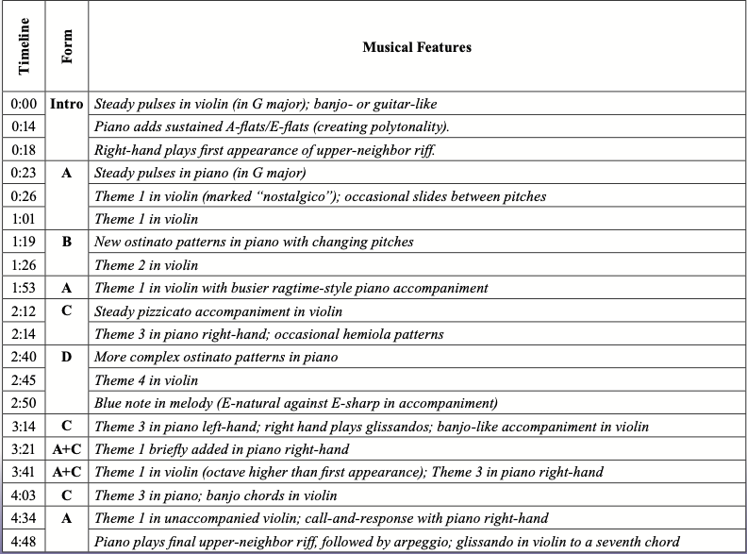
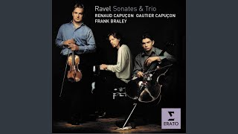

Slide 5

Thank You!

